Slide 1
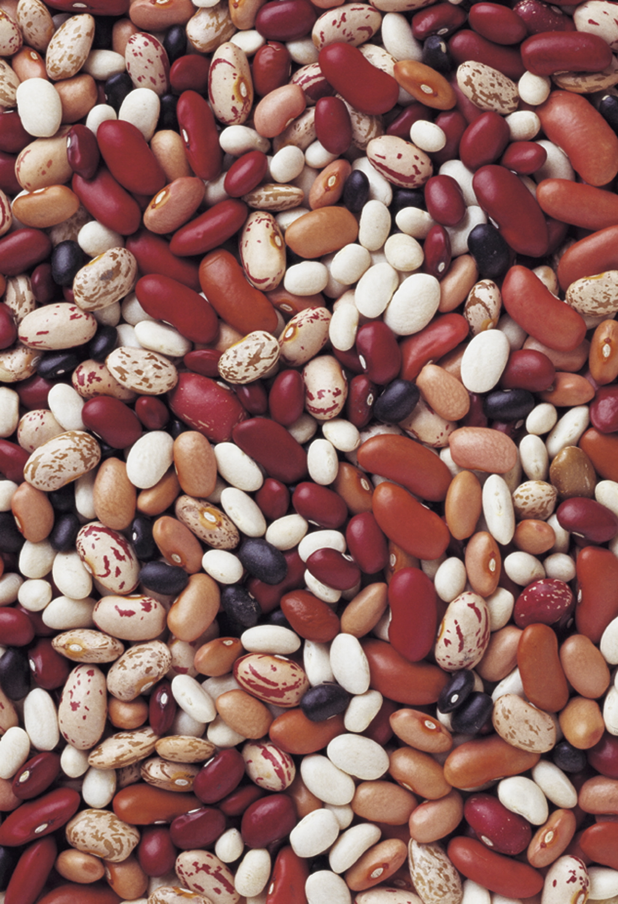
Alternative Crops
This material is based upon work that is supported by the National Institute of Food and Agriculture, U.S. Department of Agriculture, under grant number 2013-51106-21005.
Authors
Adria Fernandez
Kristine Moncada
Constance Carlson
Craig Sheaffer
Notes:
Narration: Welcome to the Alternative Crops module in our Transitioning to Organic series. Image: University of Minnesota Extension

Slide 2
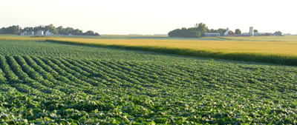
Alternative Crops: What Are They?
Crops that are less commonly grown
In MN: crops other than corn, soybean, hay, and wheat
Notes:
Narration: For the purposes of this module, we can define alternative crops as any crop that is not one of Minnesota’s major crops. 74% of agricultural land is devoted to corn, soybean, hay, and wheat. Many other crops are grown, but no other crop claims even 1% of the state’s total acreage. For this module, we will consider any crop other than corn, soy, hay, and wheat to be alternative crops. These crops represent important opportunities to add diversity to your organic rotation. Image: Southwest Research and Outreach Center, University of Minnesota

Slide 3
Alternative Crops
Why try an alternative crop?
Preparing for an alternative crop
Growing alternative crops
Notes:
Narration: In this module, we’re going to explore less common alternative crops that may be suitable for organic systems in Minnesota and surrounding regions. First we’ll discuss the potential roles of alternative crops in your rotation, including some reasons to consider alternative crops, and some general considerations for their use. Then we’ll look at several categories of alternative crops and how to grow them, including grain legumes, processing crops, alternative small grains, and other grains. Image: David L. Hansen, University of Minnesota

Slide 4
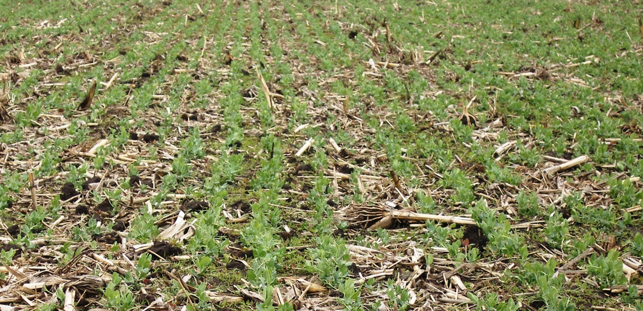
Advantages of Diverse Rotations
Biological and ecological benefits
Discourage pest and disease buildup
Fully use available resources
Improve soil health
Organic field peas
Notes:
Narration: First, let’s look at why you might want to consider including alternative crops in your rotations. Diverse rotations have many economic and ecological advantages over shorter, less diverse rotations. Expanding rotations beyond the major crops can discourage pest and disease buildup by varying the timing and types of disturbance and plant hosts present. Diverse crop rotations can make more efficient use of soil, water, and sunlight resources. They can also improve soil health, including protecting from erosion and nutrient leaching, and promoting a diverse and active soil microbial community. Image: Carmen Fernholz

Slide 5
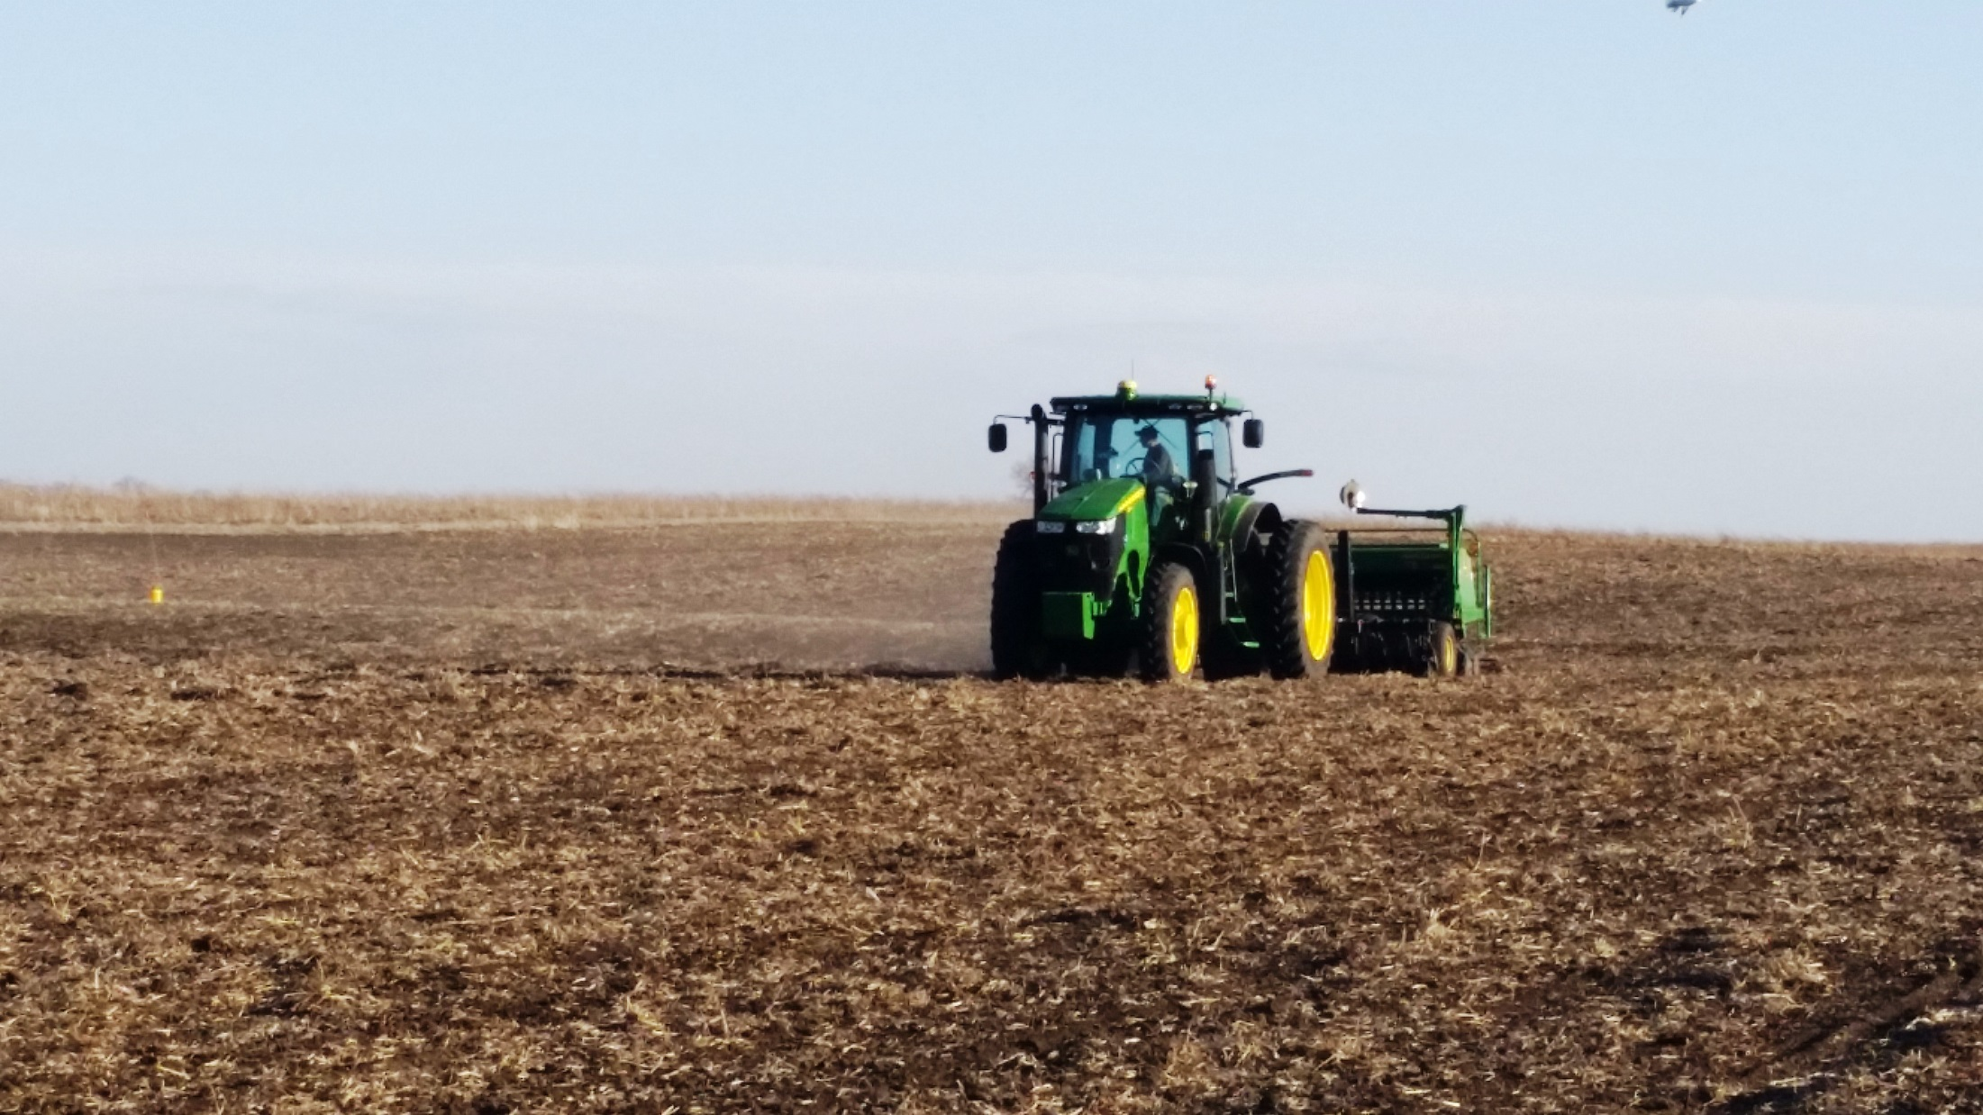
Advantages of Diverse Rotations
Management benefits
Economic benefits
Notes:
Narration: Diverse rotations may be helpful to you as a farm manager by distributing management and labor needs across the season. Alternative crops can also give you an entry into diverse and potentially lucrative markets. All of these benefits are explored more fully in the Rotations module in this series (link).
Image: Carmen Fernholz

Slide 6
Alternative Crops
Why try an alternative crop?
Preparing for an alternative crop
Growing alternative crops
Notes:
Narration: There are several steps to take as you prepare to incorporate alternative crops into your rotation.
Image: David L. Hansen, University of Minnesota

Slide 7
Preparing for Alternative Crops
Exploring markets
Planning crop management
Reducing expenses and potential losses
Notes:
Narration: You’ll need to begin by exploring markets for these crops, as well as planning for the management they will need, and taking steps to reduce the expenses and potential losses associated with them. We’ll discuss each of these in a little more detail.
Image: Pixabay

Slide 8
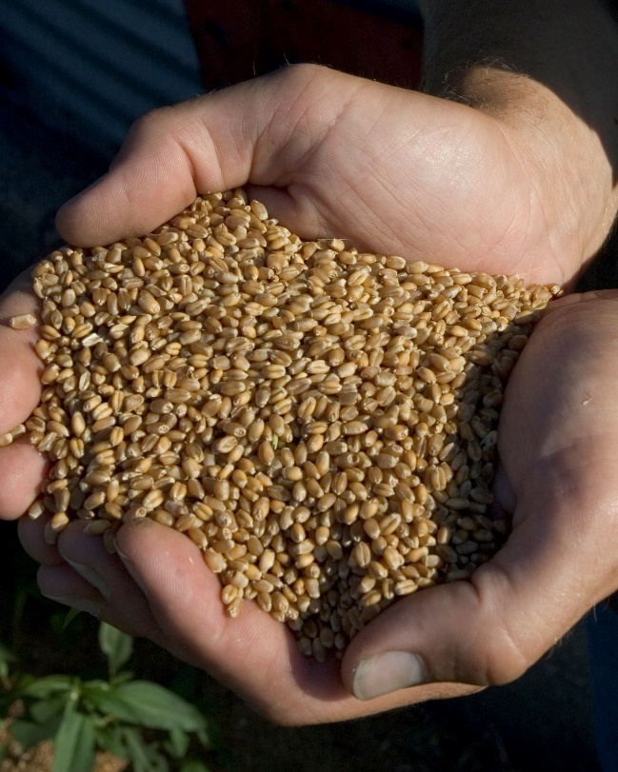
Exploring Markets
Expect to put in more time and effort
Seek out experienced growers
DON’T plant a new crop assuming you can sell it later!
Notes:
Narration: In general, when growing less common crops, you should expect to put more time and effort into marketing your products. Your best bet, if at all possible, is to seek out growers in your area who have experience with the crops you are considering, and learn from their experiences. Definitely don’t just plant a crop assuming you can sell it later—do the marketing legwork first. You can find more details on how to approach marketing of alternative crops in the “Marketing” and “Economics of New Crops” modules in this series.
Image: University of Minnesota Extension

Slide 9
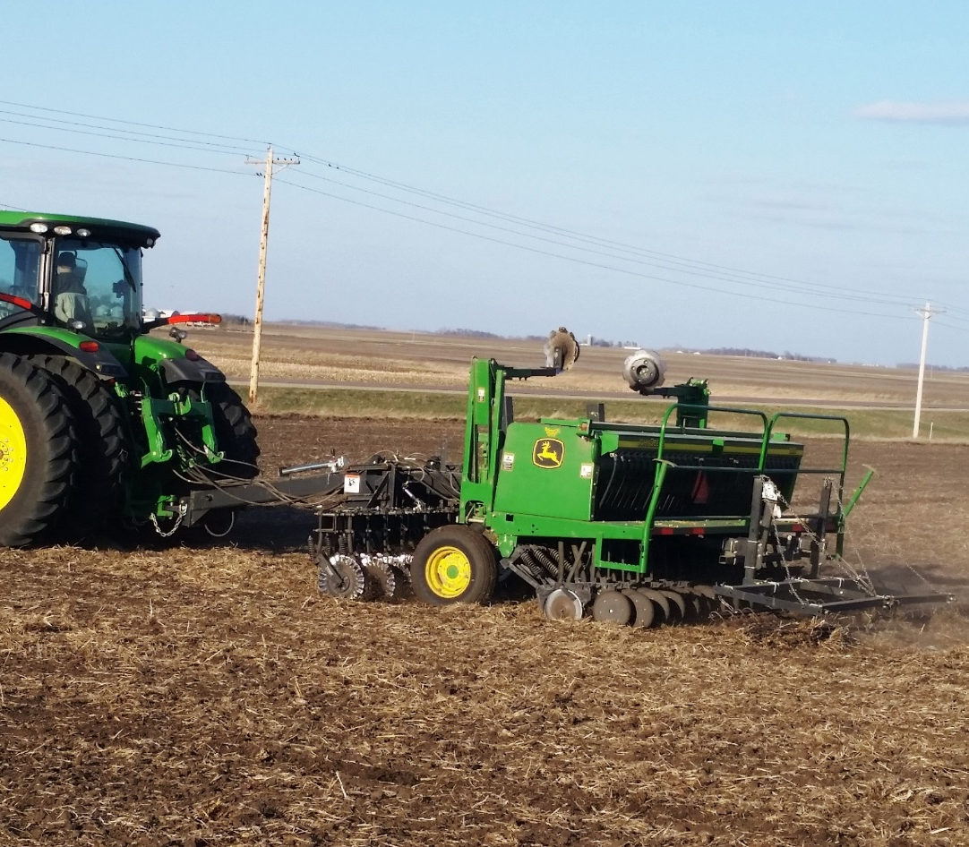
Planning Crop Management
Make a schedule of field operations
Source specialized equipment
Be aware of crop-specific quality standards
Notes:
Narration: Managing additional diversity in your rotation requires some planning. You’ll want to make a schedule of the different field operations that will be needed during the season. Consider the equipment that will be needed for each operation, so you have plenty of time to find a source for any specialized equipment that you may need to buy, borrow, or hire. And be aware, when planning your operations, of crop-specific quality standards that may require special handling, transportation, or storage.
Image: Carmen Fernholz

Slide 10
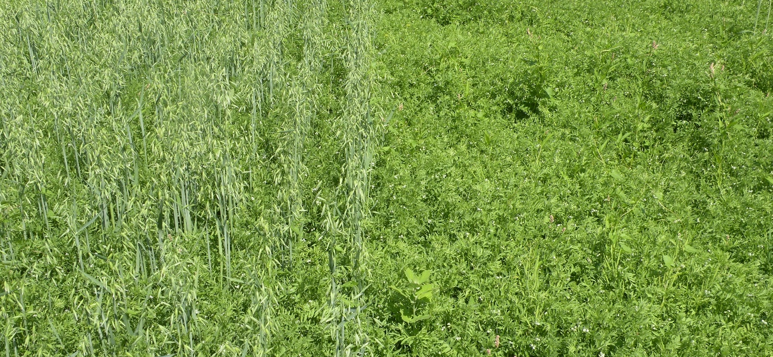
Reducing Expenses and Losses
Consider starting with a test plot
Look into grants for startup costs
Notes:
Narration: There are several steps you can take to mitigate the risks involved in making the leap to less common crops. Try starting with a test plot, to see how a crop works on your farm before making a bigger investment. In some cases, grants may be available from Sustainable Agriculture Research and Education (SARE), state agencies, or other organizations for farmers who want to add infrastructure or experiment with new crop enterprises. Image: Adria Fernandez, University of Minnesota

Slide 11
Reducing Expenses and Losses
Consider whole-farm insurance (USDA’s Whole Farm Revenue Protection program)
Notes:
Narration: Insurance options for diversified operations are not always straightforward. Getting adequate insurance coverage can be difficult for organic crops that do not have a well-established history on your farm or in your region. Nonetheless, you may want to look into whether the USDA’s Risk Management Agency’s Whole Farm Revenue Protection program would be advantageous to your farm.
Image: USDA

Slide 12
Alternative Crops
Why try an alternative crop?
Preparing for an alternative crop
Growing alternative crops
Notes:
Narration: In this section of our module, we will discuss specific alternative crops that you may want to consider.
Image: David L. Hansen, University of Minnesota

Slide 13
Growing Alternative Crops
Grain legumes
Processing crops
Alternative small grains
Other grains
Notes:
Narration: We will cover four main categories of crops: grain legumes, processing crops, alternative small grains, and other grains.
Image: David L. Hansen, University of Minnesota

Slide 14
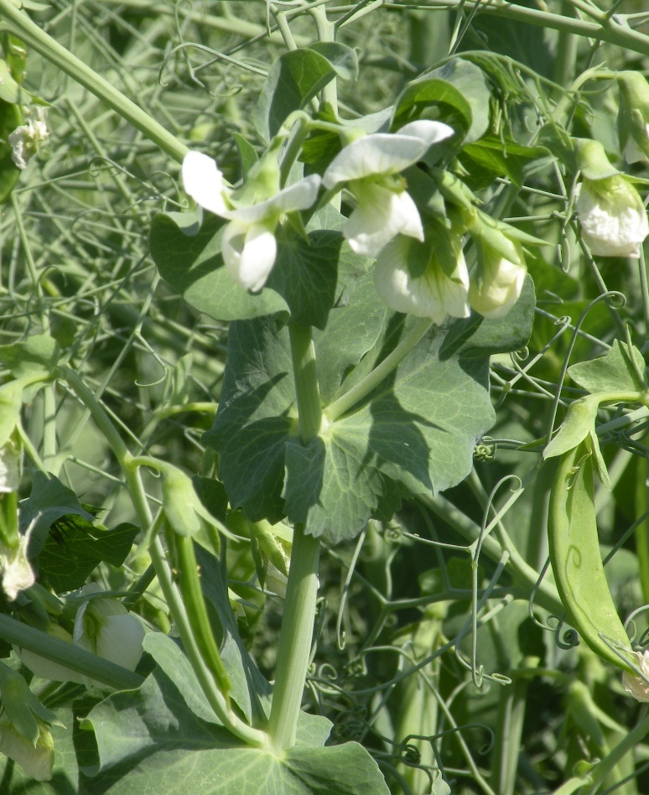
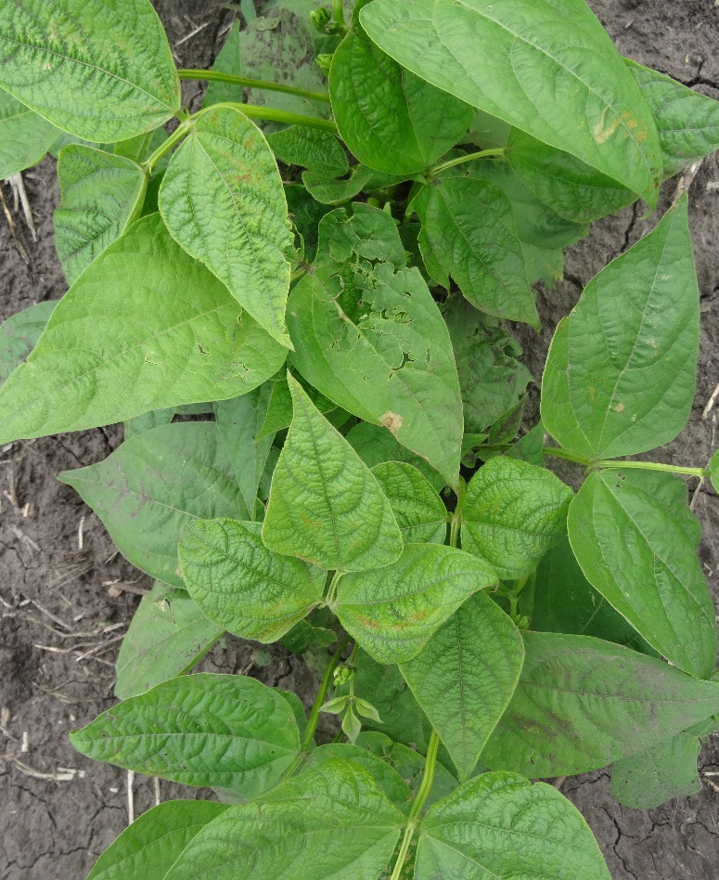
Grain Legumes
Dry Pea
Field Bean
Notes:
Narration: One potentially valuable category of crops is grain legumes. These include dry pea and field bean (also called dry bean).
Images: Adria Fernandez, University of Minnesota (pea); Kristine Moncada, University of Minnesota (field bean)

Slide 15
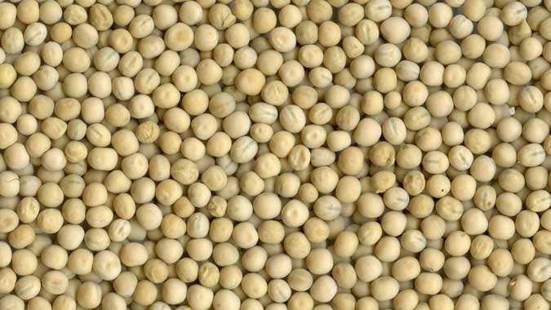
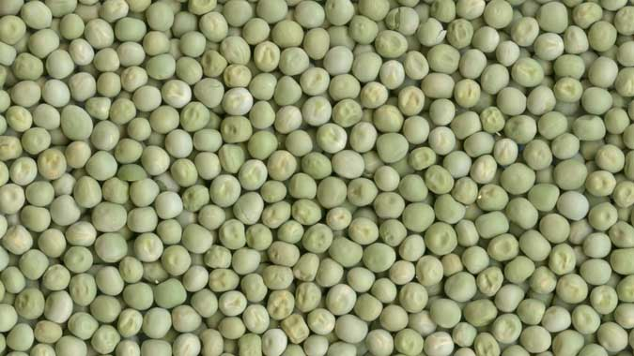
Dry Pea: Overview
Early planted, cool-season crop; harvested in July
Biomass can contribute to soil N
Food or feed types
Green or yellow color for food
Any color for feed
Notes:
Narration: Dry pea is an early-planted, cool-season legume crop. Generally peas in Minnesota can be harvested in July, leaving the remainder of the season open for cover or winter crop planting. Peas can be particularly beneficial in your rotations because their biomass can contribute to soil nitrogen stocks, if the peas are well nodulated with appropriate rhizobium strains. Field peas come in a variety of colors and are used as both food and livestock feed. Only the green and yellow seed colors are used for food, while any color may be used for feed.
Images: USDA-GIPSA

Slide 16
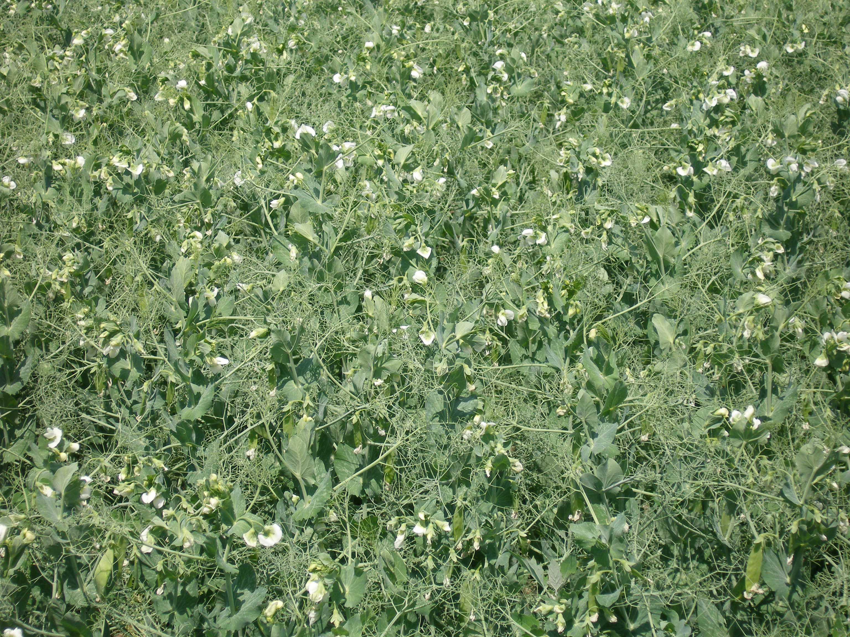
Dry Pea: Production
Plant as early as possible (not after May 15)
Inoculate seed with Rhizobium
Can survive frost after emergence
Sensitive to excess heat/moisture at flowering
Control weeds with pre- or early post-emergence tine weeding
Harvest by direct combining or swathing
Notes:
Narration: Dry pea should be planted as early as possible, and not after May 15. Breeding work is underway on fall-planted, winter-hardy field peas, but none of the currently available winter varieties are reliably hardy in Minnesota. Seed should be inoculated with an appropriate strain of Rhizobium bacteria to ensure that the peas will nodulate and fix nitrogen. The seedlings can survive some frost after emergence. However, the plant is sensitive to excess heat and moisture during flowering, which can damage yields. Weeds can be controlled with pre-emergence or early post-emergence tine weeding. Dry pea is harvested either by direct combining, or by swathing followed by combining.
Image: Carmen Fernholz

Slide 17
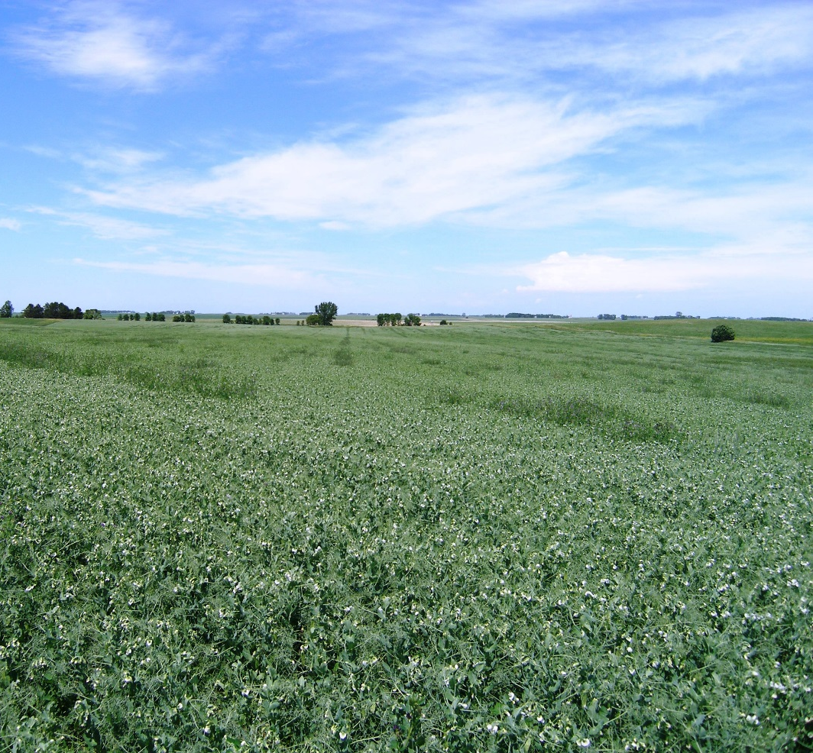
Dry Pea: Variety Selection
Vining/leafy (indeterminate) or semi-leafless (determinate)
Choose semi-leafless types for less lodging and uniform maturity at harvest
Disease resistance
Notes:
Narration: Pea varieties may be either vining (also called leafy) or semi-leafless. For Minnesota environments, the determinate semi-leafless varieties are preferable to the indeterminate vining types because they will have more uniform seed maturity at harvest. There are many pea varieties that are resistant to one or more of the diseases that peas are susceptible to.
Image: Carmen Fernholz

Slide 18
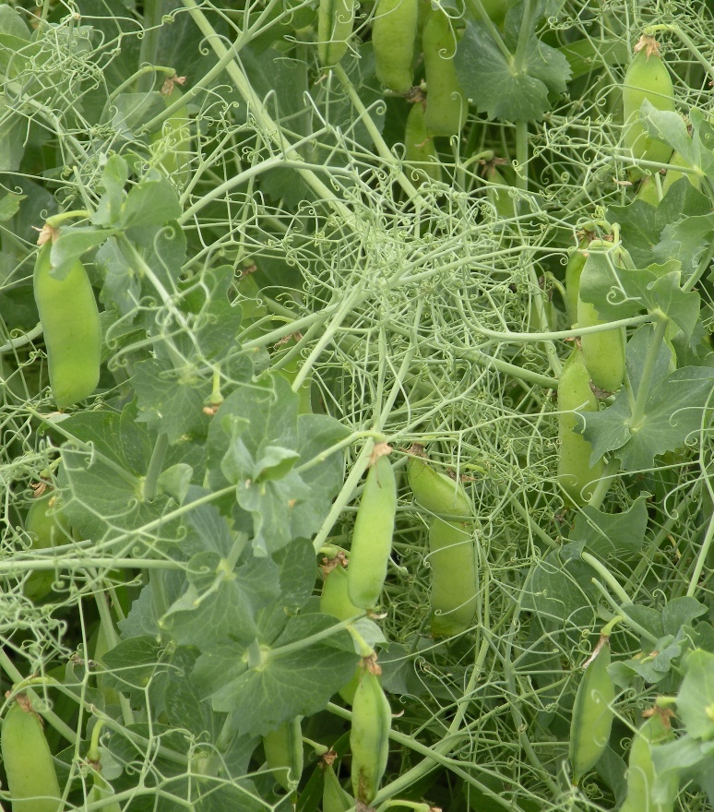
Dry Pea: Special Considerations
Harvest considerations
Prostrate growth habit/lodging
Shattering
Notes:
Narration: There are some challenges involved in harvesting peas. Their prostrate growth habit and tendency to lodge can make them difficult to pick up with the combine, and the pods are also prone to shattering.
Image: Adria Fernandez, University of Minnesota

Slide 19
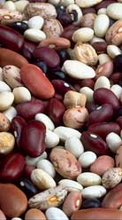
Field Beans: Overview
Also known as dry bean or dry edible bean
Market classes include:
Black
Pinto
Navy
Great Northern
Notes:
Narration: Another alternative grain legume to consider is field bean, also known as dry bean or dry edible bean. These come in a wide range of market classes; common ones include black, pinto, navy, and Great Northern.
Image: University of Minnesota Extension

Slide 20
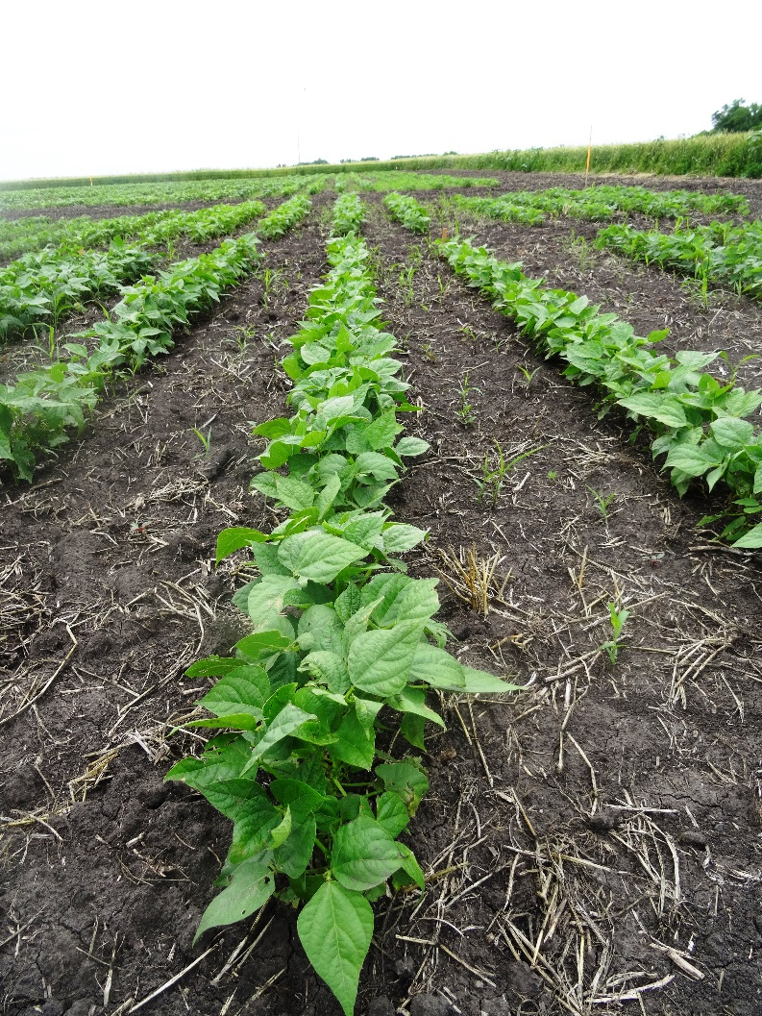
Field Beans: Production
Plant late May to early June
Control weeds with cultivation before flowering
Harvest by direct combining or windrow followed by combining
Damage to seed coat during harvest will lead to steep price discounts
Notes:
Narration: Organic field beans should be planted late May to early June in Minnesota. Weeds can be controlled with cultivation before flowering, but once the beans flower, they are susceptible to damage from cultivation. Field beans are harvested by direct combining or by windrowing followed by combining. Appropriate equipment and settings are crucial, as damage to the seed coat during harvest will lead to steep price discounts.
Image: Kristine Moncada, University of Minnesota

Slide 21
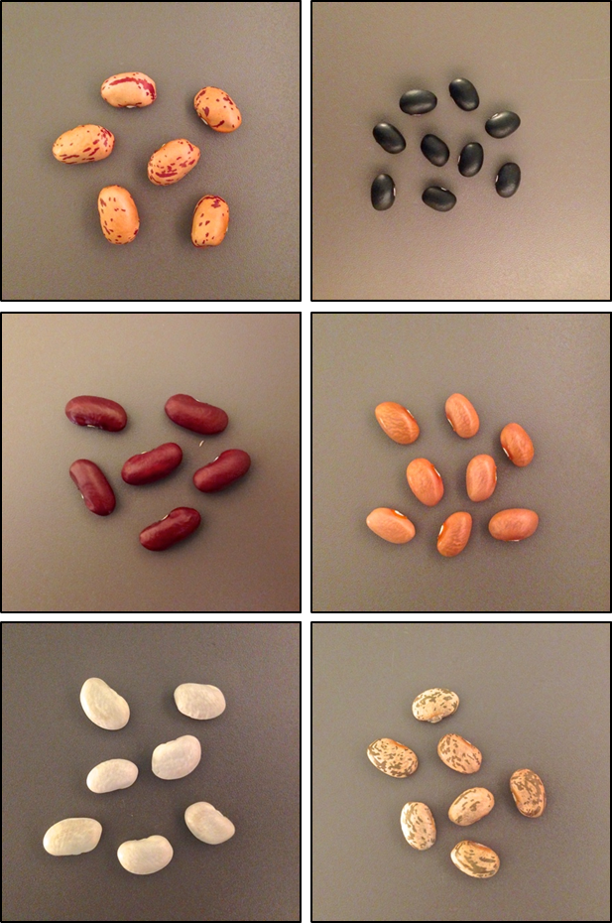
Field Beans: Variety Selection
UMN research: black, pinto, and navy classes are less risky for MN organic growers
Kidney and cranberry beans are higher risk
Notes:
Narration: Research at the University of Minnesota suggests that the least risky market classes of dry bean for Minnesota organic growers are black, pinto, and navy. Larger sized bean such as kidney and cranberry beans may be lower in profitability due to reduced yields and so may be higher risk, especially for less experienced growers.
Image: Hannah Swegarden

Slide 22
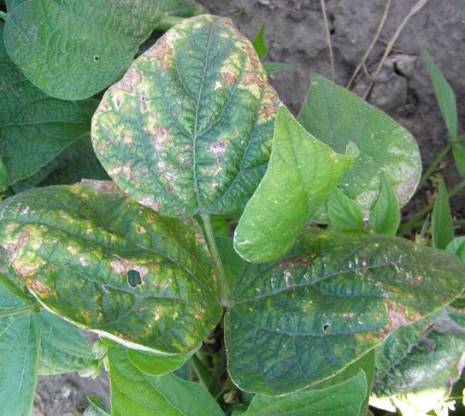
Field Beans: Variety Selection
Disease resistance
Rust
Anthracnose
Mosaic virus
White mold
Root rots
Bacterial blight
Bean plant infected with common bacterial blight
Notes:
Narration: Disease resistance is another important consideration when selecting varieties. Especially in humid or poorly drained conditions, beans are vulnerable to a range of diseases including rust, anthracnose, mosaic virus, root rots, and bacterial blights. You will want to choose cultivars resistant to the pathogens most problematic on your farm and in your area.
Image: Michelle Grabowski, University of Minnesota Extension

Slide 23
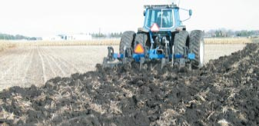
Field Beans: Special Considerations
Disease prevention
Bury residues and keep frequency in the rotation low
Source high quality, disease free seed
Notes:
Narration: Even with genetically resistant varieties, disease is a major constraint on dry bean production in Minnesota. To minimize the impact of diseases, bean residues should be buried rather than left on the soil surface after harvest, and the frequency of beans in the rotation should be kept low to prevent the buildup of pathogens. You can also reduce bean losses to disease by sourcing only high quality, disease free seed.
Image: University of Minnesota Extension

Slide 24
Growing Alternative Crops
Grain legumes
Processing crops
Alternative small grains
Other grains
Notes:
Narration: Another type of alternative crop to consider is processing crops.
Image: David L. Hansen, University of Minnesota

Slide 25
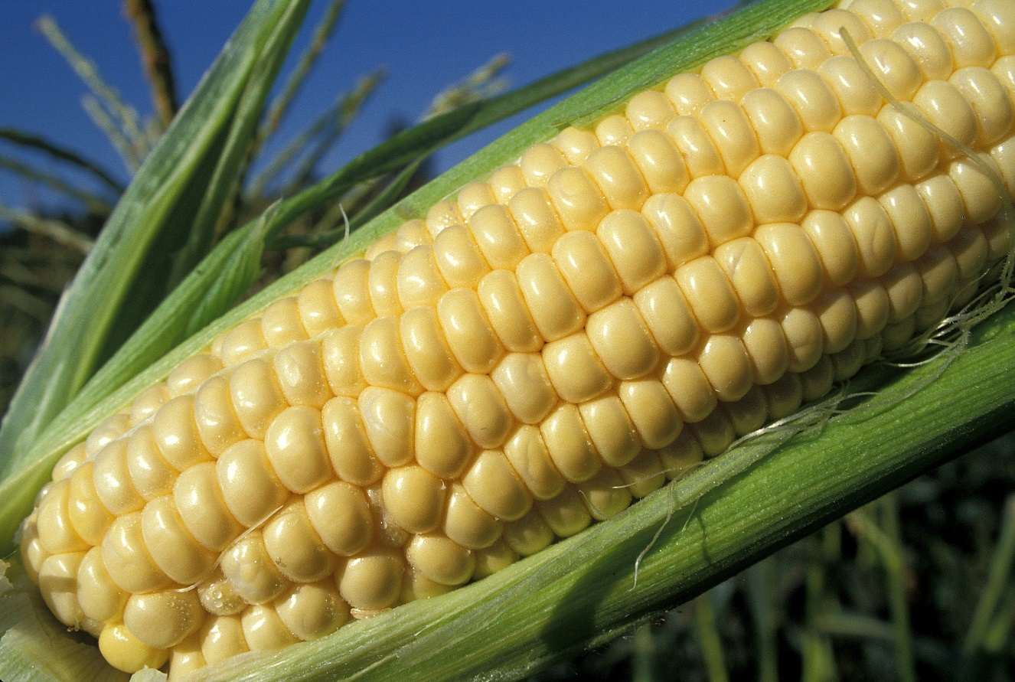
Processing Crops
Peas
Snap beans (green beans)
Sweet corn
Used for freezing or canning
Notes:
Narration: This category of crops are harvested while seed is still immature, and used for freezing or canning. Processing crops in Minnesota include peas, snap beans (also known as green beans), and sweet corn.
Image: Doug Wilson, USDA-ARS

Slide 26
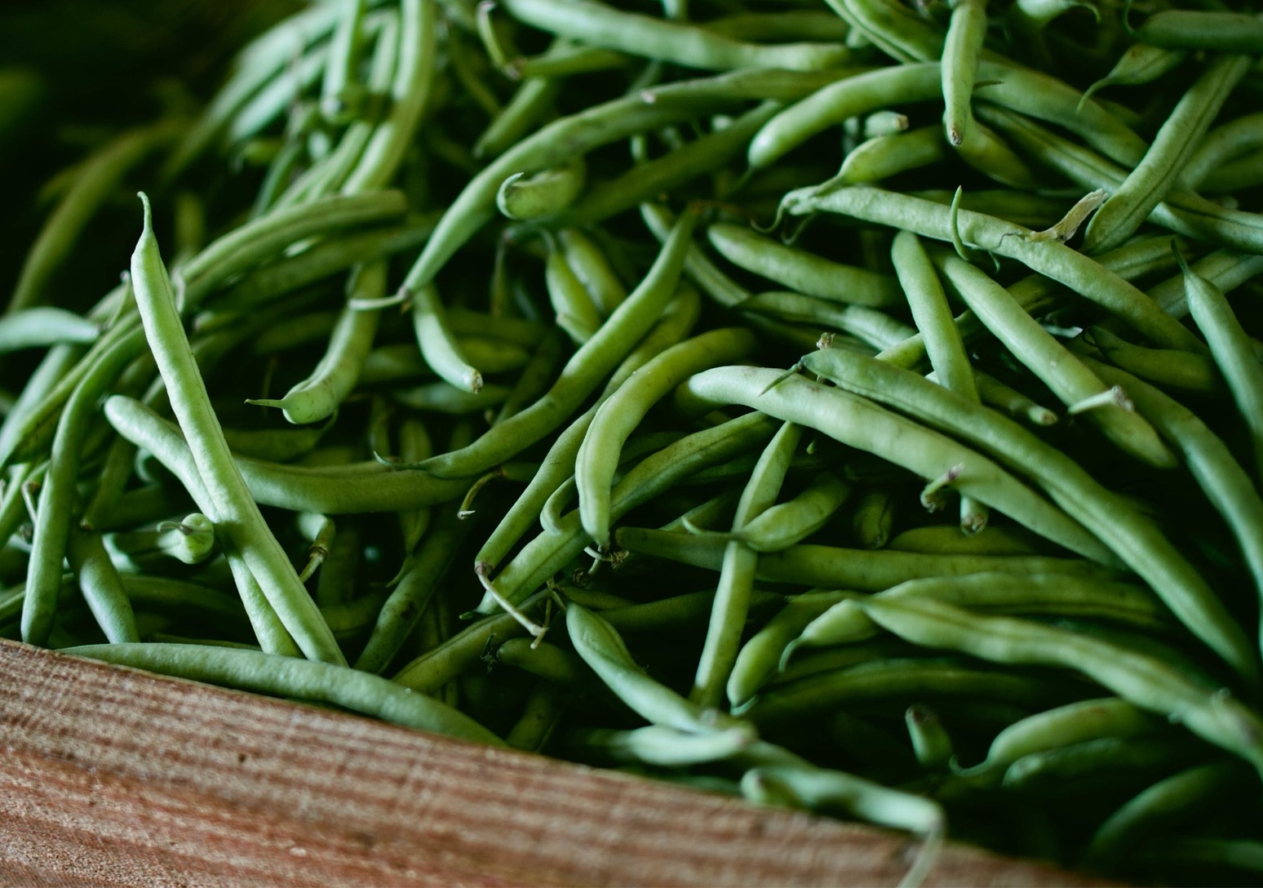
Processing Crops
Generally grown under contract with broker/processor
Markets may be geographically limited
Opportunities in southern MN
Processor generally harvests and transports
Will schedule planting and harvest to suit their needs
Notes:
Narration: These crops are generally grown under contract with a particular broker or processor. The availability of these contracts may be geographically limited, but there are opportunities in southern Minnesota, which is a major center of processing crop production. The processor generally harvests and transports the crop, and will schedule your planting and harvest times to meet their needs and capacity.
Image: Pixabay

Slide 27
Processing Peas: Overview
Also called green peas, canning peas
Immature pea seed
Southern Minnesota leads in processing pea production
Notes:
Narration: Processing pea is sometimes called green pea or canning pea. It is the immature seed of the pea plant. Southern Minnesota is the largest center of processing pea production in the nation; however, only a small portion of this crop is organic.
Image: University of Minnesota Extension

Slide 28
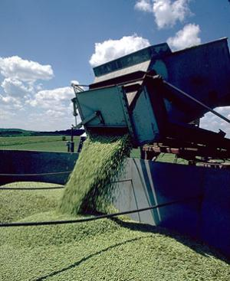
Processing Peas: Production
Inoculate with appropriate Rhizobium
Weed control as for field pea
Harvested using specialized combine
Peas are shelled in field
Notes:
Narration: Processing pea can be planted from late March through early May, though yields will be highest when it is planted early. Seed should be inoculated with appropriate Rhizobium strains. Weed control in processing pea is similar to field pea, as described earlier. Processing peas are harvested using a specialized combine that shells the peas in the field. Image: David L. Hansen, University of Minnesota

Slide 29
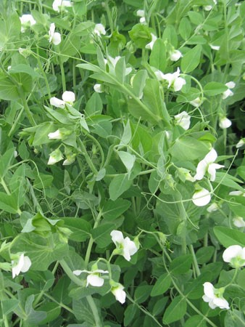
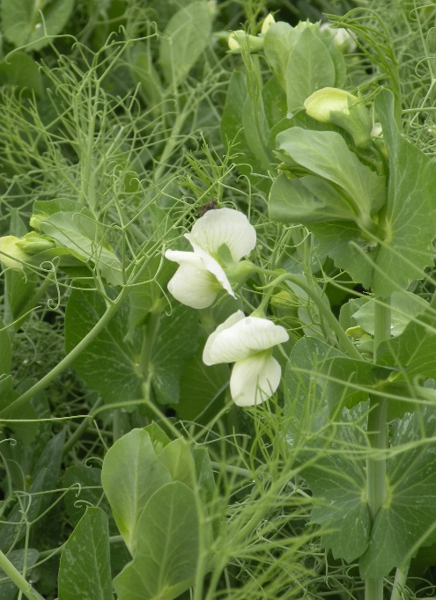
Processing Peas: Variety Selection
Varieties may vary for canning vs. freezing
Similar considerations to dry pea
Disease resistance
Semi-leafless varieties
Vining pea
Semi-leafless pea
Notes:
Narration: Variety selection in processing pea will depend on their intended end use; varieties may be different for canning vs. freezing. Other variety selection considerations are similar to those in dry pea, particularly disease resistance. As with dry pea, semi-leafless varieties are generally preferable to vining types for Minnesota environments.
Images: ForeverGreen, University of Minnesota (leafy); Adria Fernandez, University of Minnesota (semi-leafless)

Slide 30
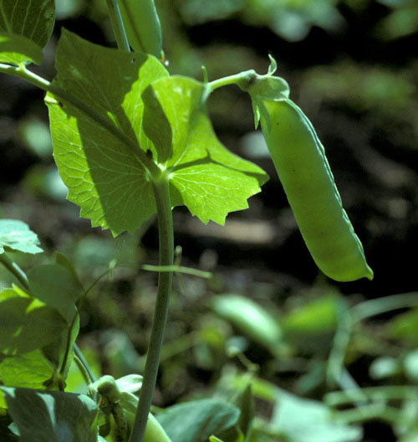
Processing peas: special considerations
Similar considerations to dry pea
Prostrate growth habit can complicate weed control and harvest
Can contribute to soil N if well-nodulated
Notes:
Narration: Considerations for growing green pea are similar to those of dry pea. In particular, its prostrate growth habit can complicate weed control and harvest, and its biomass can contribute to soil nitrogen if the plants are well-nodulated.
Image: University of Minnesota Extension

Slide 31
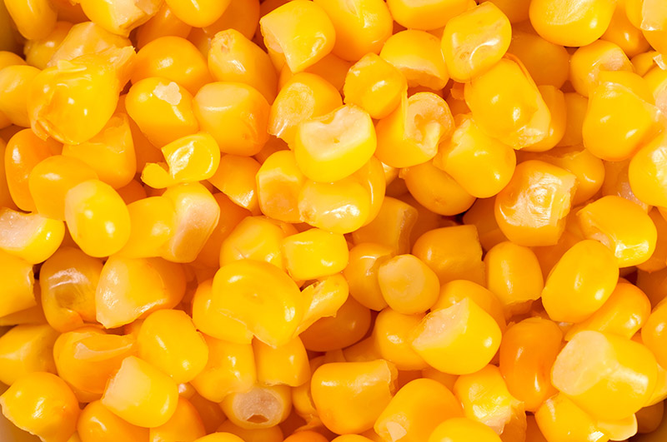
Sweet Corn: Overview
For fresh market (sale as whole ears) or processing (canning/freezing)
Various genetic types
Normal sugary (su) is standard for processing
Supersweet (sh₂) and sugary enhanced (se) for fresh market
Notes:
Narration: Sweet corn is another crop to consider. It can be grown for fresh market, meaning that it is sold as whole ears or corn on the cob; or for processing, meaning that it will be canned or frozen. Various genetic types of sweet corn have been developed. Normal sugary varieties are standard for processing. Supersweet and sugary enhanced types are preferred for fresh market.
Image: University of Minnesota Extension

Slide 32
Sweet Corn: Production
Plant when soil temps are appropriate
55-60° F for su and se varieties
<60° F for sh₂.
Weed control options include cultivation, flame weeding, cover crop mulch
Harvested using specialized machinery
Whole ears in husks are transported to processing facility
Notes:
Narration: Sweet corn should be planted when soil temperatures are appropriate. That means between 55 and 60 degrees for normal sugary and sugary enhanced varieties, and over 60 degrees for supersweet. Weed control options in sweet corn include cultivation, flame weeding, and cover crop mulches. Sweet corn is harvested using specialized machinery. Whole ears in husks are transported to processing facilities.

Slide 33
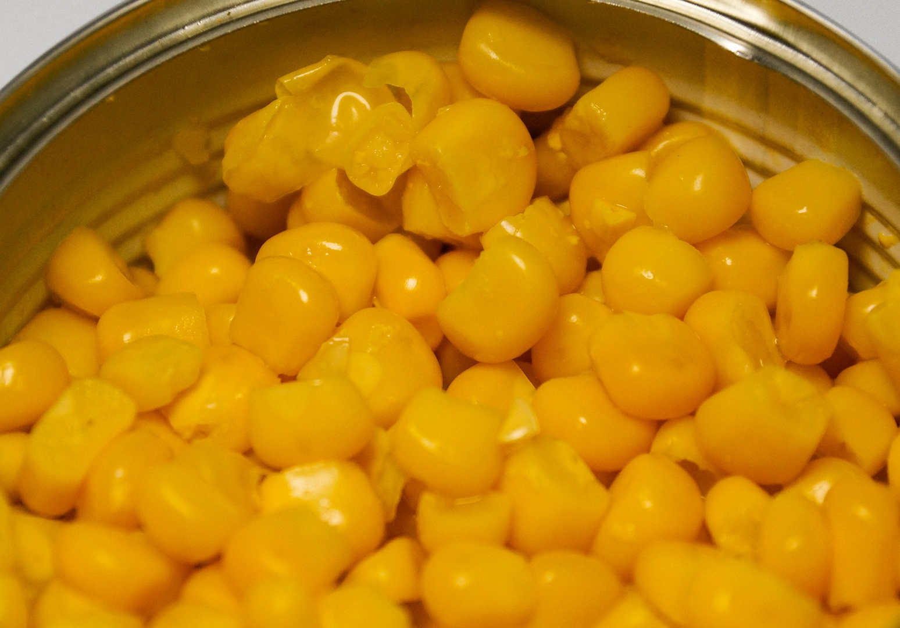
Sweet Corn: Variety Selection
White, yellow, or bicolor kernel color
Generally yellow for processing
Several states conduct variety trials
Most conducted in conventional
WI organic trial (focus is fresh market varieties): http://varietytrials.eorganic.info/node/736
Non-GMO varieties required for organic production
Notes:
Narration: Sweet corn varieties on the market include white, yellow, and bicolor kernel colors. Yellow corn is generally desired for processing uses. Universities in several states conduct and publish sweet corn variety trials, although most are conducted in conventional systems. Results from organic trials in Wisconsin, focused on fresh market varieties, can be accessed on the eOrganic website. When choosing sweet corn varieties, bear in mind that there are GMO varieties on the market, which are not suitable for organic production.
Image: Pixabay

Slide 34
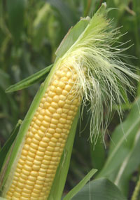
Sweet Corn: Special Considerations
Cross-pollination can affect crop quality
GMO contamination
Field corn or popcorn
Kernel color
Separate from other corn varieties
>660 feet
>1 week, preferably 3-4
Notes:
Narration: Because corn pollen is windborne and can travel from field to field, sweet corn crops have to be protected from cross-pollination by other corn varieties on your farm or neighboring farms. Organic corn can be contaminated by pollen from neighboring plantings of GMO varieties. Sweet corn can also be cross-pollinated by field corn or popcorn, resulting in some starchy kernels, or by sweet corn of a different color, producing off-color kernels. A separation of 660 feet is generally considered sufficient to prevent most corn cross-pollination, or a difference in pollination date of at least 1 week, preferably 3-4 weeks. The “Preventing GMO Contamination” module in this series has more information on protecting organic corn.
Image: University of Minnesota Extension

Slide 35
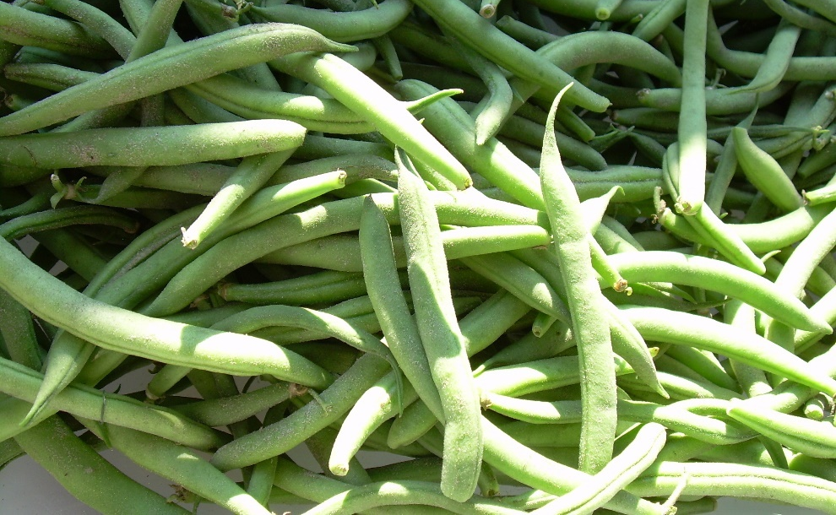
Snap Bean: Overview
Also called French beans or haricot beans
Common bean (Phaseolus vulgaris) varieties selected for edible immature pods
Tight processor specifications for pod and seed characteristics
May differ for canning vs. freezing
Notes:
Narration: Another major processing crop in Minnesota is snap bean, also known as French bean or haricot bean. These are common bean varieties that have been selected for their edible immature pods. Processors of snap beans will have tight specifications for pod and seed characteristics, which may differ for canning vs. freezing use.
Image: University of Minnesota Extension

Slide 36
Snap Bean: Production
Alternate with non-legumes in rotation to prevent pathogen buildup
Weed control includes stale seedbed, tine or flame weeding, inter-row cultivation
Harvested using specialized equipment
Notes:
Narration: Plantings of snap bean should not immediately precede or follow soybean, dry bean, or other legumes in your rotation, in order to prevent the buildup of pathogens. Weed control options for snap bean include stale seedbed, tine or flame weeding, and inter-row cultivation. The beans are harvested using specialized mechanical pickers.
Image: annawaldl, Pixabay

Slide 37
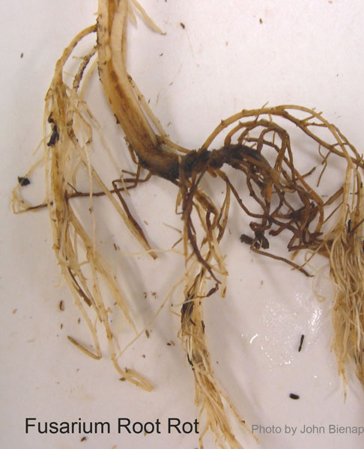
Snap Bean: Variety Selection
Look for resistance to root rot and other pathogens
Fast-canopying bush varieties for weed suppression
Notes:
Narration: In choosing snap bean varieties, you will want to look for resistance to root rot and other pathogens, which can present the same challenge to snap bean production that we discussed for dry bean. For organic systems, you will also want to choose fast-canopying bush type snap beans to maximize the crop’s ability to compete with and suppress weeds.
Image: University of Minnesota Extension

Slide 38
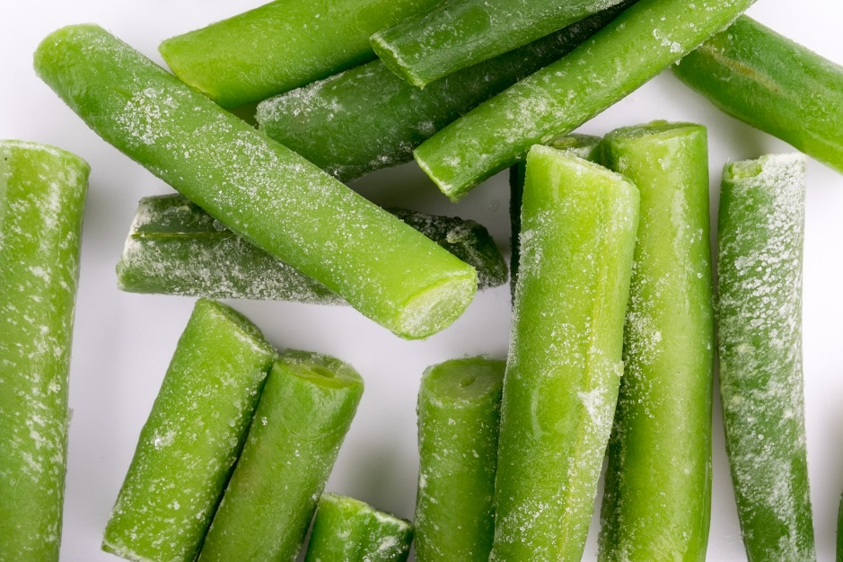
Processing Crops: General Considerations
Processor contracts will specify practices
Quality standards are specific and exacting
Production and harvest constraints and risks
Know the terms of your contract
Notes:
Narration: There are unique considerations involved in growing processing crops. Contracts with processors will dictate varieties planted, timing of operations, and other practices. Quality standards are highly specific and very exacting, and the window for harvest and transport is very short. You should be sure to know what the terms of your contract specify in case of production or harvest difficulties or quality issues.
Image: LeoNeoBoy, Pixabay

Slide 39
Growing Alternative Crops
Grain legumes
Processing crops
Alternative small grains
Other grains
Notes:
Narration: Another category of alternative crops for Minnesota organic systems is the alternative small grains.
Image: David L. Hansen, University of Minnesota

Slide 40
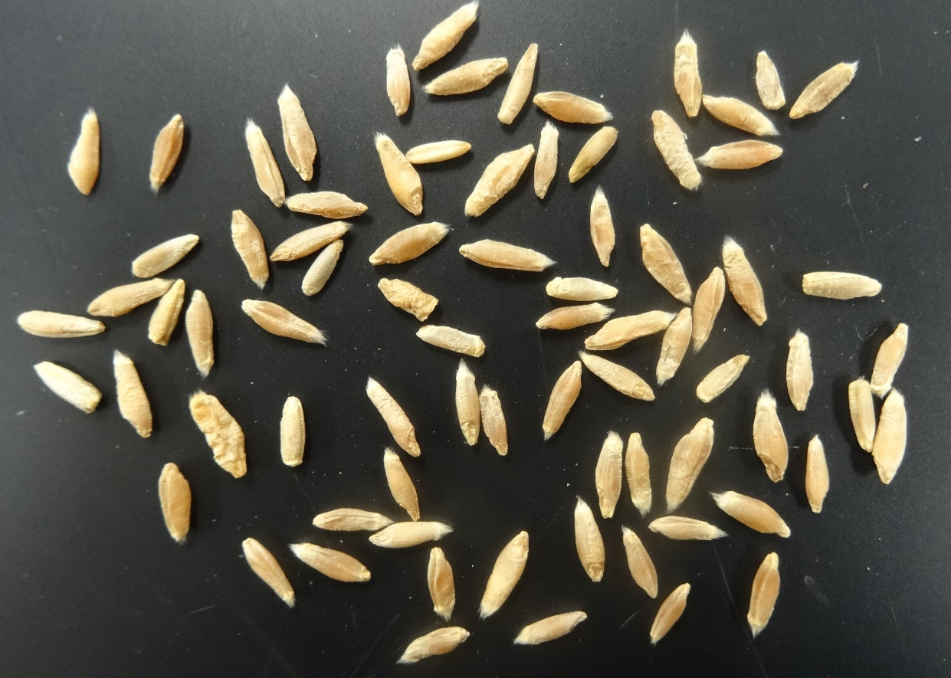
Alternative Small Grains
Oat
Barley
Cereal rye
Specialty wheats (einkorn, emmer, spelt)
Triticale
Triticale seed
Notes:
Narration: Alternative small grains for Minnesota range from the more familiar oat, barley, and cereal rye to emerging specialty grains such as specialty wheat varieties including einkorn, emmer, and spelt; and triticale, a rye x wheat hybrid.
Image: Kristine Moncada, University of Minnesota

Slide 41
Small Grains: Overview
Spring-planted | Fall-planted
Oat | Winter wheat/spelt
Barley | Winter rye
Spring wheat/spelt | Triticale
Spring rye
Growing markets for specialty and “ancient” grains
Differing moisture, nutrient, and management needs
Described in detail in Small Grains module
Notes:
Narration: Small grains can be divided into spring-planted, winter-planted, and types. Spring-planted small grains include oat, barley, spring wheats, spring ryes and spring triticale. The fall-planted types include winter wheat and spelt, winter rye, and winter triticale. There are growing markets for specialty and so-called “ancient” grains, as processors incorporate these grains into new products for health-oriented consumers. Each of these crops will have its own unique moisture, nutrient, and management needs. You can find more complete information on growing and marketing small grains in the Small Grains module in this series.

Slide 42
Growing Alternative Crops
Grain legumes
Processing crops
Alternative small grains
Other grains
Notes:
Narration: There are several other grain crops that may be suitable alternatives for some organic systems in Minnesota.
Image: David L. Hansen, University of Minnesota

Slide 43
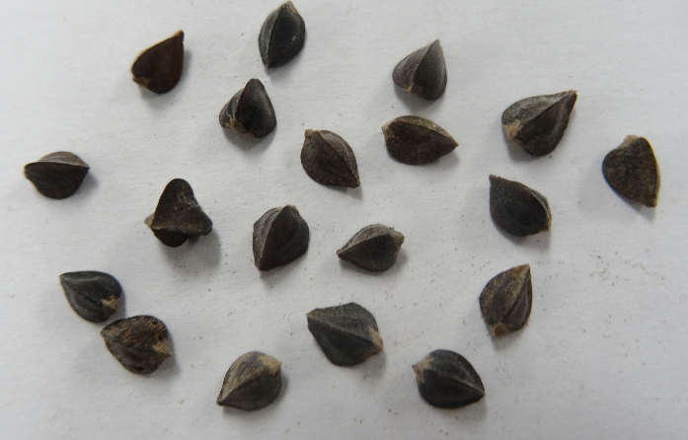
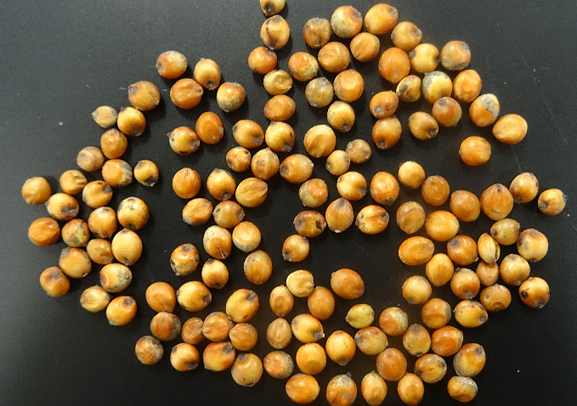
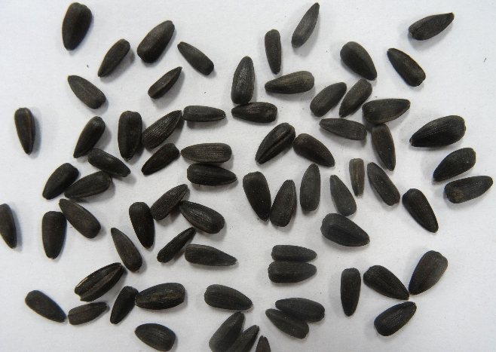
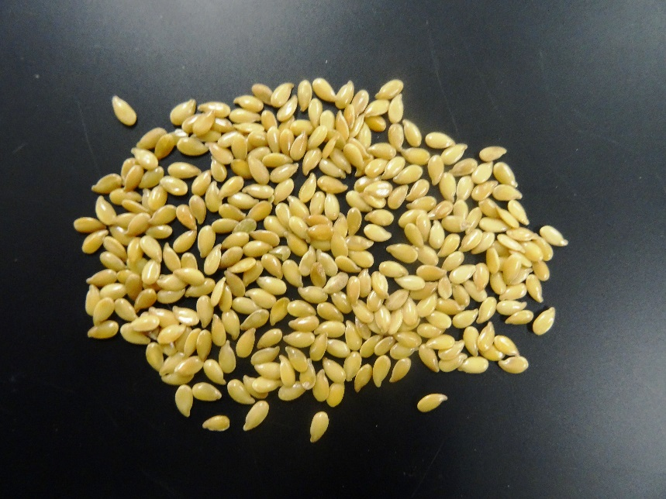
Other Grains
Buckwheat
Sorghum
Sunflower
Flax
Notes:
Narration: These other grains include buckwheat, millet, sorghum, sunflower, and flax.
Images: Kristine Moncada, University of Minnesota

Slide 44
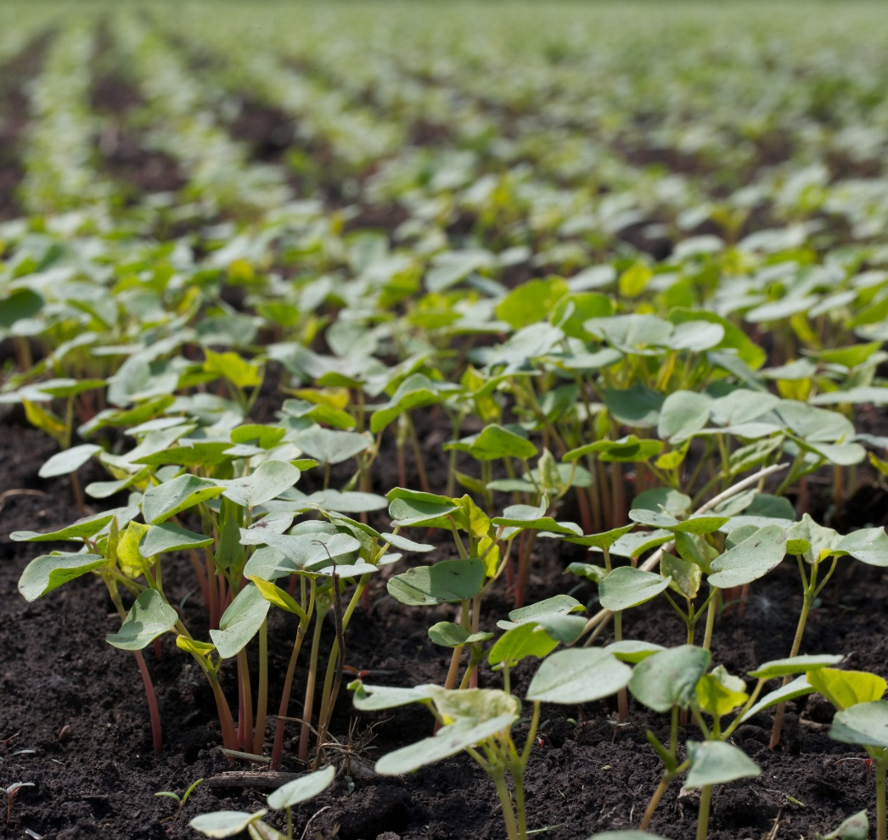
Buckwheat: Overview
Fast-growing annual
Highly valued as green manure, smother crop for weeds
Short growth period (10-12 weeks) allows flexibility in timing
Notes:
Narration: Buckwheat is a fast-growing annual that can be harvested for grain or tilled down for green manure. It is valued for its ability to rapidly produce a large amount of readily decomposable biomass, making it a valuable green manure for adding organic matter to soils. This rapid growth also makes it a useful smother crop for weed control. It’s a great rotation crop, since its growth period is very short, only about 10-12 weeks, allowing a wide range of potential planting and harvesting times.
Image: David L. Hansen, University of Minnesota

Slide 45
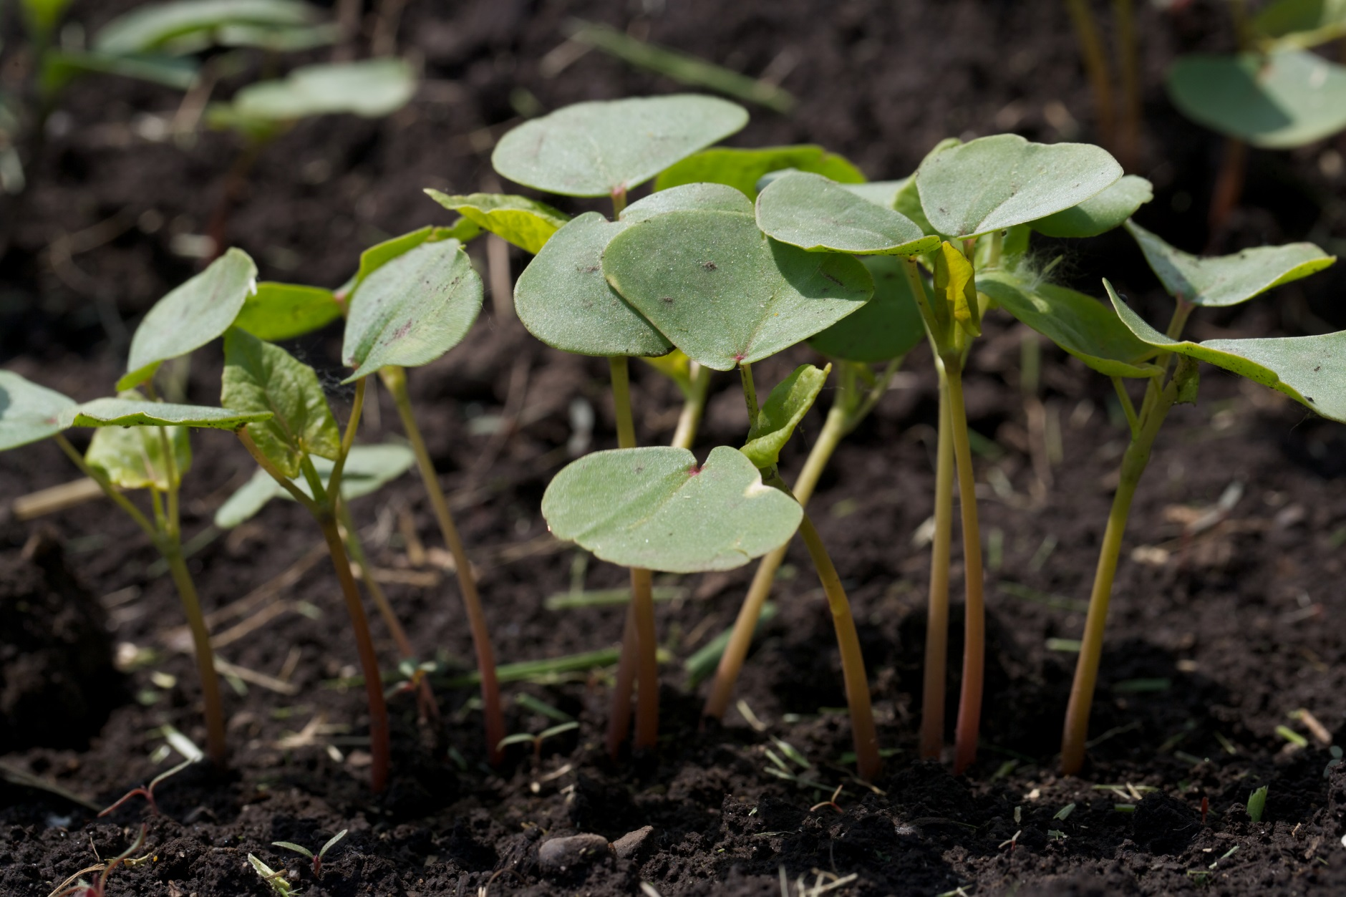
Buckwheat: Production
Highest yields if planted as soon as danger of frost is past
Minimize weeds with pre-plant tillage
Buckwheat canopies quickly to exclude weeds
Swath if harvesting before frost; can be direct combined if frost-killed
Requires adequate soil P
Notes:
Narration: Buckwheat grain yield will be highest if it is planted early, as soon as the danger of frost has passed. Weeds in buckwheat can be minimized with pre-planting tillage. Buckwheat canopies quickly, and can exclude weeds quite effectively. Buckwheat is very sensitive to frost. If you’re harvesting before a frost, you’ll want to swath it before combining. The grain can be direct combined if the crop has already been frost-killed. One thing to note in growing buckwheat is that the crop requires adequate phosphorus, and will not thrive in P-deficient soils.
Image: David L. Hansen, University of Minnesota

Slide 46
Buckwheat: Special Considerations
Grain may be difficult to sell
Do not plant after small grains or flax
Volunteer seed will make buckwheat grain cleaning difficult
Buckwheat seed
Flax seed
Notes:
Narration: Although buckwheat is highly beneficial in crop rotations, markets for buckwheat grain are small and may be difficult to access. It is not recommended to plant buckwheat following small grains or flax, as volunteer seed of these crops is difficult to clean from buckwheat grain.
Images: Kristine Moncada, University of Minnesota

Slide 47
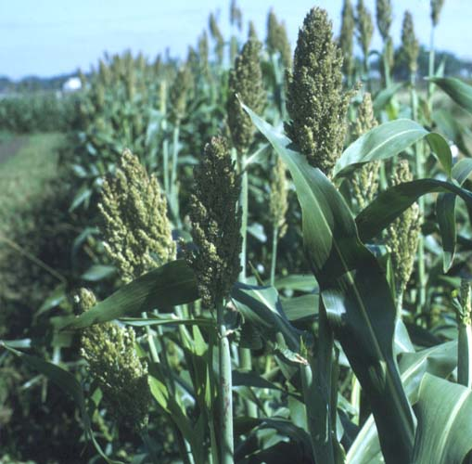
Sorghum: Overview
Also known as milo
Generally used in US for livestock feed; also can be food
Thrives in hot weather; few disease or insect problems
Notes:
Narration: Sorghum is a relative of corn, also known as milo. Sorghum grain is generally used in the US as a livestock feed, and is also a food grain, although it is not widely consumed in this country. Sorghum thrives in hot weather, and suffers from few disease or insect problems.
Image: University of Minnesota

Slide 48
Sorghum: Production
Plant mid-May to early June (soil temps 60-65° F)
Performs best in warm temperatures
Some varieties will not mature in Minnesota
Fertility requirements are similar to corn
Control weeds with stale seedbed or cultivation up to 6 inches tall
Harvest by combining
Notes:
Narration: Sorghum should be planted in mid-May to early June, when soil temperatures have reached 60-65 degrees. Sorghum performs best in warm temperatures and, like millet, maturity dates vary. Some varieties will not mature in Minnesota growing seasons, so be sure to choose varieties with suitable maturities. Sorghum’s fertility requirements are similar to those of corn; it is considered a heavy feeder. Weeds in sorghum can be minimized with a stale seedbed, and the crop can be cultivated until it reaches six inches tall. Sorghum is harvested by combining.
Image: David L. Hansen, University of Minnesota

Slide 49
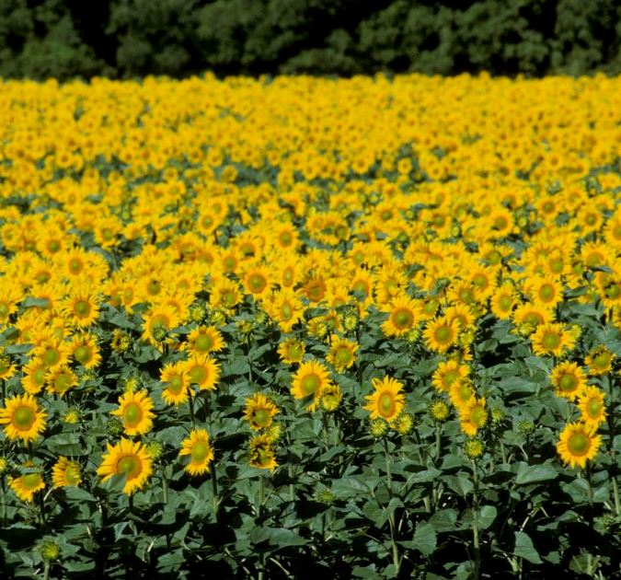
Sunflower: Overview
Major types are oilseed and confectionary
Most commercial varieties are hybrids
Some varieties require pollinators
Notes:
Narration: Sunflowers are a crop that can make a striking addition to your farm. The major market types of sunflower are oilseed and confectionary. Most commercial sunflower varieties are hybrids. Some varieties require insect pollination for good seed set.
Image: David L. Hansen, University of Minnesota

Slide 50
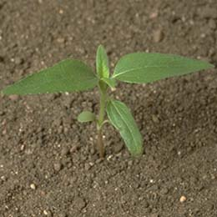
Sunflower: Production
Plant when soil temps are <50° F for uniform emergence
Control weeds with pre-plant and pre-emergence harrowing, inter-row cultivation
Critical period is first 4 weeks
Combine harvest using sunflower head attachment and seed pan
Notes:
Narration: Sunflowers should be planted when soil temperatures are above 50 degrees to ensure uniform emergence. Weeds can be controlled using pre-plant and pre-emergence harrowing, and inter-row cultivation after emergence. The critical period for weed control in sunflower is the first four weeks; after that, newly emerged weeds have little ability to damage the crop. Sunflowers are harvested by combining, using a sunflower head attachment and a seed pan to catch shattering seed.
Image: University of Minnesota Extension

Slide 51
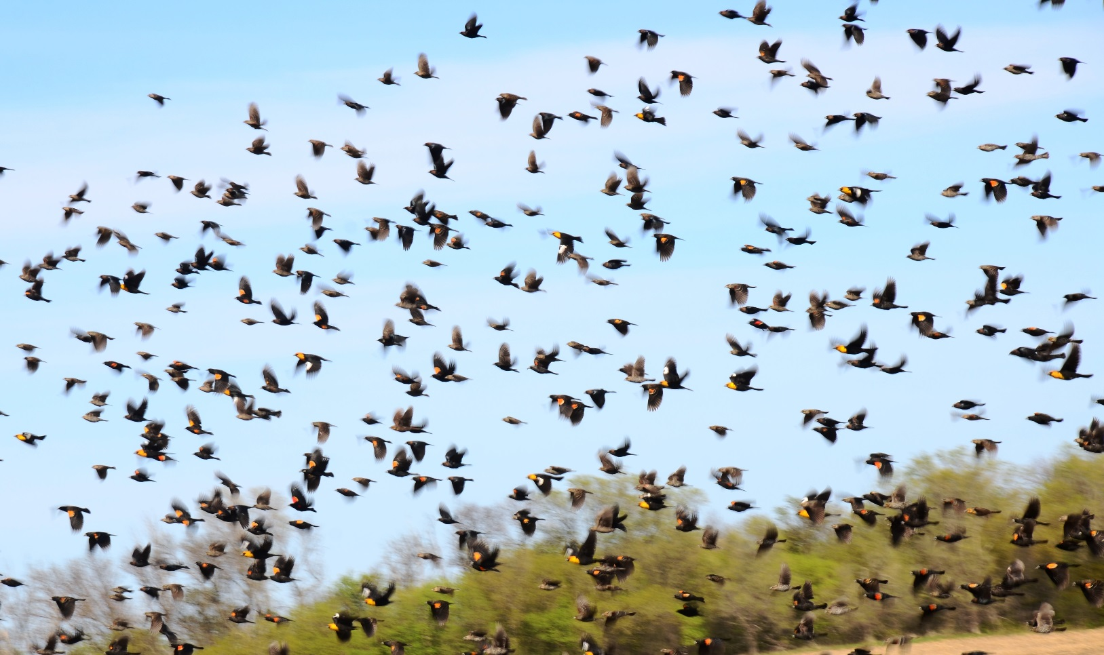
Sunflower: Special Considerations
Bird and insect predation can be issues
Notes:
Narration: One thing to note with sunflower is that bird and insect predation can be significant issues. It is sometimes possible to reduce bird predation using fright methods such as aluminum strips or owl decoys.
Image: Carmen Fernholz

Slide 52
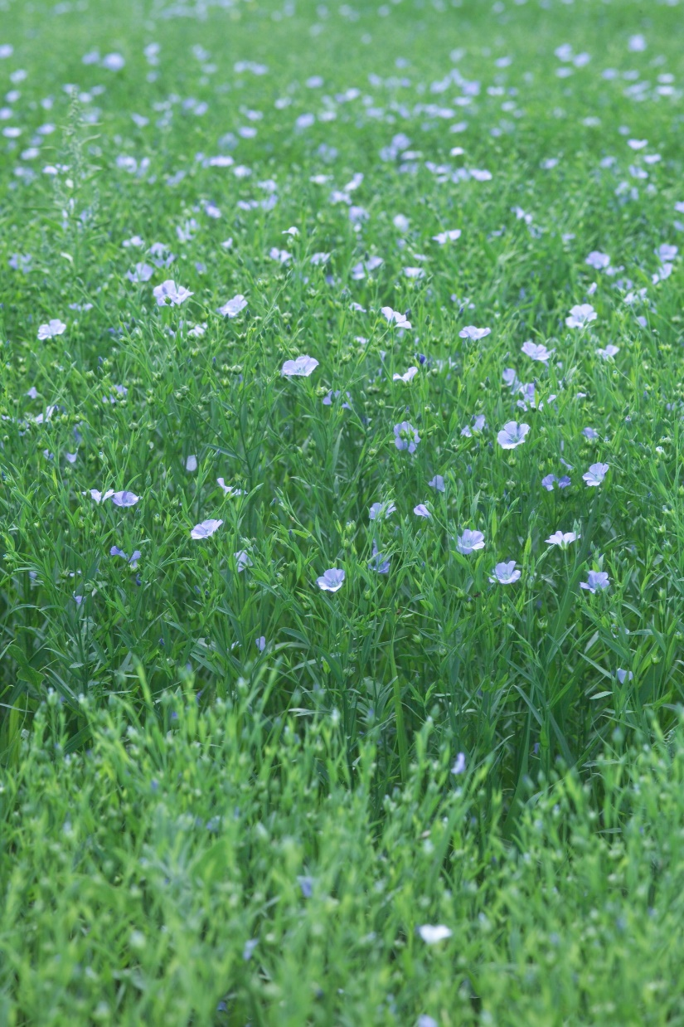
Flax: Overview
Cool season annual
Oilseed and health food crop
Golden seed for food
Brown seed for oil
Notes:
Narration: Another less common crop option is flax. Flax is a cool season annual crop that is used as an oilseed and sold as a health food product. Generally, golden-seeded varieties are grown for food use, while brown-seeded varieties are used for oil.
Image: University of Minnesota

Slide 53
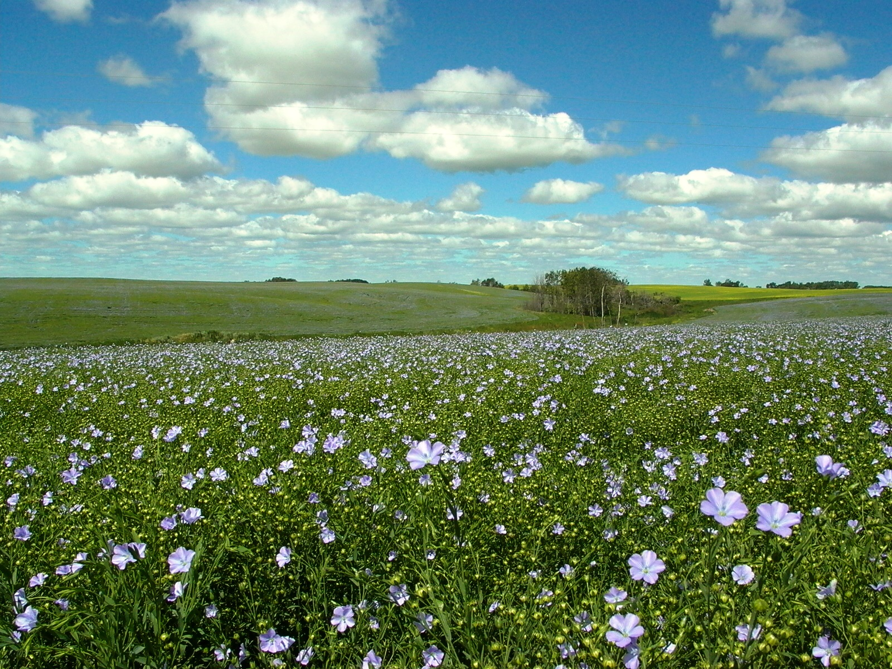
Flax: Production
Plant late April to early May for best yields
Fertility requirements similar to small grains
Weed control
Multiple pre-plant cultivations
Underseeding with clover or other forage
Harvest by windrowing followed by combining
Notes:
Narration: For best yield, flax in Minnesota should be planted in late April to early May, around the same time as oats. Its fertility requirements are relatively modest, similar to small grains. Weed control is a major challenge in flax. The seedbed should be cultivated two or more times before planting. You may want to consider underseeding the crop with clover or another forage to smother weeds. Flax is generally windrowed and allowed to dry before being combined.
Image: Jim Stordahl, University of Minnesota

Slide 54
Flax: Special Considerations
Sensitive to poor drainage, excess moisture, and drought
Extremely vulnerable to weed competition
Notes:
Narration: Flax can be quite a difficult crop to grow. It is very sensitive to adverse conditions, including poor drainage, excess moisture, and drought. It is also extremely vulnerable to weed competition, so it’s very important to plant it in a weed-free seedbed in a field with relatively low weed pressure.
Image: David L. Hansen, University of Minnesota

Slide 55
Summary: Risks of Alternative Crops
Markets: DO NOT plant without ensuring market access
Weed competition
Weather vulnerabilities
Notes:
Narration: Alternative crops can be particularly challenging to those newly transitioning to organic. Market access is a major challenge, and again, you should NOT plant a crop unless you know how you will sell it. Many less common crops are susceptible to weed competition, and can easily be completely overtaken if weed pressure is strong. Some of these crops are vulnerable to weather, particularly to high temperatures or excessive or deficient moisture at critical flowering times.

Slide 56
Summary: Rewards of Alternative Crops
Strong consumer demand for certified organic
Can select crops to suit conditions and constraints
Notes:
Narration: However, there can be strong consumer demand for these products, and few certified organic growers producing them. If you are able to successfully grow these crops and connect with buyers, they may be quite high-value. They can also help you build a rotation that best suits your farm, including options for soil protection, for optimizing labor schedules, and for low-fertility or droughty conditions.

Slide 57
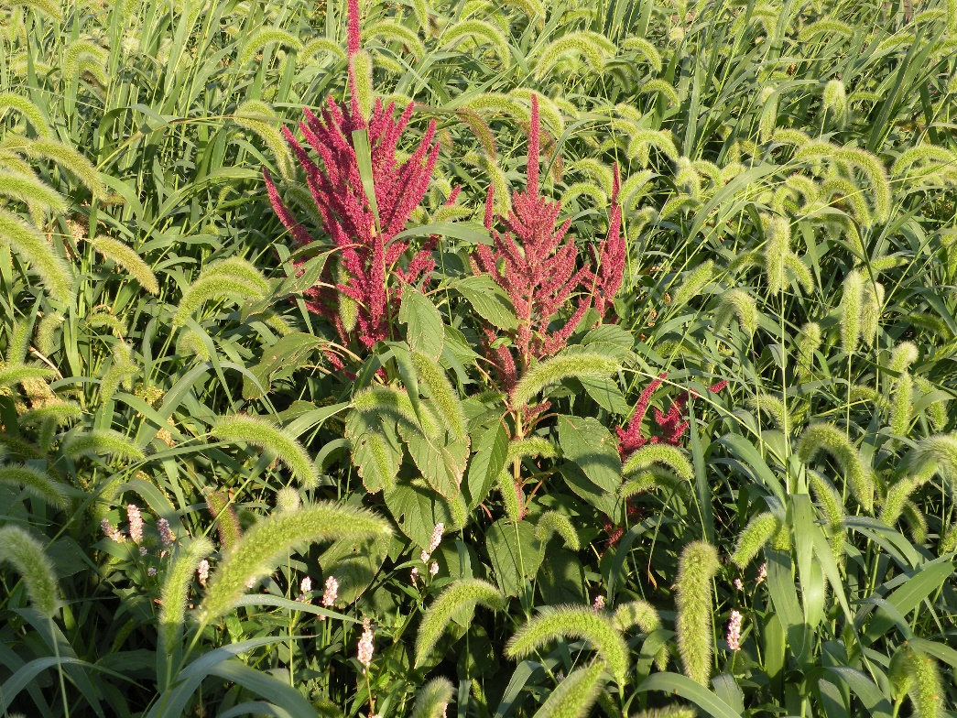
Approaching Alternative Crops
Experiment at a small scale
Consult with experienced growers
Choose favorable land
Well-drained
Lower weed pressure
Amaranth overwhelmed by weeds
Notes:
Narration: When planting a new crop, it’s a good idea to start with a small-scale experiment. Rather than making a large investment, consider planting a small test plot. That way, if you have to plow down a crop that is overrun with weeds, or the grain is not of marketable quality, you won’t be facing a major loss. It’s very important to get input from growers who have firsthand experience with these crops, even if it means seeking out farmers from outside your region. This can give you a better sense of the potential and the pitfalls of the crop you’re considering, and save you from making preventable mistakes. Finally, if you choose to experiment with potentially high-value, high-risk crops, it’s worth choosing good land for your test plots. It may be tempting to use a spot where your usual crops don’t do well anyway, but many of these crops are very susceptible to weed pressure and excessive moisture. If you try them out on well-drained ground with lower weed pressure, you can get a more accurate idea of the potential productivity and quality of these grains, so that you can decide whether it’s worth experimenting more with them. Image: University of Minnesota

Slide 58
Resources: Production Guides
Dry pea
https://hort.purdue.edu/newcrop/afcm/drypea.html
http://agresearch.montana.edu/wtarc/producerinfo/agronomy-nutrient-management/Pulses/NDSUFactSheet.pdf
Sunflower
http://www.agmrc.org/media/cms/sunflower_guide_69AF73CC348B6.pdf
http://www.gov.mb.ca/agriculture/crops/production/print,sunflowers.html
Dry bean
http://library.ndsu.edu/tools/dspace/load/?file=/repository/bitstream/handle/10365/17658/A-602-1990.pdf?sequence=2.
https://hort.purdue.edu/newcrop/articles/ji-beans.html
http://corn.agronomy.wisc.edu/Crops/FieldBean.aspx
Organic sweet corn
https://content.ces.ncsu.edu/organic-sweet-corn-production
https://attra.ncat.org/attra-pub/viewhtml.php?id=31
Organic processing pea
https://www.ces.ncsu.edu/redirects/pdfs.php?src=2013/12/pea.pdf
Alternative Field Crops Manual
https://hort.purdue.edu/newcrop/afcm/index.html
Notes:
Narration: Many published resources are available to help you decide how to fit alternative crops into your rotations and how best to manage them. Production guides for individual crops are available from a variety of sources. The Alternative Field Crops Manual is also an excellent resource for a wide range of crops.

Slide 59
Other Resources
Organic variety trials (searchable by crop)
http://varietytrials.eorganic.info/
List of companies offering organic grain production contracts
http://non-gmoreport.com/articles/2017-non-gmo-and-organic-grain-production-contracts/
USDA Whole Farm Revenue Protection Program
https://www.rma.usda.gov/policies/wfrp.html
Other modules in this series:
Marketing
Small grains
Economics of New Crops
Rotations
Preventing GMO Contamination
Notes:
Narration: Organic variety trial results can be accessed through eOrganic’s searchable database. The Non-GMO Project has complied a list of companies offering organic grain production contracts, though this is time-sensitive information that is likely to change. Information on the USDA’s pilot offering of the Whole Farm Revenue Protection Program is available from the Risk management Agency’s website. And we encourage you to refer to other modules in this series that may be helpful, including Marketing, Small Grains, Economics of New Crops, Rotations, and Preventing GMO Contamination.

Slide 60
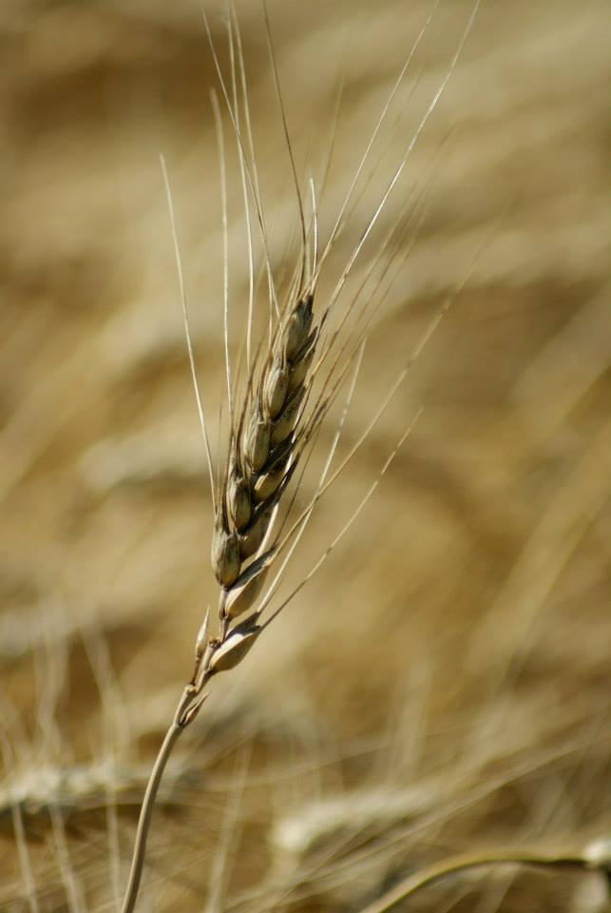
© 2017 Regents of the University of Minnesota. All rights reserved. The University of Minnesota is an equal opportunity educator and employer.
This material is based upon work that is supported by the National Institute of Food and Agriculture, U.S. Department of Agriculture, under grant number 2013-51106-21005.
Notes:
Narration: This material is based upon work that is supported by the National Institute of Food and Agriculture.
Image: Constance Carlson, University of Minnesota

Slide 61
References
Albert Lea Seed. 2010. Triticale. http://www.alseed.com/UserFiles/Documents/Product%20Info%20Sheets-PDF/Basics%20Triticale-2010.pdf
Kelly, James D. Program Objectives: Dry Bean (Phaseolus vulgaris) Breeding and Genetics Program. Michigan State University, East Lansing, MI.
Moncada, Kristine; Sheaffer, Craig; and Stordahl, Jim. 2010. Chapter 14: Alternative crops. In Moncada K.M. and Sheaffer, C. C. (eds.). Risk Management Guide for Organic Producers. University of Minnesota, St. Paul, MN.
OSU Department of Horticulture. 2010. Peas, Processing -- Eastern Oregon. Oregon State University, Corvallis, OR. http://horticulture.oregonstate.edu/content/peas-processing-eastern-oregon-0
Swegarden, H., and C.C. Sheaffer and T.E. Michaels. 2015. Yield stability of heirloom dry bean (Phaseolus vulgaris L.) cultivars in Midwest organic production. HortScience. 51(1):8-14.
USDA-ERS. 2017. Dry Beans. https://www.ers.usda.gov/topics/crops/vegetables-pulses/dry-beans/#major
USDA-NASS. 2016 State Agriculture Overview: Minnesota. USDA NASS, Washington, DC. https://www.nass.usda.gov/Quick_Stats/Ag_Overview/stateOverview.php?state=MINNESOTA

