Slide 1
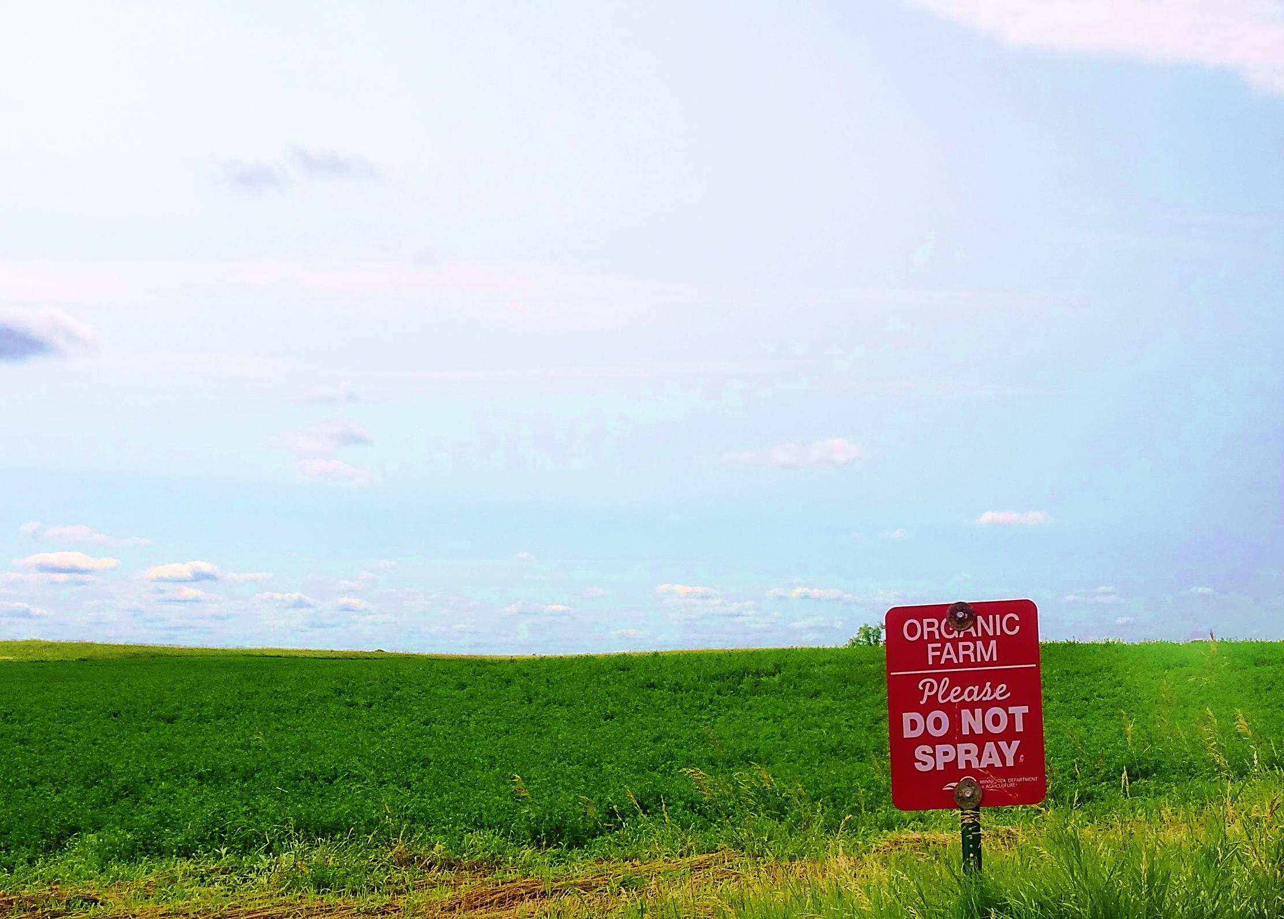
Organic Certification
Authors
Kristine Moncada
Harriet Behar
Jim Riddle
Constance Carlson
Craig Sheaffer
This material is based upon work that is supported by the National Institute of Food and Agriculture, U.S. Department of Agriculture, under grant number 2013-51106-21005.
Notes:
Narration: Welcome to our Organic Certification module.
Image: Kristine Moncada, University of Minnesota

Slide 2
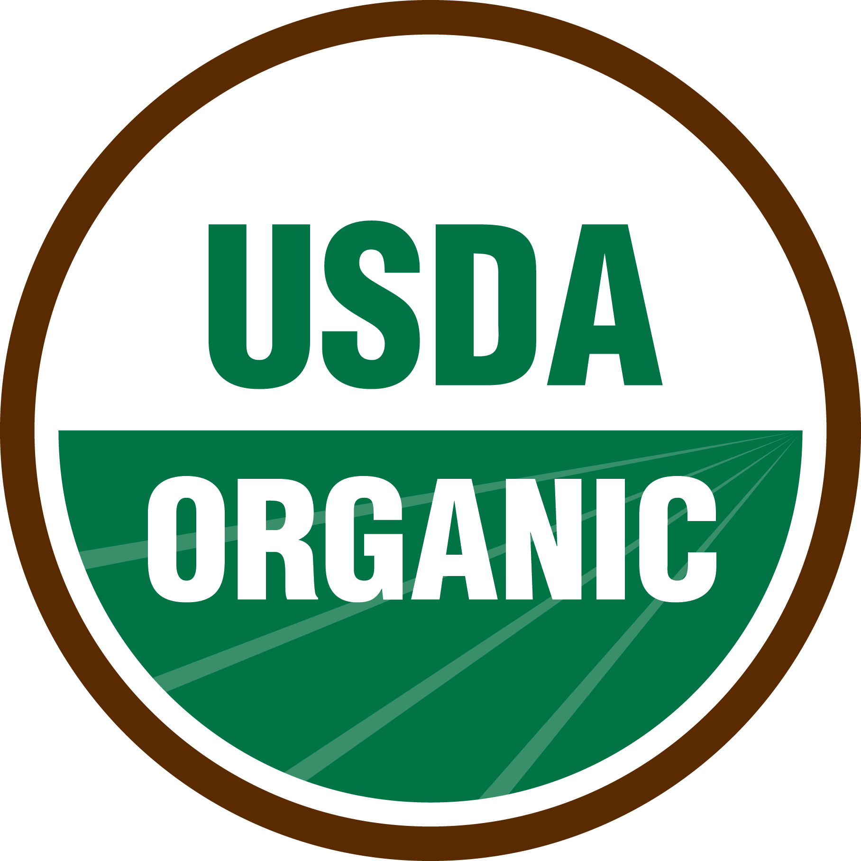
Why Get Certified?
Use of organic seal
Access to organic markets
Improve profitability potential
Increase environmental sustainability
Protect from contamination
Notes:
Narration: Why should you consider organic certification? Only farmers that are certified can legally use the USDA organic seal. Certification allows you access to organic markets and to potentially improved profitability. Not only that, but certified organic practices can increase the environmental sustainability of your operation and help protect the environment from contamination from synthetic pesticides and other harmful substances. For more on how organic is defined by the National Organic Program, please watch our What is Organic? module.
Image: USDA-AMS

Slide 3

Organic Certification
Overview
Choosing a Certification Agency
Applying for Certification
Inspection
Decision Process
Notes:
Narration: We are going to cover the steps in the organic certification process. First, let’s start with an overview of the basics.
Image: Kristine Moncada, University of Minnesota

Slide 4
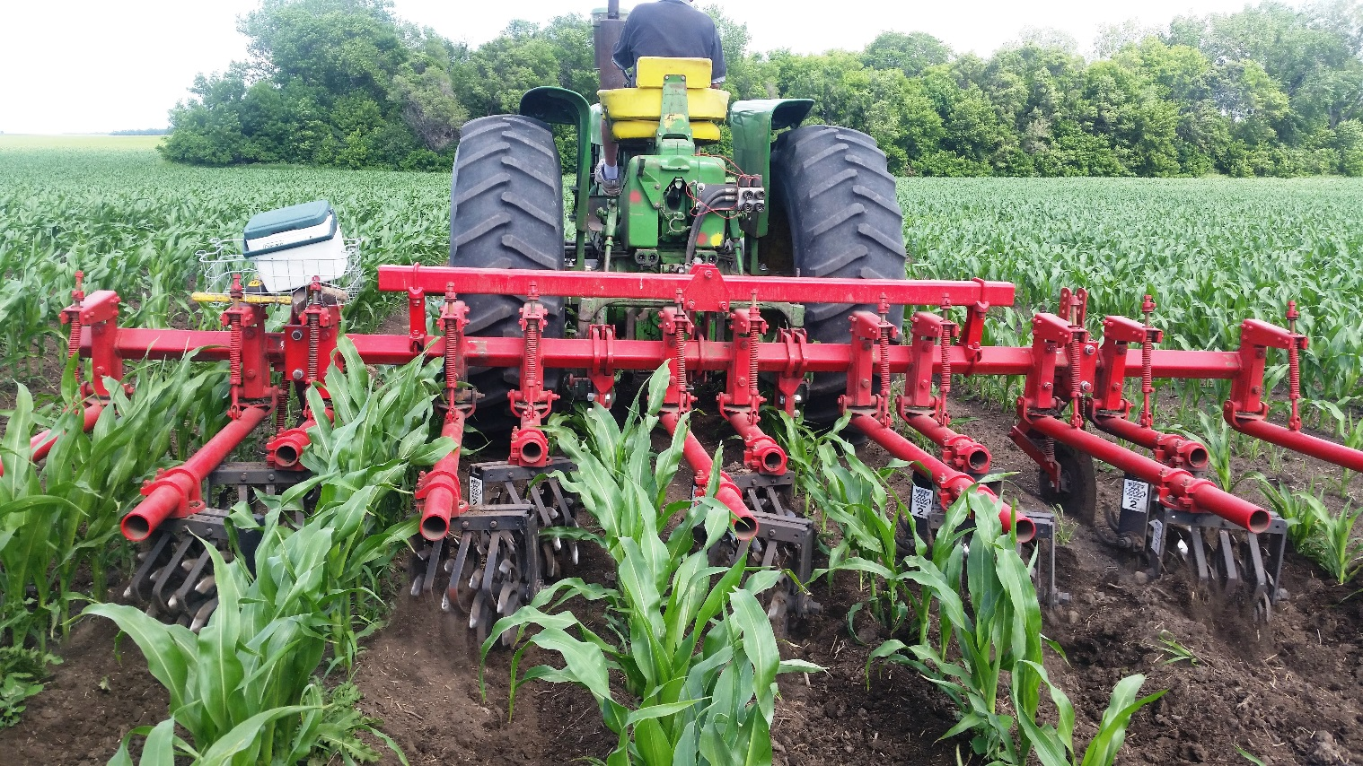
Certification
Process that verifies organic regulations have been followed
Notes:
Narration: What exactly is certification? Certification is the process that verifies organic regulations have been followed by the farmer.
Image: Carmen Fernholz

Slide 5
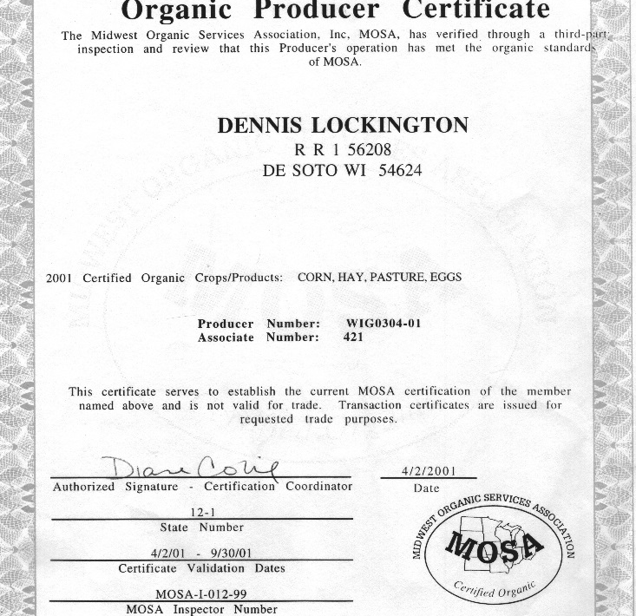
Certification Overview
Farmer works with certifying agency
Organic certificate issued annually
Allows crops, livestock and processed products to be sold as organic
Notes:
Narration: To get certified, farmers must work with certifying agencies, which are organizations in the business of conducting organic certification. An organic certificate is issued annually by the certifier when all requirements are met. Once an operation is certified, crops, livestock and processed products can be sold as organic.
Image: Harriet Behar, MOSES

Slide 6
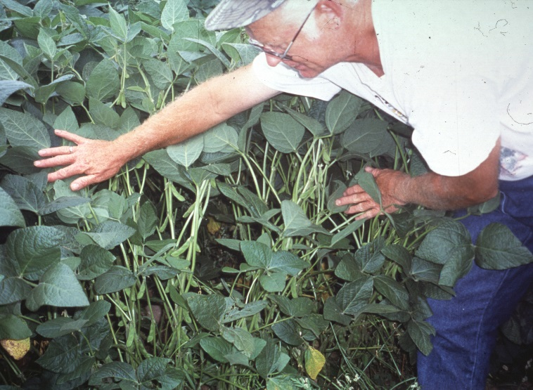
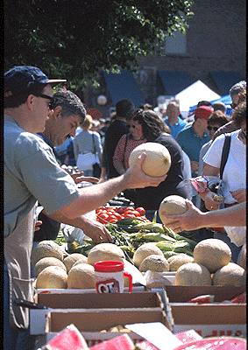
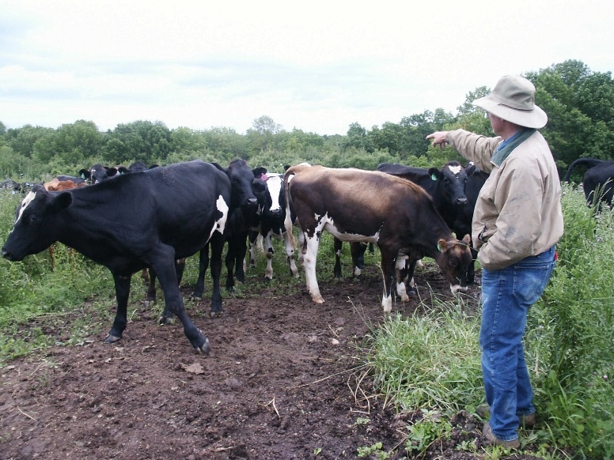
Who Needs to be Certified?
Crop producers, livestock producers, and processors
Operations with more than $5,000 in annual organic sales
Not required in transition
Notes:
Narration: Organic crop producers, livestock producers and processors all need to be certified. (Please note we are primarily focusing on crop producers for the purposes this module.) There is an additional factor to consider: the amount of sales. Operations with more than $5,000 in annual organic sales have to be certified. Operations with less than $5,000 can still use organic term (but not the seal) if they are following NOP rules and their production is sold directly to the final organic consumer. Lastly, you should know that farmers who are just transitioning to organic are not required to be certified.
Images: Harriet Behar and Jerry DeWitt, MOSES

Slide 7
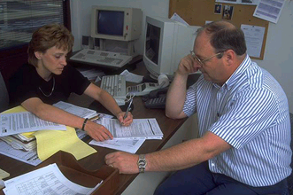
Who Certifies Organic Farmers?
The USDA does not certify farmers
Accredits certifiers as agents to conduct organic certification
Notes:
Narration: The USDA Agricultural Marketing Service administers the National Organic Program, but it does not certify farmers. Instead, it accredits certifiers as agents to conduct organic certification.
Image: USDA

Slide 8
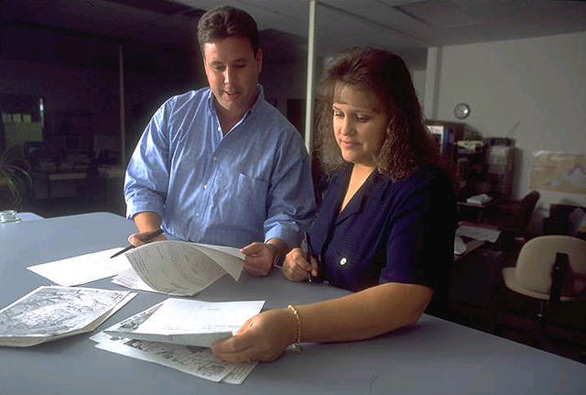
Who Are Certifying Agents?
U.S. or International
Private or State-sponsored
For-profit or non-profit
Notes:
Narration: Worldwide, there are 80 certifiers - 48 in U.S. and 32 in other countries. They can be private or state-sponsored. For instance, Iowa’s Department of Agriculture and Land Stewardship has a certification program, but Minnesota’s Department of Agriculture does not. Some universities and crop improvement associations are also approved to certify organic operations. Certifying agents can be for-profit or non-profit.
Image: USDA

Slide 9
Organic Certification
Overview
Choosing a Certification Agency
Applying for Certification
Inspection
Decision Process
Notes:
Narration: As stated in the previous slide, there are many certification agencies from which to choose. How will you decide?
Image: Kristine Moncada, University of Minnesota

Slide 10
Finding a Certifier
The USDA-AMS lists certifiers by each state
Minnesota Department of Agriculture lists certifiers that operate in MN
Other states will have their lists as well
(Check Resources at end of this modules for links)
Notes:
Narration: The USDA Agricultural Marketing Service lists all the certifiers in the country by state. In Minnesota, the Minnesota Department of Agriculture, offers a list of certifiers that operate in MN. Other state’s departments of agriculture will offer similar lists.

Slide 11
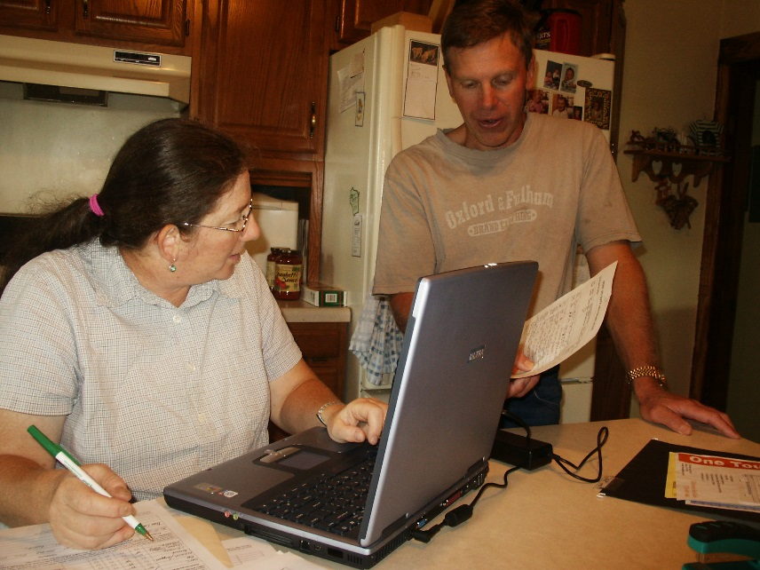
Choosing a Certifier –
First Considerations
Does the certifier operate in your state?
Are they approved to certify your type of operation?
Can they certify your operation in time for you to sell your first organic crop?
Do your potential buyers have any preference regarding which certifier you choose?
Notes:
Narration: You are allowed to choose any accredited certifying agent that suits your needs. First, make sure that the certifier operates in your state. Verify that the certifier covers your type of operation, whether it is crop, livestock or processor. For instance, most certifiers will certify crop operations, but they may not certify processors or handlers. If you are selling to international markets, an international agency and their certificate may help in marketing. Another consideration is timeliness. Can they certify your operation in time for you to sell your first organic crop? Certification can take 4-6 months from submitted application to your certificate, so plan accordingly to find a certifier. And lastly, if you have potential buyers lined up, do they have a preference on which certifier you use?
Image: Harriet Behar, MOSES

Slide 12

Learning about Certifying Agencies
Get recommendations
Visit agency websites
Visit certifier booths at organic conferences or other events
Notes:
Narration: How can you learn more about certifying agencies? Ask others who farm organically for recommendations. You can visit the agencies’ websites for program manuals and forms and you can contact them directly if you have questions. Another way to connect is to visit certifiers’ booths at organic conferences. This can be a good way to make contacts and ask questions in person, as well as determining if the philosophy of the certifying agency matches yours.

Slide 13
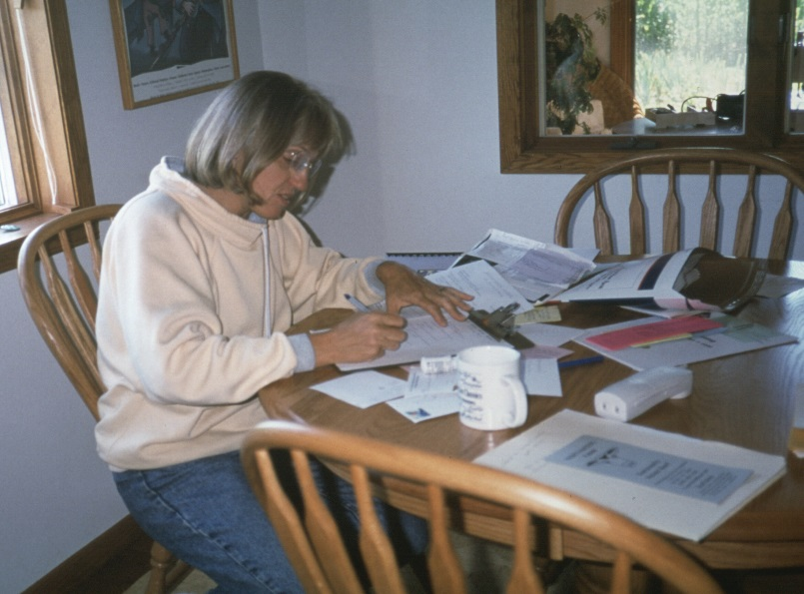
How Much Will Certification Cost?
Costs vary by agency
Fees are public
Can be based on production volume and/or sales
Crops, livestock and handling require separate certifications
Notes:
Narration: Certification costs vary by agency, but National Organic Programs rules require fees to be public. Certification agencies may base their fees on production volume and/or sales. Contact certifying agencies for estimates for your operation. Crops, livestock and handling will each require separate certifications.
Image: Harriet Behar, MOSES

Slide 14

Typical Costs
In 2012, median in MN = $1000
Nationally
  $700 for small operation
  $1000-2000 for medium operation
  $6000 for a large operation
Cost share is available
Notes:
Narration: In 2012, the Minnesota Department of Agriculture reported that the median certification costs in Minnesota was around $1000. Nationally, the USDA says costs range from $700 for a small operation, $1000-$2000 for a medium one, and around $6000 for a large operation. The costs are generally not all paid up front. A fee will be paid upon application submission, for instance, and then the fee for inspection will be paid when the inspection gets scheduled. Cost share programs for certification are available either at the state or federal level. Please see the Resources module for information on cost share programs available to you. Current programs cover up to $750 per certification per year.

Slide 15
Organic Certification
Overview
Choosing a Certification Agency
Applying for Certification
Inspection
Decision Process
Notes:
Narration: Once you’ve decided which certification agency to use, you will need to apply for certification.
Image: Kristine Moncada, University of Minnesota

Slide 16

When to Apply
3-6 months BEFORE you are ready to sell an organic crop
Notes:
Narration: The certification process takes some time so don’t wait until the last minute. Apply 3 to 6 months before you are ready to sell your crop as organic. Retroactive certification for a crop from a previous crop year is not allowed.
Image: Pixabay

Slide 17
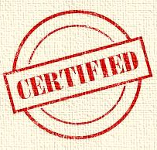
What You Will Need to Start
Records from transition years
Field maps
Organic System Plan (OSP) of your certifying agency
Notes:
Narration: What will you need to start certification? You will need your transition records, such as seed tags, fertility inputs, and field history, and supporting documents along with your field map. Please see our module on record keeping for more information on these. You will also need to complete your certifier’s Organic System Plan, which basically functions as your application to become certified.

Slide 18
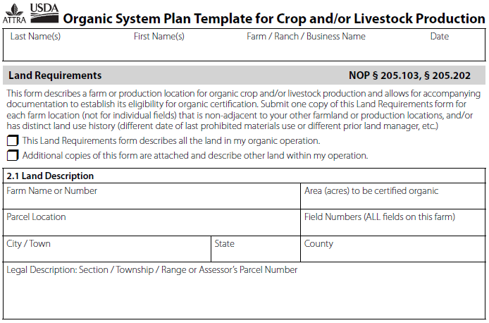
Organic System Plan (OSP)
A management plan
Includes written strategies for all aspects of production
Assists certifier in determining organic compliance
Notes:
Narration: The records you have been keeping will play a key role in completing your OSP. The OSP is a management plan of how you will meet the goals of an organic system. It is required by NOP rules and your certifier when you apply to be certified. You will update it every year you remain certified. It includes written plans concerning all aspects of agricultural production as described in NOP rules. Your OSP helps your certifier figure out if your operation is compliant. While numerous pages long, many of the questions your need to answer are multiple choice check boxes and you will not need to write a lengthy narrative of your farm activities.

Slide 19
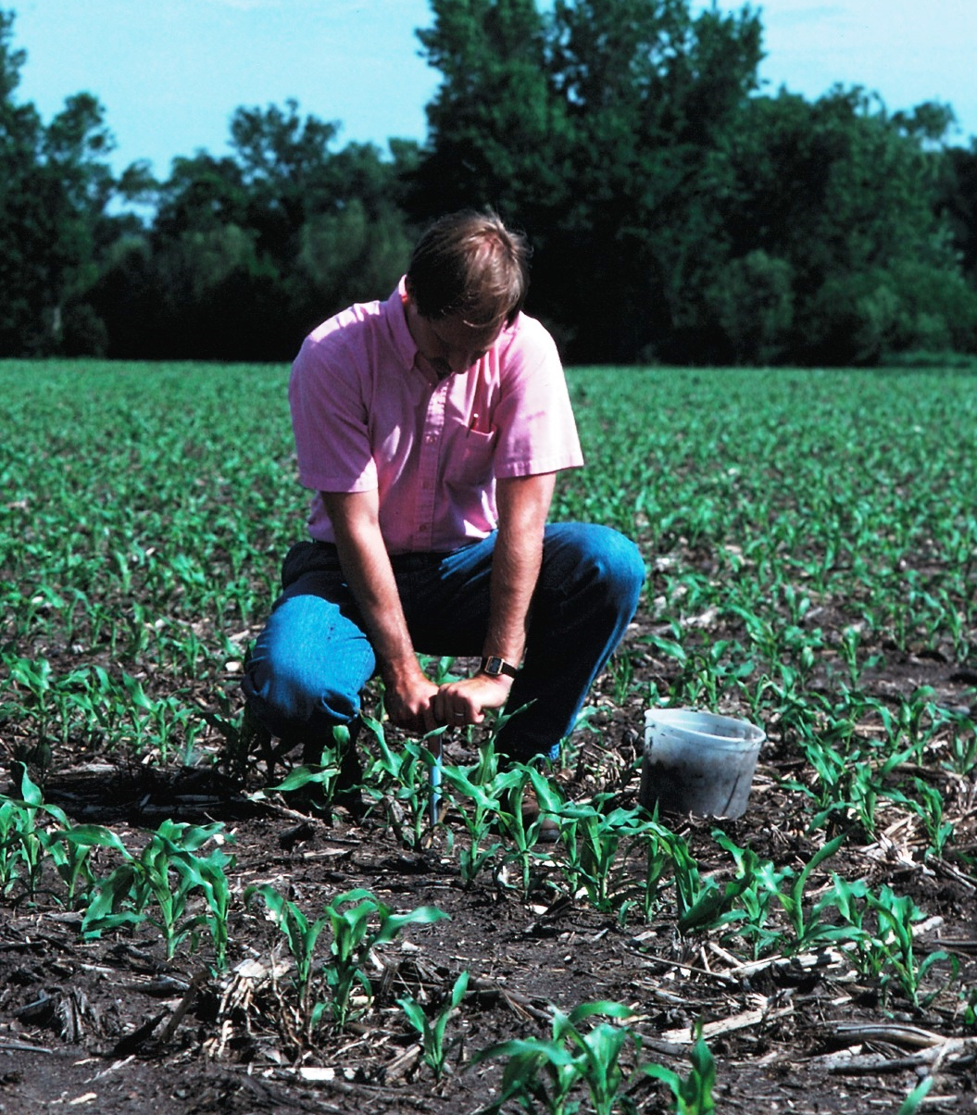
OSP Details
Equipment and maintenance
Inputs to be used
How to address potential problems
Monitoring practices
Notes:
Narration: The Organic System Plan includes detailed production practices such as equipment and maintenance and inputs you will be using. You need to include problems you anticipate and how you will address them. Other questions to answer include: how will you monitor your production such as by soil testing or how you will prevent contamination such as commingling.
Image: Lynn Betts, USDA-NRCS

Slide 20

Tips for Completing OSP
Allow adequate time
Answer as completely and clearly as possible
Be realistic
Notes:
Narration: The first time you fill out an OSP, it will be time-consuming, taking several hours to complete. Answer all the questions and answer as completely as possible – be clear otherwise the document might be sent back from the certifier. Be conscientious – don’t rush because that can be a reflection of your commitment. You are required to follow your OSP, so make sure that the information you provide is realistic and accurate. Remember that this document goes to the certifier who, unlike the inspector, will not be visiting your farm in person so paint a complete picture of your operation. The certifier is the one who decides your fate!

Slide 21

OSP Resources
Certifiers’ websites
ATTRA – template with detailed instructions
MOSES – organic certification fact sheets
(Check Resources at end of this modules for links)
Notes:
Narration: Most certifiers’ websites have downloadable OSP forms to check out. ATTRA has detailed instructions on the elements of an OSP by following a specific example of a farm. Midwest Organic and Sustainable Education Service also has fact sheets on certification.

Slide 22
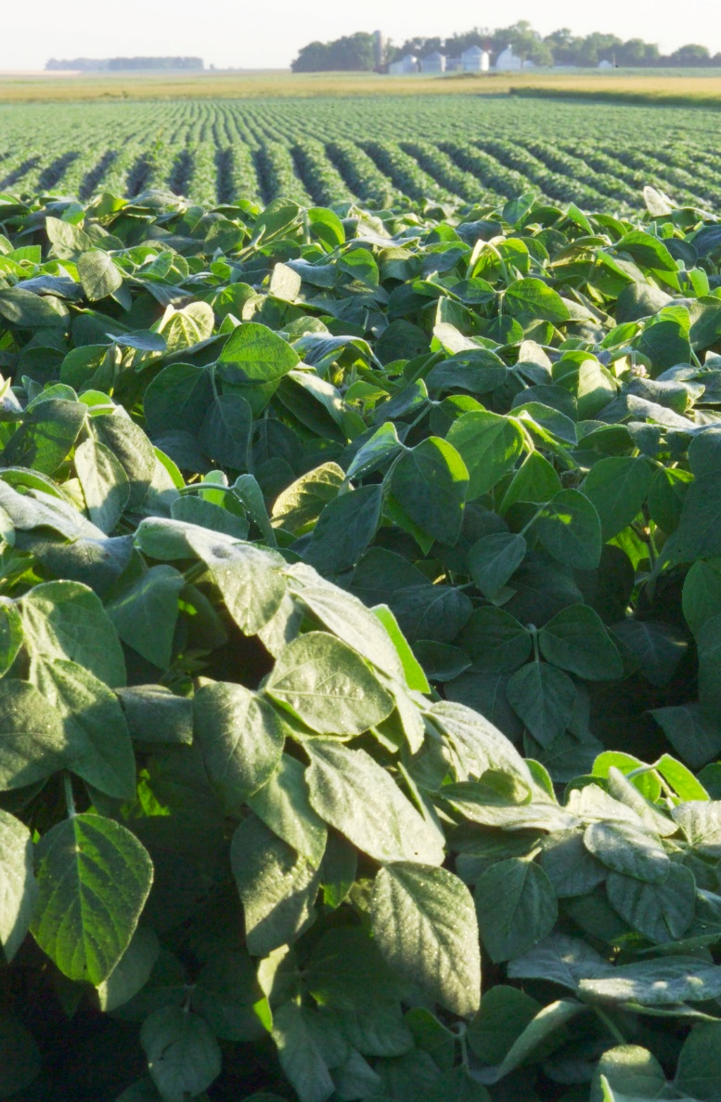
OSP – Making Changes
Some flexibility
Contact your certifier before making changes
Keep track of changes and be able to explain why
Always follow organic regulations
Always verify new materials are acceptable before purchase and use
Notes:
Narration: You may worry about your Organic System Plan being written in stone. The key word here is “plan” so you will have some flexibility. Changes such as in your rotation may happen and may be allowed. Contact your certifier before you make changes. You must keep track of changes and remember that any change must follow organic regulations. Contact your certifier especially when using a new material so they can verify it is allowed. Your certifier is the best resource if you have any questions about particular substances.
Image: David L. Hansen, University of Minnesota

Slide 23
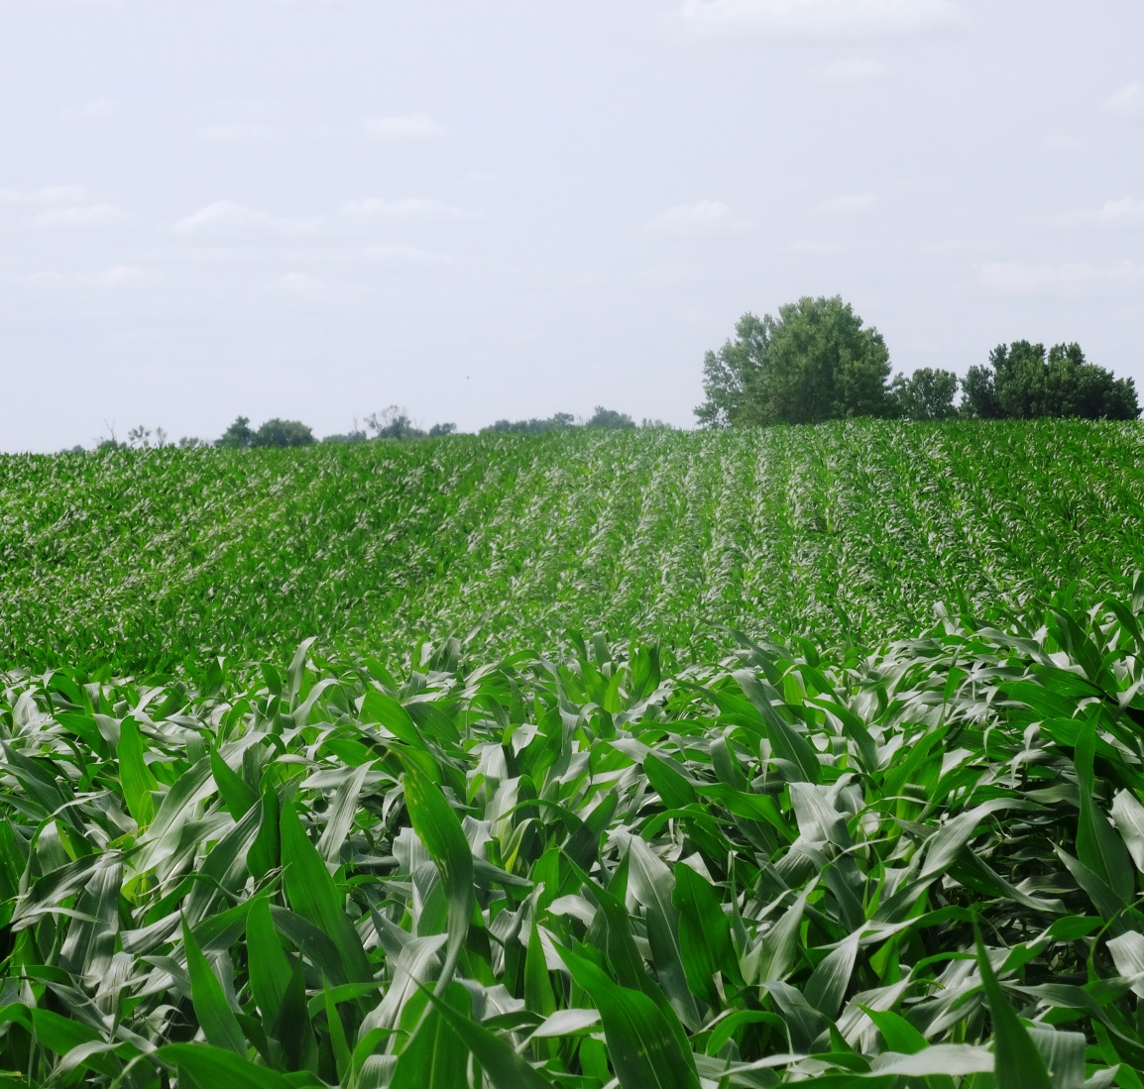
After Submitting Application
The certifier does an initial review of your OSP for compliance
May contact you if there are questions
Next step is setting up the inspection
Notes:
Narration: What happens after you submit your application? First, the certifier reviews your application (OSP) to make sure you meet the organic regulations for your farm’s production. If there are any areas left blank, the certifier will ask for them to be completed. If there are other questions concerning compliance to the organic rules, they may also ask for clarification. The certifier will determine when you are ready for the next step, which is the inspection.
Image: Kristine Moncada, University of Minnesota

Slide 24
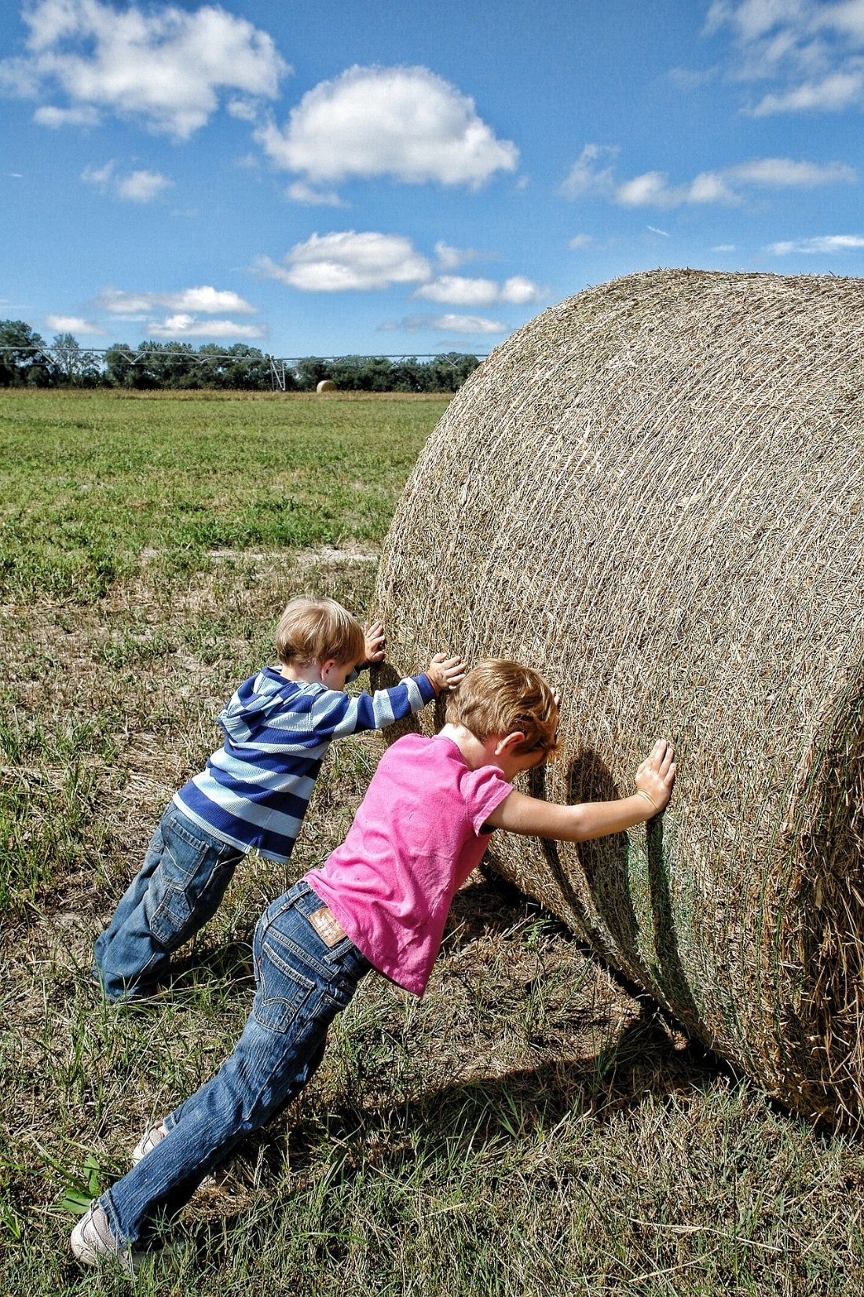
One Final Note
Your OSP should be less work in subsequent years
Notes:
Narration: This process probably seems like a lot of work! Please remember that your original OSP will be used as the base for future years. So in each subsequent year, the updates will be much shorter than the first year, which is more comprehensive.
Image: Pixabay, LoveToTakePhotos / 263

Slide 25
Organic Certification
Overview
Choosing a Certification Agency
Applying for Certification
Inspection
Decision Process
Notes:
Narration: Now that you’ve submitted your OSP and your certifier has indicated that you are ready, the next step is the inspection.
Image: Kristine Moncada, University of Minnesota

Slide 26
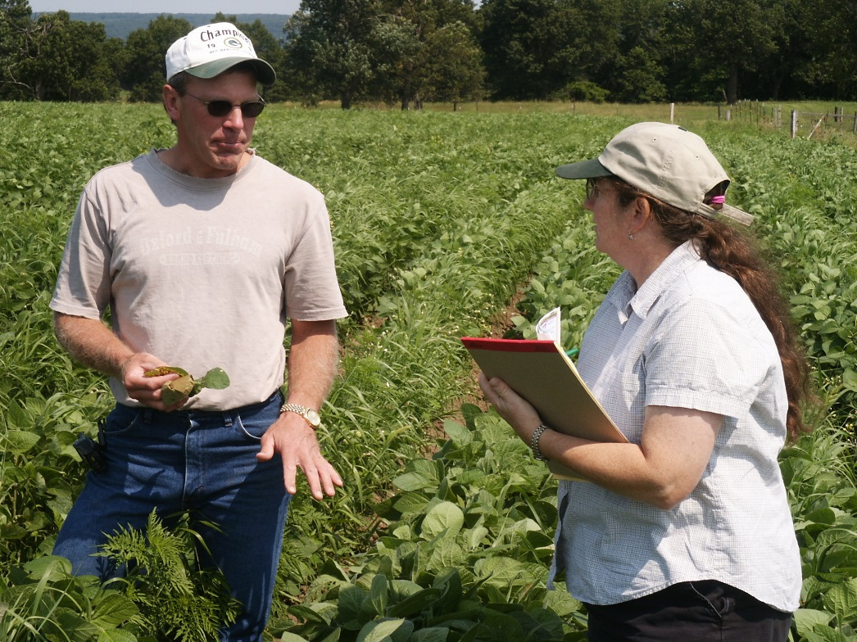
Purpose of Inspection
Compliance with NOP rules
Accuracy of OSP
Assess records and audit trail
Notes:
Narration: The inspection is the process where an inspector from your certification agency visits your farm. The inspection ensures that your operation is in compliance with NOP rules and that your OSP is accurate. It also assesses your records and audit trail. One example of what they will verify is that the production of each crop matches what is sold (to prevent non-organic product from being sold as organic).
Image: Harriet Behar, MOSES

Slide 27
Certifier vs. Inspector
Not the same person!
Certifier
  Does not visit your farm
  Verifies NOP rules are being followed based on OSP and inspector report details
  Decides fate of certification
Inspector
  Visits your farm
  Verifies OSP matches up with site
  Does not make certification decision
  Staff of agency or independent contractor
Notes:
Narration: We’ve been using the terms “certifier” and “inspector”, but we realize exactly who these people are can be confusing. It is a NOP rule that the person who certifies can’t be same person who inspects. Here is an outline of the differences between a certifying agent and an inspector. Inspectors visit your farm, while certifiers do not. Your certifier verifies that what is on your OSP follows NOP rules and your inspector verifies that your farm practices match your OSP. Your inspector does not make a decision on certification. That is up to your certifier. Often, inspectors are independent contractors and most are members of the International Organic Inspectors Association (IOIA).

Slide 28
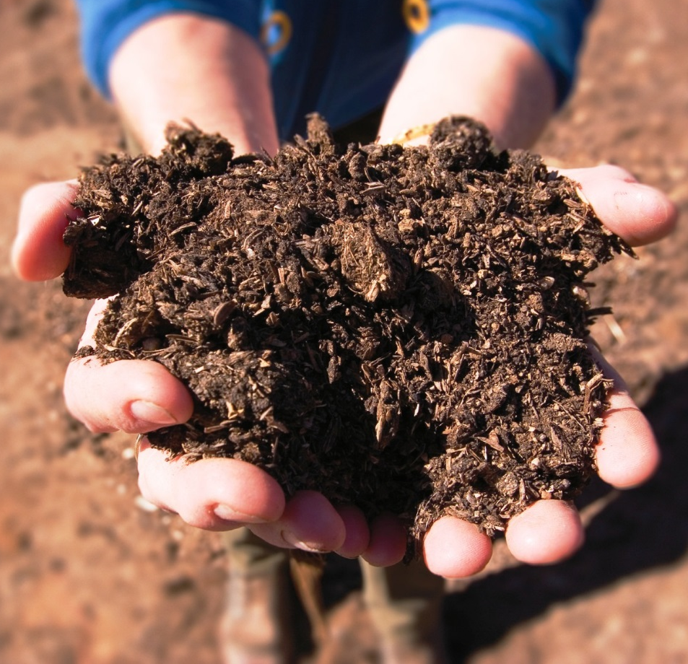
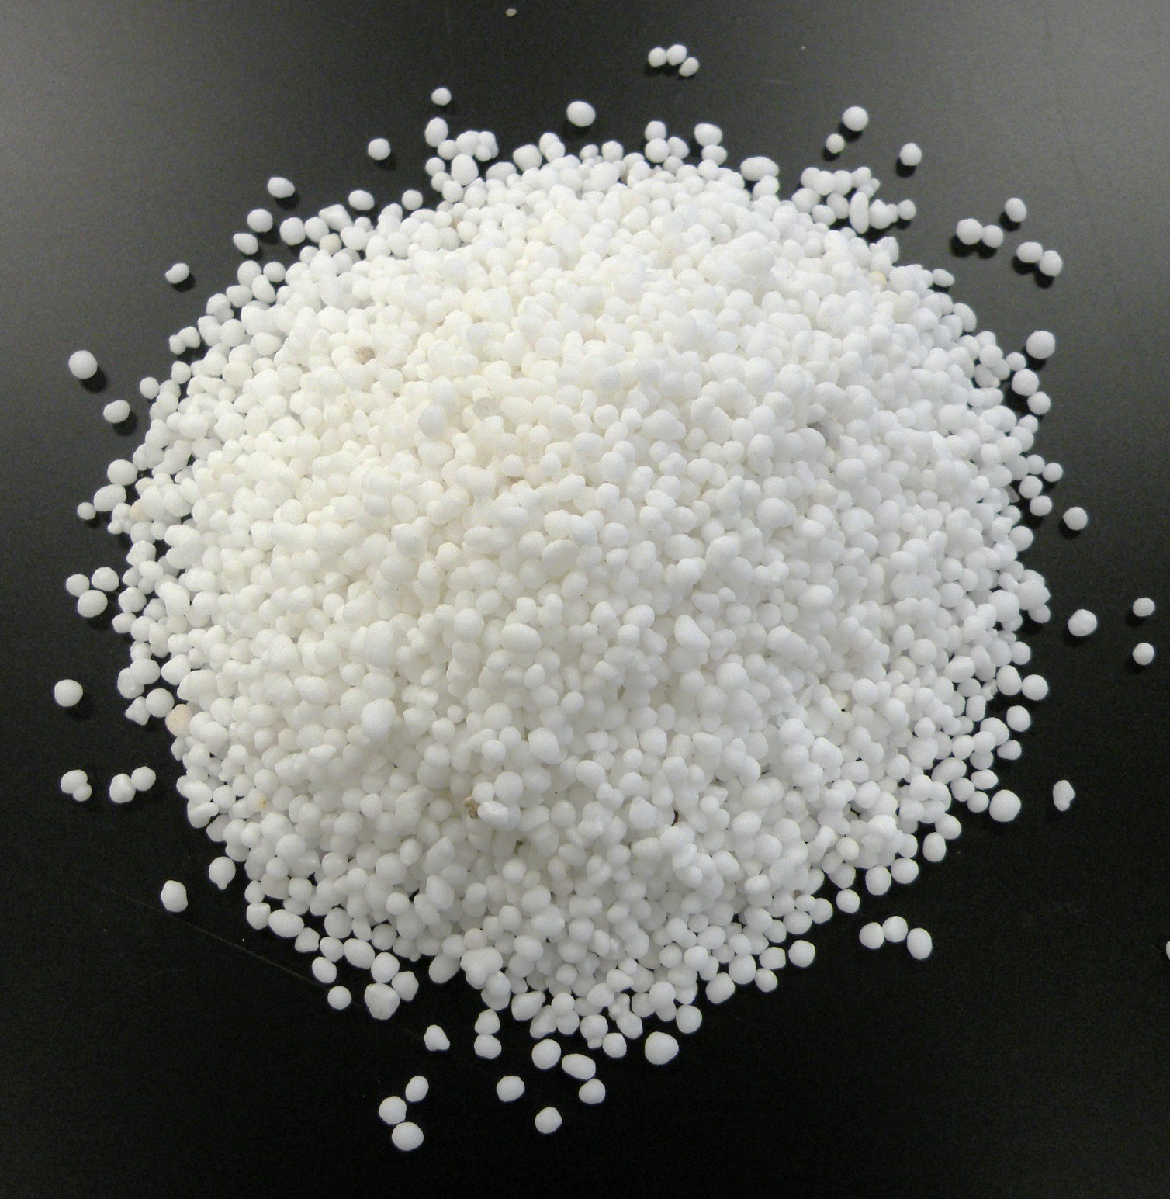
Certifiers and Inspectors ≠
Crop Consultants
They can tell what is allowed and prohibited
COMPOST = allowed
UREA = prohibited
Notes:
Narration: Remember certifiers and inspectors are not crop consultants. You can ask questions of either person, but neither can offer advice beyond what is prohibited and what is allowed so that you will be compliant. Please check out the other modules in this series to get specific organic production information. Additionally, our Resources module has information on organizations, such as the Midwest Organic and Sustainable Education Service, that can offer educational materials and other assistance.
Image: USDA-NRCS (compost); Kristine Moncada, University of Minnesota (urea)

Slide 29
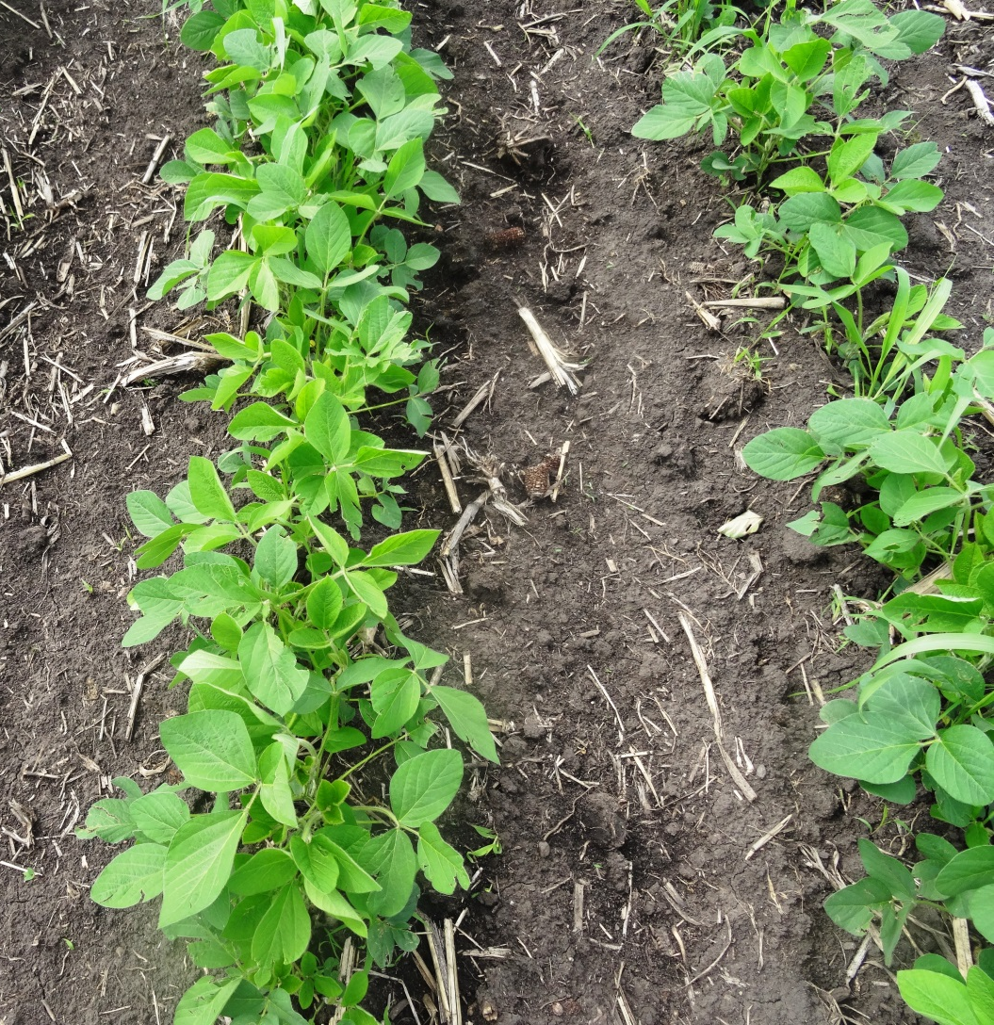
Scheduling Your Inspection
Occurs when crops still in field
Someone knowledgeable of the operation needs to be there
Can take 2-6 hours depending on operation
Notes:
Narration: Once you are ready to schedule your inspection, be aware that it must occur when crops are in the field. So in the Upper Midwest, it can’t happen in winter! Someone who is knowledgeable of the operation will need to be present. Generally, an inspection can take several hours so make sure to take that into account.
Image: Kristine Moncada, University of Minnesota

Slide 30
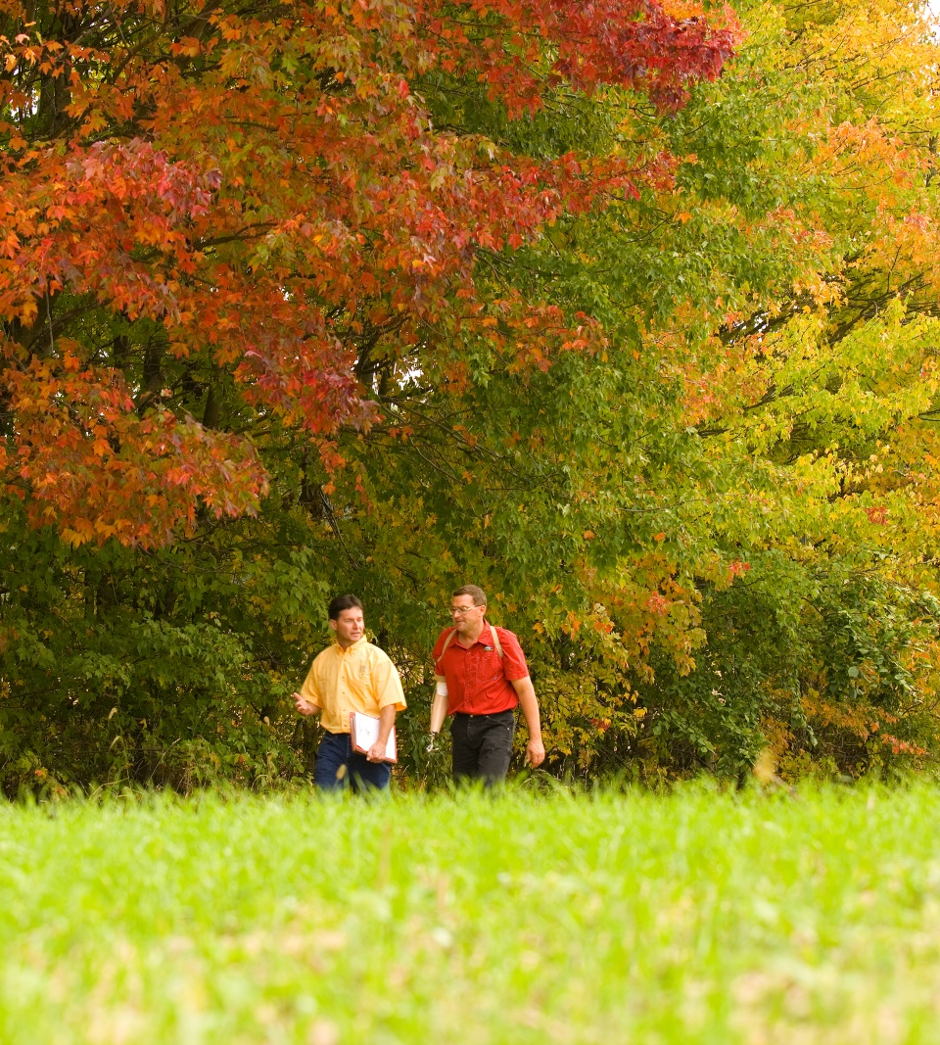
Inspection Overview
Beginning meeting
Farm tour
Records review
Exit interview
Notes:
Narration: Here is an overview of how your inspection might occur. At the beginning, you have a meeting, and then there will be a tour of your farm. Next there will be a review of your records and finally an exit interview.
Image: Scott Bauer, USDA-ARS

Slide 31
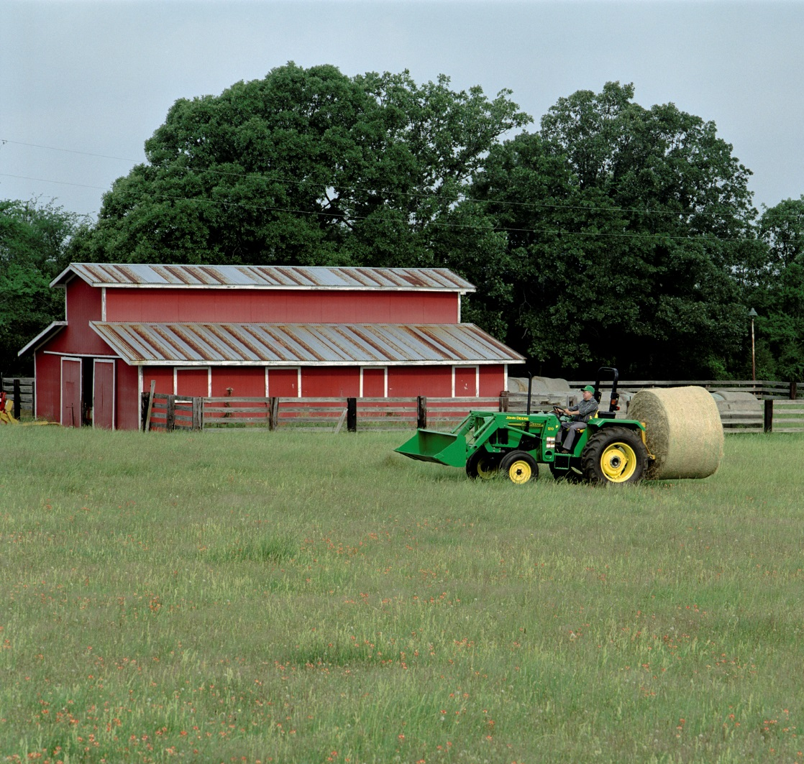
What Will Be Inspected
Anything relating to production
With split operations, conventional side will be inspected, too
All records
Notes:
Narration: If it has to do with your production, organic or not, it is fair game to be inspected. If you have a split operation, the inspector will audit the conventional side, too. Basically, everything that is part of your record-keeping (labels, receipts, field maps, logs, soil tests, etc.) will need to be available for the inspector. You should not have to worry about privacy; inspectors will keep your information confidential with the certification agency.
Image: John Deere

Slide 32

Tips for Your Inspection
Be ready on time
Have all documents available
If your OSP is complete and correct, things will go fine
Share any changes in the OSP with the inspector
You have to pay if they need to come back!
Notes:
Narration: The inspector will probably have other appointments so be ready on time. Have all documents available for the inspection. If your OSP is complete and correct, things will go fine. If there are changes to the OSP, be prepared to share the changes with the inspector. You should be ready to address any issues brought up by the certifier with the inspector. Remember that if the inspector has to come back, it will be at your expense!

Slide 33
Non-Compliance
Uh-oh!
Notes:
Narration: As we said, if you have prepared your OSP well, things should go smoothly. However, it is possible your inspector could find something about your operation that is not in compliance with NOP rules.

Slide 34
Common Non-Compliance Issues
Lack of records
Use of non-organic or synthetically-treated seed
Use of prohibited materials
Lack of labels for inputs, seed or feed
Missing application deadlines
How the agency will treat each issue will depend on the nature of the infraction
Notes:
Narration: Here are some of the common non-compliance issues during the certification process: lack of records; use of synthetically-treated seed; use of prohibited materials; lack of labels for inputs, seed or feed; and missing application deadlines. Regarding the use of prohibited materials, don’t just take vendors’ word that inputs are allowed. You must check with your certifier and make sure to get documentation from the vendor. How your certifier will treat each non-compliance issue will depend on the nature of the infraction.

Slide 35
Organic Certification
Overview
Choosing a Certification Agency
Applying for Certification
Inspection
Decision Process
Notes:
Narration: The certification process is not finished yet! The certifier still needs to decide whether to grant certification to your operation.
Image: Kristine Moncada, University of Minnesota

Slide 36
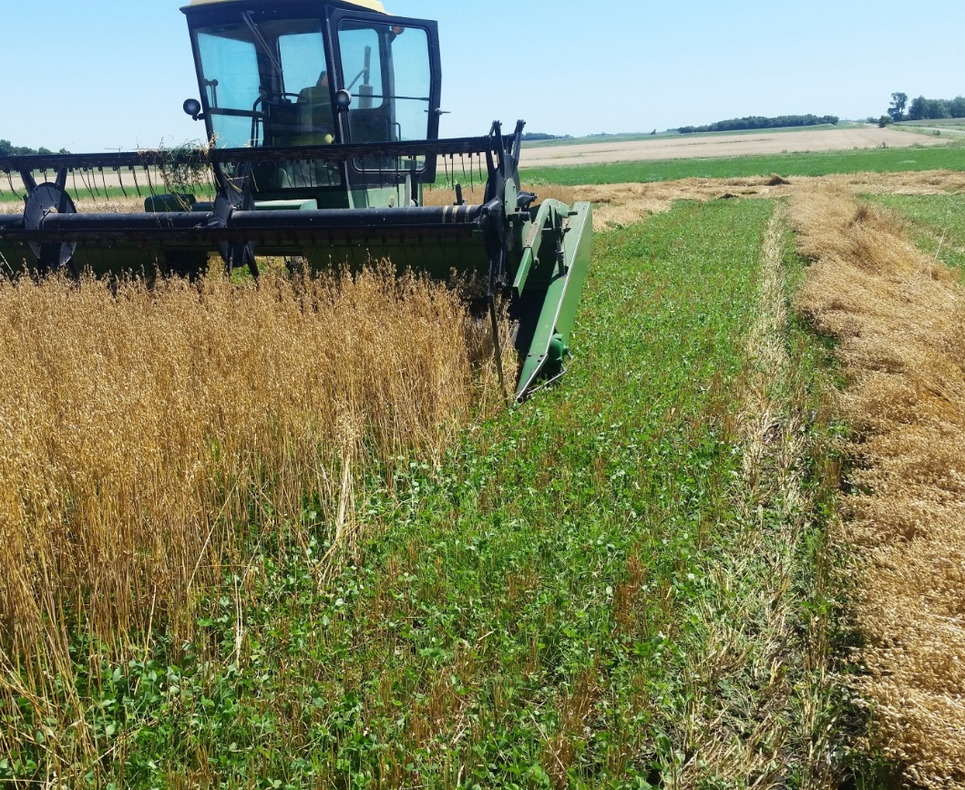
Post-Inspection
Inspector writes report
Certifier reviews report and application
Certifier makes decision
Notes:
Narration: After your inspection, the inspector will write a report detailing what they saw on your farm and how it compares to your written OSP and to the organic regulations.. The certifier reviews the report and your application. They will be looking for whether regulations were followed in the prior 36 months, if the OSP is complete and accurate, and if the inspection matches the OSP. Then they make a decision on your certification.
Image: Carmen Fernholz

Slide 37
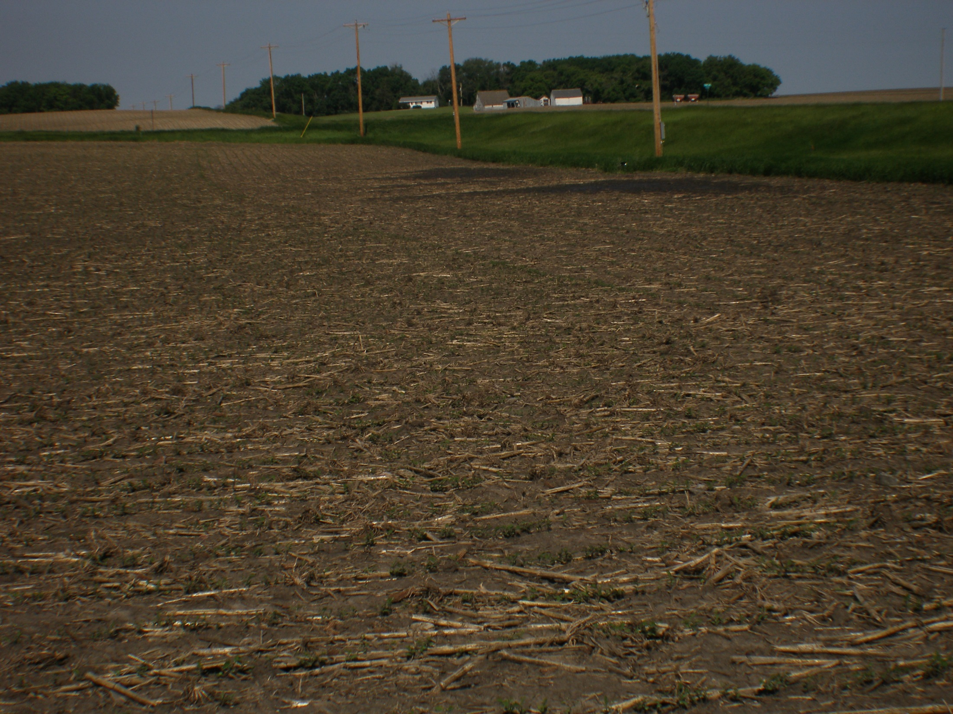
Certifier Decision –
Possible Outcomes
Certification
Certification with conditions
Notice of Noncompliance for issues that are correctable
Notice of Noncompliance and Denial of Certification for non-correctable violations
Notes:
Narration: The certifier may provide certification with or without conditions. They may issue a notice of minor noncompliance for issues that are correctable, for which the producer will have a specific time frame to make changes. Correctable issues might be missing documentation that the corn requested for organic certification was grown from an untreated nonGMO seed. In a less-than-ideal situation, the certifier may issue a denial of certification for non-correctable violations, or a major noncompliance. An example of a non-correctable issue might be use of a prohibited synthetic herbicide on a field requested for organic certification. Certifiers must detail the reasons for all non-compliances and/or denials of certification.
Image: Carmen Fernholz

Slide 38
Overview of Certification
Transition period
Complete OSP
Certifier review
Inspection
Certifier review
Operation certified
Recertify on a yearly basis
Notes:
Narration: In this module, we covered the basic steps in the certification process as shown in this diagram. Once you are a certified organic farmer, you will need to recertify on a yearly basis. Don’t worry, the recertification process likely will be less time-consuming. Remember to renew according to the certifier’s timeline for your operation.

Slide 39
Resources
USDA-AMS – Organic Certification and Accreditation
USDA-AMS – Organic Certifying Agents
Minnesota Department of Agriculture – USDA-Accredited Organic Certifiers Active in Minnesota
Minnesota Institute for Sustainable Agriculture – Minnesota Guide to Organic Certification
ATTRA – Organic System Plan Template for Crop and/or Livestock Production
Midwest Organic and Sustainable Education Service – Guidebook for Organic Certification
Notes:
Narration: For more information on this topic, please visit these sites.

Slide 40
Organic Certification
Overview
Choosing a Certification Agency
Applying for Certification
Inspection
Decision Process
Notes:
Narration: We hope that we have provided you with a good summary of what happens during the certification process. Good luck with your certification!
Image: Kristine Moncada, University of Minnesota

Slide 41
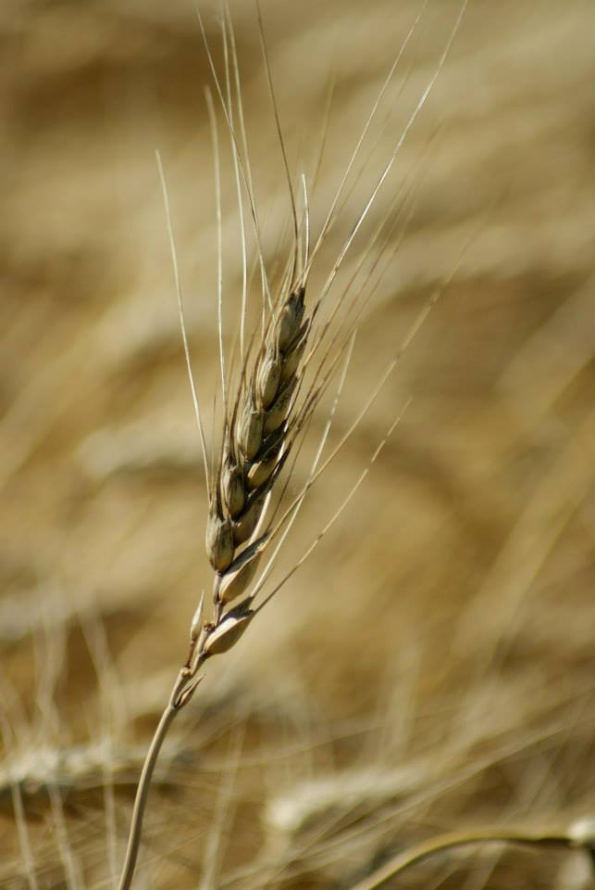
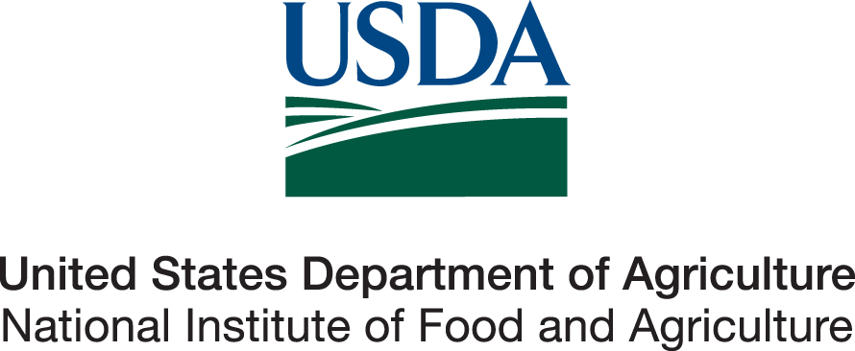
© 2017 Regents of the University of Minnesota. All rights reserved.
The University of Minnesota is an equal opportunity educator and employer.
This material is based upon work that is supported by the National Institute of Food and Agriculture, U.S. Department of Agriculture, under grant number 2013-51106-21005.
Notes:
Narration: This material is based upon work that is supported by the National Institute of Food and Agriculture.
Image: Constance Carlson, University of Minnesota

Slide 42
References
Baker, B. and J. Riddle. 2015. Organic System Plan Overview. http://articles.extension.org/pages/20975/organic-system-plan-overview
Behar, H., L. Langworthy, and J. Nelson. 2016. Guidebook for Organic Certification. Midwest Organic and Sustainable Education Service. https://mosesorganic.org/publications/guidebook-for-certification/
Coleman, P. 2012. Guide for Organic Crop Producers. National Center for Appropriate Technology (NCAT). http://www.ams.usda.gov/sites/default/files/media/Guide%20for%20Organic%20Crop%20Producers_0.pdf
Kircher, C. 2014. Insights from an Organic Certifier – Webinar. Science and Technology Training Library. http://www.conservationwebinars.net/webinars/insights-from-an-organic-certifier
Kuepper, G. 2006. Organic System Plans: Field and Row Crops and Pasture and Range Systems. ATTRA, the National Center for Appropriate Technology. https://attra.ncat.org/attra-pub/summaries/summary.php?pub=167
Minnesota Department of Agriculture. 2016. USDA-Accredited Organic Certifiers Active in Minnesota. http://www.mda.state.mn.us/en/food/organic/production/usda-accredited.aspx
MOSES. 2017. Top 10 reasons to grow organic. https://mosesorganic.org/whyorganic/for-farmers/
Riddle, J. 2002. Most Common Mistakes Made by Certified Crop Operators and/or Certification Applicants. https://attra.ncat.org/sorg/mistakes.html

Slide 43
References (cont.)
Riddle, J. and L. Gulbranson. 2011. Minnesota Guide to Organic Certification. Minnesota Institute for Sustainable Agriculture. https://www.misa.umn.edu/publications/mn-guide-organic-certification
USDA-AMS. 2014. Separation of Duties in Certification Decisions. https://www.ams.usda.gov/sites/default/files/media/2006.pdf
USDA-AMS. 2015. Organic Sound and Sensible Project - What Does Organic Certification Cost? https://www.youtube.com/watch?v=C2KSTAvmBnU&feature=youtu.be
USDA-AMS. 2015. Organic Sound and Sensible Project - What is an Organic Systems Plan? https://www.youtube.com/watch?v=GeZZxRd8ulY&feature=youtu.be
USDA-AMS. 2017. Organic Certification and Accreditation. https://www.ams.usda.gov/services/organic-certification
USDA-AMS. 2017. Becoming a Certified Operation. https://www.ams.usda.gov/services/organic-certification/becoming-certified
USDA-AMS. 2017. Accredited Certifying Agents. http://www.ams.usda.gov/AMSv1.0/ams.fetchTemplateData.do?template=TemplateJ&navID=ACAsLinkNOPAQSSQuestions&rightNav1=ACAsLinkNOPAQSSQuestions&topNav=&leftNav=NationalOrganicProgram&page=NOPACAs&resultType=&acct=nopgeninfo

