Slide 1
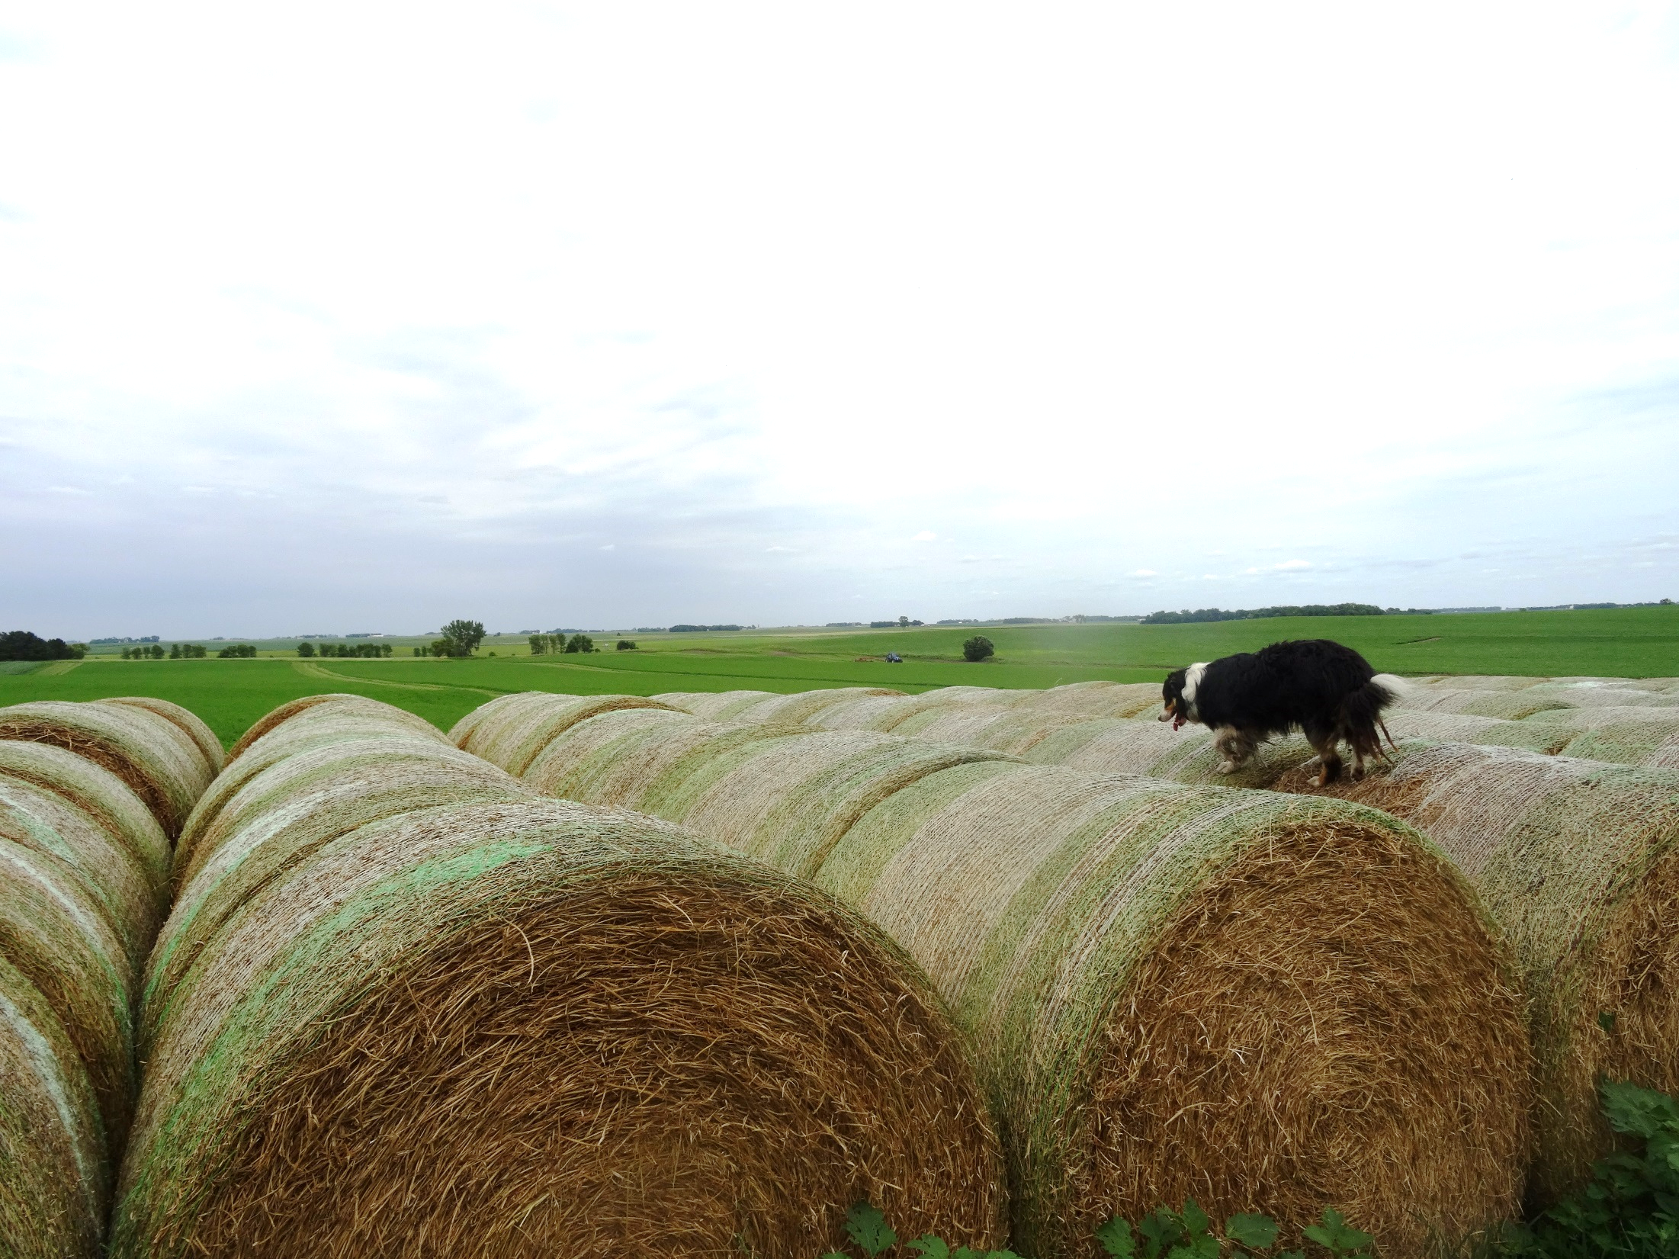
Harvesting and Storage of Forages
This material is based upon work that is supported by the National Institute of Food and Agriculture, U.S. Department of Agriculture, under grant number 2013-51106-21005.
Authors
Craig Sheaffer
Kristine Moncada
Constance Carlson
Notes:
Narration: Welcome to our module on harvesting and storage of forages. Image: Kristine Moncada, University of Minnesota

Slide 2
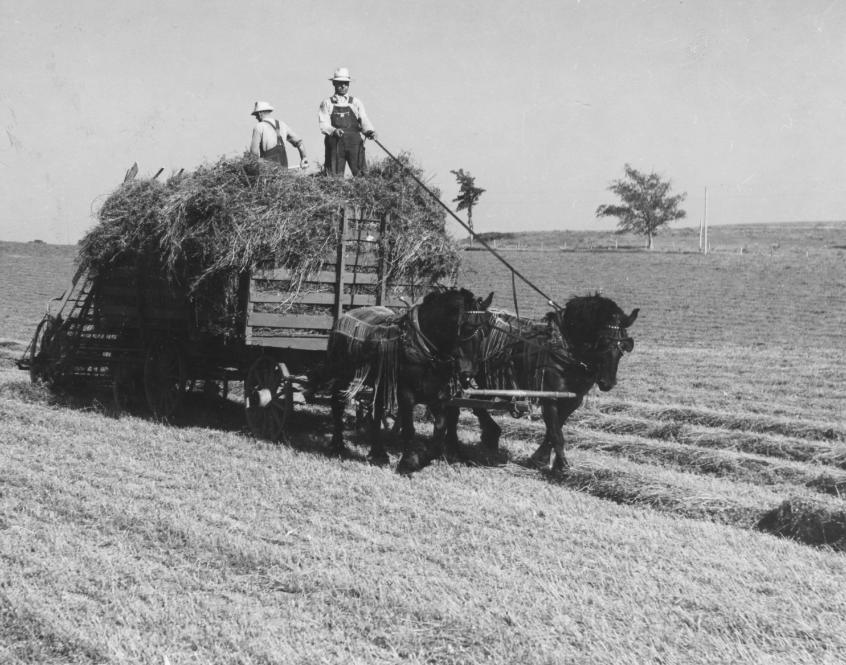
Introduction
Notes:
Narration: Making hay for storage and later feeding and for sale is an important, yet challenging, activity. Haymaking has been practiced by farmers for centuries in northern regions where grazing by livestock was impossible during the winter months. Without hay feeding, livestock growth and milk production would suffer, and sometimes livestock would not survive. Before development of equipment for harvesting hay, it was an exhausting labor-intensive activity involving many workers. Image: Minnesota Agricultural Experiment Station

Slide 3
Harvesting and Storage of Forages
What is Hay?
Cutting and Drying
Raking
Baling
Transport
Storage
Moisture Content
Notes:
Narration: Let’s start by describing what hay is and some goals of haymaking.
Image: Craig Sheaffer, University of Minnesota

Slide 4
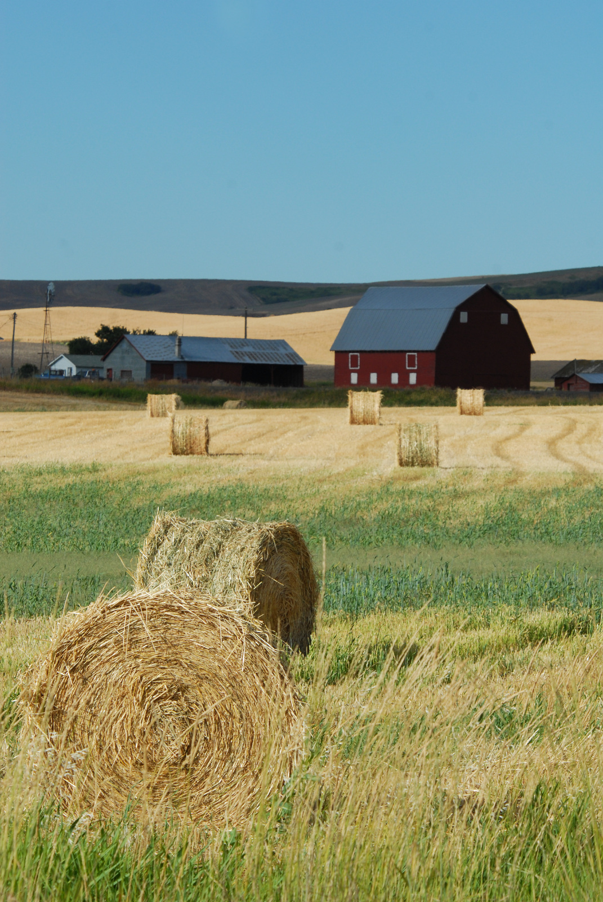
What Is Hay?
Forage stored in air
Low moisture (>20%)
Sun-dried
Packaged
Notes:
Narration: By definition, hay is grass and legume forage that is harvested and stored in the air. It contrasts with silage that is stored in a specialized structure without air called a silo. To allow for storage in the air without molding, hay must be dried to a moisture content of less than 20%. Most often hay is dried in the field using the sun’s energy for drying. After drying, hay is picked up and put into a package called a bale.
Image: Ron Nichols, USDA-NRCS

Slide 5
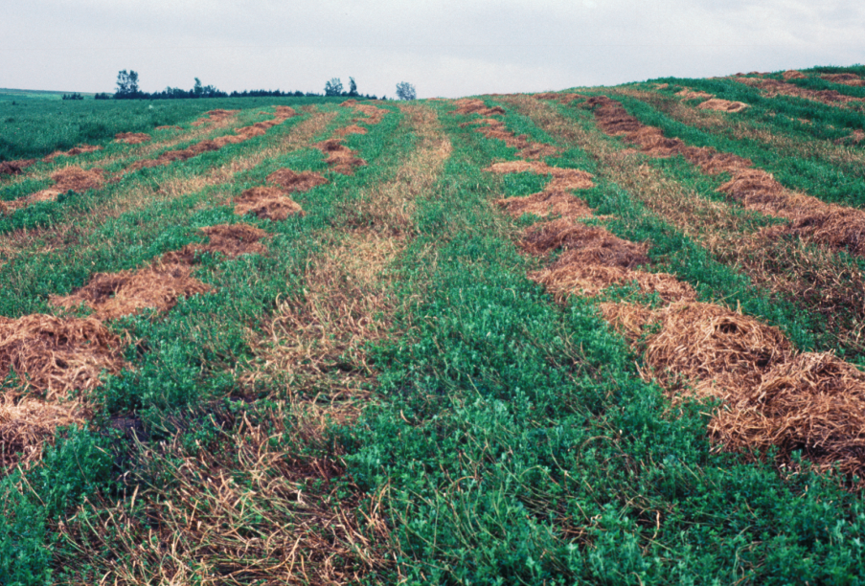
Goals of Haymaking
Minimize field losses
Minimize storage losses
Alfalfa hay that is rained-on during drying and has suffered loss of both forage quality and yield.
Notes:
Narration: The goals of haymaking are to minimize field and storage losses. Because of the need to achieve the target moisture in the forage and dependence on the weather, making good quality hay is challenging. It is typically not possible to save all the forage yield and forage quality that is produced in the field, but producers should still attempt to minimize losses.
Image: Craig Sheaffer, University of Minnesota

Slide 6
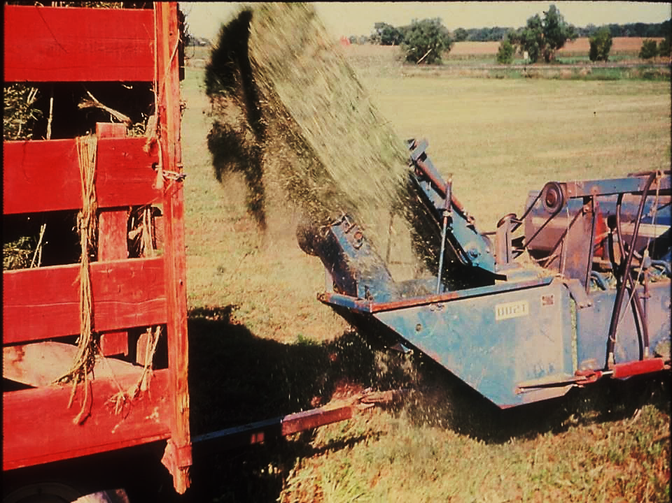
Alfalfa Leaf Shattering
Notes:
Narration: This is a visual example of leaf loss due to shattering during baling of hay. It is likely because the hay has been baled too dry.
Image: Craig Sheaffer, University of Minnesota

Slide 7
Harvesting and Storage of Forages
What is Hay?
Cutting and Drying
Raking
Baling
Transport
Storage
Moisture Content
Notes:
Narration: Here are the steps in haymaking. They include cutting the standing forage, drying the forage in the field, turning the cut forage to facilitate drying, packaging of the dried forage using a baler, transporting the baled hay, and finally storage.
Image: Craig Sheaffer, University of Minnesota

Slide 8
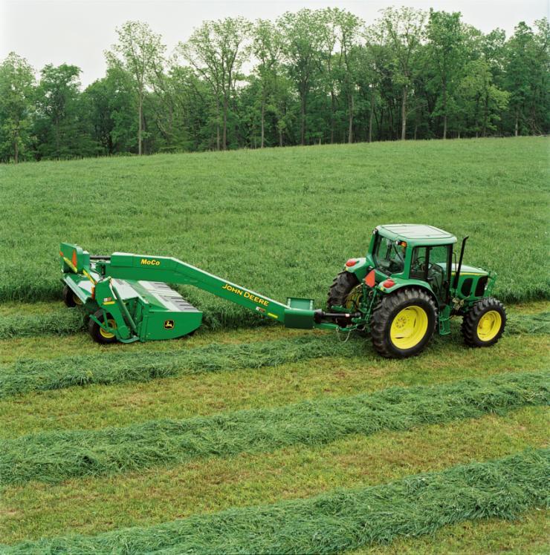
Cutting Standing Forage
Notes:
Narration: The first step in haymaking is to cut the standing forage. Here an alfalfa field is being cut with a mower conditioner. A mower conditioner not only cuts the forage but has rollers or knives that cut or lacerate the stems to increase the drying rate of the forage.
Image: John Deere

Slide 9
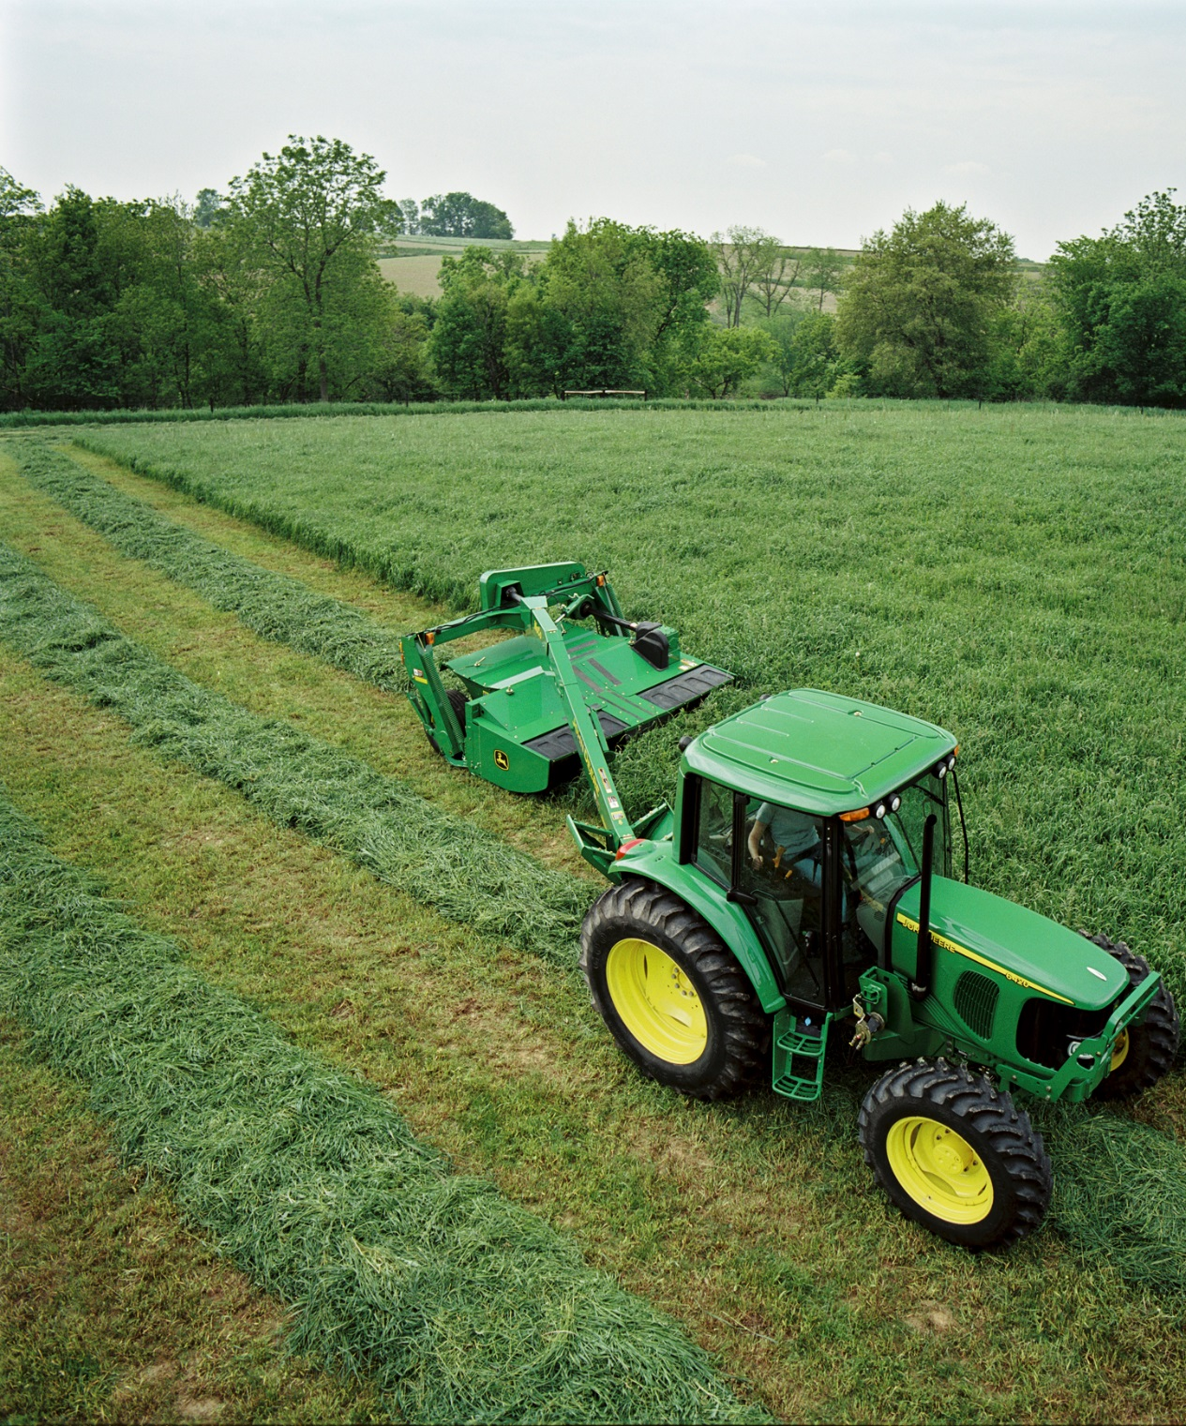
Windrows
Will dry on top
Need raking so underside will dry
Notes:
Narration: Cut hay is often placed in windrows for drying. Windrows will dry on the top but will need to be raked so the underside will dry, too.
Image: John Deere

Slide 10
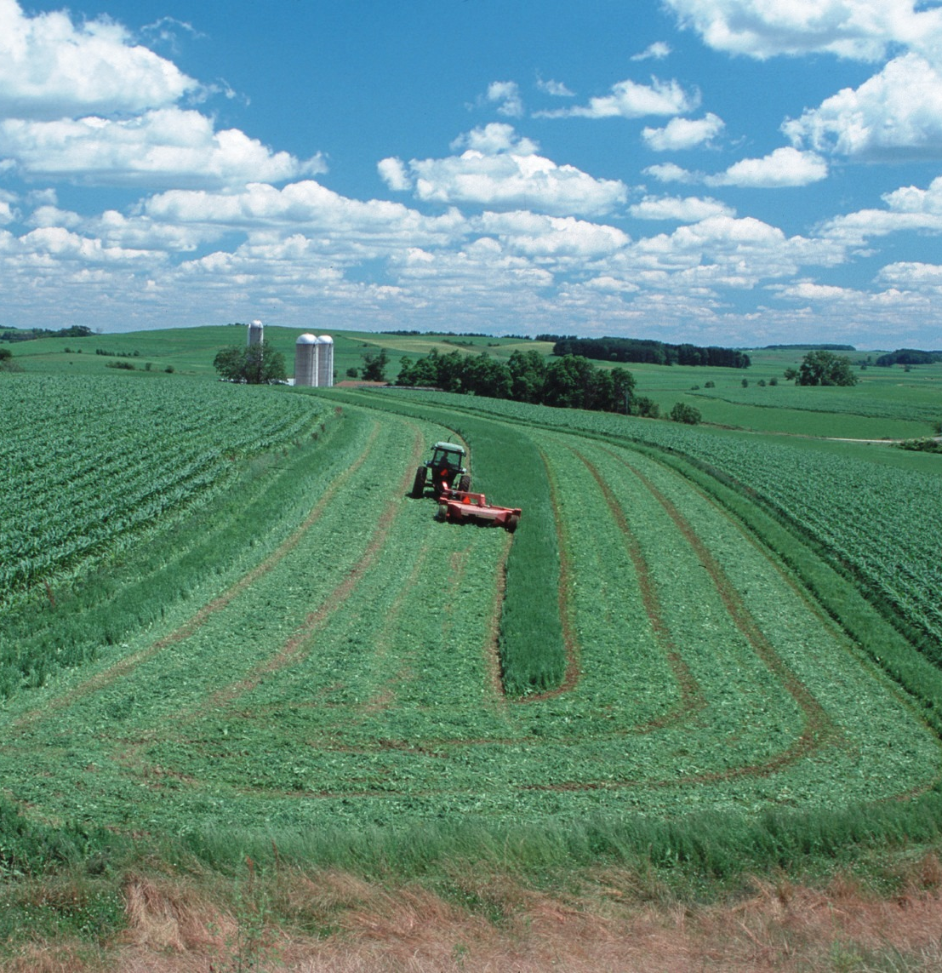
Wide Swath
Exposes more of forage to sun and wind
Notes:
Narration: Research has shown that to facilitate drying, it is better to deposit hay in a wide swath for drying and not into a tight windrow as shown in the previous slide. The wide swath exposes more of the cut forage to the sun’s energy and to the wind. After the top of the hay is dry, the swath of hay can be raked into a windrow for baling. Image: Bob Nichols, USDA-NRCS

Slide 11
Forage Drying
Forage moisture content changes from ~80% uncut and drying to <20%
Moisture loss depends on sun’s energy; aided by wind, low humidity
Typically takes 2-4 days
Notes:
Narration: Before we continue with a discussion of haymaking it is important to describe the hay drying process. Making good quality hay is all about managing the hay moisture content. Standing grass and legume forage can contain as much as 80% moisture and the goal is to rapidly dehydrate the cut forage to less than 20% moisture. Hay made at greater than 20% moisture will mold and we will talk about that later. Forage drying is dependent on the sun’s energy and wind and it typically takes 2-4 days of field drying to achieve proper moisture levels for storage. Drying times are shorter if the hay mass is less dense, if the soil is drier, and if there is low humidity and wind. Of course, rain during haymaking can prevent drying and can actually rewet partially dried hay; hence, that expression, “make hay while the sun shines”.
Image: Julie A. MacSwain, USDA-NRCS

Slide 12
Harvesting and Storage of Forages
What is Hay?
Cutting and Drying
Raking
Baling
Transport
Storage
Moisture Content
Notes:
Narration: The next step in haymaking is raking the hay. Raking is necessary to complete the drying process for the underside of the cut forage. Raking deposits the cut forage into a windrow that can be picked up by a baler.
Image: Craig Sheaffer, University of Minnesota

Slide 13
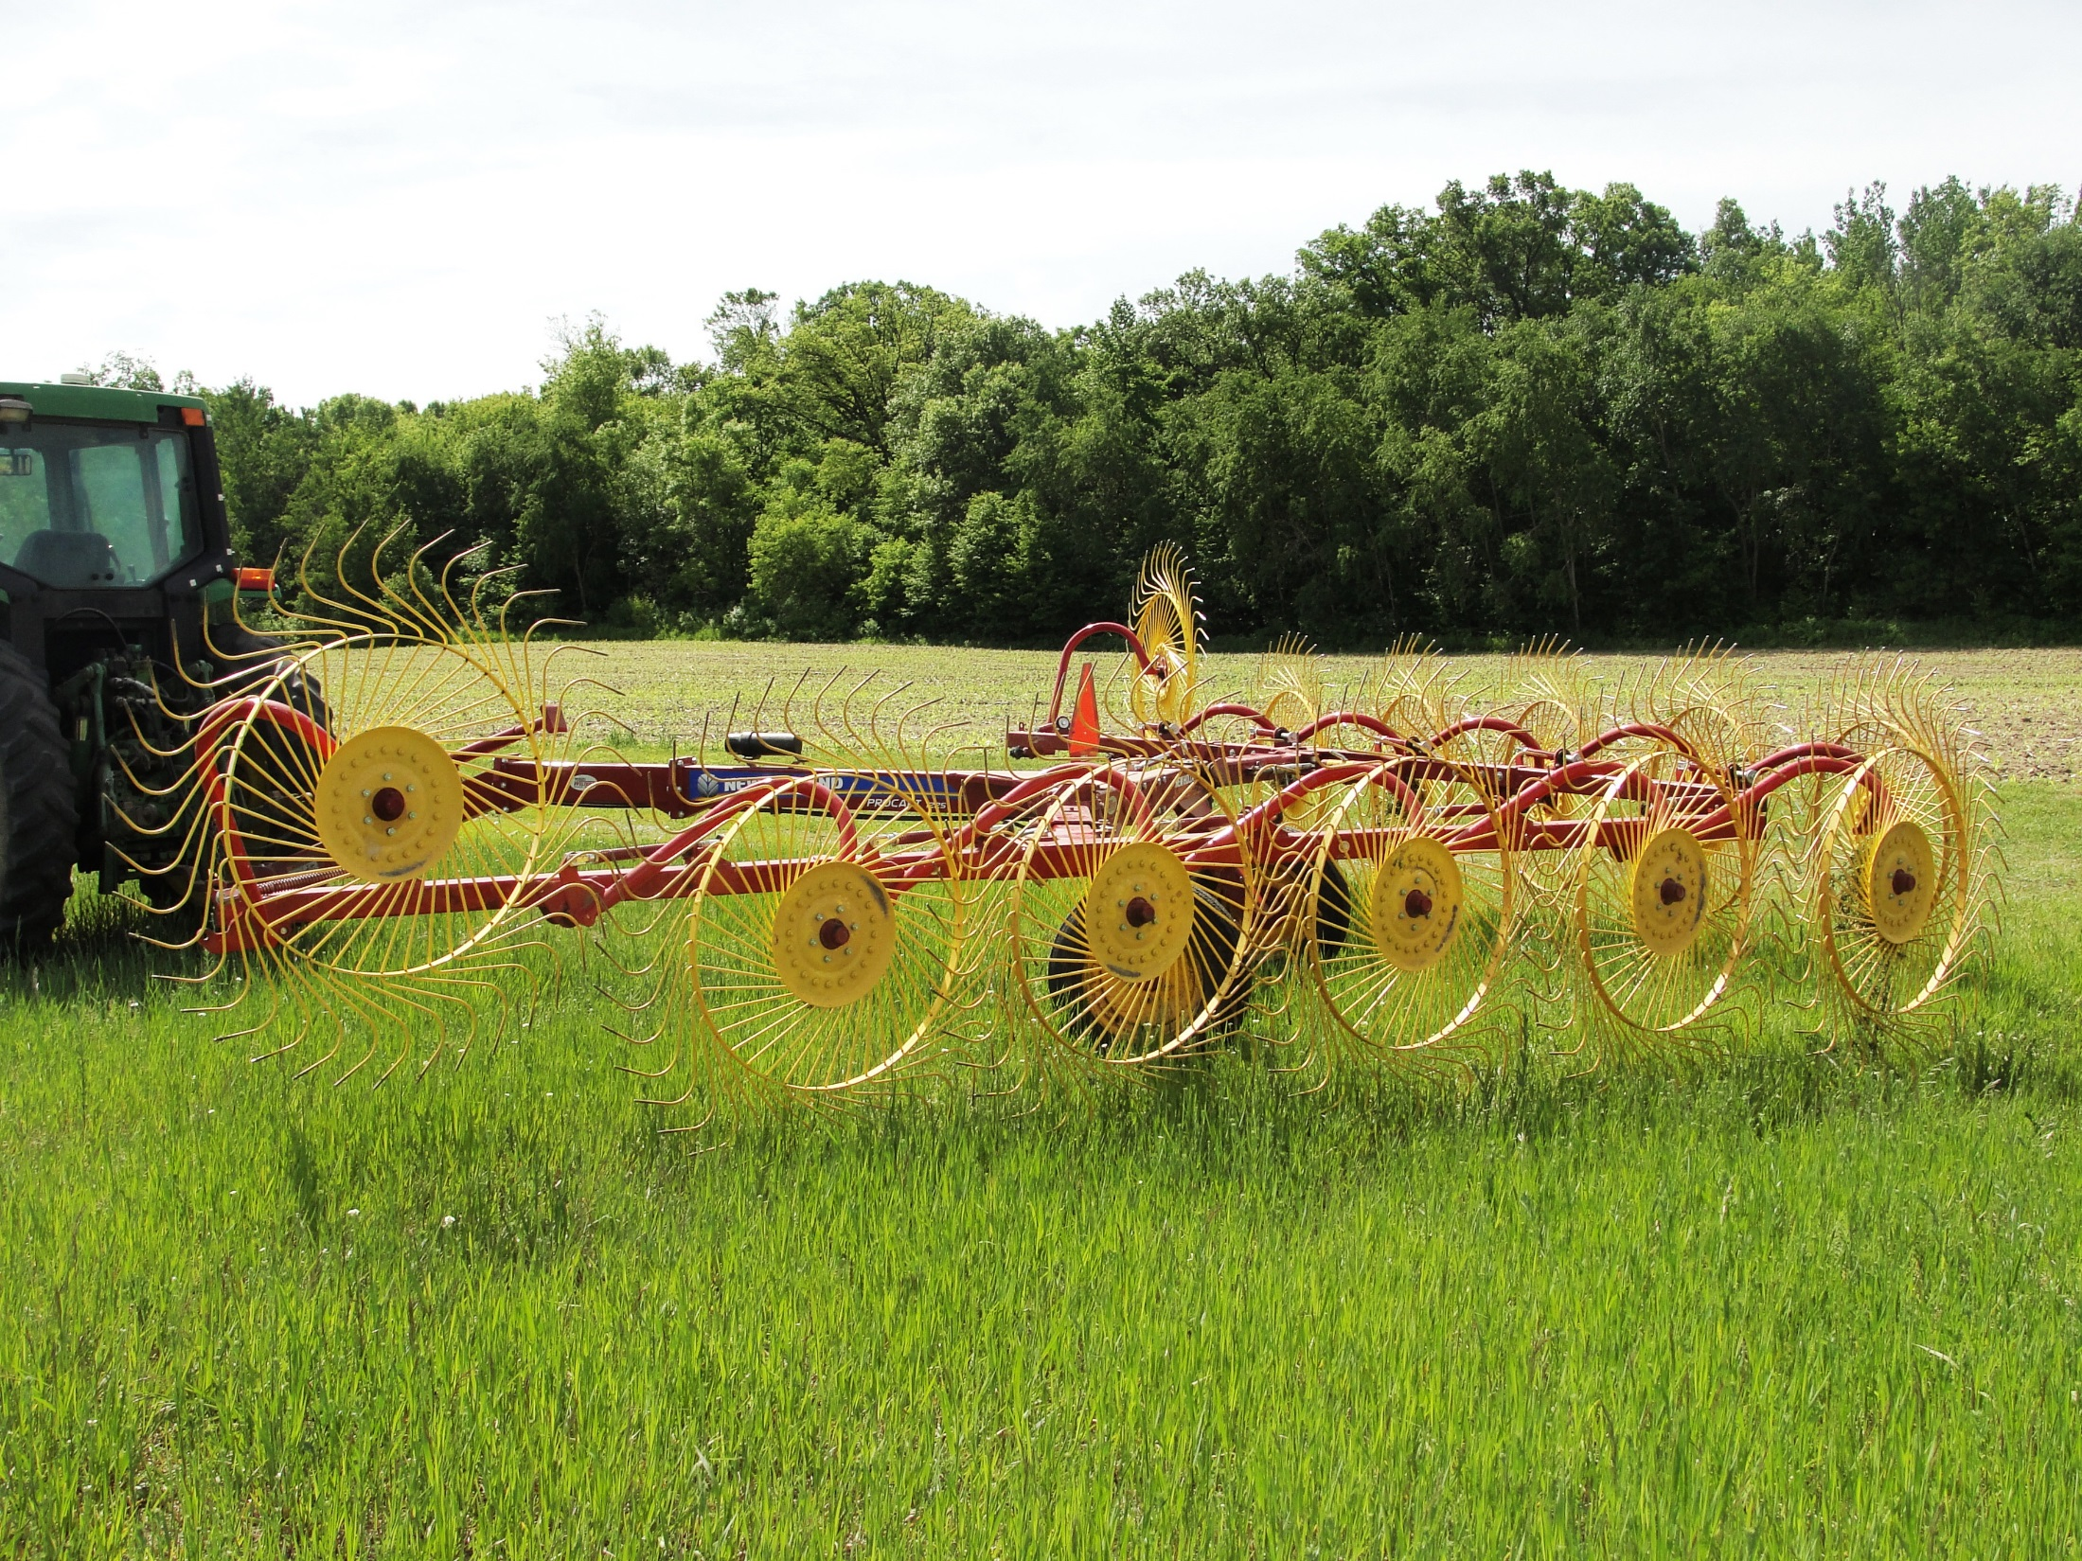
Wheel Rake
Notes:
Narration: There are different types of rakes; here is a wheel rake that is driven by contact with the soil. Hay that is raked with a wheel rake often has more soil contamination and leaf loss than hay made with a side delivery rake or other types of hay rakes.
Image: Krishona Martinson, University of Minnesota

Slide 14
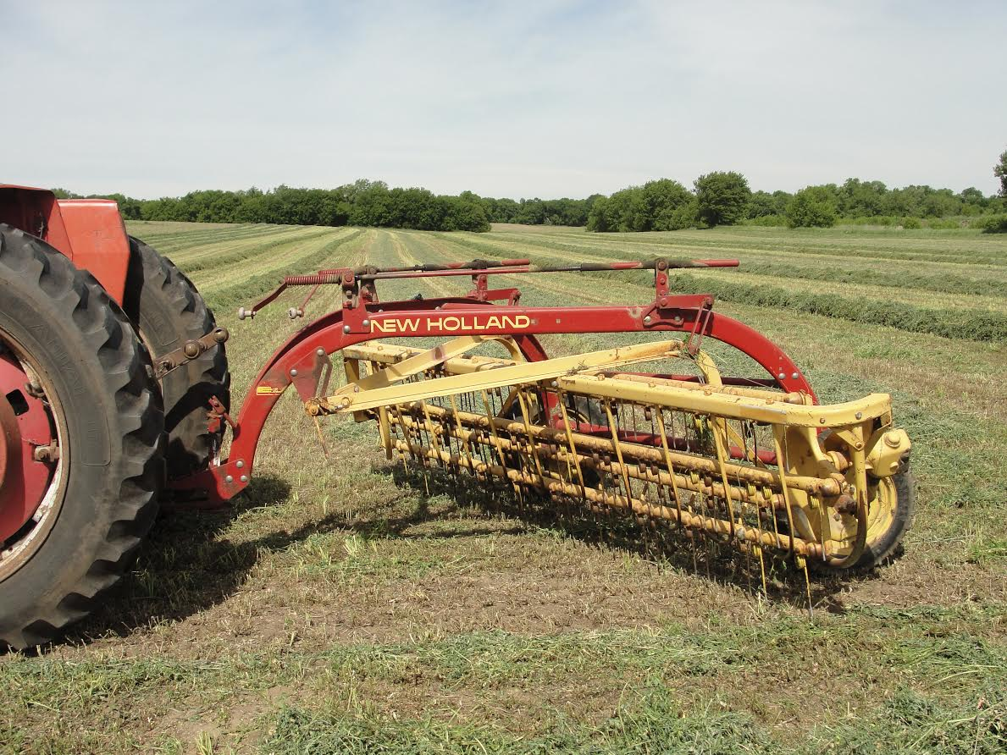
Side Bar Rake
Notes:
Narration: Here is another type of rake called a side bar or side-delivery rake.
Image: Krishona Martinson, University of Minnesota

Slide 15
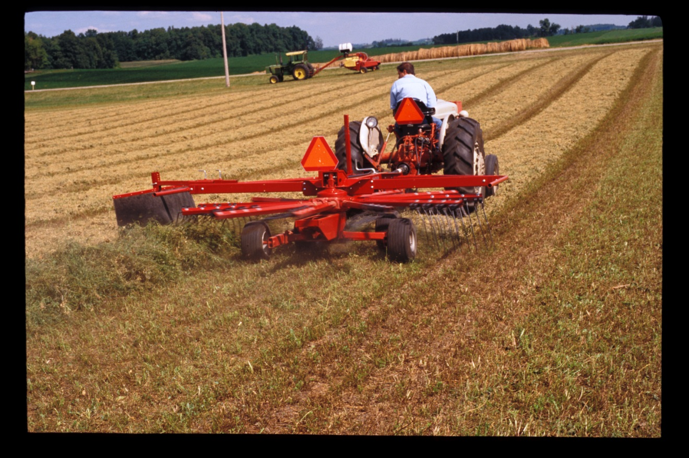
Rotary Rake
Notes:
Narration: And finally, a rotary rake.
Image: Craig Sheaffer, University of Minnesota.

Slide 16
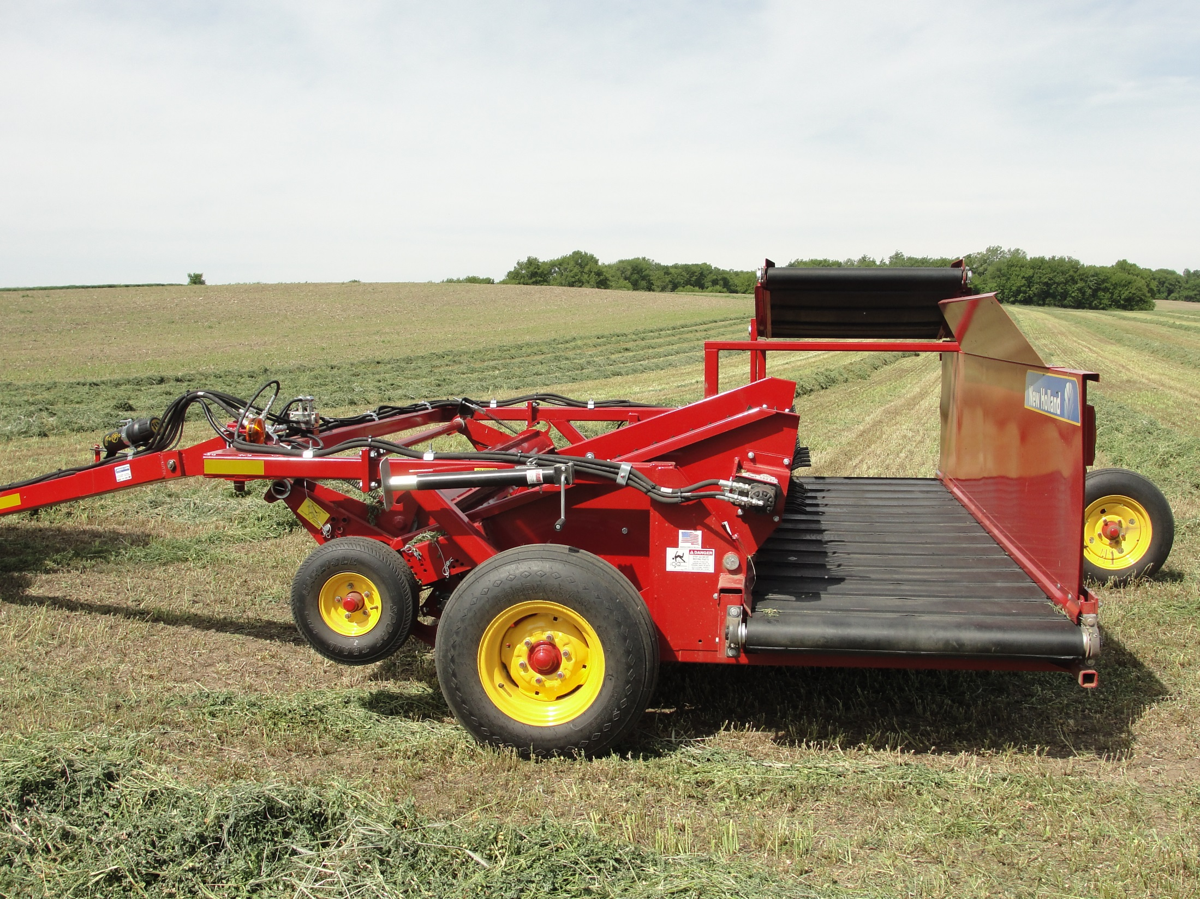
Windrow Inverter
Notes:
Narration: Here is a windrow inverter; it replaces traditional rakes as it picks up and moves the hay. It results in less leaf loss and soil contamination than wheel or side delivery rakes.
Image: Krishona Martinson, University of Minnesota

Slide 17
Harvesting and Storage of Forages
What is Hay?
Cutting and Drying
Raking
Baling
Transport
Storage
Moisture Content
Notes:
Narration: The next step in haymaking is picking up and packaging the hay. For larger balers, rakes merge hay from two windrows together. Raking can result in significant loss of dried forage leaves. Therefore, it should be done when hay is only partially dry.
Image: Craig Sheaffer, University of Minnesota

Slide 18
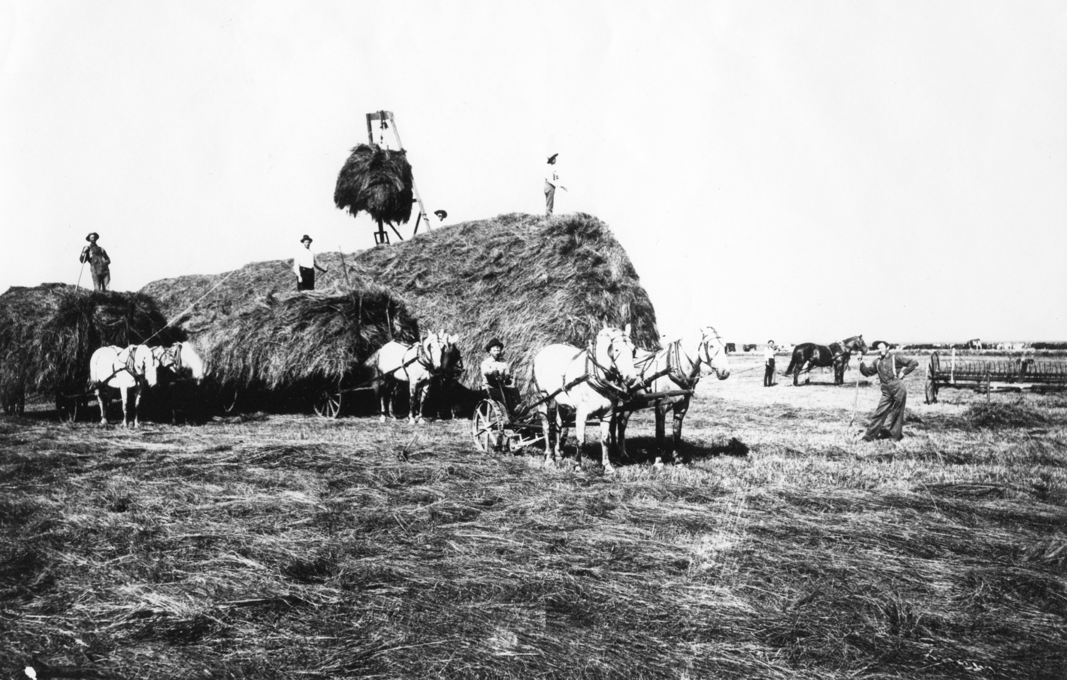
Hay Wagon
Notes:
Narration: In the old days, harvesting hay was a very labor intensive effort. Hay was picked up by hand or in this case with the hay loader. The men on the wagon distributed the hay over the surface of the wagon.
Image: Minnesota Agricultural Experiment Station

Slide 19
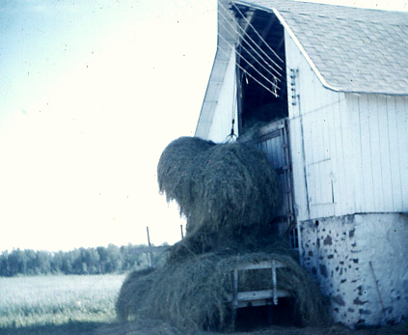
Lifting Hay
Notes:
Narration: When the hay and its wagon got to the barn, it had to be lifted into the hay mow at the top of the barn using ropes and pulleys. Horses on the ground were used to provide the power for lifting.
Image: Craig Sheaffer, University of Minnesota

Slide 20
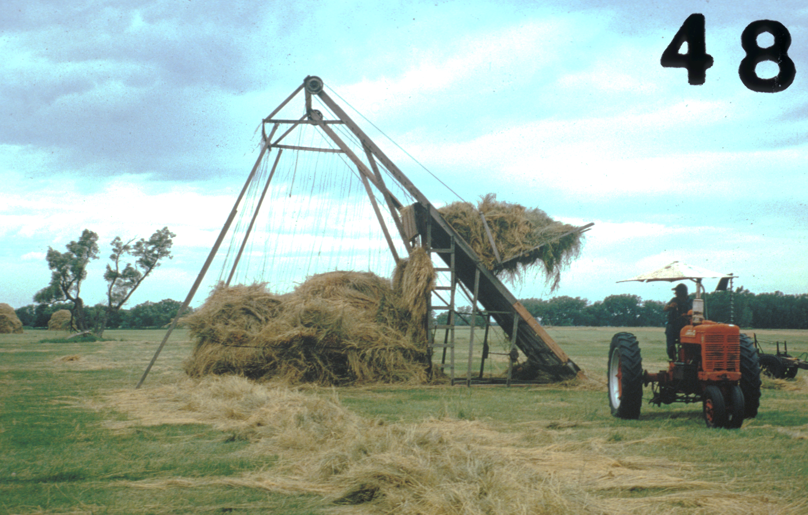
Hay Lifter
Notes:
Narration: Here’s a little later time, with a hay lifter that is creating a stack of hay.
Image: Craig Sheaffer, University of Minnesota

Slide 21
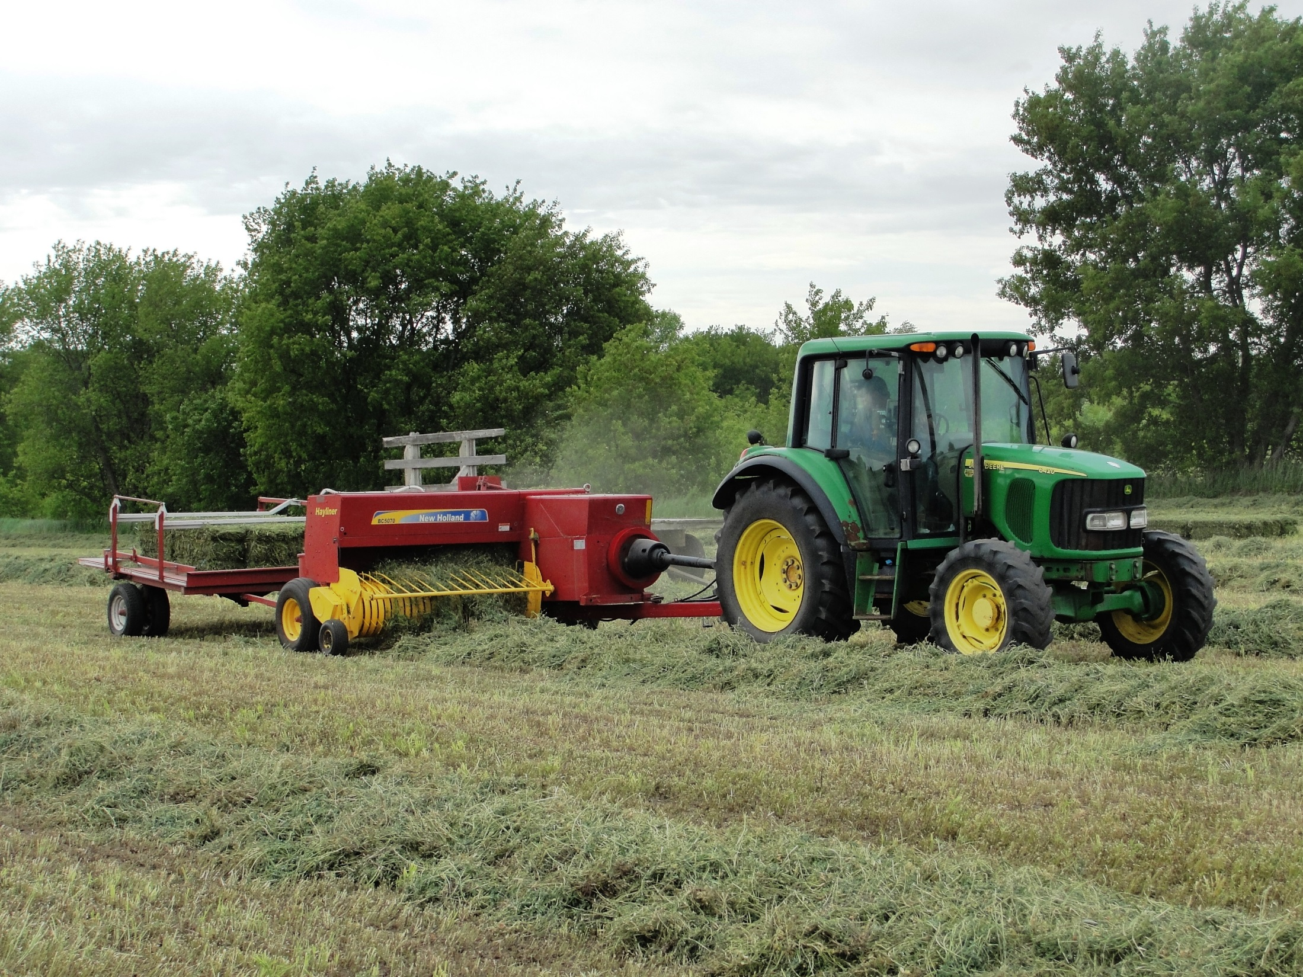
Bale Types and Weights
Small Squares 40 lb to 100 lb
Med. Squares 450 lb to 800 lb
Large Squares 800 lb to 1000 lb
Med to Lg Round 550 lb to 2000 lb
Notes:
Narration: Today, all hay is baled or packaged in the field. Baling makes pick-up, transportation, and storage easier. Baling also reduces labor needs. There are different types and sizes of bales available.
Image: Abby Neu, University of Minnesota

Slide 22
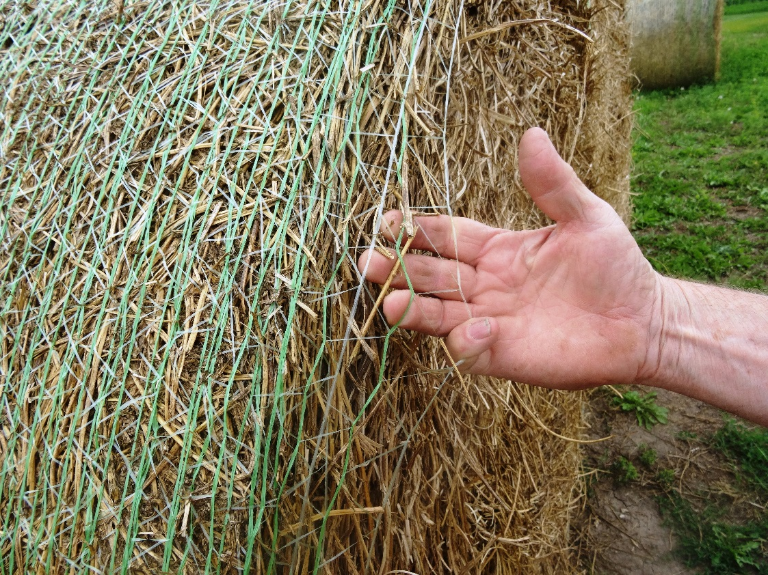
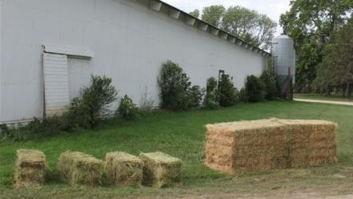
Bale Packaging
Notes:
Narration: The first bales were small rectangular and round bales. Today larger square and round bales that must be handled by machinery are used. Hay in rectangular bales is bound by twine or wire while large round bales is bundled by twine or plastic net wrapping.
Image: Craig Sheaffer, University of Minnesota (square bales); Kristine Moncada, University of Minnesota (round bale)

Slide 23
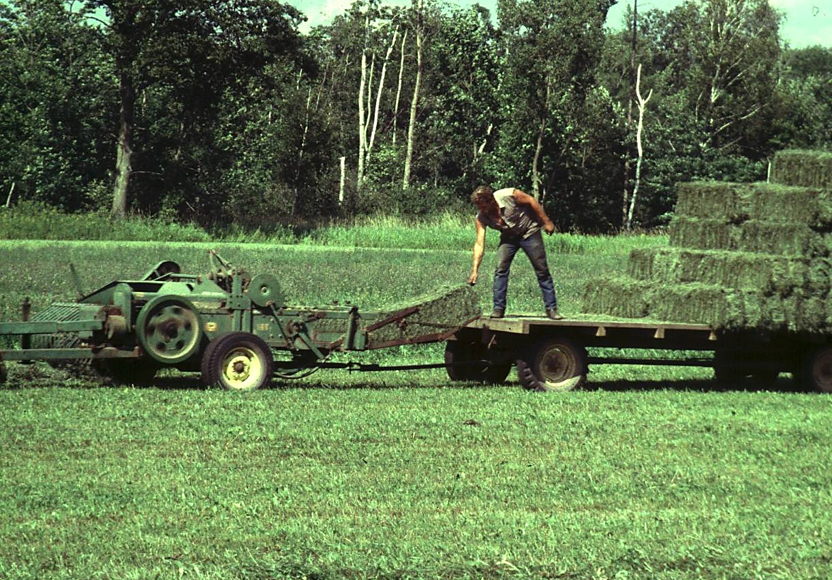
Older Square Baler
Notes:
Narration: Here is an older square baler harvesting a grass hay. This baler required a farmer on the wagon to pick up and stack the hay bales that likely weigh close to 70 lb.
Image: Craig Sheaffer, University of Minnesota

Slide 24
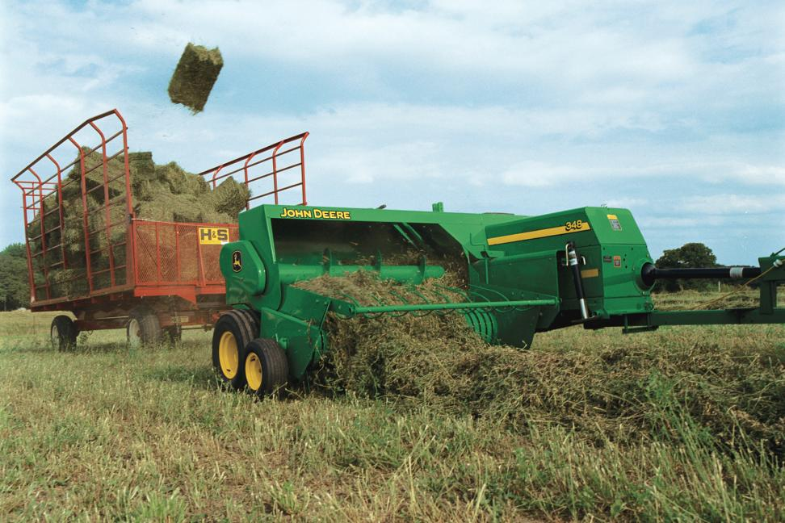
Bale Thrower
Notes:
Narration: A bale thrower eliminates the need for a laborer in the hay wagon. These small square bales are typically 40-50 lb in weight.
Image: John Deere

Slide 25
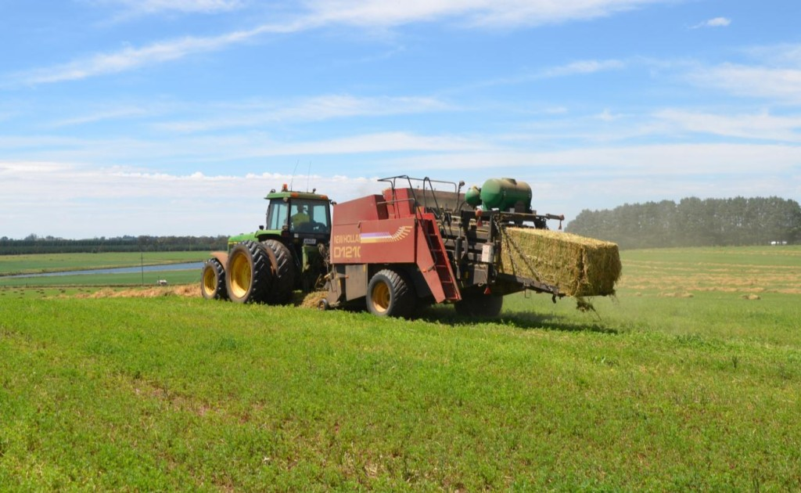
Large Square Baler
Notes:
Narration: Here is a large square baler. The advantage of larger machinery is faster harvest from the field and mechanization of pickup and transportation

Slide 26
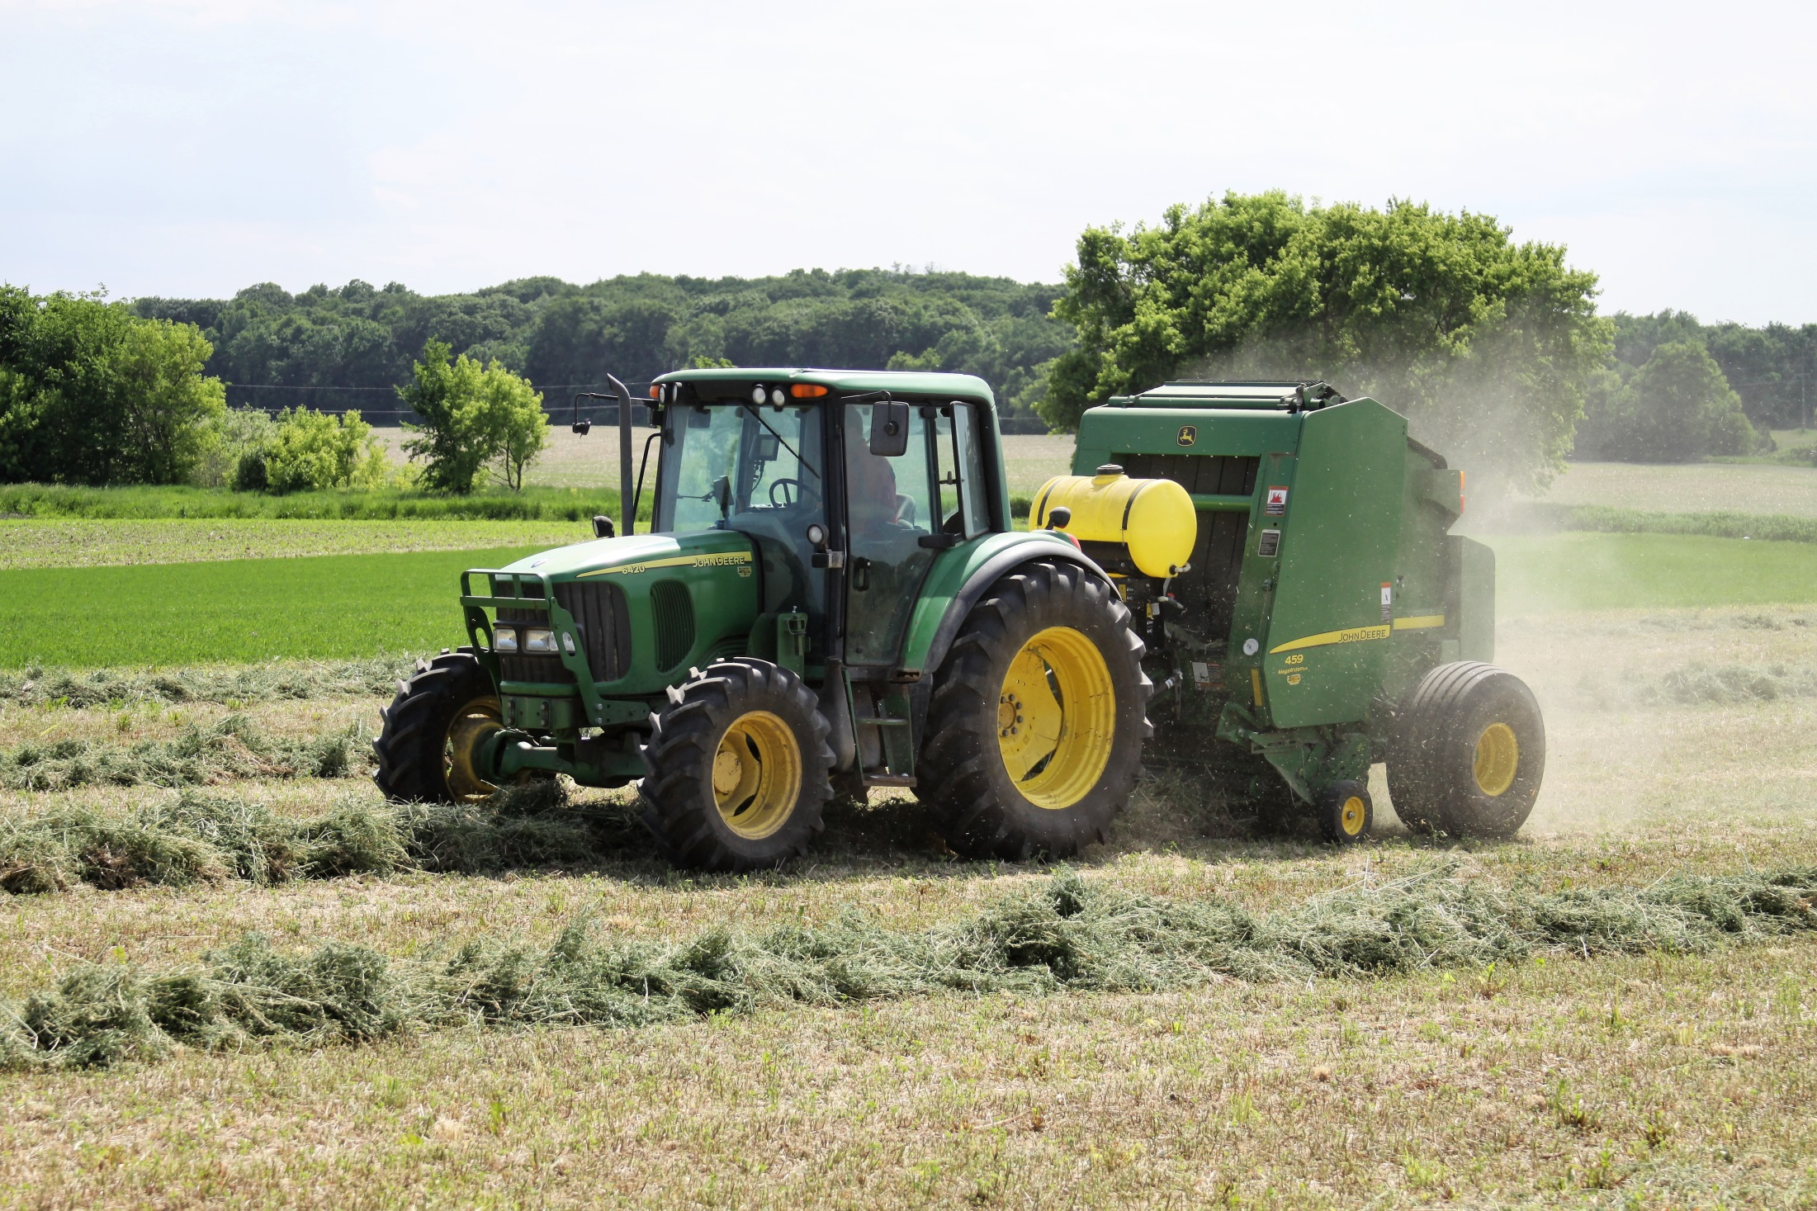
Large Round Baler
Notes:
Narration: Large round bales are another type of packaging. Here a baler is picking up alfalfa hay from a windrow. These round bales usually weigh from 800-1000 lb. Unfortunately, that dust is from hay leaves that have been powdered by the baler.
Image: Amanda Grev, University of Minnesota

Slide 27
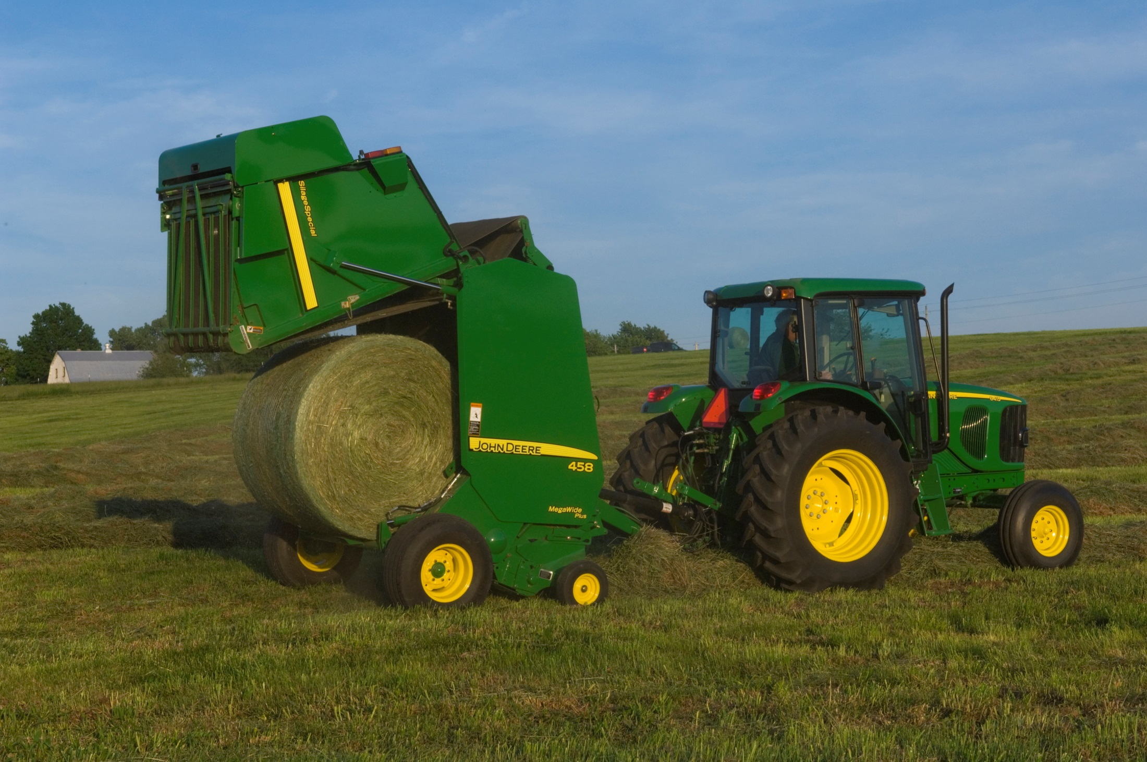
Large Round Baler
Notes:
Narration: Here is a completed round bale being deposited in the field
Image: John Deere

Slide 28
Harvesting and Storage of Forages
What is Hay?
Cutting and Drying
Raking
Baling
Transport
Storage
Moisture Content
Notes:
Narration: The next step is transporting of hay from the field to storage. Sometimes bales are left in the field but that is not a best management practice. Transportation methods depend on the availability of equipment.
Image: Craig Sheaffer, University of Minnesota

Slide 29
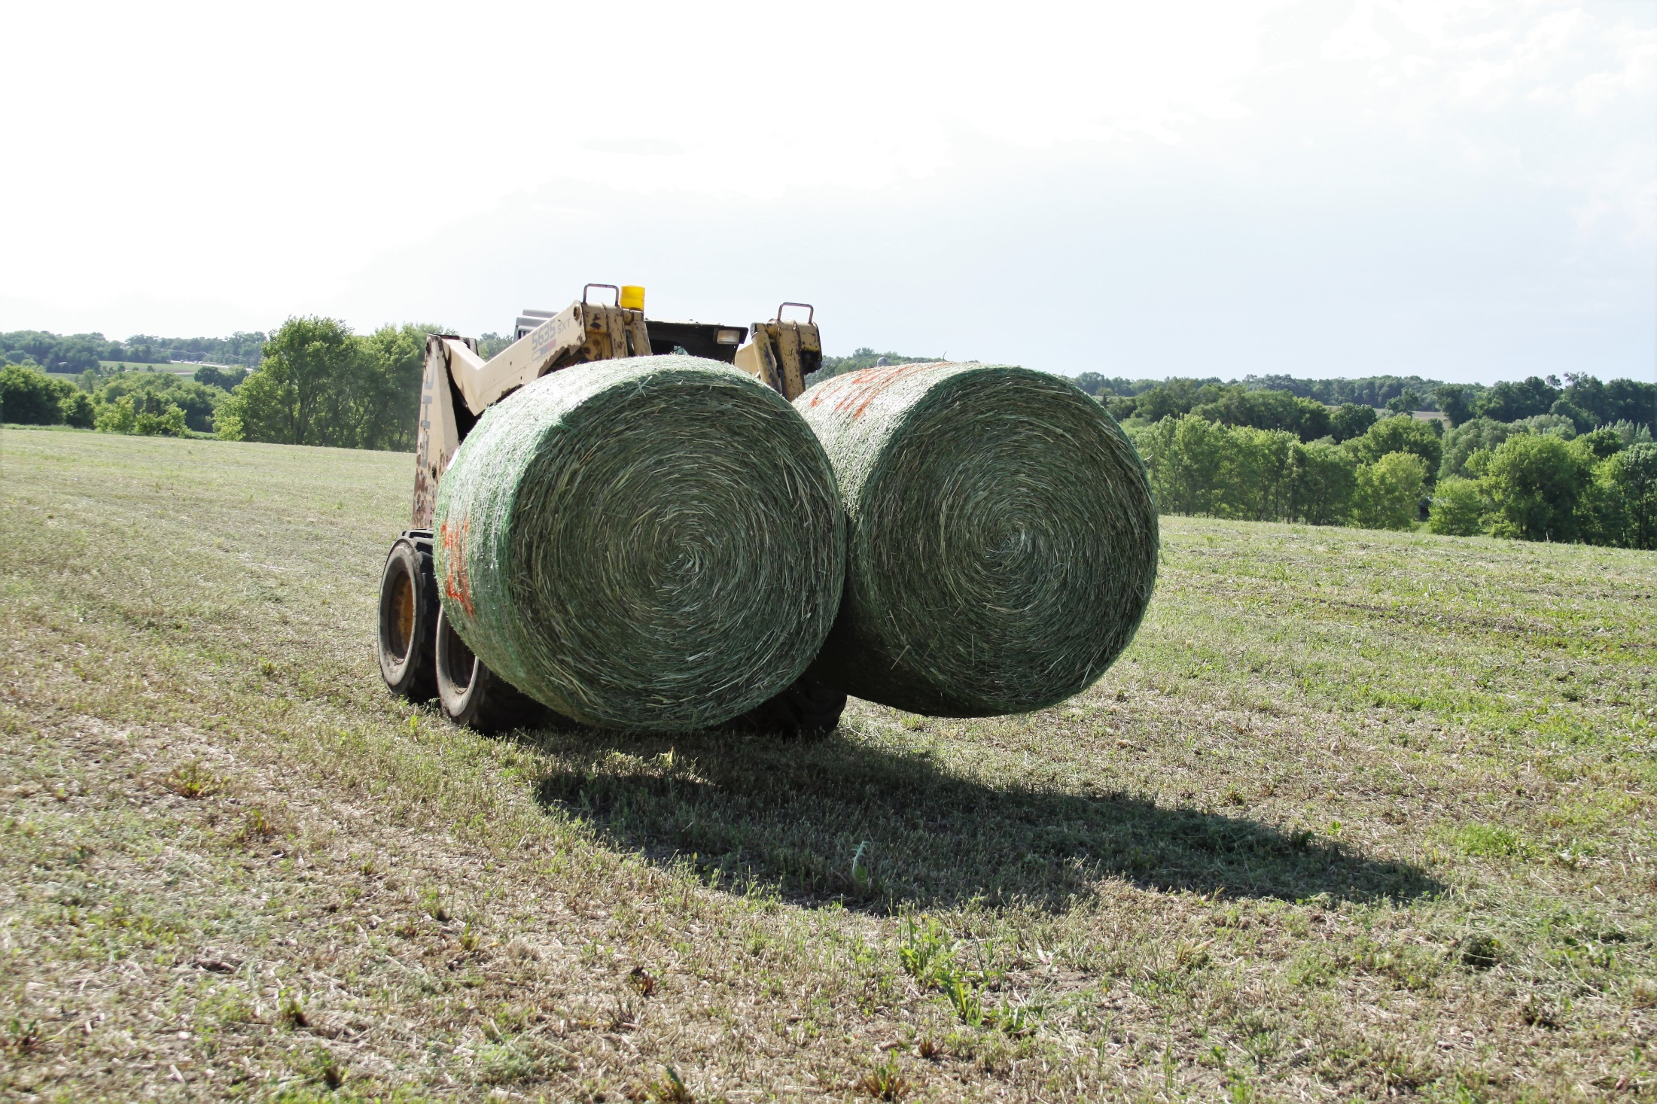
Large Round Bale Pickup
Notes:
Narration: Here large round bales are being picked up following baling and then will be placed on a hay wagon.
Image: Amanda Grev, University of Minnesota

Slide 30
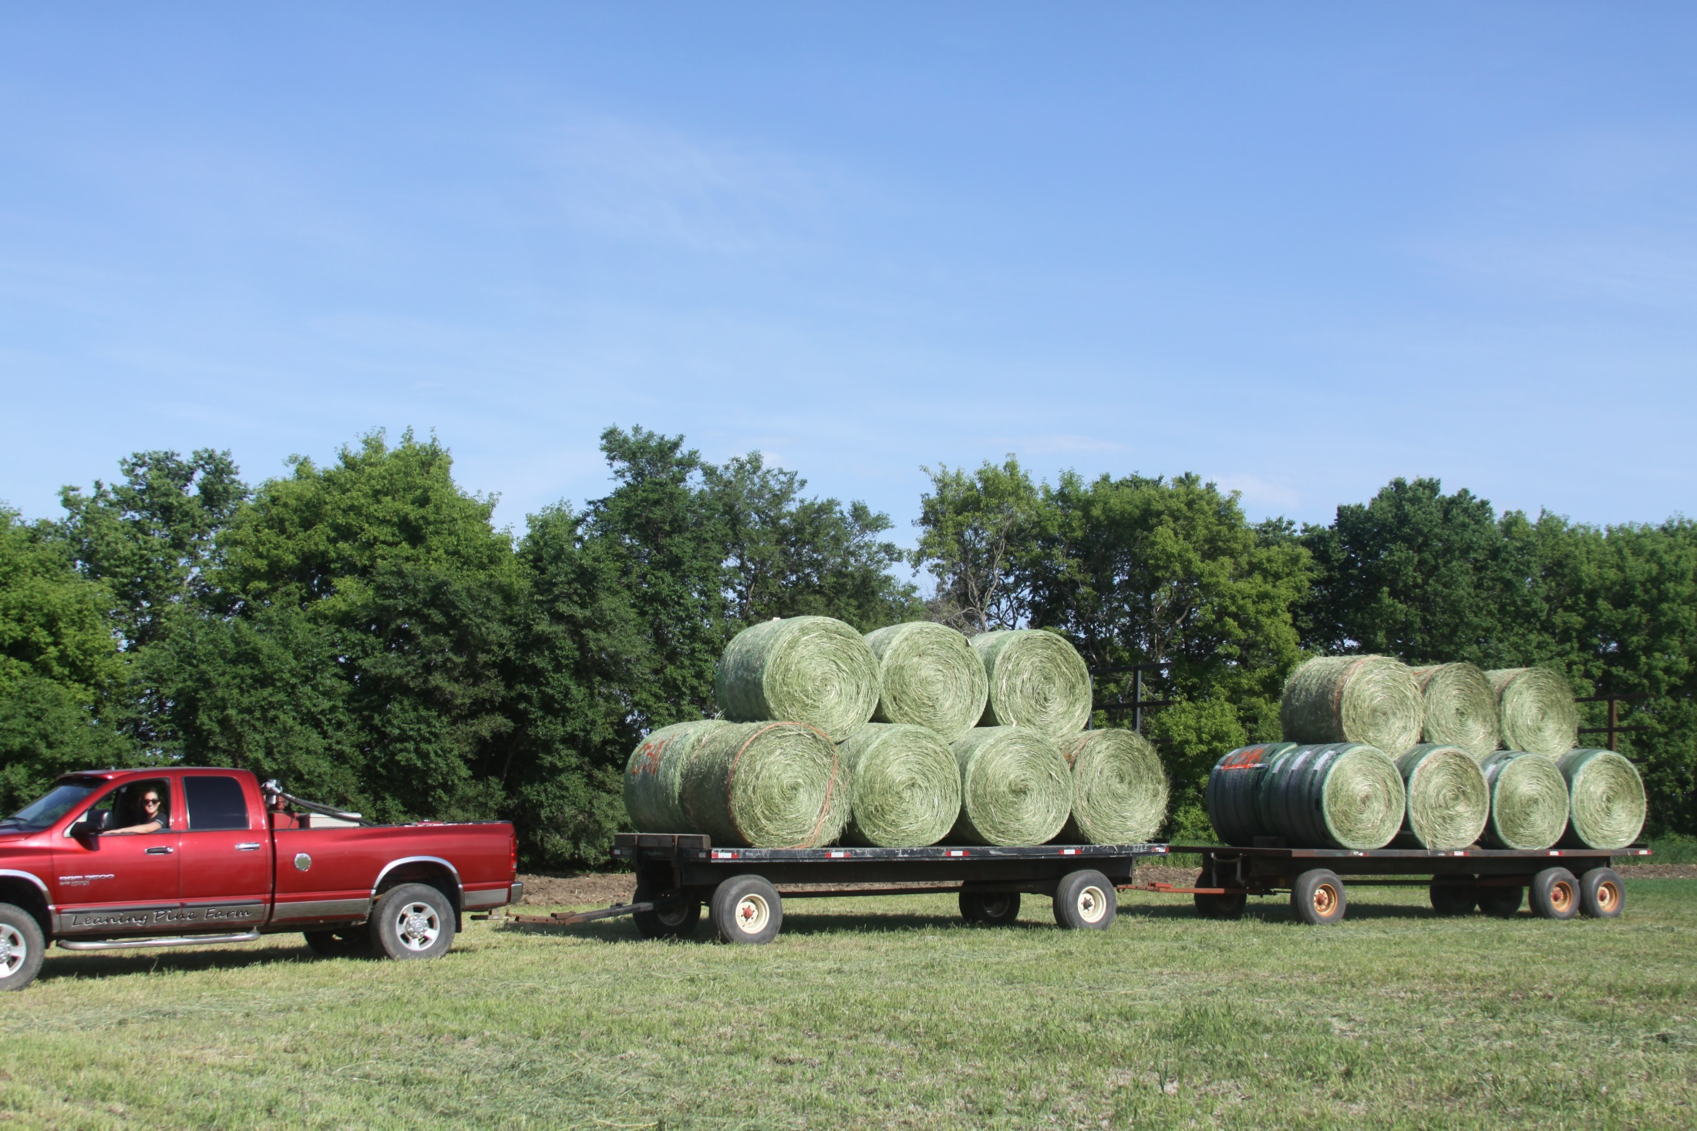
Large Round Bale Transport
Notes:
Narration: Large round bales being transported to a storage site. Image: Amanda Grev, University of Minnesota

Slide 31
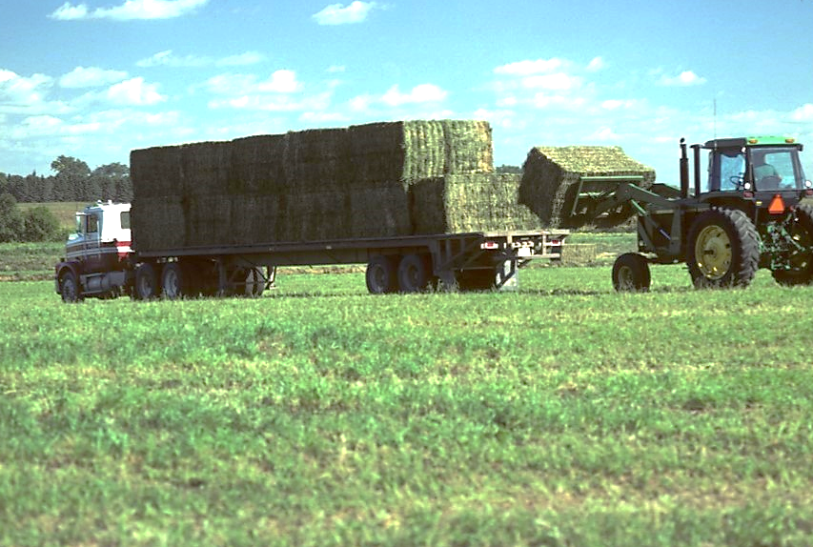
Large Rectangular Bale Pickup
Notes:
Narration: Similarly, large rectangular bale handling and transportation has been mechanized. Large rectangular bales can be efficiently stacked and consolidated on trailers for transportation.
Image: David Hansen, University of Minnesota

Slide 32
Harvesting and Storage of Forages
What is Hay?
Cutting and Drying
Raking
Baling
Transport
Storage
Moisture Content
Notes:
Narration: The goal in storage is to minimize quality loss.
Image: Craig Sheaffer, University of Minnesota

Slide 33
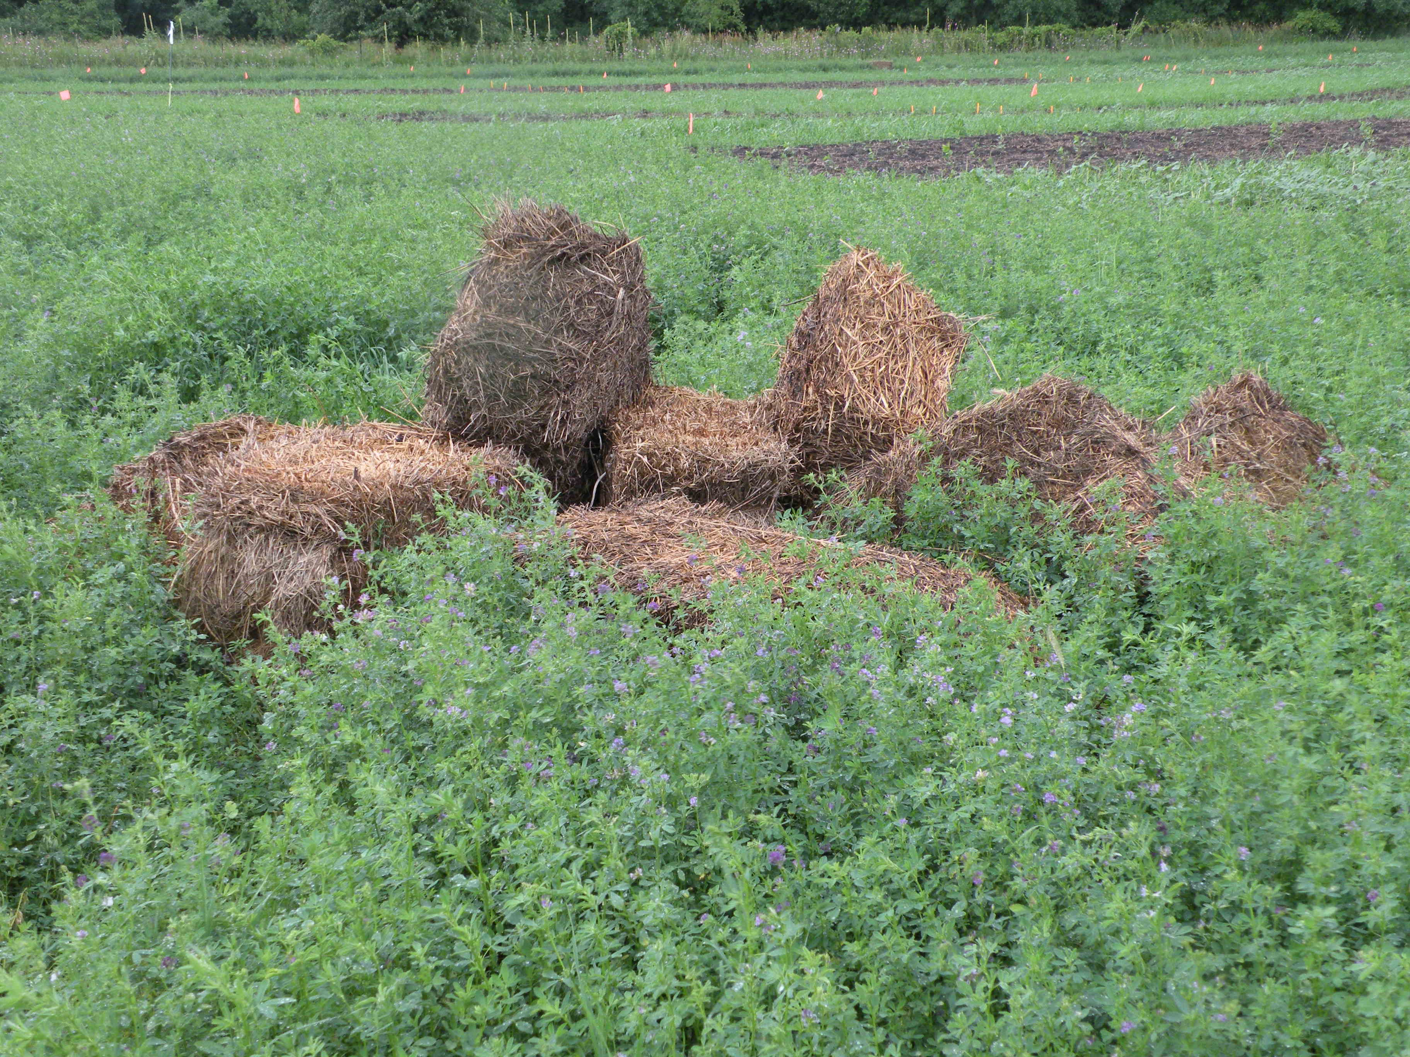
Moldy Bales
Notes:
Narration: To minimize loss during storage, bales should be stored inside or under cover. Bales that are left outside in the field and in contact with the soil quickly deteriorate because when rewetting occurs, mold develops.
Image: Craig Sheaffer, University of Minnesota

Slide 34
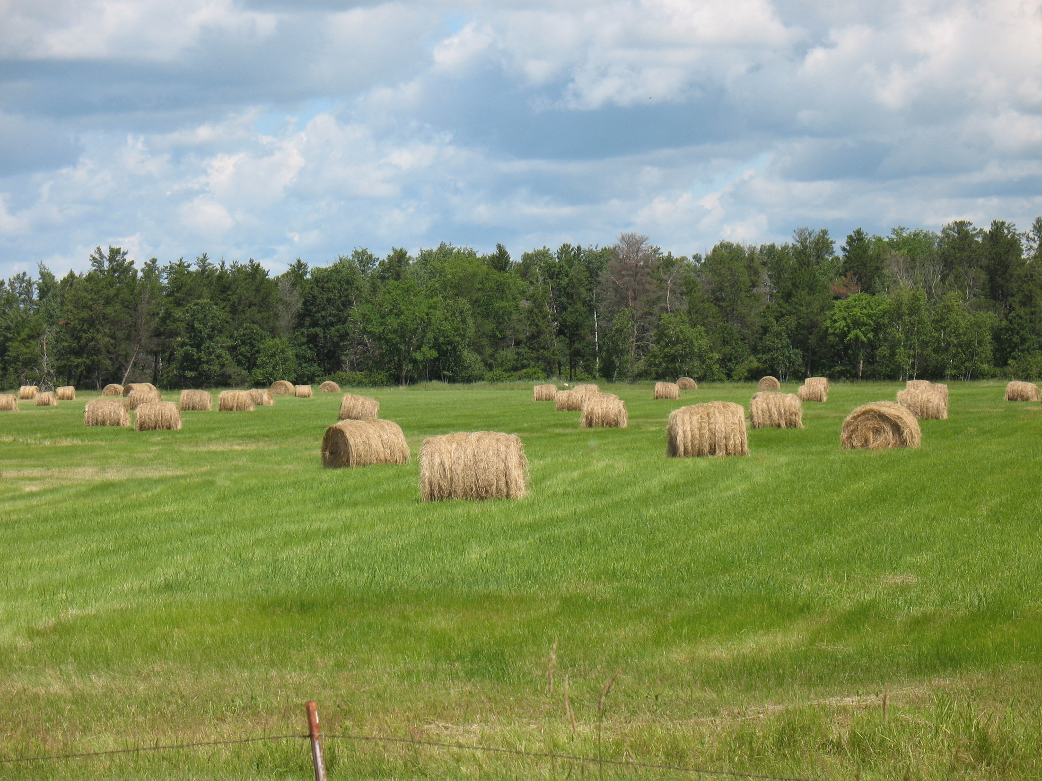
Round Bales in Field
Notes:
Narration: Here are some round bales left in the field. Round bales keep better outside than square bales, but we can expect a 50% loss in quality within a year.
Image: Craig Sheaffer, University of Minnesota

Slide 35
Outside Storage
Notes:
Narration: Notice the round bales that have been stored outside over winter without cover and how the snow has collected.
Image: Craig Sheaffer, University of Minnesota

Slide 36
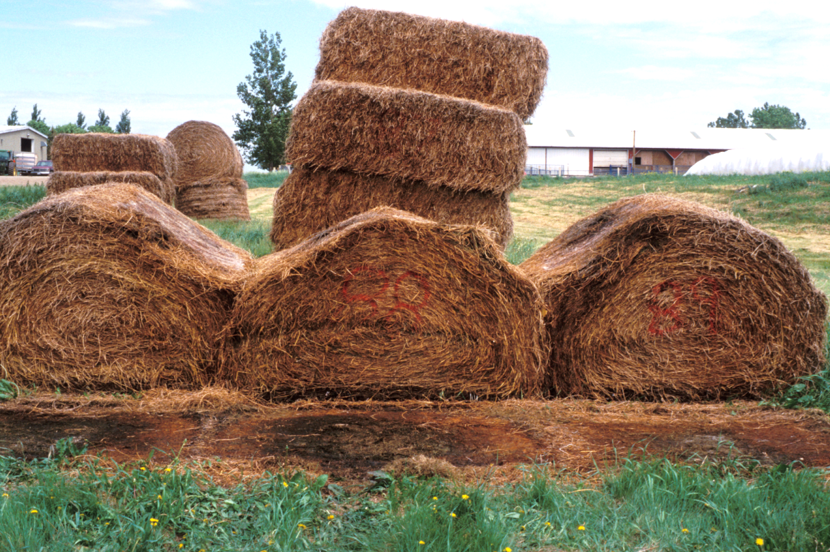
Following Spring
Notes:
Narration: Let’s see what happened to the bales by the following spring: the round bales in the fore ground that were a bottom row in contact with the ground have partially decomposed. The large square bales in the background have also deteriorated and have begun to sag.
Image: Craig Sheaffer, University of Minnesota

Slide 37
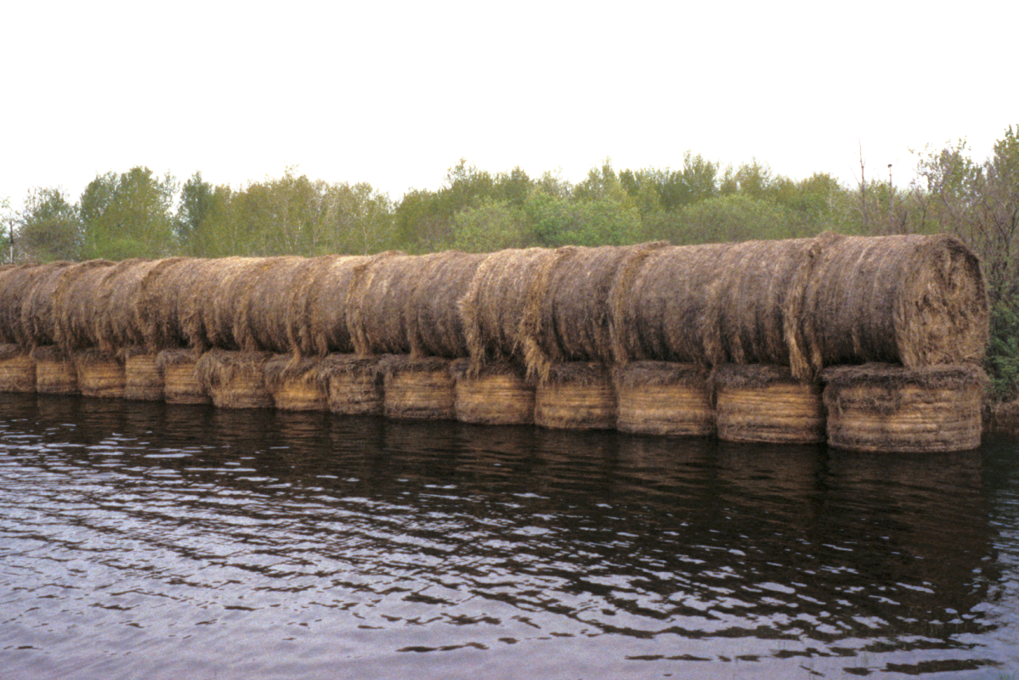
Store in Well-Drained Spot
Notes:
Narration: Here is one way to keep your round bales from getting wet; at least the top layer! Lesson from this image: store your bales in a well drained spot.
Image: Craig Sheaffer, University of Minnesota

Slide 38
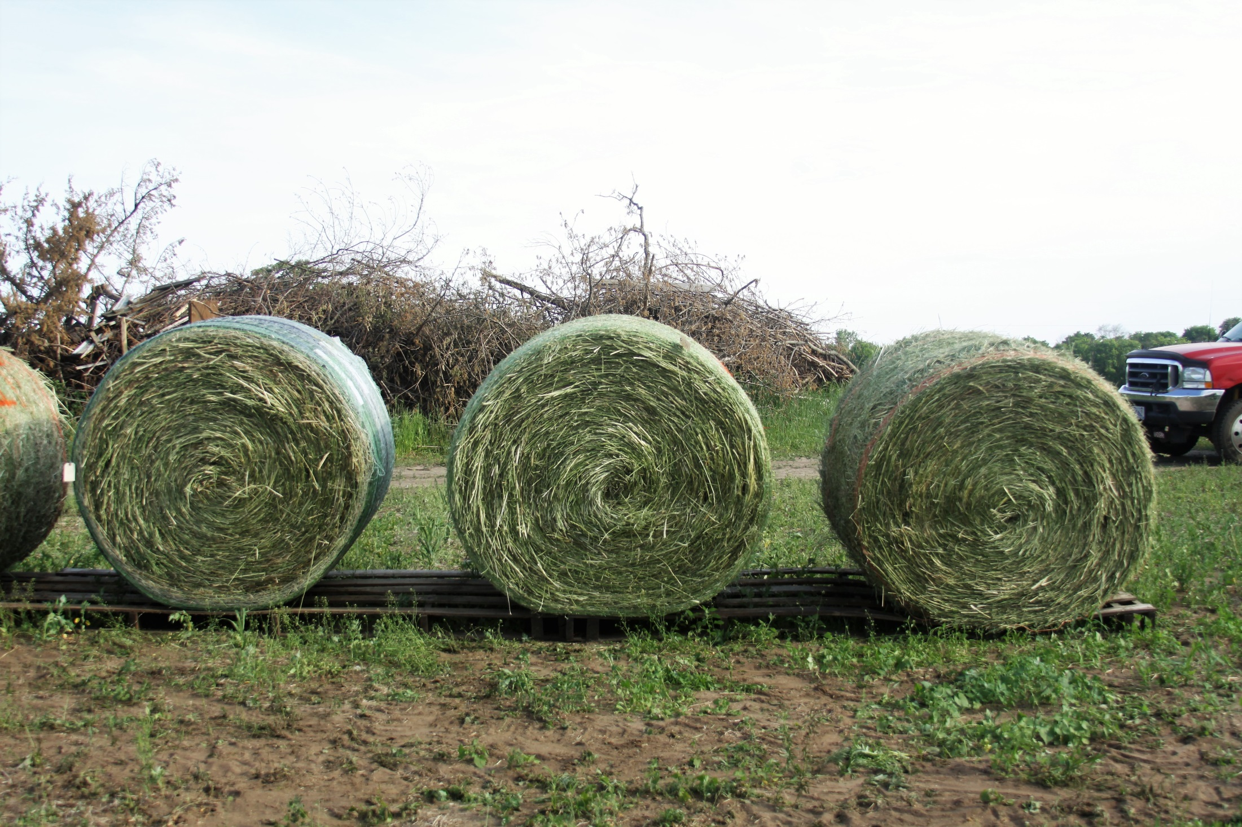
Storage on Pallets or Gravel
Notes:
Narration: Round bales that are stored outside should be off the ground on pallets or gravel so that they cannot wick up moisture from the soil. Also note how these bales do not touch each other to provide a contact point for moisture collection. Note that the bale on the left is covered with a plastic wrap applied at the baler. This is a commercial product called B-wrap.
Image: Amanda Grev, University of Minnesota

Slide 39
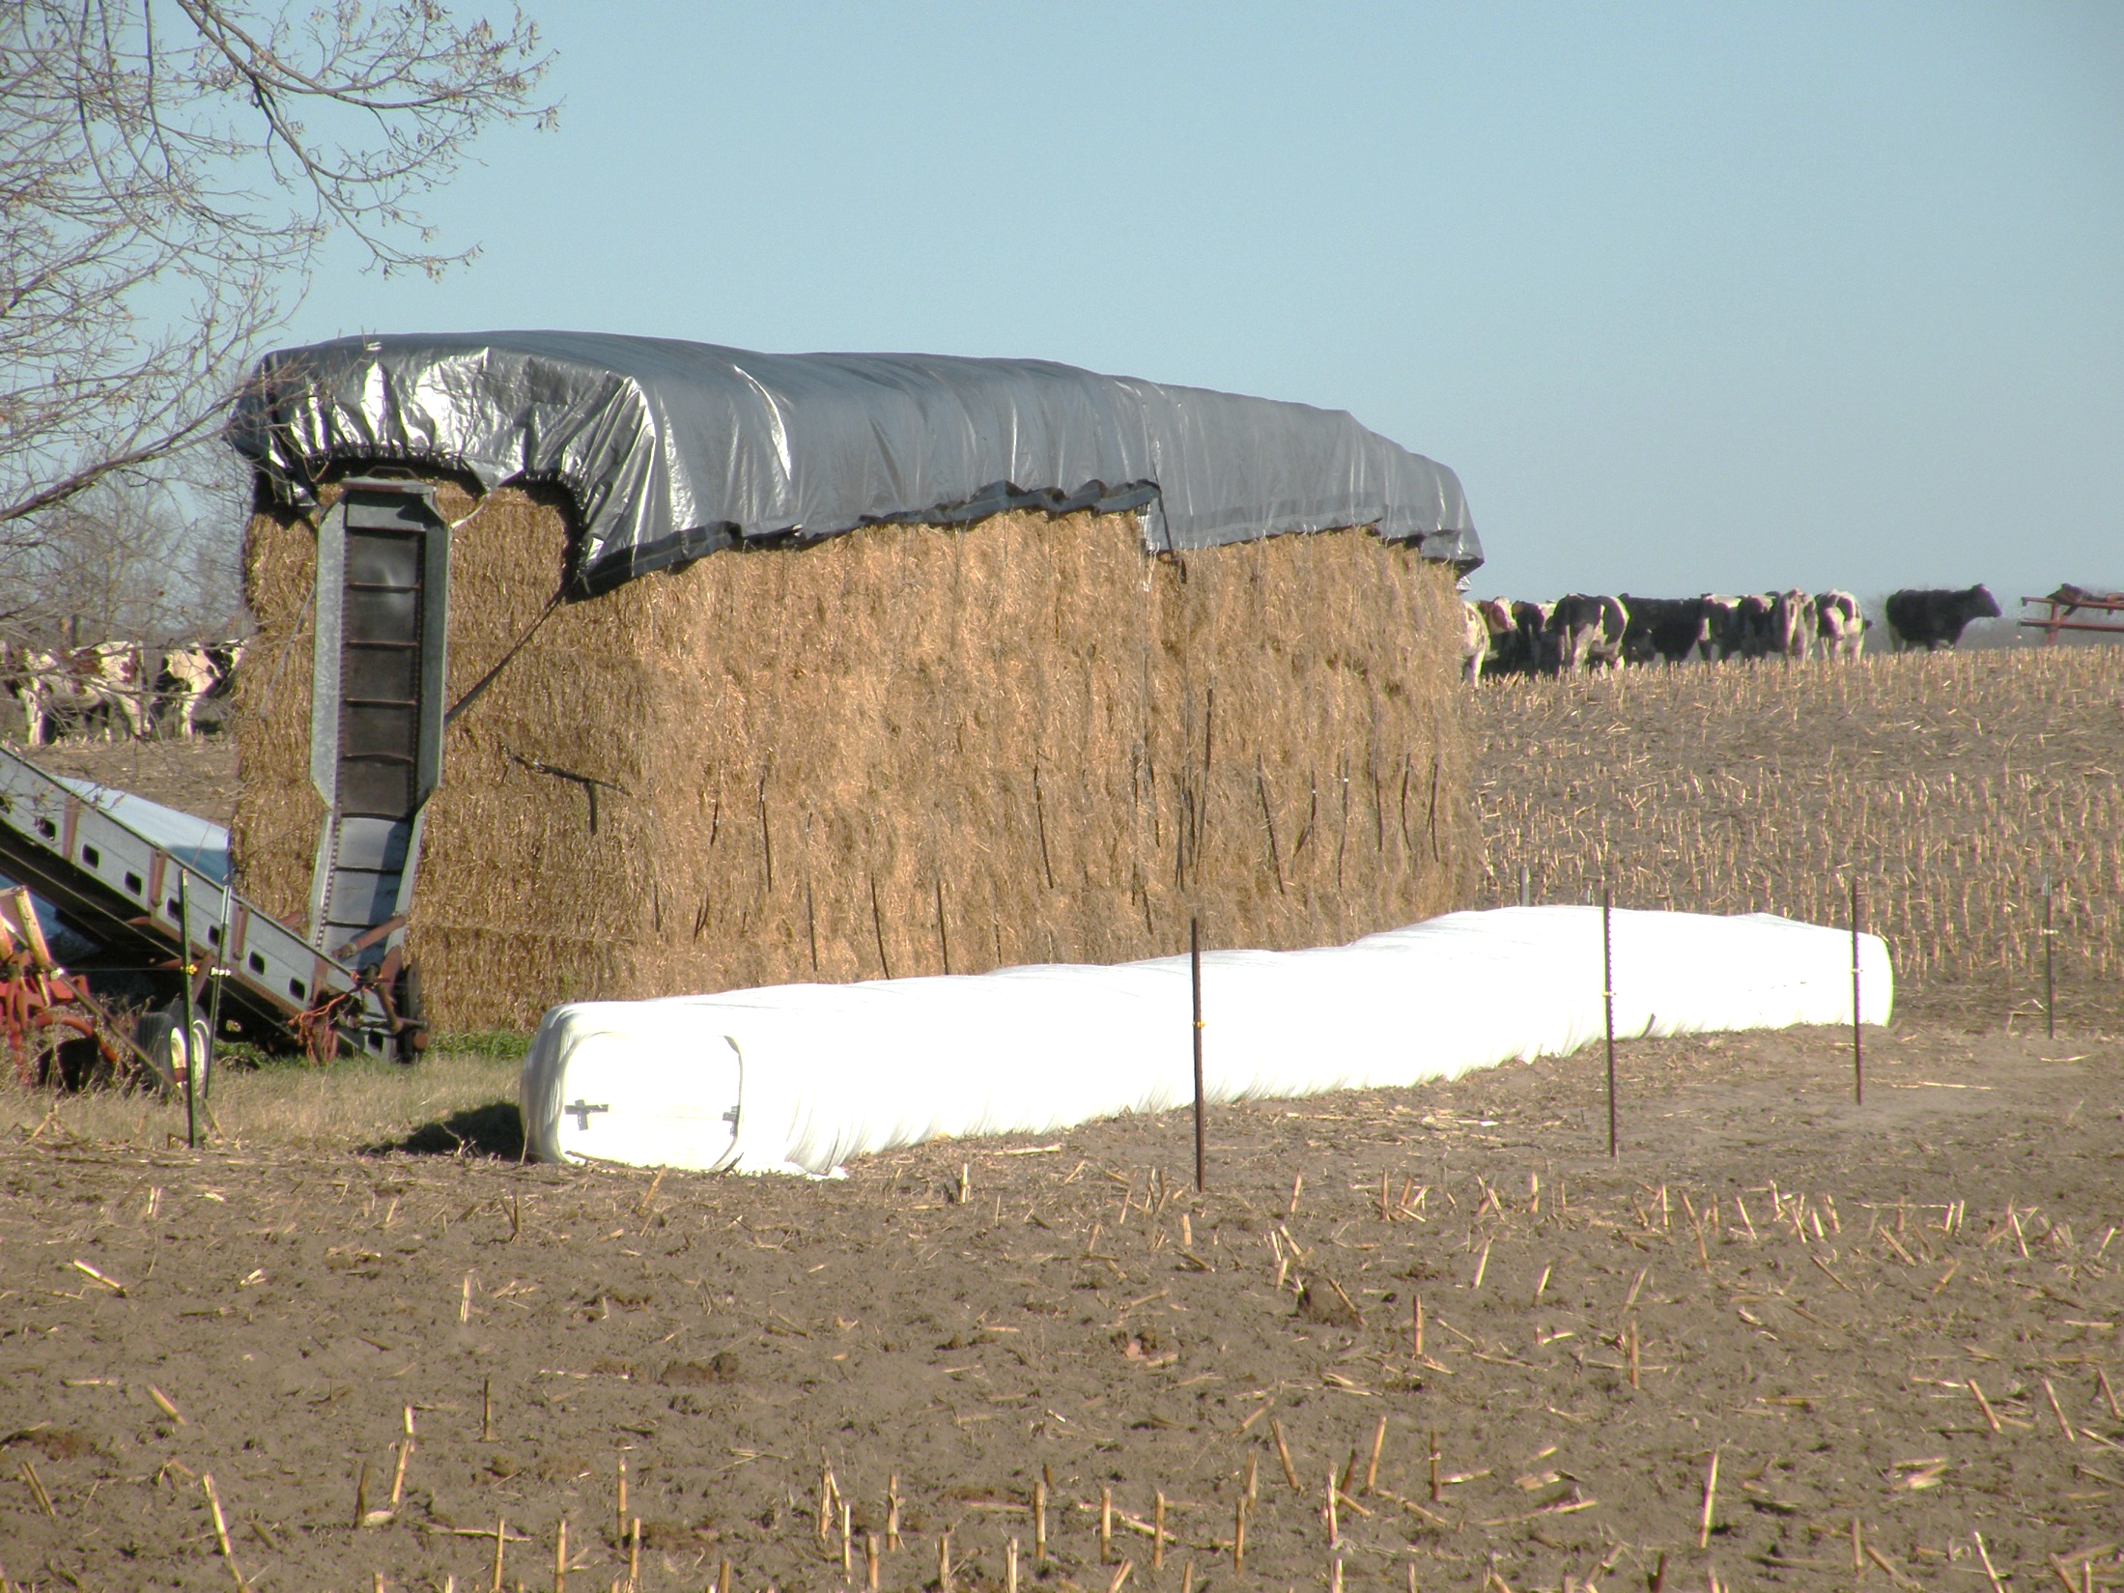
Plastic Covering
Notes:
Narration: Here is another outside storage situation. The plastic cover will protect the top of the hay pile, but water can still be absorbed from the exposed sides. The white row is small square bales that are covered with plastic. Plastic covering is becoming a more common practice and is a way to protect the baled hay.
Image: Craig Sheaffer, University of Minnesota

Slide 40
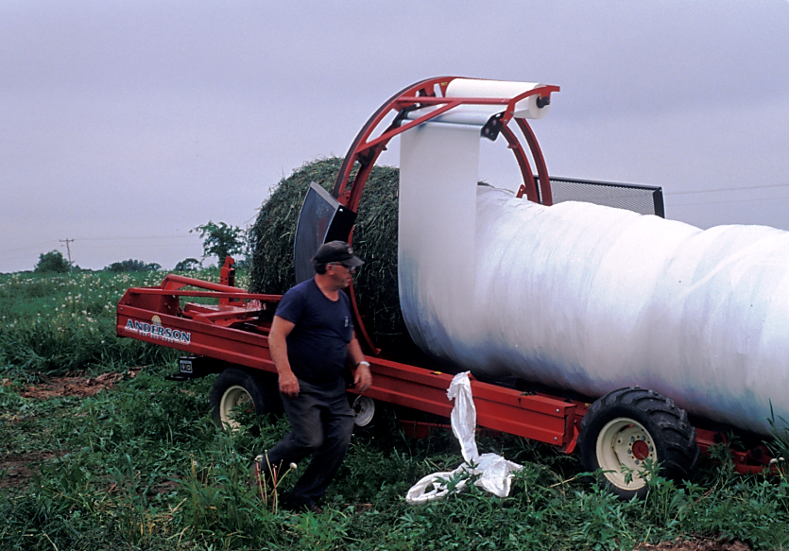
Plastic Wrapping
Notes:
Narration: Here is plastic wrapping of large round bales. The plastic wrapping excludes all the air and creates an air tight anaerobic situation. Providing the plastic remains intact, these bales can be permanently preserved.
Image: Craig Sheaffer, University of Minnesota

Slide 41
Harvesting and Storage of Forages
What is Hay?
Cutting and Drying
Raking
Baling
Transport
Storage
Moisture Content
Notes:
Narration: We have now reviewed the steps in haymaking. They include cutting the standing forage, drying the forage in the field, turning the cut forage to facilitate drying, packaging of the dried forage using a baler, transporting the baled hay, and storage.. But before we leave the topic of hay making, we need to say a few words about how to determine hay moisture. For haymaking, moisture content is a very critical factor because if hay is made too wet, we can expect prolonged respiration by the hay and then mold growth.
Image: Craig Sheaffer, University of Minnesota

Slide 42
Improper Moisture
> 20%: risk of mold growth
< 15%: excess field loss due to leaf shattering
Notes:
Narration: The nutrients in hay are a growth media for bacteria and especially fungi. If hay is baled at a moisture content greater than 20%, there is a risk of fungi or mold growth. Typically, as moisture content increases, so does the mold growth. In contrast, if hay is baled too dry, there is a greater risk of leaf shatter and loss.

Slide 43
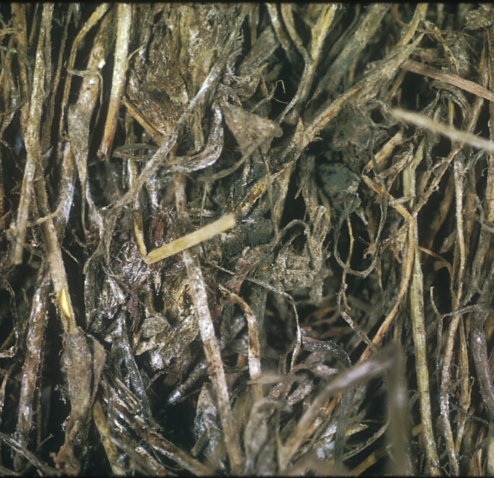
Moldy alfalfa hay
Notes:
Narration: UGH! Here is some moldy alfalfa hay that was made at about 25% moisture. Molding deteriorates hay nutritive value, reduces dry mass, and can lead to spontaneous combustion. Farmers who work around moldy hay can develop a condition called farmers lung. The moldy hay can lead to respiratory problems in livestock and cause colic in horses.
Image: Craig Sheaffer, University of Minnesota

Slide 44
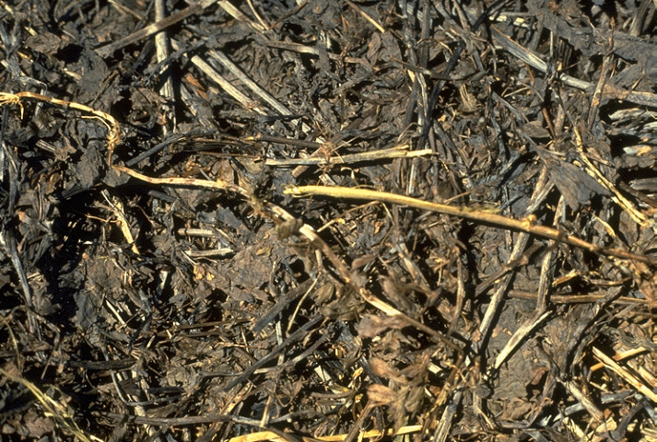
Heat damaged alfalfa hay
Notes:
Narration: This is some alfalfa hay that has undergone extreme heating and turned black. Fortunately, it did not spontaneously combust.
Image: Craig Sheaffer, University of Minnesota

Slide 45
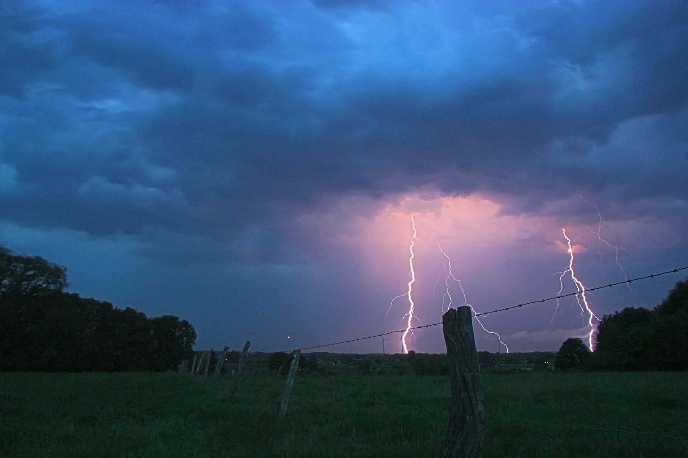
Why Incorrect Moisture Occurs
Measurement technique
Variation in the field
Fear of rain
Notes:
Narration: Farmers know the necessity of making hay at the correct moisture content but often hay is made at moisture levels leading to the aforementioned problems. Here are three reasons: The first is the measurement technique or how they are determining the moisture content. The second is variation within a field; fields do not typically uniformly dry. And third, there is a fear of rain. If hay is almost dry and there is a threat of rain, farmers will often take the risk and package the hay.
Image: Pixabay

Slide 46
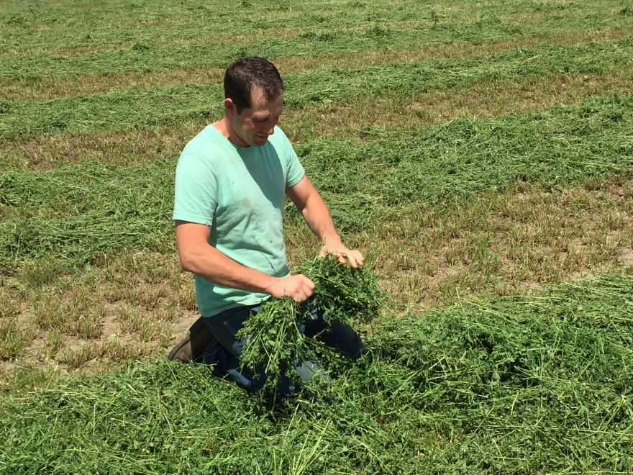
Hay Moisture
Determined in the field by farmer
Subjective: feel, smell
Electronic
Drying a subsample
Notes:
Narration: Farmers determine hay moisture using three approaches. These include, a very subjective approach that includes feeling the forage, smelling it, or twisting stems to see if moisture is extruded. If moisture is extruded then many feel it is too wet to bale. Unfortunately, these subjective methods are prone to inaccuracy. A better approach is using electronic methods that measure the flow of electricity through the forage with more moisture providing more flow. Moisture testing equipment can be found and purchased through the internet.
Image: Craig Sheaffer, University of Minnesota

Slide 47
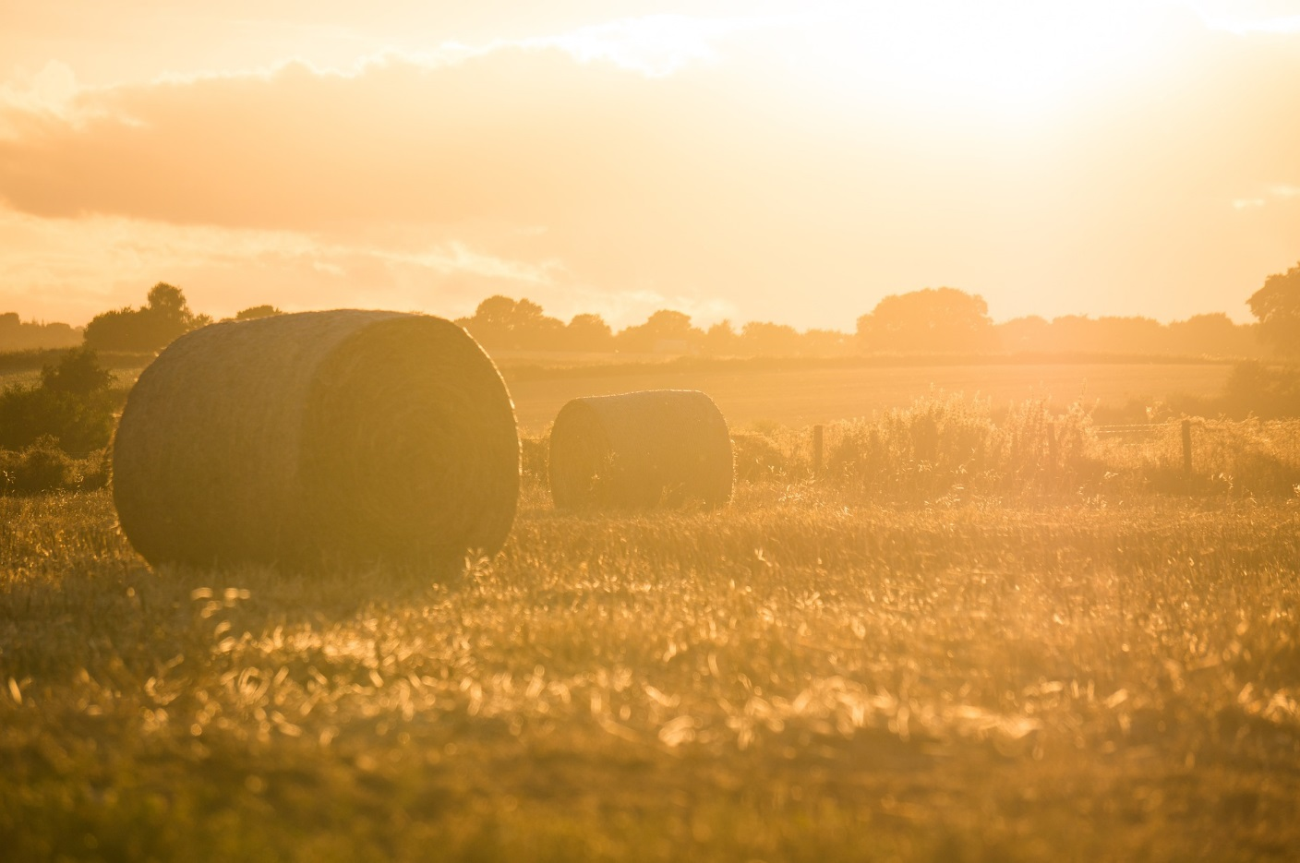
Conclusions
Haymaking challenges:
Minimize field losses
Minimize storage losses
Make hay while the sun shines!
Notes:
Narration: In this unit, we have reviewed haymaking and its challenges. In summary, these challenges revolve around management of the moisture content of the crop. Like all of agriculture, haymaking is dependent on the weather and farmers who make hay need to plan ahead to “make hay while the sun shines.”
Image: Pixabay

Slide 48
REFERENCES and RESOURCES
Sheaffer, C.C., et al., 2003. Forage Legumes. Minnesota Agriculture Experiment Station Bull. 608-2003. St. Paul MN.
Sheaffer, C. 2010. Forages in Risk Management Guide for Organic Producers. University of Minnesota. https://organicriskmanagement.umn.edu/sites/organicriskmanagement.umn.edu/files/forages.pdf
Undersander et al., 2011. Alfalfa management guide. ASA-CSSA-SSSA, Madison, WI. https://www.agronomy.org/files/publications/alfalfa-management-guide.pdf
Notes:
Narration: Here are some resources we recommend to explore forages further.

Slide 49
Harvesting and Storage of Forages
What is Hay?
Cutting and Drying
Raking
Baling
Transport
Storage
Notes:
Narration: We’ve reached the conclusion of our module. Thanks for watching!

Slide 50
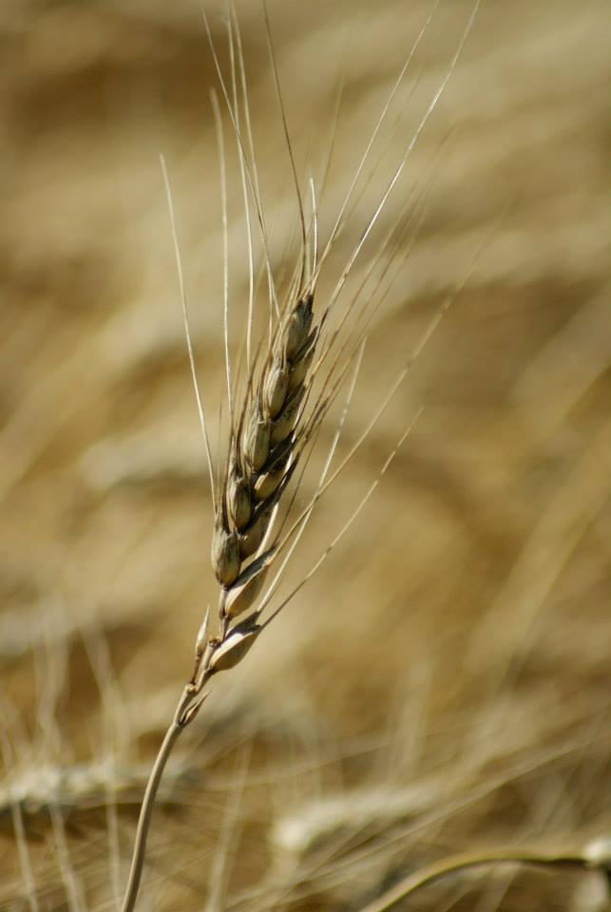
© 2017 Regents of the University of Minnesota. All rights reserved. The University of Minnesota is an equal opportunity educator and employer.
This material is based upon work that is supported by the National Institute of Food and Agriculture, U.S. Department of Agriculture, under grant number 2013-51106-21005.
Notes:
Narration: This material is based upon work that is supported by the National Institute of Food and Agriculture.
Image: Constance Carlson, University of Minnesota

