Slide 1
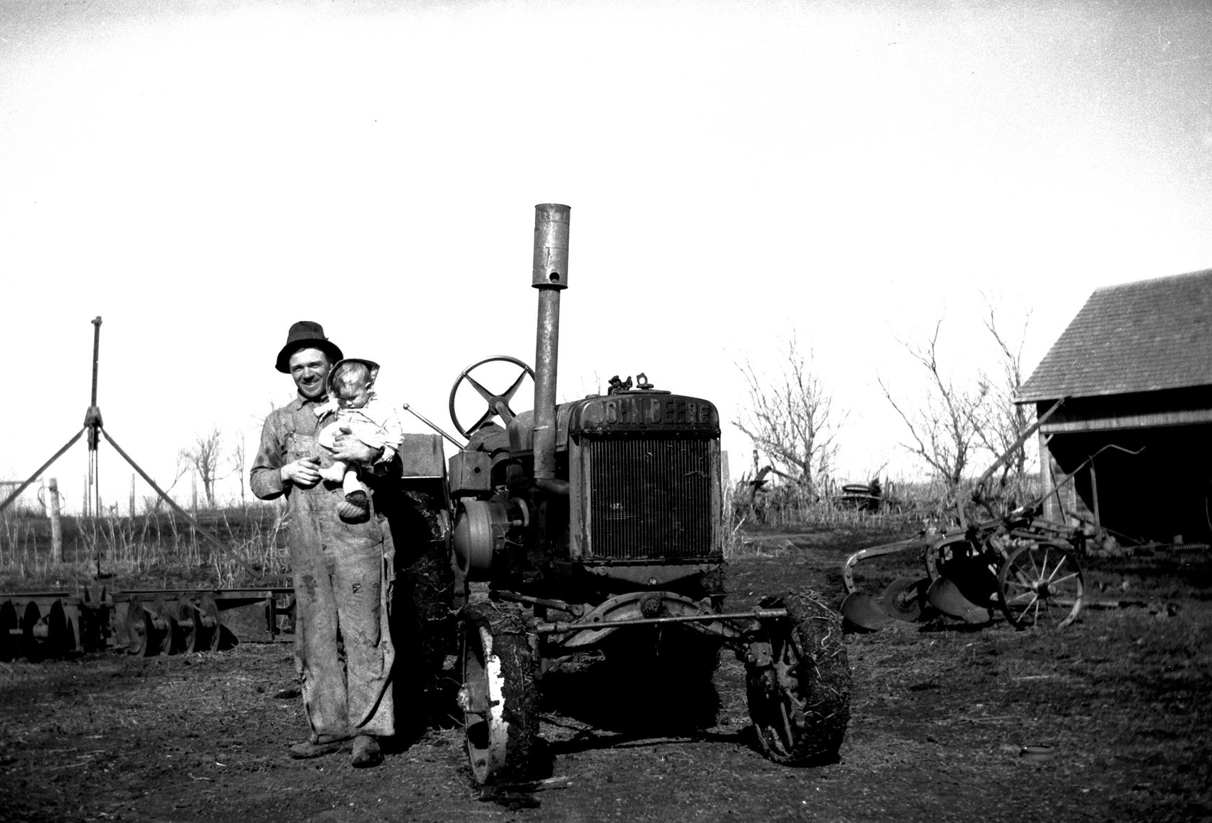
History of Organic Farming
This material is based upon work that is supported by the National Institute of Food and Agriculture, U.S. Department of Agriculture, under grant number 2013-51106-21005.
Authors
Kristine Moncada,
Constance Carlson,
Jim Riddle,
Carmen Fernholz,
Craig Sheaffer
Notes:
Narration: Welcome to our History of Organic Farming module.
Image: Carmen Fernholz

Slide 2
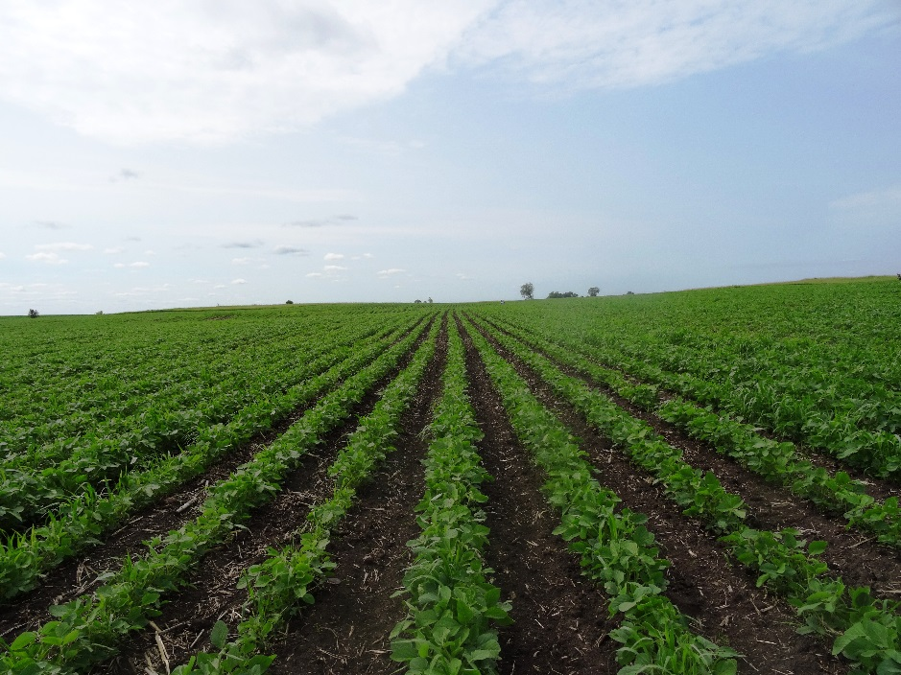
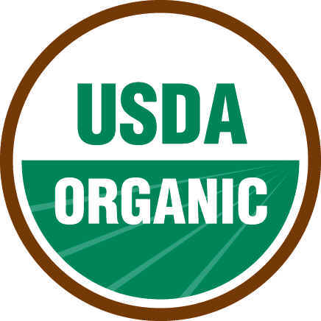
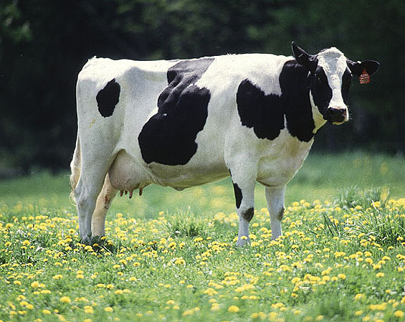
Introduction
The National Organic Program (NOP) was established in 2002
Movement began many years before
Notes:
Narration: The National Organic Program (NOP) and the USDA certified organic seal were established in 2002 -- not even 20 years ago. However, organic methods and the organic movement have a rich history that began many years before. Images: Kristine Moncada, University of Minnesota (soybean field); Keith Weller, USDA-ARS (dairy cow)

Slide 3
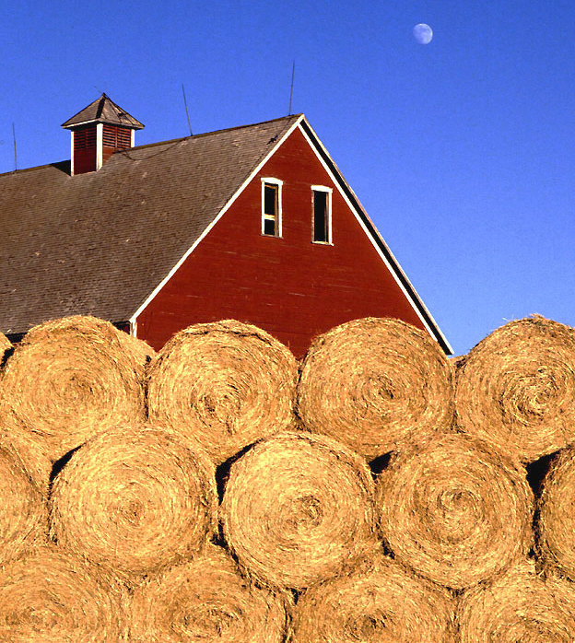
History of Organic
Beginnings
U.S. Movement
USDA Involvement
Organic Today
Notes:
Narration: We will first discuss the changes in agriculture that eventually lead to the organic movement.
Image: Scott Bauer, USDA-ARS

Slide 4
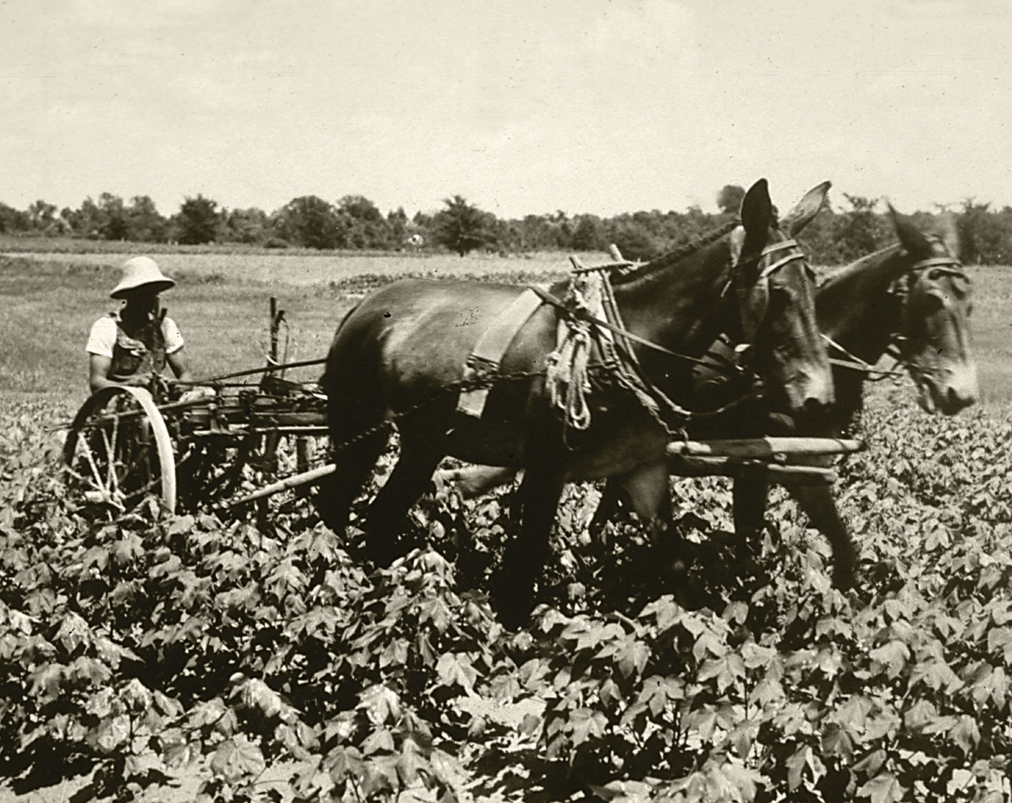
Prior to Organic Movement
Early 20th century
Industrialization of agriculture
Mechanization
Specialization
Use of synthetic fertilizers and pesticides
Cultivation in the 1930s
Notes:
Narration: To understand why the organic movement started, we need to understand farming practices in the early part of the 20th century. Prior to the 1920s, most agriculture could be considered organic by today’s standards. Pest and weed management was handled mostly through manual labor and most farms had livestock for manure, which provided the main source of nutrients for crops. After the 1920s, and especially post-WWII, agriculture started becoming industrialized. It was a time of great change where farms were becoming more mechanized and specialized, and synthetic chemicals were more prevalent. Image: USDA-NRCS

Slide 5
Corn Acreage Treated with Herbicides, 1952-2008
Economic Research Service, USDA, 2016
Notes:
Narration: For example, in 1952, about 10% of corn acres were treated with herbicides. By 1982, just thirty years later, nearly 95% of corn acreage had herbicide applied.

Slide 6
Fertilizer Use in U.S. Agriculture, 1960-2011
Economic Research Service, USDA, 2016
Notes:
Narration: Before the availability of inexpensive synthetic nitrogen fertilizers, farmers were more dependent on crop rotations and manures for fertility. After 1960, there was a dramatic increase in the amount of fertilizer applied to fields, particularly synthetic nitrogen.

Slide 7
The Roots of Organic Farming
Europe
1920s – 1950s
Opposition to industrial agriculture
Emphasis on soil health
Europe
Notes:
Narration: Organic farming as we know it has its roots in a movement within Europe that occurred in the 1920s – 1950s. This movement was in response to the industrialization of agriculture, particularly the growing use of synthetic nitrogen inputs and pesticides. Most farmers in this movement had diverse operations that included livestock, poultry, vegetable and grain production. The movement began an emphasis on soil health that is still present today in organic farming. Here’s a brief review of some of the influential people in the early organic movement.

Slide 8
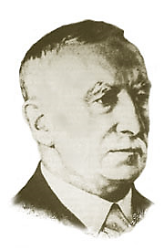
Sir Albert Howard (1873-1947)
The “father” of organic agriculture
Concepts:
Healthy soils for healthy plants and animals
Humus (the organic component of soil) was critical for health soils
Never used the term “organic”
Notes:
Narration: Sir Albert Howard, an Englishman, is commonly regarded as the father of organic agriculture. Important concepts were developed then that are still important today. There was a concentration on the connection of healthy soils to plant and animal health and the importance of humus, which is the organic component of soil. Interestingly enough, he never used the term “organic”.
Image: Wikipedia https://en.wikipedia.org/wiki/File:Albert_Howard.jpg

Slide 9
Lord Northbourne (1896-1982)
Coined the term “organic” in 1939
Introduced the concept of the “farm as an organic whole”
Notes:
Narration: The first use of the term organic came from Lord Northbourne, also an Englishman in 1939. Lord Northbourne believed that the farm should be managed “as an organic whole”. This is where the concept of holistic management comes from in organic agriculture.

Slide 10
History of Organic
Beginnings
U.S. Movement
USDA Involvement
Organic Today
Notes:
Narration: Now that we have learned a little about events that were happening in Europe, we will move to the effect they had in the U.S.
Image: Scott Bauer, USDA-ARS

Slide 11
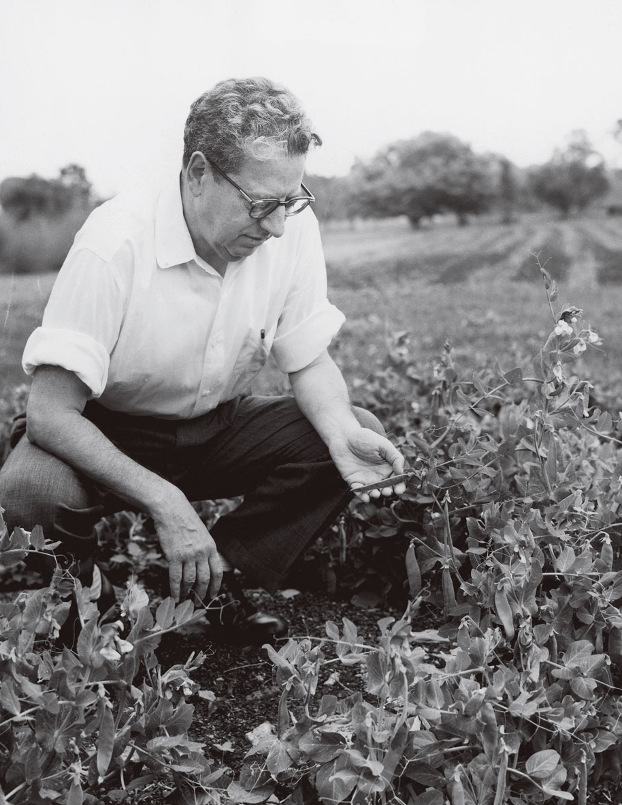
J.I. Rodale (1898 – 1971)
Inspired by movement in Europe
Introduced organic farming concepts to the U.S.
Founded the Rodale Institute (still influential today)
Notes:
Narration: J.I. Rodale was inspired by the thinkers and the organic movement of Europe. He introduced organic farming concepts to the American public. He founded the Soil and Health Foundation, which eventually became the Rodale Institute. The Rodale Institute is still highly influential to organic farmers and gardeners today.
Image: Rodale Institute

Slide 12
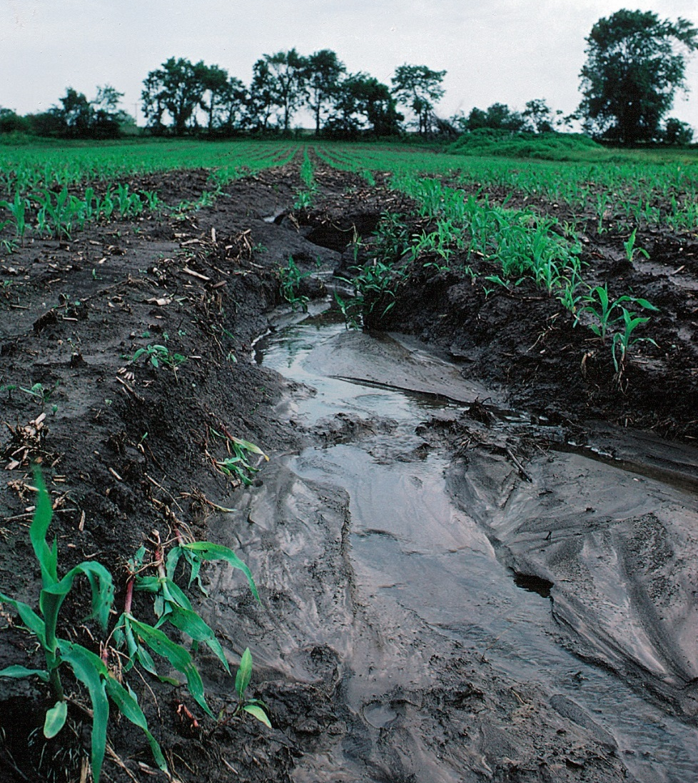
Concerns of U.S. Organic Movement (1960s)
Pesticide hazards to health of people and animals
Decline in soil health
Water pollution
Costs of synthetic inputs
Loss of family farms and local markets
Unhealthy soil (due to erosion)
Notes:
Narration: Those with interest in organic food and agriculture had concerns with many issues with the trends of agriculture at the time. They were troubled by the ill effects of pesticides, declines in soil health, water pollution, the costs of synthetic inputs like fertilizers and pesticides, and the loss of family farms and local markets. Many of these concerns still hold true today!
Image: Lynn Betts, USDA-NRCS

Slide 13
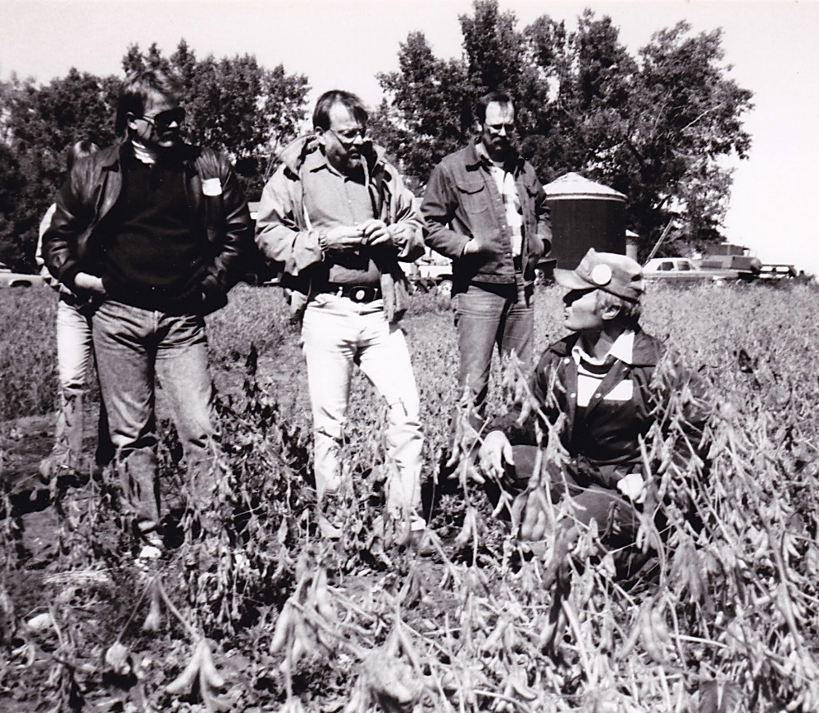
Early Organic Community
No governmental oversight
Organic on a local scale with word of farmer trusted
Information acquired from other farmers and Rodale Institute
No organic premium or formal markets
Notes:
Narration: What was organic like in the early days? Many of the decision-making groups we know today, such as the National Organic Program hadn’t been formed yet. Organic production and awareness was a grassroots effort that occurred at the local level where people knew their farmers and trusted that organic practices were being followed. Organic farmers acquired information from each other and organizations such as the Rodale Institute. Producers for the most part did not receive an organic premium in these days; they had ethical motivations to be organic rather than financial. Grain producers, for instance, sold in the conventional markets.
Image: Carmen Fernholz

Slide 14
1970s
Different groups of farmers and consumers cooperated to develop their own:
Organic standards
Certification processes
Notes:
Narration: Demand for organic food was rising so different groups of farmers and consumers cooperated to develop their own organic standards and certification processes. owever, they were not necessarily consistent from state to state. There was no national organic standard. Image: Life Magazine, 1970

Slide 15
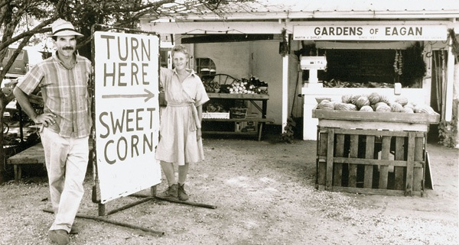
“Organic farmers were working out systems on their own farms; often they were isolated and faced harassment and ridicule in their own communities. Two of the greatest challenges at the time were lack of growing information and confusion about what organic meant.” -- Atina Diffley, Turn Here Sweet Corn
Notes:
Narration: In her book, Turn Here Sweet Corn, Atina Diffley, an organic farmer and advocate, describes what organic farming was like in those early days: “Organic farmers were working out systems on their own farms; often they were isolated and faced harassment and ridicule in their own communities. Two of the greatest challenges at the time were lack of growing information and confusion about what organic meant.”
Image: Atina Diffley

Slide 16
1980s
In 1980, 3 states (OR, ME, CA) had legal definitions of “organic”
Organic Growers and Buyers Association helped MN pass organic regulations in 1985
Meeting of the Organic Growers and Buyers Association in Madison, MN
Notes:
Narration: The 1980s were important to the development of organic as we know it today. The organic movement started to be defined by state governments. Oregon, Maine, and California had legal definitions of organic by 1980. In the Upper Midwest, the Organic Growers and Buyers Association worked with the state of Minnesota to pass organic rules and regulations in 1985. Image: Carmen Fernholz

Slide 17
Rise of Private Certification
By mid-1980s, many different certifying agencies existed
Each developed their own organic rules
Organic Certification
Notes:
Narration: Just like today, organic producers in the mid-1980s obtained certification through private or state agencies. By this time, organic producers had many certifying agencies from which to choose. Private agencies were governed by their own members who developed their own rules to define organic.

Slide 18
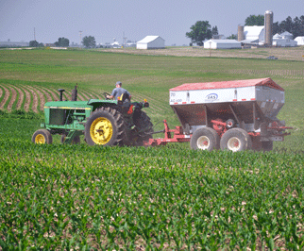
Organic Practices Varied Across the Country
Use of synthetic fertilizers or pesticides
How long to transition
Often 12-month period
Some thought too long, others not long enough
Urea application
Notes:
Narration: Not only did different states have different organic standards, so did different certification agencies in places without statewide regulation. For instance, unlike today, some places allowed synthetic pesticides to be used sparingly or as a last resort. Some allowed the synthetic fertilizer urea to be used. Today, it takes three years without the use of prohibited materials for land to be certified. But back then, the transition period was often 12 months, which some thought too long and others not long enough. Image: USDA-NRCS

Slide 19
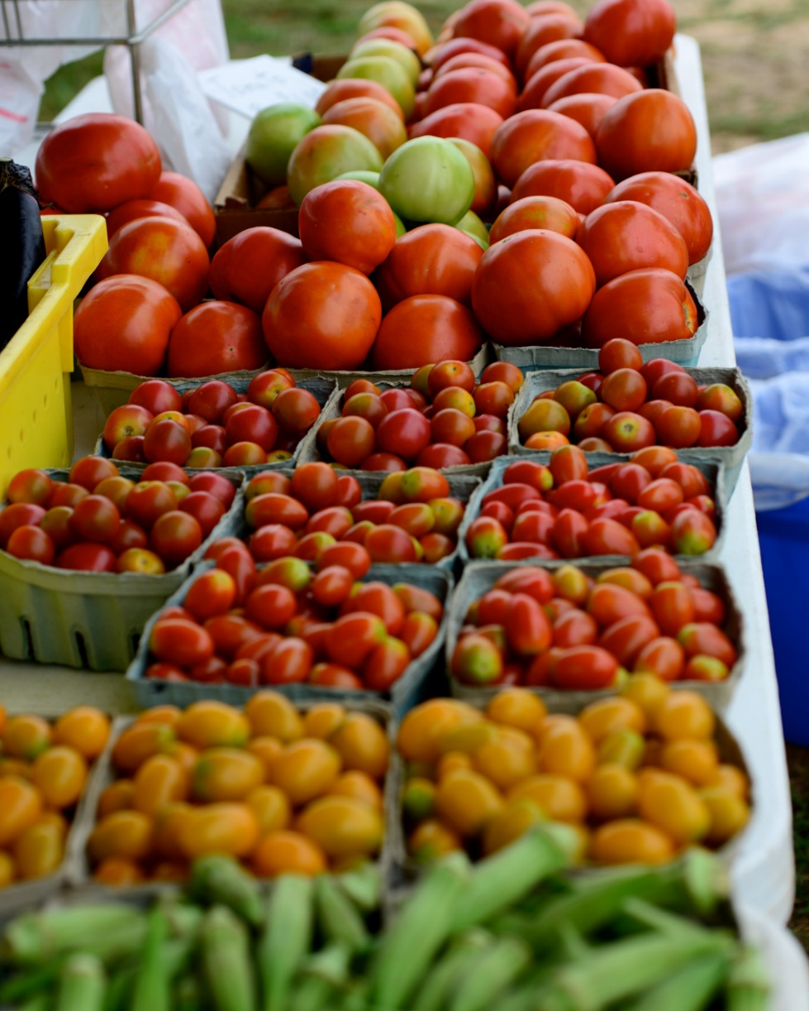
Problems Due to Lack of Consistent Standards
Organic?
Marketing more difficult due to uncertainty of what organic meant
Worries over “cheaters” using organic label without organic methods
Organic?
Organic?
Organic?
Notes:
Narration: Because of the lack of consistent standards, marketing organic products was more difficult. Consumers couldn’t be sure which methods were being used. Because prices for organics were increasing, people were worried that this would incentivize cheaters to use organic labels without organic methods.
Image: Stephen Kirkpatrick, USDA-NRCS

Slide 20
History of Organic
Beginnings
U.S. Movement
USDA Involvement
Organic Today
Notes:
Narration: The irregularities of the organic system needed to be addressed. This is the time when the USDA became involved.
Image: Scott Bauer, USDA-ARS

Slide 21
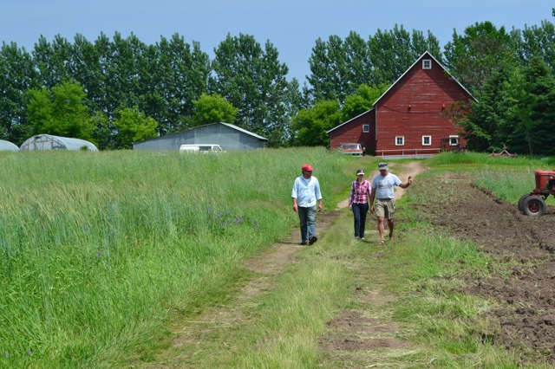
The Organic Foods Production Act (OFPA) 1990
Result of organic industry petition for the USDA to regulate organic
Passed by Congress in 1990
Notes:
Narration: These inconsistent standards led the organic industry to petition the USDA to regulate organic agriculture. As a result, Congress passed the Organic Foods Production Act of 1990. Image: Mary Sue Stevens http://awakeningalandscape.smugmug.com/

Slide 22
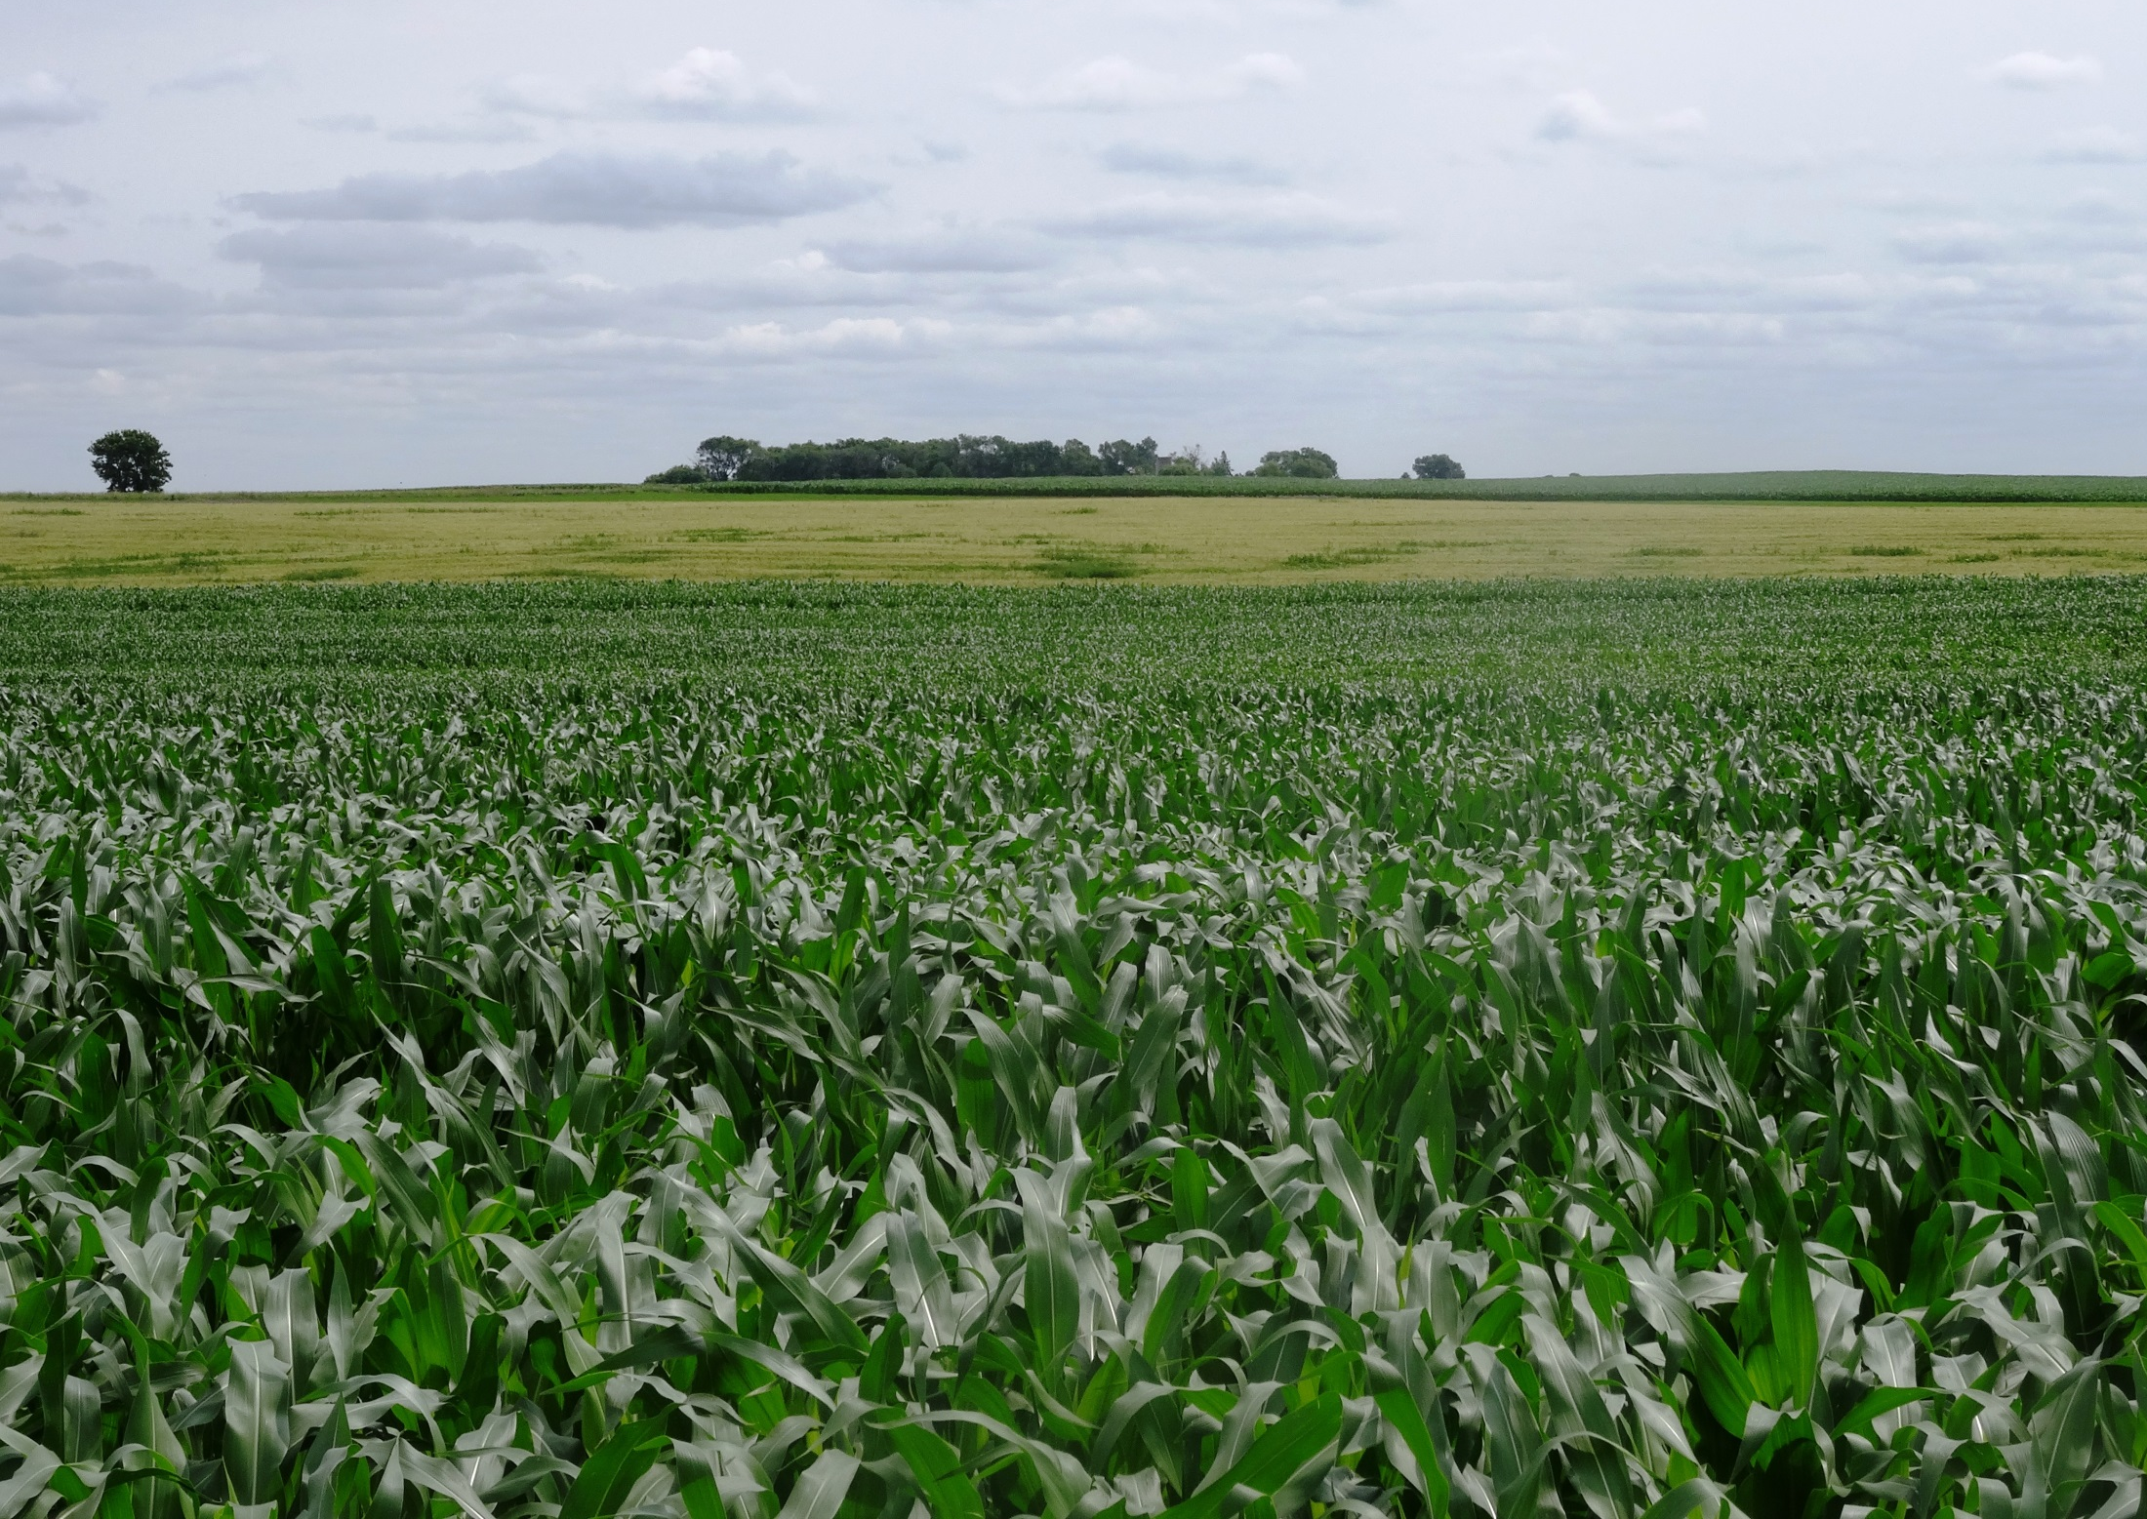
Goal of OFPA
For “organic” to become a marketing term with uniform standards so that consumers would be assured of the integrity of the term
Notes:
Narration: The goal of the Organic Foods Production Act was for “organic” to become a marketing term. This may seem counterintuitive to the grassroots foundation of the organic movement, but uniform standards would allow consumers to be assured of the integrity of organic.
Image: Kristine Moncada, University of Minnesota

Slide 23
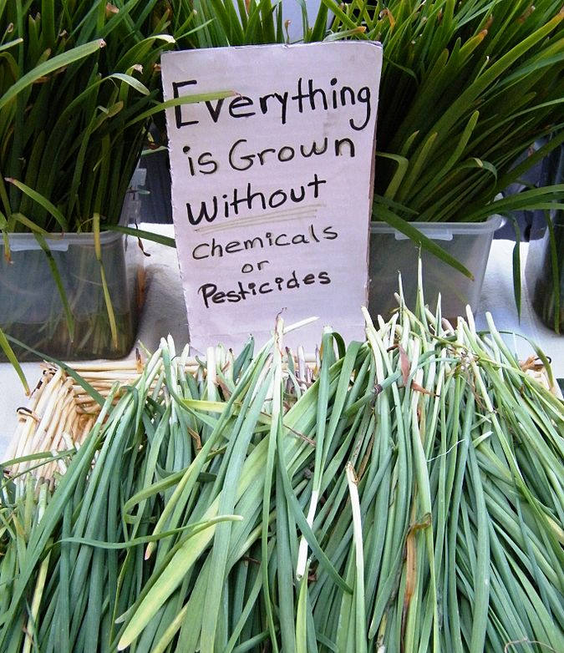
What OFPA Did
Mandated USDA develop national organic standards
Made it illegal to use term “organic” unless standards were met
Required certification
Notes:
Narration: The Organic Foods Production Act did several things. It mandated that the USDA develop national organic standards so that everyone in the country would be following the same rules. It made it illegal to use the term “organic” unless the standards were met. This was important so that enforcement could be done in cases of cheating. It also required certification by a state or independent certifier accredited by the USDA.
Image: Wikipedia

Slide 24
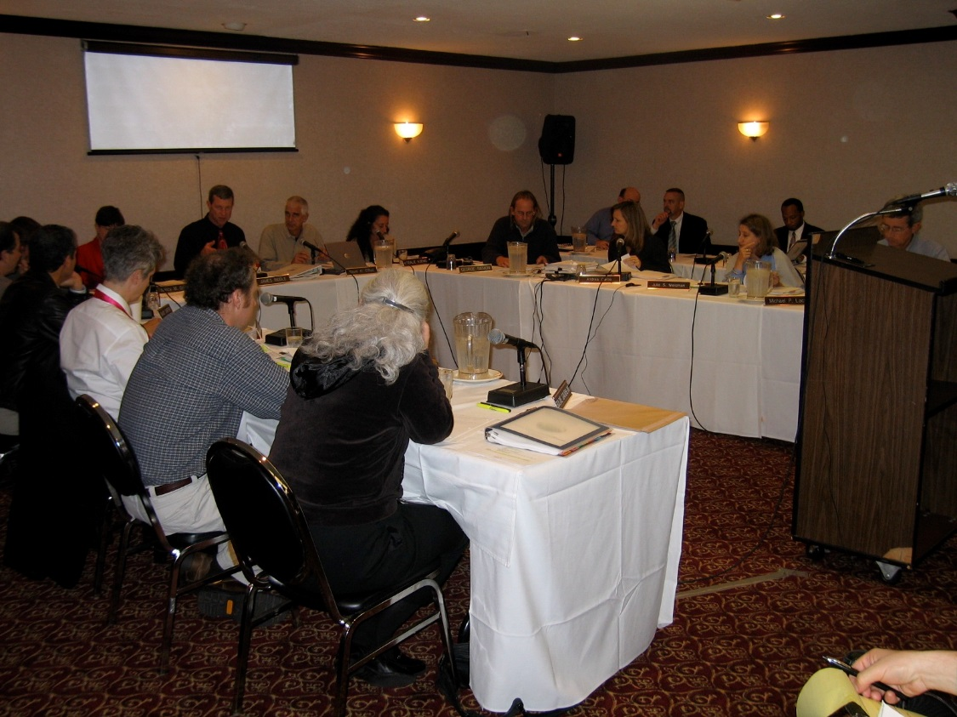
National Organic Standard Board (NOSB)
Formed to advise USDA
Citizen volunteers
Organic farmers, processors, retailers, scientists, environmentalists, advocates, and certifying agents
National Organic Standard Board meeting
Notes:
Narration: However, the USDA would not be alone in determining organic standards. The National Organic Standards Board was formed to advise the USDA. This board is composed of volunteer citizen advisors who can be organic farmers, processors, retailers, scientists, environmentalists, advocates and certifying agents.
Image: Jim Riddle

Slide 25
USDA’s First Attempt at Defining Organic (1997)
Met with outrage
Included irradiation, sewage sludge, GMOs, synthetic pesticides
USDA withdrew this version
Pesticide application
Notes:
Narration: The process to develop national organic standards went on much longer than anticipated. The USDA’s first attempt at defining organic wasn’t until 1997. Unfortunately, it was met with outrage from the organic community! The recommendations followed some of the recommendations of the NOSB, but included irradiation, sewage sludge, synthetic pesticides, and genetically modified organisms.
Image: David L. Hansen, University of Minnesota

Slide 26
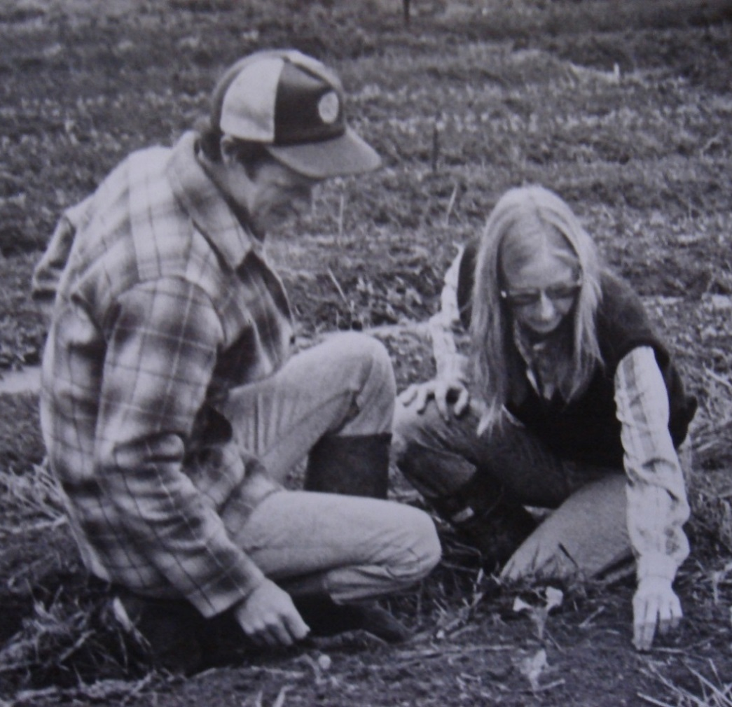
“In 1997, when the USDA issued the first proposed organic rule, it did not reflect organic standards. They also ignored the recommendations of their National
Organic Standards Board. I did an in-depth critique of the proposed rule, which informed the rest of the organic community. It inspired 275,000 comments to be submitted about the proposed rule, which set a new record at the time. Luckily, the USDA withdrew that proposed rule.”
---Jim Riddle, organic farmer and advocate
Jim Riddle and his wife, Joyce Ford
Notes:
Narration: Jim Riddle, an organic farmer and advocate from Minnesota, had this to say about that time: “In 1997, when the USDA issued the first proposed organic rule, it did not reflect organic standards. They also ignored the recommendations of their National Organic Standards Board. I did an in-depth critique of the proposed rule, which informed the rest of the organic community. It inspired 275,000 comments to be submitted about the proposed rule, which set a new record at the time. Luckily, the USDA withdrew that proposed rule.”
Image: Jim Riddle

Slide 27
USDA’s Second Attempt (2000)
The Final Rule was released in 2001 and went into effect in 2002
Still in use today
By 2002, producers were using the USDA certified organic seal
Notes:
Narration: With modifications, the USDA’s second attempt at establishing organic regulations was a success. While some changes have happened along the way, these are the same rules we have today. Please watch the “What Is Organic?” module for more information. By 2002, producers were using the USDA certified organic seal.

Slide 28
History of Organic
Beginnings
U.S. Movement
USDA Involvement
Organic Today
Notes:
Narration: So what is the status of organic today?
Image: Scott Bauer, USDA-ARS

Slide 29
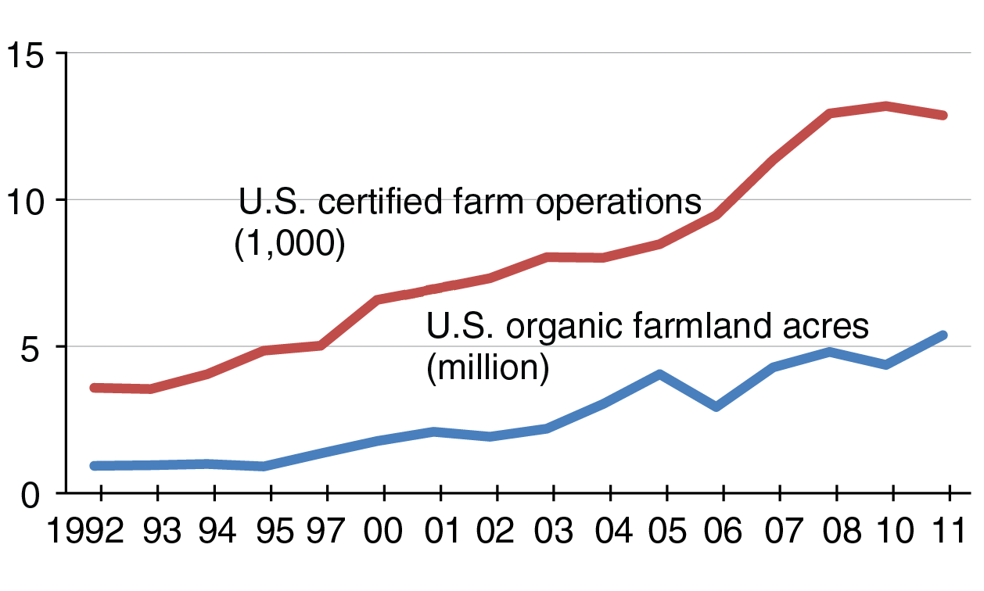
U.S. Organic Farmland Acres and Number of Operations, 1992-2011
Source: USDA-ERS, 2013
Notes:
Narration: Since the Organic Foods Production Act, the number of certified organic acres and certified farm operations in the U.S. has been trending upward.

Slide 30
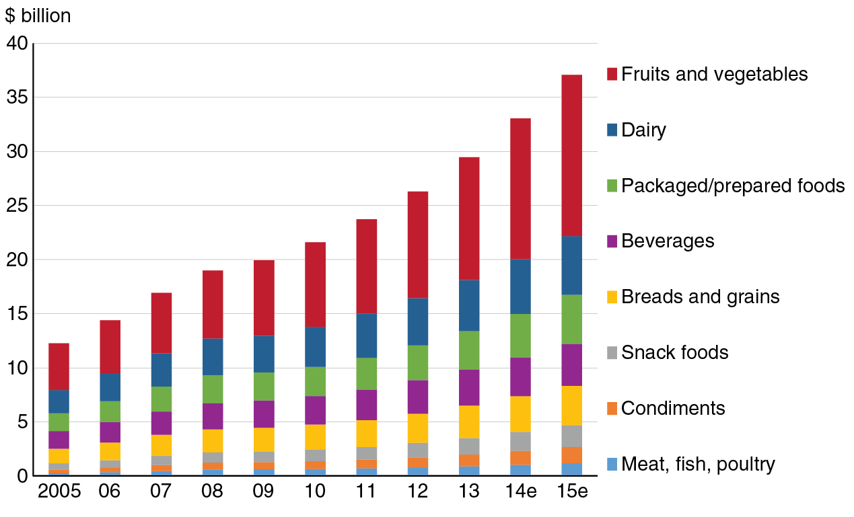
Organic Food Retail Sales, 2005-2015e
e = estimated. Source: USDA ERS using data from Nutrition Business Journal, 2015
Notes:
Narration: Consumers depend on the USDA Organic label as a reliable source for food grown under organic production practices. Since the National Organic Program was instituted, the market for organic foods has only grown in the United States. Sales for 2014 were estimated to be over $35 billion, more than twice as much as 10 years ago. Every food category has shown increases.

Slide 31
U.S. Mandatory Spending on Organic Agriculture, 2002-2014 Farm Acts (farm bills)
Economic Research Service, USDA, 2016
Notes:
Narration: Here is how much funding the last three Farm Acts devoted to organic agriculture. This includes support for organic research, organic agriculture data collection, and the organic cost share program (For more information on these programs, please see our Resources module). As you can see, each successive Act increased funding, which demonstrates the commitment our country has for organic.

Slide 32
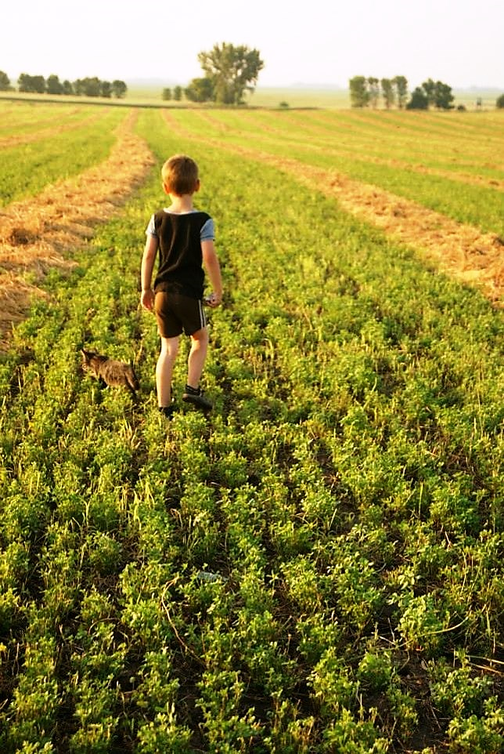
The Future
"In the end, each of us is involved in the history of agriculture because each of us is an eater and each of us is an organism of this earth. As eaters we will define and determine the history of agriculture as we drive our cars, as we shop the grocery aisles, as we eat at the local restaurants, as we buy our clothes. And as long as we are eating, we are creating the history of agriculture.” -- Carmen Fernholz, Organic Farmer
Note: cycle through some more scenic images here
Notes:
Narration: Where will organics go in the next 5, 10 or 20 years? The history of organic agriculture has shown us that advances in organics have always been driven by the farmers and consumers who strive for an agricultural system that feeds both the land and the community. The future of organics, then, is up to all of us. Carmen Fernholz, a long-time organic farmer from Minnesota, has this to say: Image: Constance Carlson, University of Minnesota

Slide 33
For More Information
National Sustainable Agriculture Oral History Archive
Organic History – Roger Blobaum
A History of Organic Farming: Transitions from Sir Albert Howard’s War in the Soil to the USDA National Organic Program
Organic and Sustainable Agriculture Collection – Wisconsin Historical Society
Notes:
Narration: If you are interested in learning more about the history of organic agriculture, please visit these sites.

Slide 34
History of Organic
Beginnings
U.S. Movement
USDA Involvement
Organic Today
Notes:
Narration: We have now completed the History of Organic module.
Image: Scott Bauer, USDA-ARS

Slide 35
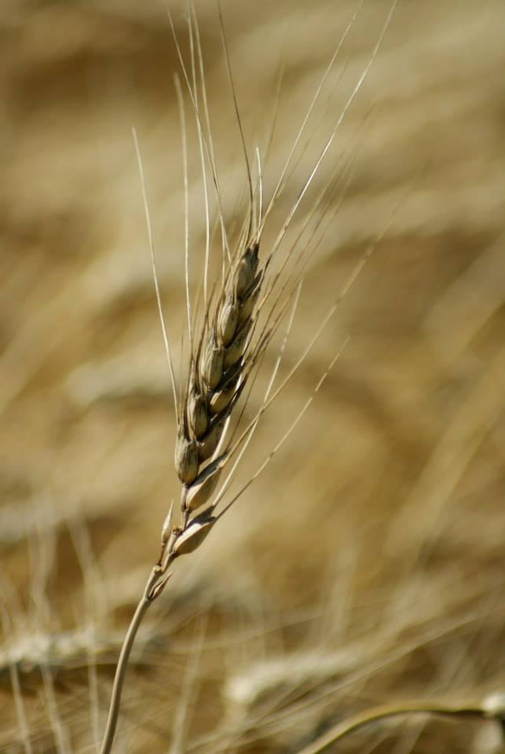
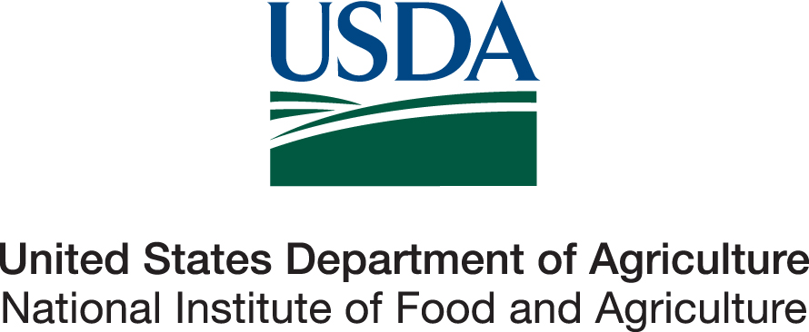
© 2017 Regents of the University of Minnesota. All rights reserved. The University of Minnesota is an equal opportunity educator and employer.
This material is based upon work that is supported by the National Institute of Food and Agriculture, U.S. Department of Agriculture, under grant number 2013-51106-21005.
Notes:
Narration: This material is based upon work that is supported by the National Institute of Food and Agriculture.
Image: Constance Carlson, University of Minnesota

Slide 36
References
Blobaum, R. 2017. A Brief History of the Organic Farming Movement in the Midwest in the 1970s. http://rogerblobaum.com/history-of-the-organic-farming-movement-in-the-1970s-in-the-midwest/
Diffley, A. 2012. Turn Here Sweet Corn: Organic Farming Works. University of Minnesota Press.
Greene, C. 2017. Organic Market Overview. USDA-ERS. https://www.ers.usda.gov/data-products/chart-gallery/gallery/chart-detail/?chartId=77567
Greene, C., G. Ferreira, A. Carlson, B. Cooke, and C. Hitaj. 2017. Growing Organic Demand Provides High-Value Opportunities for Many Types of Producers. USDA-ERS. https://www.ers.usda.gov/amber-waves/2017/januaryfebruary/growing-organic-demand-provides-high-value-opportunities-for-many-types-of-producers/
Gold, M. and J. Gates. 2007. Tracing the Evolution of Organic/Sustainable Agriculture: A Selected and Annotated Bibliography https://www.nal.usda.gov/afsic/tracing-evolution-organic-sustainable-agriculture
Heckman, J. 2007. A History of Organic Farming: Transitions from Sir Albert Howard’s War in the Soil to the USDA National Organic Program http://www.westonaprice.org/health-topics/a-history-of-organic-farming-transitions-from-sir-albert-howards-war-in-the-soil-to-the-usda-national-organic-program/
John Hopkins Center for a Livable Future. 2014. Industrialization of Agriculture. http://www.foodsystemprimer.org/food-production/industrialization-of-agriculture/

Slide 37
References (cont.)
John Hopkins Center for a Livable Future. 2014. Industrialization of Agriculture. http://www.foodsystemprimer.org/food-production/industrialization-of-agriculture/
Kroese, R. 2015. Interview with Jim Riddle, Joyce Ford, and Doug Nopar. http://umedia.lib.umn.edu/node/1198165
Kuepper, G. 2010. A Brief Overview of the History and Philosophy of Organic Agriculture. Kerr Center for Sustainable Agriculture. http://kerrcenter.com/wp-content/uploads/2014/08/organic-philosophy-report.pdf
Nehring, R., C. Osteen, S.J. Wechsler, A. Martin, A. Vialou, and J. Fernandez-Cornejo. 2014. Pesticide Use in U.S. Agriculture: 21 Selected Crops, 1960-2008. USDA-ERS. https://www.ers.usda.gov/publications/pub-details/?pubid=43855
Nehring, R. 2016. Fertilizer Use and Price. USDA-ERS. https://www.ers.usda.gov/data-products/fertilizer-use-and-price.aspx
Rodale Institute. 2016. About Us. http://rodaleinstitute.org/about-us/mission-and-history/
Sustainable Agriculture Research and Education. 2003. History of Organic Farming in the United States. http://www.sare.org/Learning-Center/Bulletins/Transitioning-to-Organic-Production/Text-Version/History-of-Organic-Farming-in-the-United-States
USDA-ERS. 2016. Increasing U.S. organic food sales encourage growth in organic farming. http://www.ers.usda.gov/topics/natural-resources-environment/organic-agriculture/organic-market-overview.aspx
USDA-ERS. 2016. Agricultural Act of 2014: Organic Agriculture. http://www.ers.usda.gov/agricultural-act-of-2014-highlights-and-implications/organic-agriculture.aspx

