Slide 1
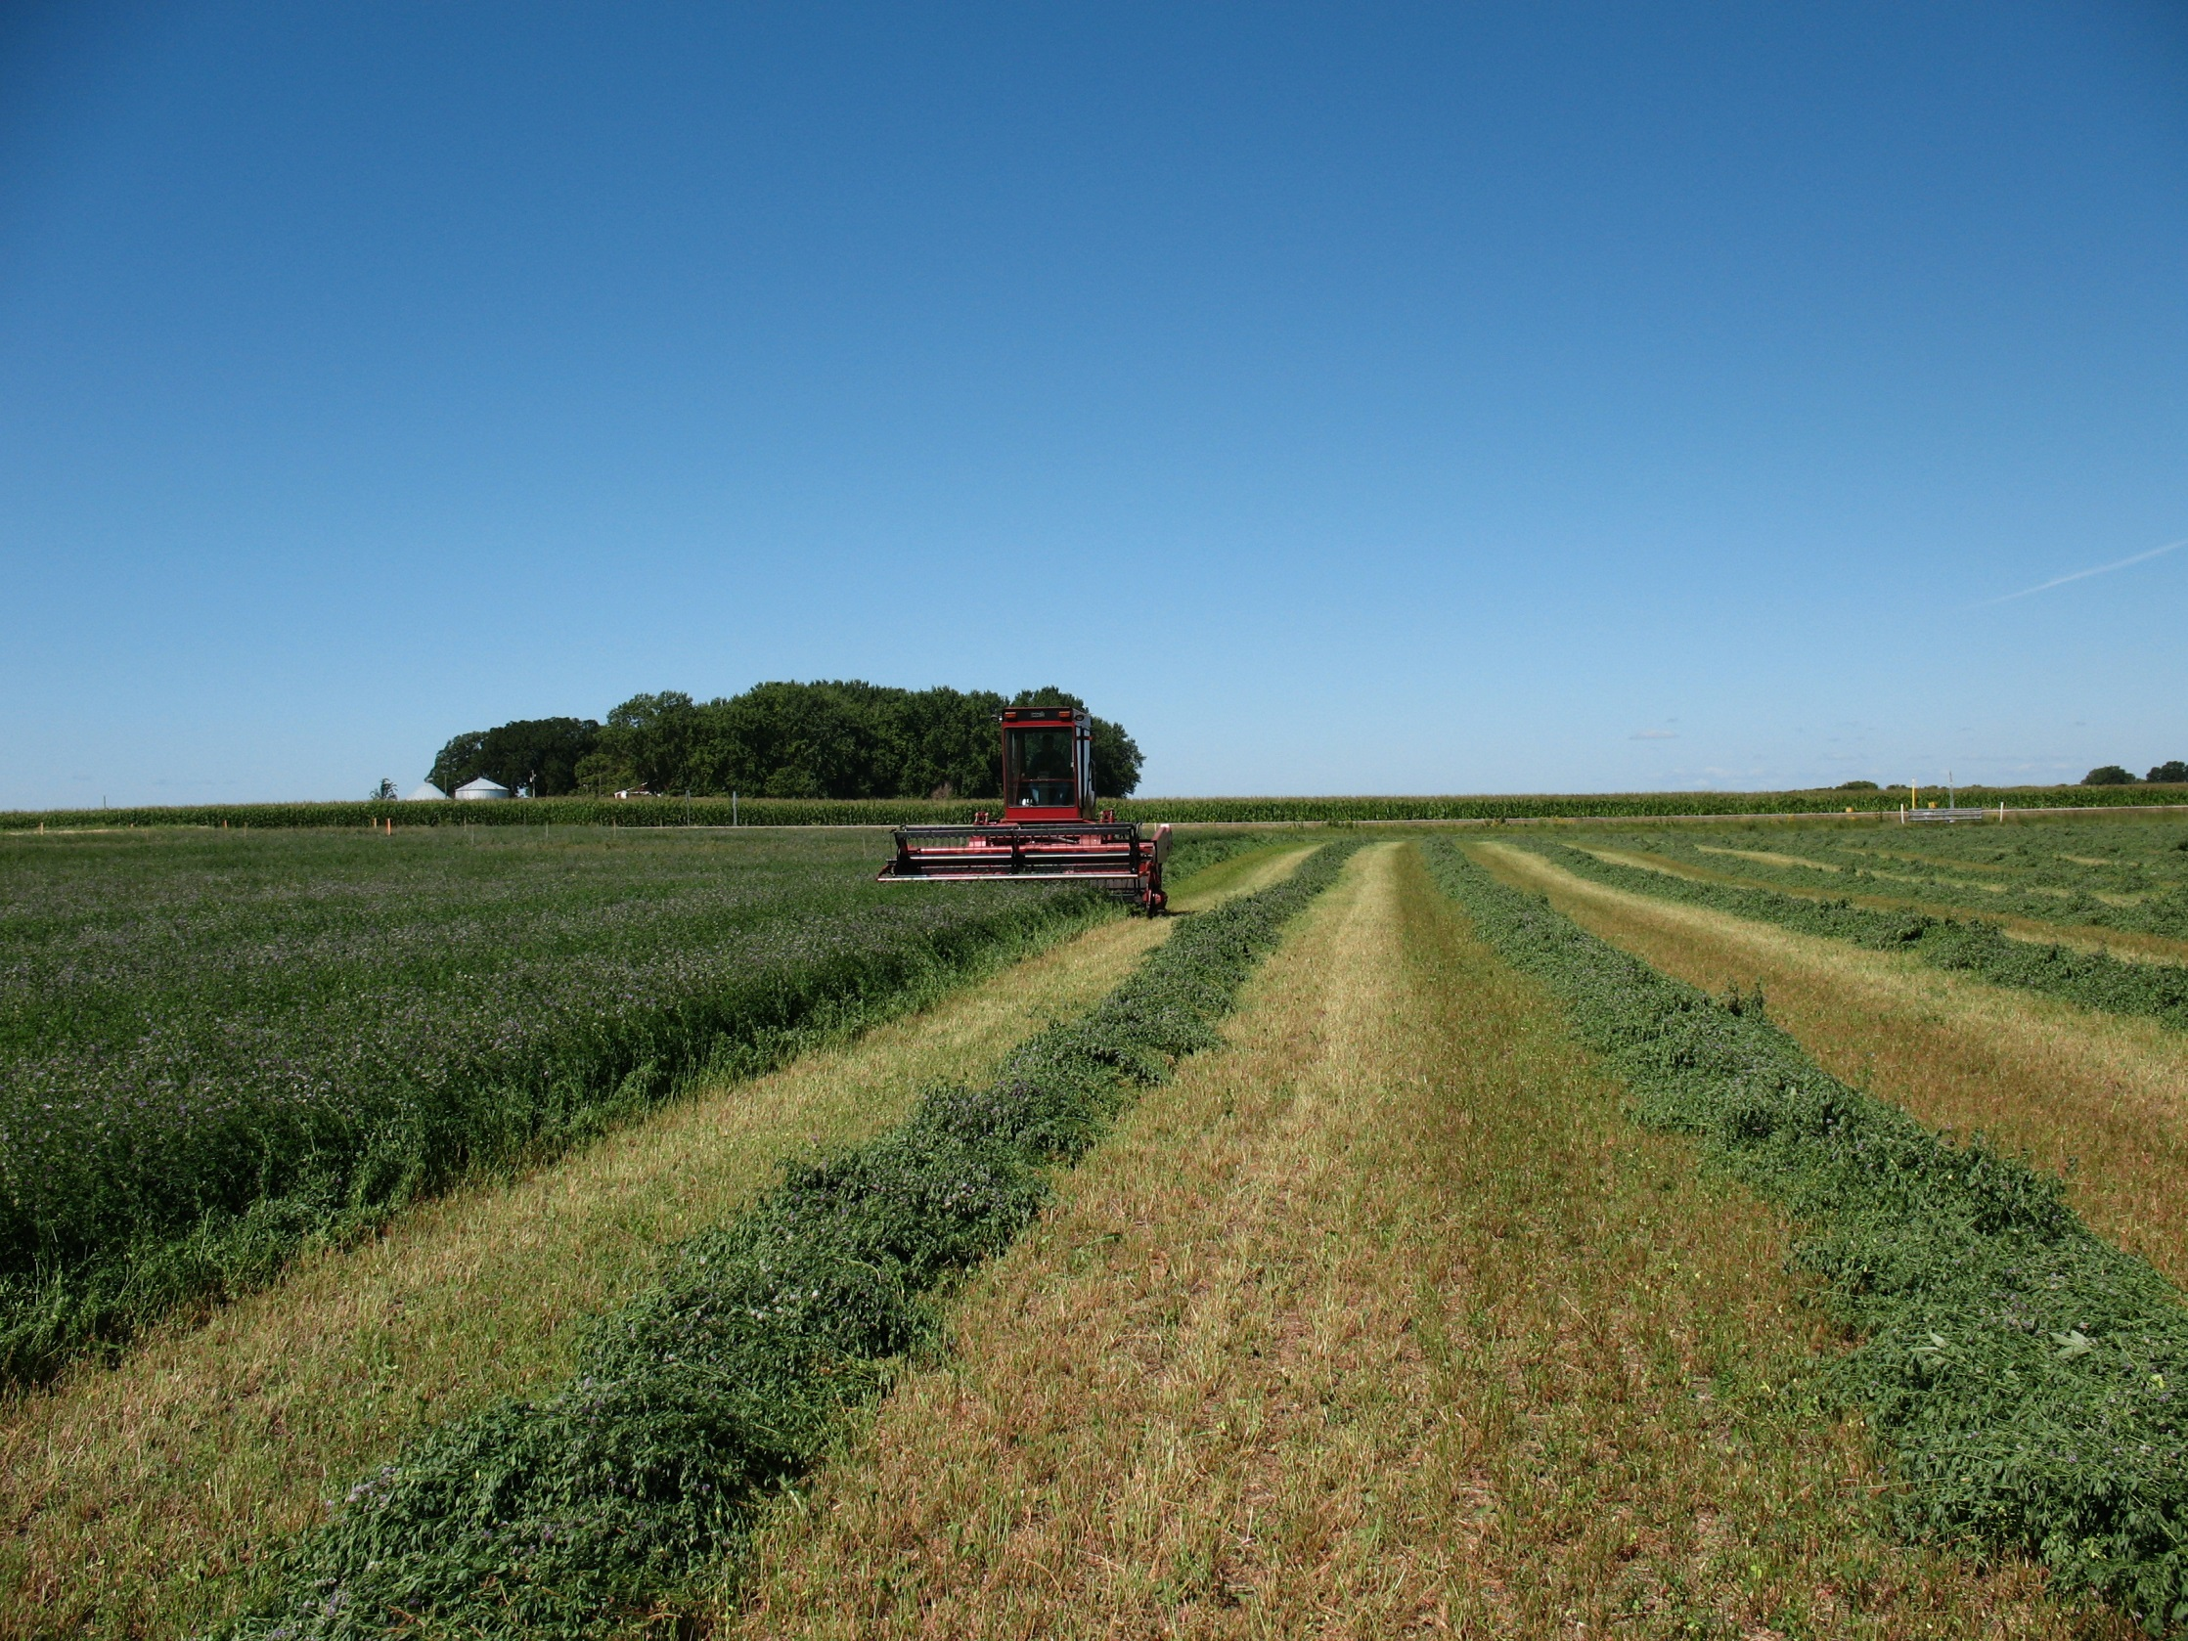
Resources for Transitioning to Organic
Authors
Kristine Moncada
Jill Sackett Eberhart
Harriet Behar
Constance Carlson
Craig Sheaffer
This material is based upon work that is supported by the National Institute of Food and Agriculture, U.S. Department of Agriculture, under grant number 2013-51106-21005.
Notes:
Narration: Welcome to our Resources for Transitioning to Organic module.
Image: Craig Sheaffer, University of Minnesota

Slide 2
Transition Period
2018
2019
2020
36 months prior to certification
Organic methods must be used
Educational resources and financial programs are available
Notes:
Narration: Let’s start out with a quick explanation of what transition is. It is the 36 months prior to certification when organic methods must be used. Three years is a long time and you may need support; this module summarizes the resources available to you during transition. We will cover education resources as well as some of the financial programs you may want to sign up for during transition.

Slide 3
Resources for Transitioning
NOP Program
Mentoring and Training
Conferences and Field Days
Regional Publications
Funding Programs
Other
Notes:
Narration: You may be considering transitioning to organic or maybe you have already started. If so, now is a great time to look into resources that are available to you. Here are the topics we will be covering in this module.

Slide 4
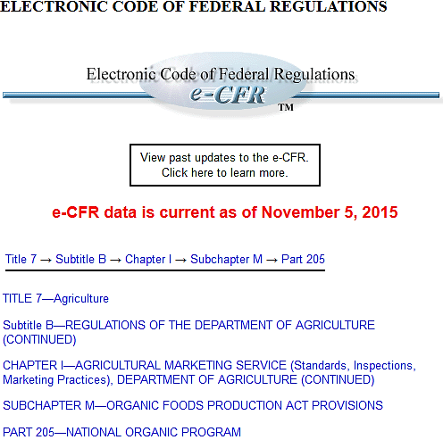
National Organic Program
Most current source of information
Includes definitions, organic production requirements and the National List
Contains legal terminology
Code of Federal Regulations
Notes:
Narration: First, let’s start with resources from the National Organic Program. The most current source of information about organic regulations is The Code of Federal Regulations. Here you can find organic definitions, organic requirements and the National List of allowed and prohibited substances. This is a very comprehensive source of information on organic. However, the Code of Regulations is probably not the best place to start learning about organic because it consists of a lot of legal terminology.

Slide 5
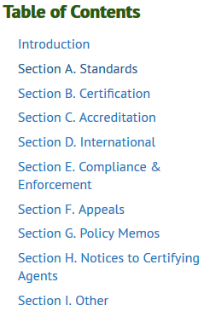
National Organic Program Handbook
For certifiers, and organic producers, handlers, and processors
Contains guidance, instructions, and policy for complying with NOP regulations
Good for details behind policy
National Organic Program Handbook
Notes:
Narration: This publication is for certifiers and organic producers, handlers and processors. It contains guidance, instructions, and policy for complying with NOP rules. This is a good resource if you are curious and want to delve into the details behind a rule. Your certifier will be very familiar with this document, however, so you can consult them when you have questions if you are not interested in sifting through the fine points of organic policy.

Slide 6
Other NOP Resources
USDA Organic Resource Guide
Guide to Organic Certification
Guide for Organic Crop Production
Guide for Organic Livestock Producers
Organic Fact Sheet Series
Notes:
Narration: The USDA Agricultural Marketing Service has several great publications on resources, certification, and crop and livestock production that may be helpful to you as someone new to organic. Another resource is their organic fact sheets. All of these publications are user-friendly with the specific purpose of assisting organic farmers, those already in transition, and farmers considering organic.

Slide 7
National Organic Program
The National Organic Program tells what the standards are
But they do not tell exactly how you should meet those standards
Year 1
Crop ?
Year 2
Crop ?
Year 3
Crop ?
Year 4
Crop ?
Four-year rotation
Notes:
Narration: One thing to remember about the National Organic Program is that they are responsible for communicating the standards, but they are not responsible for details on how you should operate. For example, they say you must have a diverse rotation, but not what your rotation should be. You will need to consult other resources for the how-to’s of organic production.

Slide 8
Resources for Transitioning
NOP Program
Mentoring and Training
Conferences and Field Days
Regional Publications
Funding Programs
Other
Notes:
Narration: We will discuss some of the training and mentor programs that may be useful to crop farmers in the Upper Midwest region.
Image: Craig Sheaffer, University of Minnesota

Slide 9
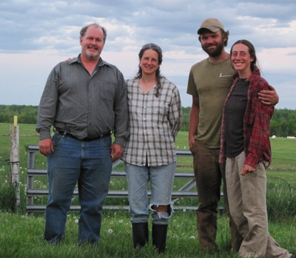
Importance of Mentorship
Can be critical to success
Mentors can be an organic neighbor, friend or family member
Programs exist for those who don’t have these
Notes:
Narration: One of the best things a new-to-organic farmer can do is to acquire a mentor. It can be critical to a transitioning farmer’s success. As a farmer, you likely trust other farmers over other sources of information. You don’t need to enter a formal mentor program if you have an organic neighbor, friend or family member who you can consult. However, for people who don’t already have someone like that, there are a few programs that can connect you to a mentor.
Image: Midwest Organic and Sustainable Education Service

Slide 10
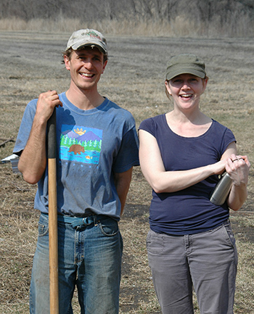
MOSES – Farmer-to-Farmer Mentoring Program
Matches experienced organic farmers with new organic farmers
Available in WI, MN, IA, IL, MI, ND and SD
Lasts about a year
Admission starts in late summer / fall
MOSES Mentoring Program
Notes:
Narration: The Midwest Organic Sustainable Education Service has the Farmer-to-Farmer Mentoring Program that matches experienced organic farmers with new organic farmers. It is available to farmers in several states. The program lasts about a year and admission starts in late summer or fall. Please visit their website for more information. They have other great resources, too.
Image: Midwest Organic and Sustainable Education Service

Slide 11
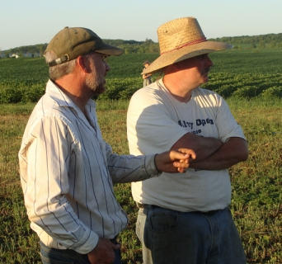
LSP Farmer Network
Provides a listing of farmers willing to network and share information as informal mentors
LSP Farmer Network
Notes:
Narration: The Land Stewardship Project, located in Minnesota, has a list of sustainable farmers who may be willing to network. This could be a great resource especially for those looking for information on growing a new crop. LSP has many other resources, especially for new farmers. Be sure to check them out!
Image: The Land Stewardship Project

Slide 12
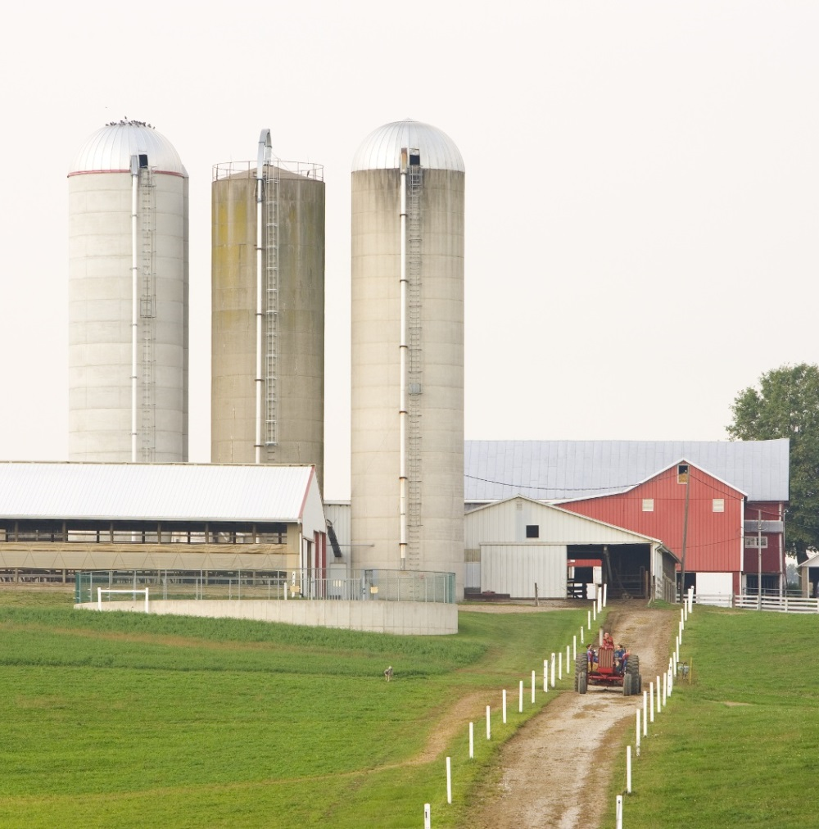
Rodale Institute – Organic Transition Course
Free, 15-hour online course
Practical information on soils, crops, marketing and certification
Rodale Organic Transition Course
Notes:
Narration: Rodale has been working in organic agriculture for over 60 years. They are based in Pennsylvania, but much of their work applies to our cropping systems, too. They offer a free online course in transitioning to organic with practical information on soil, crops, marketing and certification. Like the other organizations we’ve mentioned in this module, Rodale has excellent resources for all kinds of organic farmers. Please visit their website for more information.
Image: Scott Bauer, USDA-NRCS

Slide 13
Resources for Transitioning
NOP Program
Mentoring and Training
Conferences and Field Days
Regional Publications
Funding Programs
Other
Notes:
Narration: A great way to learn AND meet other organic farmers is to attend conferences and field days.
Image: Craig Sheaffer, University of Minnesota

Slide 14
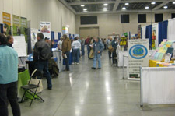
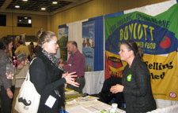
Minnesota Department of Agriculture – Minnesota Organic Conference
January in St. Cloud, MN
Many presentations and networking opportunities
Trade show
MDA Organic Conference
Notes:
Narration: The Minnesota Department of Agriculture holds an annual organic conference every January in St. Cloud, MN. The conference has regional organic researchers and farmers giving presentations on a wide variety of topics. It’s a great opportunity to network, too. They have a trade show for certifying agencies, organic vendors, and other exhibitors.
Image: Minnesota Department of Agriculture

Slide 15
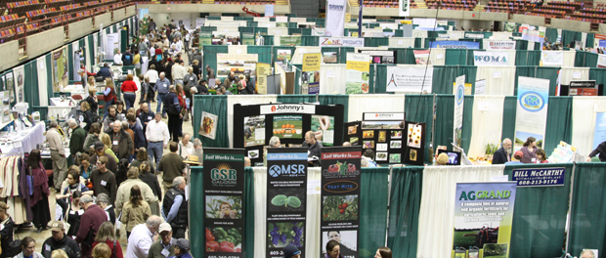
MOSES Organic Farming Conference
Country’s largest organic conference
February in La Crosse, WI
Organic University, presentations, trade show, and networking
MOSES Organic Conference
Notes:
Narration: The MOSES Conference is the largest organic conference in the country. This conference is held in February in La Crosse, Wisconsin. The conference also has an Organic University before the conference with day-long, in-depth workshops.
Image: Midwest Organic and Sustainable Education Service

Slide 16
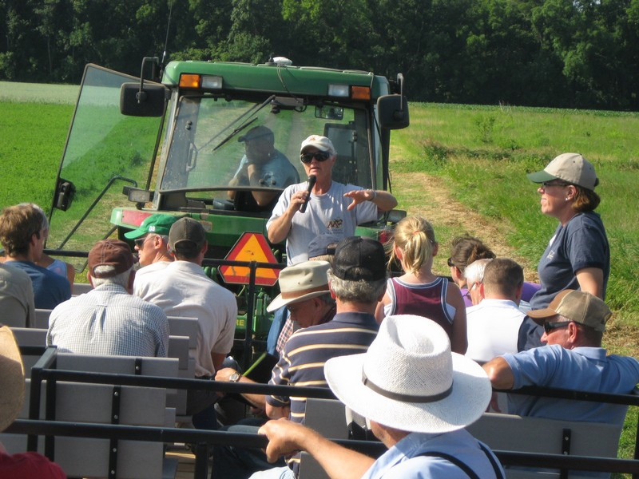
SWROC’s Organic Field Day
Southwest Research and Outreach Center, Lamberton, MN
Held annually in July
Field plot tours and presentations by University of Minnesota researchers and others
Southwest Research and Outreach Center
Notes:
Narration: The University of Minnesota’s Southwest Research and Outreach Center in Lamberton, MN holds an organic field day every July. It’s a great way to learn about current organic research being conducted at the University of Minnesota. Image: Tom Michaels, University of Minnesota

Slide 17
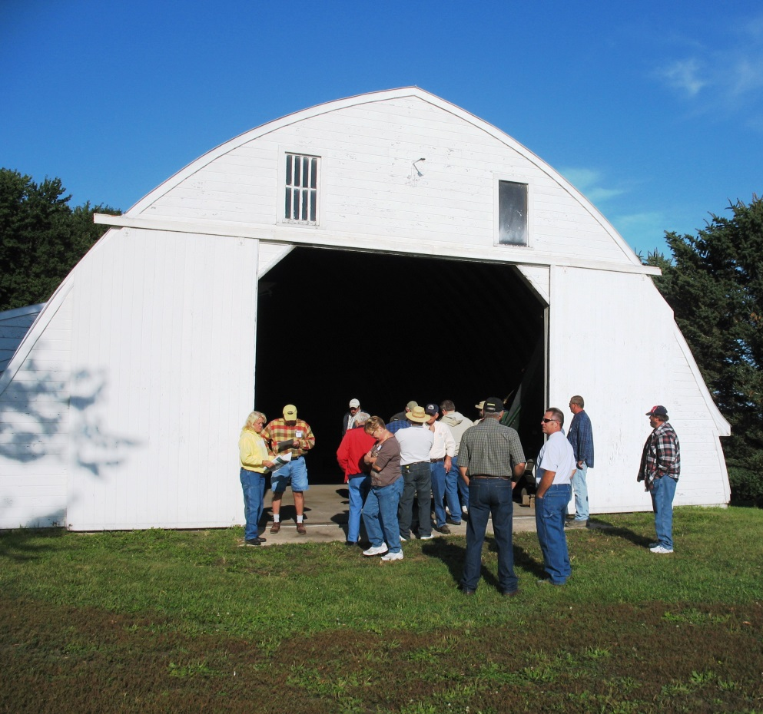
Other Conference, Field Day and Workshop Sources
Minnesota Institute for Sustainable Agriculture
Midwest Organic and Sustainable Education Service
Sustainable Farming Association
Land Stewardship Project
Practical Farmers of Iowa
Northern Plains Sustainable Ag
Notes:
Narration: The Upper Midwest has a wealth of field day and workshop opportunities for organic and sustainable farmers. Here is a list of some organizations that offer field days and workshops. But there are opportunities beyond the organizations on this list to watch for. You can visit these websites for more information on their offerings.

Slide 18
Resources for Transitioning
NOP Program
Mentoring and Training
Conferences and Field Days
Regional Publications
Funding Programs
Other
Notes:
Narration: There are many publications on organic farming. We will focus on a few free publications we think will be especially helpful in transitioning to organic for farmers in our region.
Image: Craig Sheaffer, University of Minnesota

Slide 19
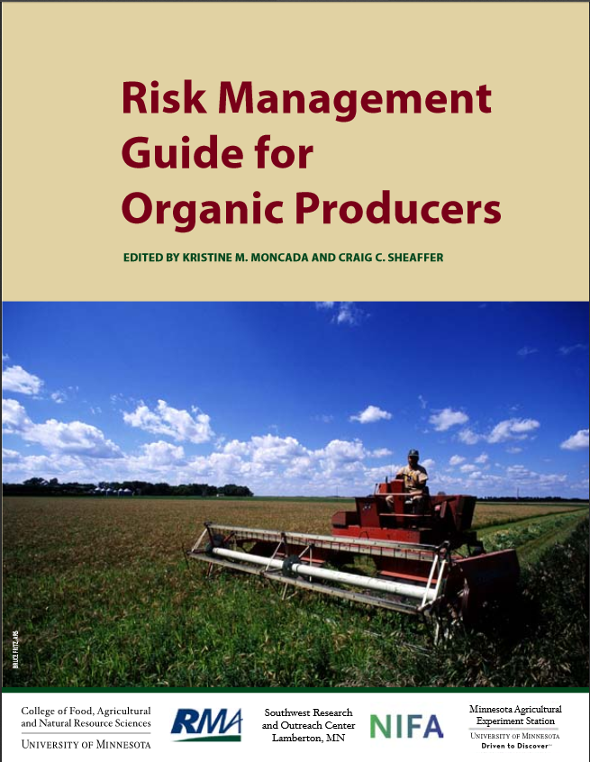
Risk Management Guide for Organic Producers
University of Minnesota
Online publication with a focus on how to minimize organic production risks for grain and forage crops
Risk Management Guide
Notes:
Narration: One publication that many of the authors of this series of modules contributed to is The Risk Management Guide for Organic Producers. This 300-page online publication from the University of Minnesota uses input from experienced organic farmers and from organic research to provide comprehensive guidelines on growing grain and forage crops.

Slide 20
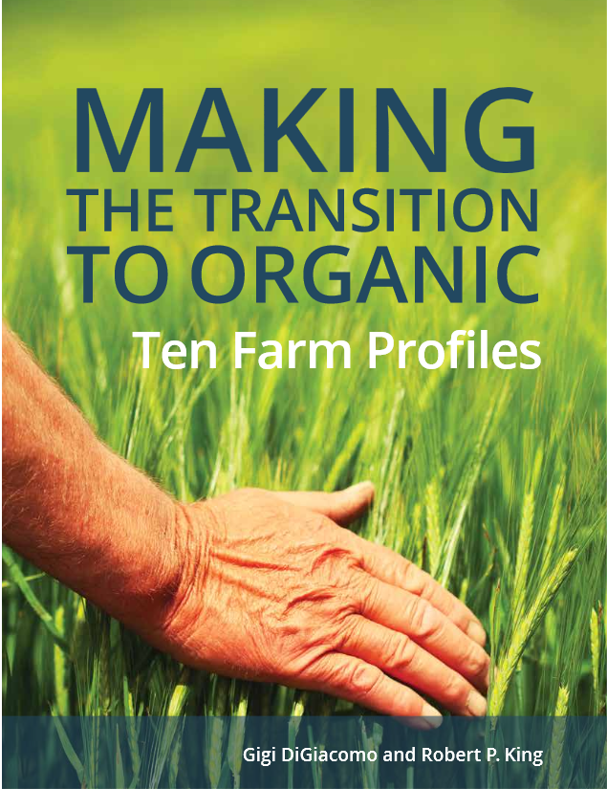
Tools for Transition Project
University of Minnesota
Publications include:
Making the Transition to Organic: Ten Farmers Who've Been There
Organic Transition Business Planner
Summary of Whole Farm and Enterprise Transition Data
Tools for Transition
Notes:
Narration: Another University of Minnesota project that has free online publications is the Tools for Transition project, which focuses on the economics of transitioning. The “Making the Transition…” publication profiles ten organic farms and their experiences during transition. They also have a publication called the Organic Transition Business Planner that covers the business aspects of transitioning including marketing, human resources and finances. Check out the Tools for Transition team’s eOrganic website for more information about this and their other publications.

Slide 21
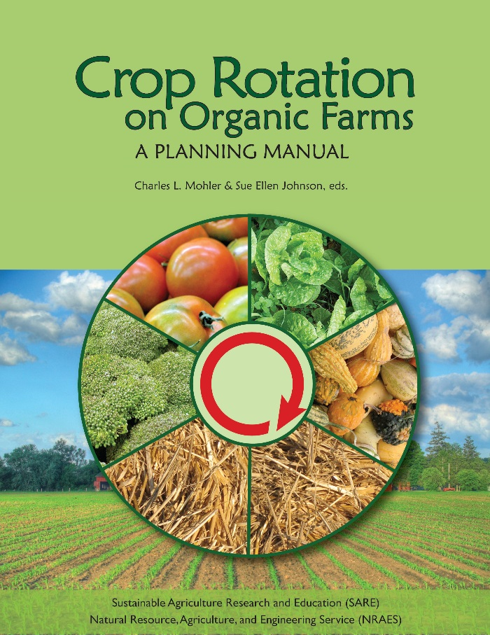
SARE Publications
Crop Rotation on Organic Farms
Transitioning to Organic Production
Growing Cover Crops Profitably
Steel in the Field
Organic Production Topic Room
Many others!
SARE Educational Resources
Notes:
Narration: The Sustainable Agriculture Research and Education organization has several great publications for organic such as Crop Rotation on Organic Farms, Transitioning to Organic Production, Growing Cover Crops Profitably, and Steel in the Field. All publications are free for download, and hard copies are available for a fee.

Slide 22
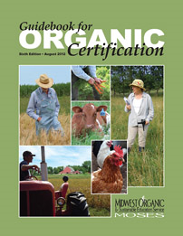
MOSES – Guidebook for Organic Certification
Provides an overview of the certification process for crop and livestock producers
MOSES has many publications, factsheets and other resources available
MOSES Guidebook for Certification
Notes:
Narration: The Midwest Organic Sustainable Education Service has their Guidebook for Organic Certification that would be particularly helpful if you are considering transitioning. This 32-page book covers everything from why this is a good time to be a certified organic farmer to what the rules are for specific types of production. MOSES has many other publications, factsheets and books available.

Slide 23
Resources for Transitioning
NOP Program
Mentoring and Training
Conferences and Field Days
Regional Publications
Funding Programs
Other
Notes:
Narration: There are government-sponsored funding programs that may be very important to investigate before you make the decision to transition to organic production.
Image: Craig Sheaffer, University of Minnesota

Slide 24
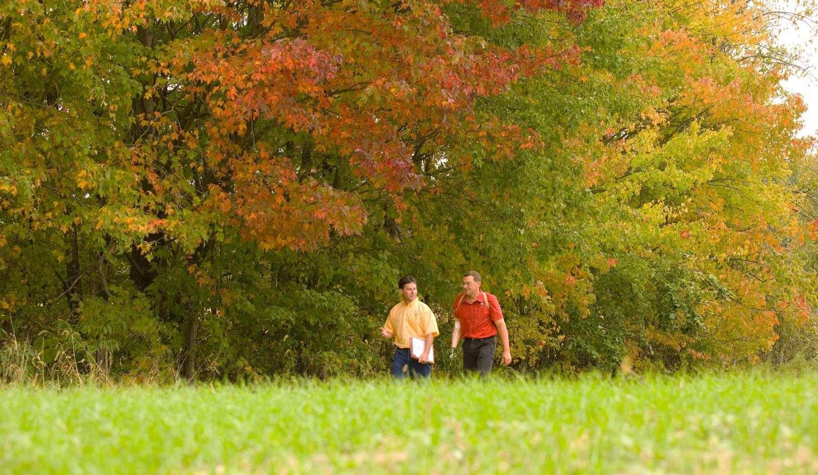
Government Programs
The Natural Resources Conservation Service (NRCS), the Farm Service Agency (FSA), and state departments of agriculture provide assistance to all farmers
Notes:
Narration: The NRCS, the FSA, and state departments of agriculture provide assistance to all farmers, whether conventional, organic or transitioning. As a farmer, you likely already have experience working with some of these programs.
Image: Scott Bauer, USDA-NRCS

Slide 25
Organic Conservation Practices
Organic agriculture has many practices that protect the environment
New conservation practices may qualify for cost share funding
Notes:
Narration: As we discussed in our “What Is Organic?” module, organic farming includes practices that can benefit the environment. These include techniques such as building healthy soils, conserving biodiversity, incorporating protective buffers, adding pollinator habitat, or including cover crops and perennials in rotations. If you are incorporating new conservation practices as part of your transition to organic, you may qualify for cost share funding.
Image: Kristine Moncada, University of Minnesota

Slide 26
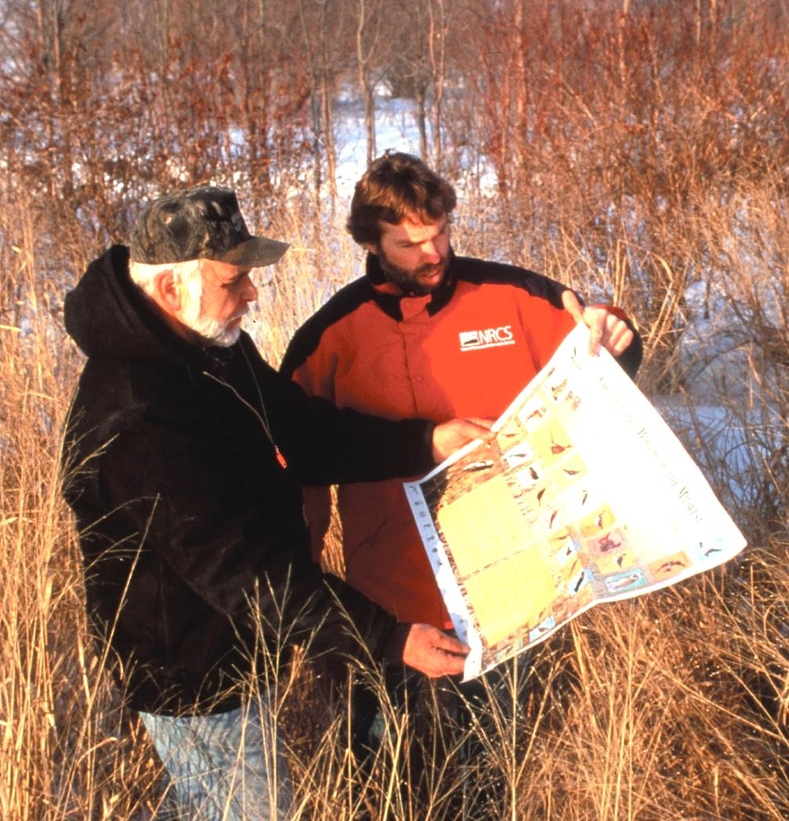
EQIP Organic Initiative (OI)
Financial and technical assistance for certain conservation practices:
Preserving habitat, soil, water, and air quality
Energy conservation
Diversification of your crop rotation
Cover cropping
Pest management
Transition to organic planning
Also regular EQIP
EQIP Organic Initiative
Notes:
Narration: The EQIP program has a special section for just certified organic and transitioning farmers. Financial and technical assistance is provided for certain conservation practices such as the ones we have listed here. Organic and transitioning farmers also are eligible for the regular EQIP program.
Image: Lynn Betts, USDA-NRCS

Slide 27
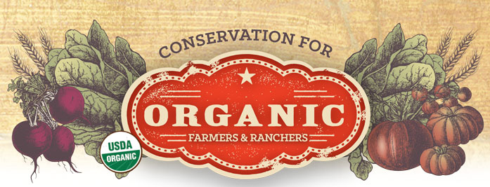
EQIP Organic Initiative (OI)
Funding is for new practices
Some practices get higher payments
Funding is approximately 75% of cost of practice
Maximum funding is $20,000 per year and $80,000 total over the 6 years of the Farm Bill
Notes:
Narration: The funding for the Organic Initiative is for new practices so definitely contact the NRCS during transition if you are beginning to implement organic conservation practices. Some practices within this program have higher payments than the standard EQIP payment due to higher costs of organic seed for organic farmers. Your local NRCS personnel should have advice for you on which program within EQIP may be more applicable to your situation. The more conservation practices you achieve, the higher the ranking and the greater chance of getting your application approved. Currently, maximum funding is $20,000 per year and $80,000 total over a period of the 6 years of the Farm Bill.

Slide 28
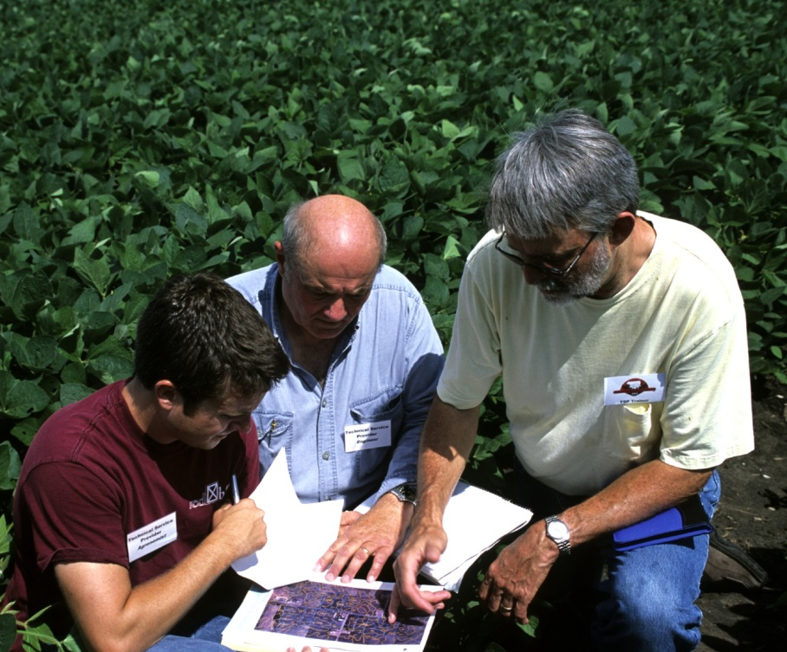
Conservation Activity Plan (CAP 138)
Funds to develop a CAP
For transitioning farmers or organic farmers adding new land
A TSP helps you develop your CAP
The CAP can be used as part of your OSP
Conservation Activity Plan 138
Notes:
Narration: CAP 138 is a program within EQIP. This is a competitive program where you can get money to develop a Conservation Activity Plan for your transition to organic. This program is for transitioning farmers, and certified ones that are adding new land in transition. The Technical Service Provider or TSP helps you develop your CAP that can be part of your Organic System Plan, a necessary component for certification. NRCS personnel cannot write CAPs, but they can help with the development. This program provides compensation for your TSP costs, which can be in the range of $2,000.
Image: Lynn Betts, USDA-NRCS

Slide 29
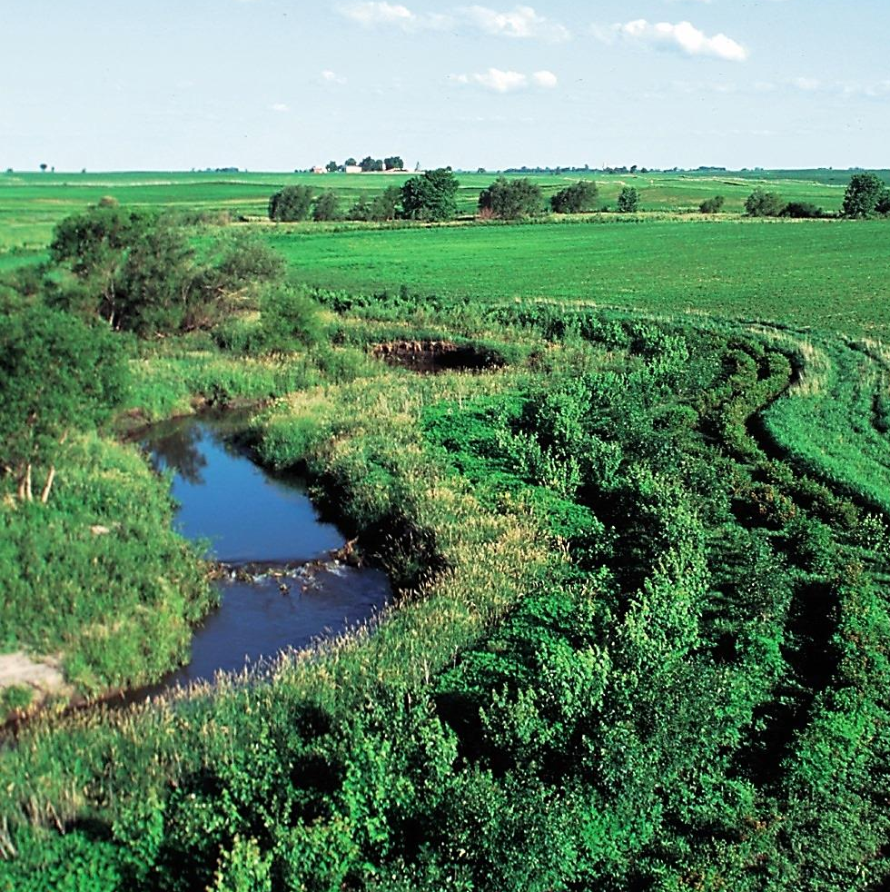
Conservation Stewardship Program (CSP)
Open to all producers
Helps farmers
Keep and improve their current conservation
Implement more conservation activities
Participants receive an annual land use payment
Maximum funding is $40,000 per year or $200,000 over 5 years
Conservation Stewardship Program
Notes:
Narration: You are probably already familiar with the Conservation Stewardship Program, which is available to all farmers, including organic and transitioning. It helps farmers keep and improve their current conservation systems and also to implement more conservation activities. Currently producers can receive an annual payment of up to $40,000 and the maximum funding is $200,000 over 5 years.
Image: Lynn Betts, USDA-NRCS

Slide 30
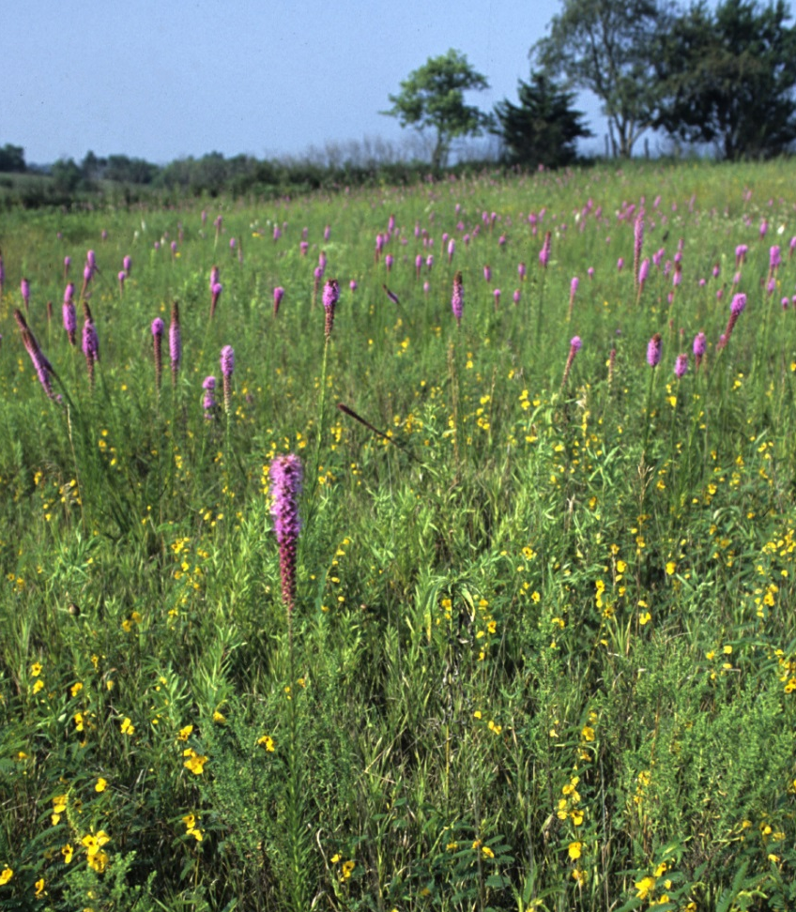
Conservation Reserve Program (CRP)
Provides rental payments for farmers removing environmentally sensitive land from farming
Includes new initiative of conservation payments for organic field buffers
Buffers must be:
Long-term = 10 – 15 years
Composed of resource-conserving plant species, such as approved grasses or trees
Conservation Reserve Program
Notes:
Narration: The Conservation Reserve Program is a competitive program to provide rental payments to farmers who discontinue cropping on environmentally sensitive land and plant species that protect the land. The CRP includes an initiative that provides payments for organic buffers. The buffers must be long-term such as for 10-15 years and be composed of approved plant species.
Image: Lynn Betts, USDA-NRCS

Slide 31
CRP – Transition Incentives Program (TIP)
Pays landowners with expiring CRP contracts to rent land to beginning farmers
Beginning farmers must use sustainable practices such as organic
Could mean a low rental payment for the beginning farmers
Transition Incentives Program
Notes:
Narration: Also with the Conservation Reserve Program is the Transitions Incentives Program. The TIP program pays landowners who have expiring CRP contracts to rent that land to a beginning farmer using “sustainable” practices such as organic. This allows new farmers to have a low-to-no land rental payment for a few years, since the land owner is receiving these CRP TIP funds.

Slide 32
Minnesota Transition to Organic Cost Share Program
For transitioning producers in Minnesota
Funded through the Minnesota Department of Agriculture
Reimburses for some of the certifier costs during transitioning (up to $750/year)
MDA Organic Cost Share Program
Notes:
Narration: There are two states in our region that offer cost share programs specifically for farmers who are transitioning to organic. The Minnesota Department of Agriculture provides a cost share to pay for certification agencies during transition, up to $750 per year. We’ve mentioned before that you are not required to have a certifier during transition, but we will discuss why you might want to anyway in a bit. Costs that are covered include: certifier’s charges, soil tests, and registration fees for regional organic conferences. You can apply for each of the 3 years of transition.

Slide 33
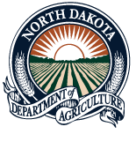
North Dakota Organic Education and Transition Cost Share Program
For transitioning producers in North Dakota
Funded through the North Dakota Department of Agriculture
Reimburses up to $750/year
ND Education and Transition Cost Share
Notes:
Narration: The North Dakota Department of Agriculture has a program very similar to Minnesota’s. Besides MN and ND, other states don’t have similar programs at this time.

Slide 34
Why Work with a Certifier during Transition?
It is recommended to have contact with a certifying agency during this period
They know the rules and you can prevent from accidentally doing or using something that will set you back
Notes:
Narration: The 3 years of transition is a long time to be working on your own. You are not required to work with a certifier in transition, but the MDA and North Dakota programs are based on the belief that doing so is beneficial (and we agree). Some mistakes in transition can set you back a substantial period of time and money. Working with a certifier and having an organic inspector visit your farm each year in transition can help you improve your organic production system. Once you are growing certified organic crops, you will be more comfortable with your system, which can result in better yields.
Image: David L. Hansen, University of Minnesota

Slide 35
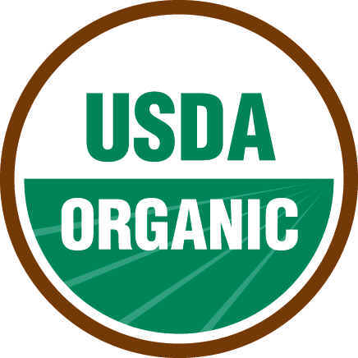
Organic Cost Share Program (After Certification)
Similar to program for cost sharing during transition
This program is available in all states
USDA-Farm Service Agency funding
Up to 75% of certification cost
Maximum of $750/year
Organic Cost Share Program
Notes:
Narration: For most of this module, we have been discussing resources that can help during transition. But we should also mention that once you become certified, you are eligible for organic cost share regardless of location. The Organic Cost Share Program is funded from the USDA Farm Service Agency and is available in all states. The program provides up to 75% of certification-related costs for a maximum of $750.

Slide 36
Resources for Transitioning
NOP Program
Mentoring and Training
Conferences and Field Days
Regional Publications
Funding Programs
Other
Notes:
Narration: Well, we still have a few more resources yet to cover!
Image: Craig Sheaffer, University of Minnesota

Slide 37
Email Lists
Sign up for these mailing lists to learn about events and news of interest to organic and sustainable producers
MISA Sustag
MOSES Organic Broadcaster
OGRAIN
eOrganic
USDA Organic Insider
Practical Farmers of Iowa
SFA Newsletter
Land Stewardship Project
Northern Plains Sustainable Ag
Minnesota Department of Agriculture Organic Network
Notes:
Narration: There’s a ton of information out there and maybe the process of keeping track of everything makes you feel overwhelmed. One way to make things easier is to sign up for email lists from organic and sustainable ag organizations. That way you will receive email newsletters and other materials with organic events and news of interest. We list some of your options here.

Slide 38
Resources for Questions
Ask MISA! – Minnesota Institute for Sustainable Agriculture
Ask an Organic Specialist – Midwest Organic & Sustainable Education Service (MOSES)
Farm Information Line – University of Minnesota Extension
Ask an Expert – MN Department of Agriculture
Ask an Expert: Organic Production – eOrganic
Ask a Sustainable Agriculture Expert – The National Sustainable Agriculture Information Service (ATTRA)
Notes:
Narration: So what if you need help on something relating to organic farming and want to talk to a person? Here are a list of resources with personnel available who should be able to answer your questions.

Slide 39
Checklist
We have included a checklist of websites listed in this modules
Click on paperclip symbol on bottom right-hand side
Notes:
Narration: We’ve referred to many different websites in this module. For your convenience, we have created a pdf of all the links we have discussed. Please click on the paperclip symbol on the bottom right-hand side of this module to access the document. Or just go back to our website for our resources listings.

Slide 40
Summary
Take advantage of available resources
Investigate all opportunities
Government programs can change so make sure you up-to-date information before committing to a practice for which you hope to be compensated
Notes:
Narration: Here are some final thoughts on the resources available to you as you transition to organic production. Take advantage of programs that apply to you and be sure to do so in a timely fashion. Some programs are only applicable for specific times in either your transition or once you become organic. The resources we have showcased in this module are by no means the only ones available. We have highlighted just a few of the programs out there. Make sure to investigate on your own for other opportunities. Attending conferences, talking with other farmers, meeting with NRCS and FSA professionals are all great ways to learn about programs available to you during transition or as an organic farmer. Lastly, you probably are aware that government programs change often, sometimes on a yearly basis, so make sure that programs you are interested in are still around when you want to make a move. The support you get from programs such as these may be critical to your success!

Slide 41
Resources for Transitioning
NOP Program
Mentoring and Training
Conferences and Field Days
Regional Publications
Funding Programs
Other
Notes:
Narration: Thank you for watching our module on resources for transitioning farmers. We hope you find opportunities that help you on your journey to becoming organic.
Image: Craig Sheaffer, University of Minnesota

Slide 42
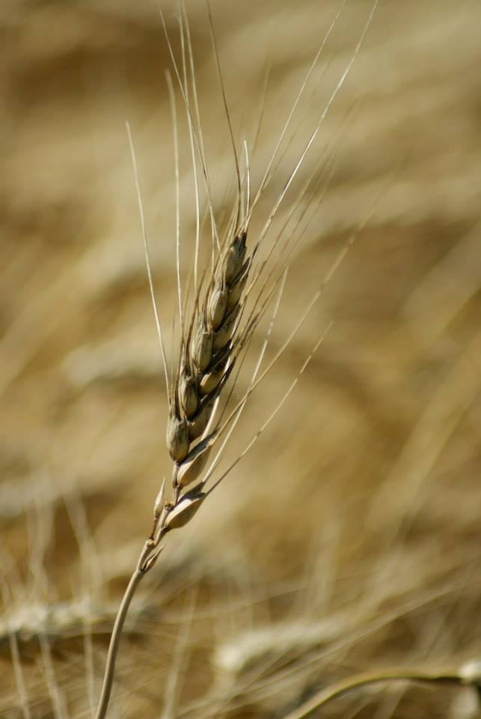
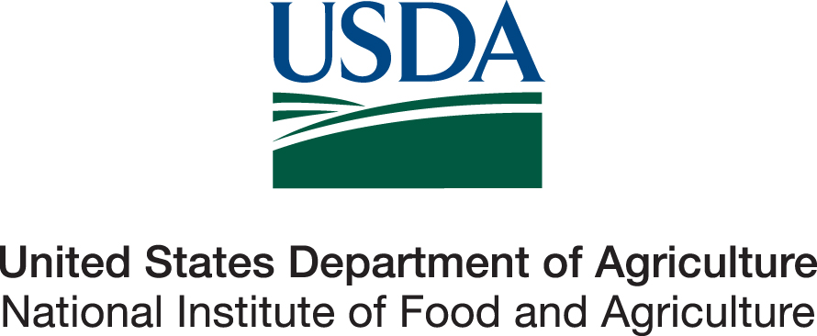
© 2017 Regents of the University of Minnesota. All rights reserved. The University of Minnesota is an equal opportunity educator and employer.
This material is based upon work that is supported by the National Institute of Food and Agriculture, U.S. Department of Agriculture, under grant number 2013-51106-21005.
Notes:
Narration: This material is based upon work that is supported by the National Institute of Food and Agriculture.
Image: Constance Carlson, University of Minnesota

