Slide 1
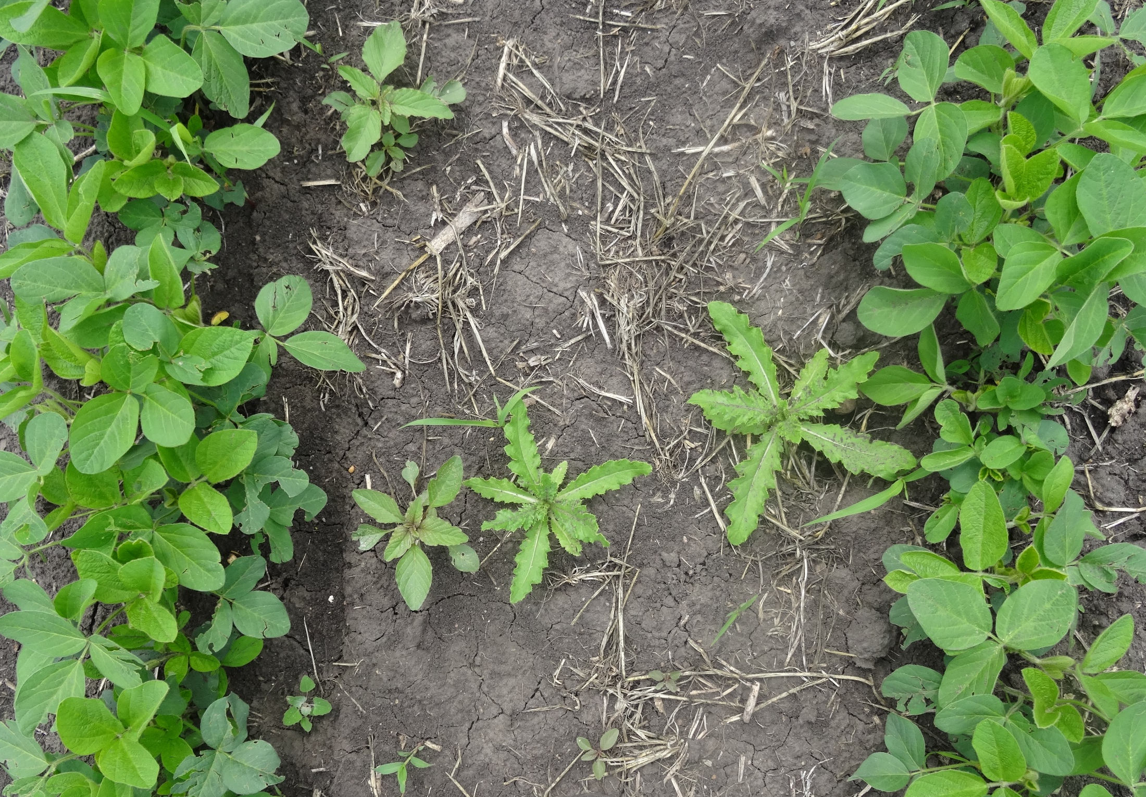
Weed Biology
This material is based upon work that is supported by the National Institute of Food and Agriculture, U.S. Department of Agriculture, under grant number 2013-51106-21005.
Authors
Kristine Moncada
Jeff Gunsolus
Constance Carlson
Craig Sheaffer
Notes:
Narration: Welcome to our Weed Biology module.
Image: Kristine Moncada, University of Minnesota

Slide 2
Weed Biology
Weed Effects on Crops
Weed Life Cycles
Weed Reproduction
Weed Emergence
Notes:
Narration: In this module, we will cover several aspects of weed biology. You may wonder why this is important to understand, but their biology can guide us in choosing the best tools to manage them.
Image: Brad Kinkaid, University of Minnesota

Slide 3
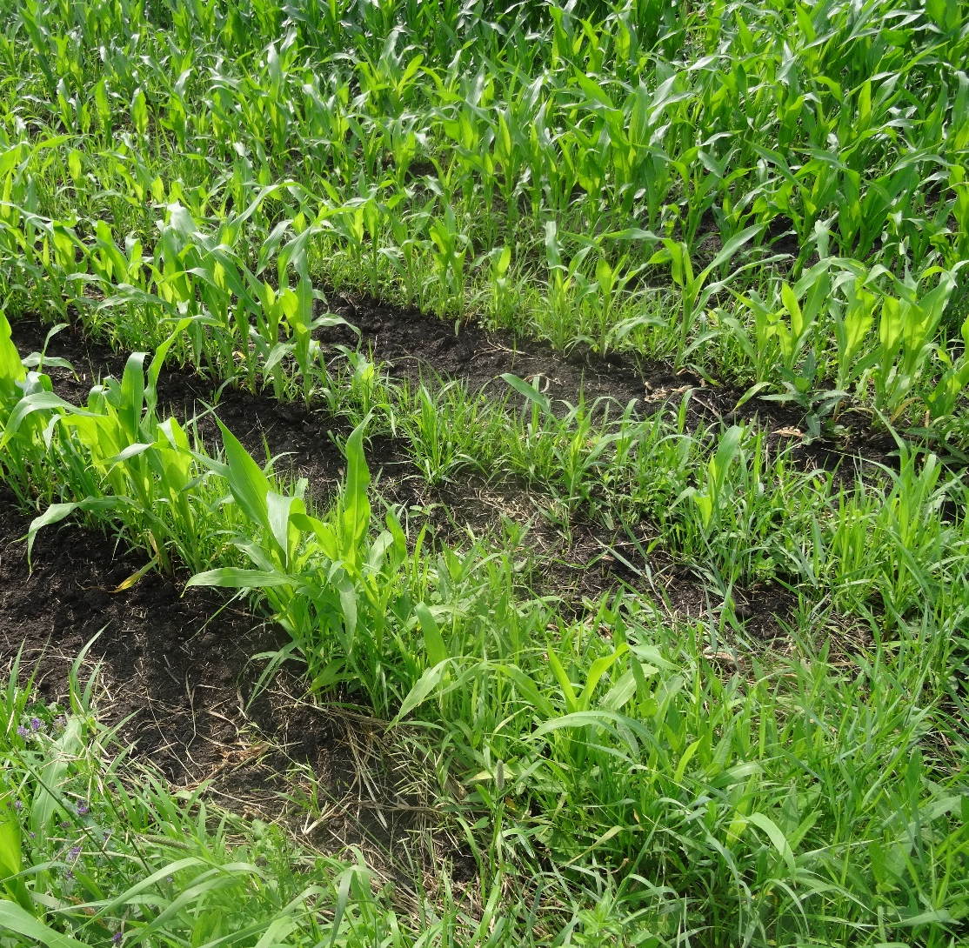
Weeds Reduce Yields
Compete with crops
Nutrients
Light
Moisture
Notes:
Narration: Most organic farmers say that weeds are one of their significant challenges. Because weeds compete with crops for nutrients, light and moisture, they have negative effects on crop yield. Image: Kristine Moncada, University of Minnesota

Slide 4
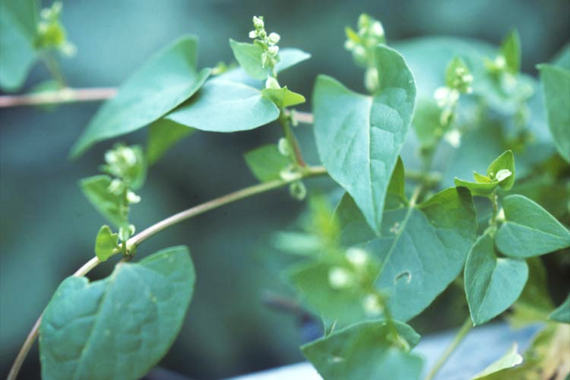
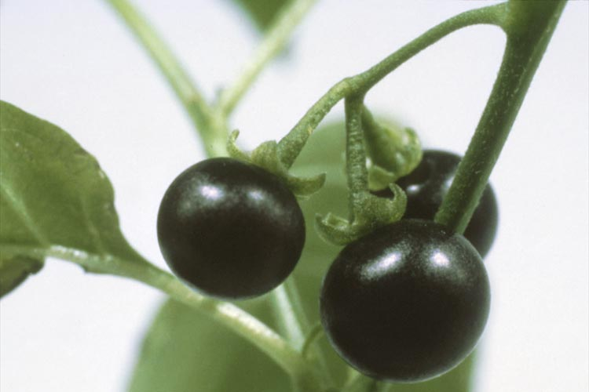
Other Negative Effects
Interfere with harvest
Reduce crop quality
Bindweed (or False Buckwheat)
Nightshade berries
Notes:
Narration: Weed effects can go beyond yield reduction to interfering with harvest such as bindweed vines that can get wrapped up in equipment or by reducing quality such as nightshade berries that stain soybeans.
Images: Strand Memorial Herbarium, University of Minnesota (bindweed and nightshade)

Slide 5
Weed Effects on Yield
Crop | Weed species | % yield loss –
 |  | 1 weed per ft²
Corn | Wild buckwheat | 10
Corn | Wild mustard | 18
Corn | Common ragweed | 21
Soybean | Green foxtail | 8
Soybean | Lambsquarters | 25
Soybean | Eastern black nightshade | 40
Source: Moncada & Huerd, 2010
Notes:
Narration: Even small populations of weeds can affect yield. Therefore, in most cases, weed control is necessary. This table shows the percentage of yield loss that might be expected due to one weed per square foot of different weed species. As you can see, when there is one especially competitive weed plant per square foot in a corn or soybean field, there can be significant yield losses.

Slide 6
Weed Biology
Weed Effects on Crops
Weed Life Cycles
Weed Reproduction
Weed Emergence
Notes:
Narration: In this section, we will cover the different life cycles of weeds.
Image: Brad Kinkaid, University of Minnesota

Slide 7
Weed Life Cycles
Seed
Reproduction
Death
Vegetative Growth
Annual:
1 Year
All in one year
Seed
Reproduction
Death
Vegetative Growth
Biennial:
2 Years
Year 1
Year 2
Seed
Reproduction
Dormancy
Vegetative Growth
Perennial:
> 2 years
Does not die after setting seed
Notes:
Narration: Weeds, just like every plant, can be categorized by their life cycle. An annual grows from seed, grows vegetatively, sets seed, and dies in one year. A biennial is similar, but the process occurs over two years. A perennial can live for many years. In temperate climates such as ours, a perennial will go dormant in the winter and come back to grow again the next spring.

Slide 8
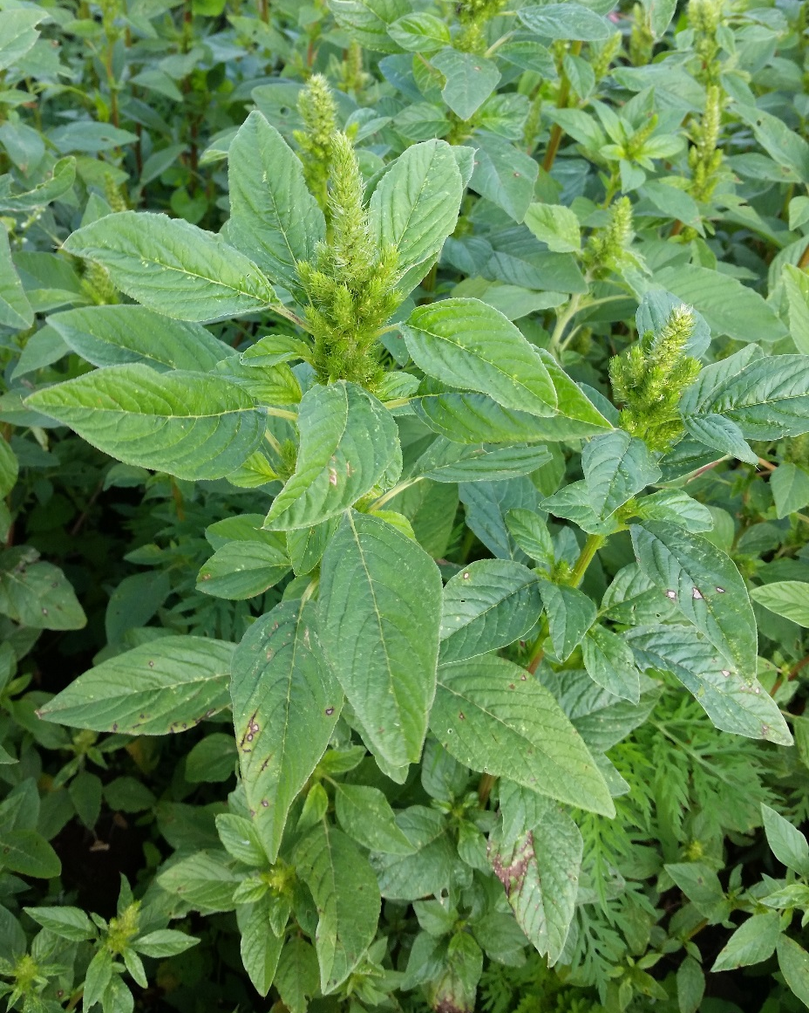
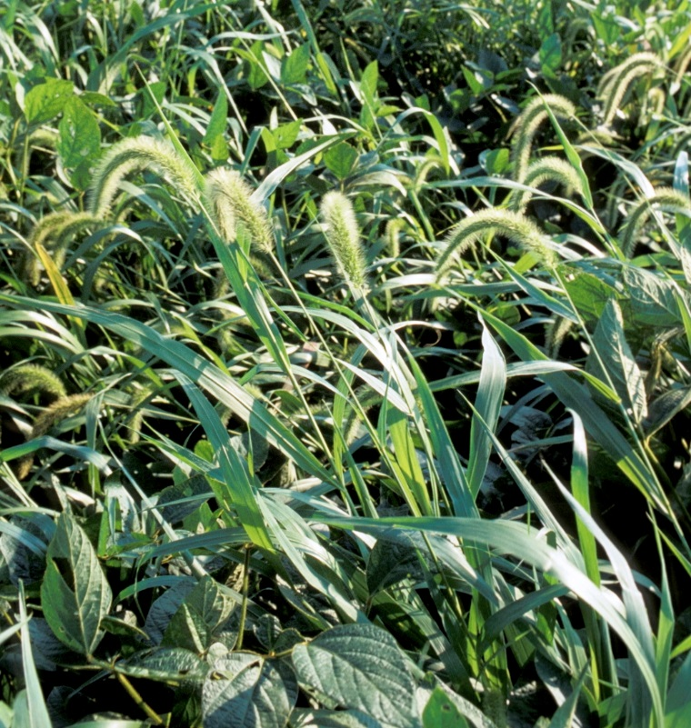
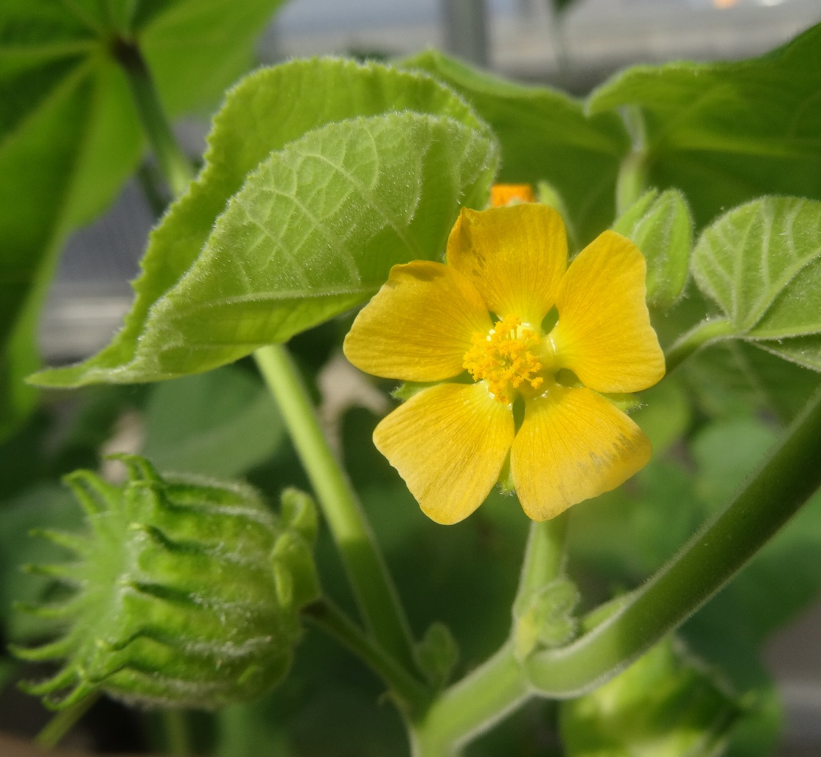
Annual Weeds
Completes its life cycle in one year
Most crops are annuals
Produce many seeds
Examples are velvetleaf, pigweeds, waterhemp, lambsquarters, and foxtails
Foxtail
Velvetleaf
Waterhemp
Notes:
Narration: An annual completes its life cycle (germination, vegetative growth, flowering, seed set, and death) in one year. Annual weeds are very successful in most cropping systems. Because most crops are also annuals, annual weeds easily adapt to these cropping systems. Annual weeds produce large amounts of seed to grow the following year. Examples that most field crop farmers would be familiar with are velvetleaf, pigweeds, waterhemp, lambsquarters, and foxtails.
Image: Waterhemp - Brad Kinkaid, University of Minnesota; Velvetleaf - Kristine Moncada, University of Minnesota; Foxtail - David L. Hansen, University of Minnesota

Slide 9
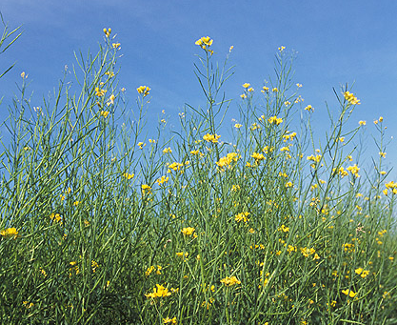
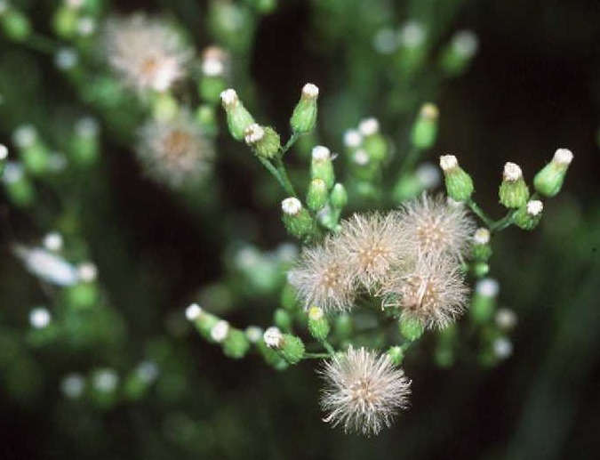
Winter Annuals
Germinates in fall and sets seeds in the spring
Common in no-till and in winter wheat and winter barley
Examples are horsetails and wild mustard
Horsetail (or marestail or horseweed)
Mustard
Notes:
Narration: Another type of life cycle that falls under the “annual” category is winter annual. Generally, annuals complete their life cycles in one season; in other words, they germinate in the spring and set seed and die by the fall. A winter annual is similar but it germinates in the fall and sets seed and dies in the spring. Winter annuals can be common in no-till and in winter annual crops such as winter wheat and winter barley. Examples are horsetails and wild mustard.
Images: Robert H. Mohlenbrock, hosted by the USDA-NRCS PLANTS Database / USDA SCS. 1991. Southern wetland flora: Field office guide to plant species. South National Technical Center, Fort Worth (horsetail); Peggy Greb, USDA-ARS (mustard)

Slide 10
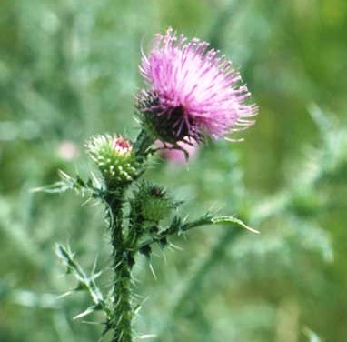
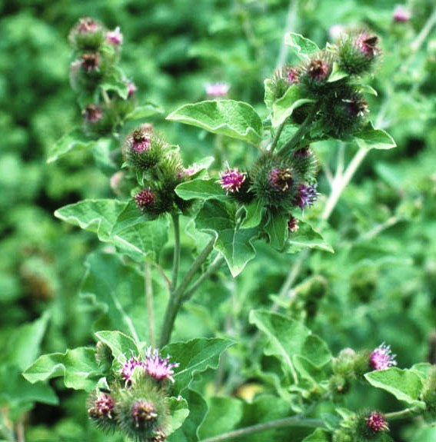
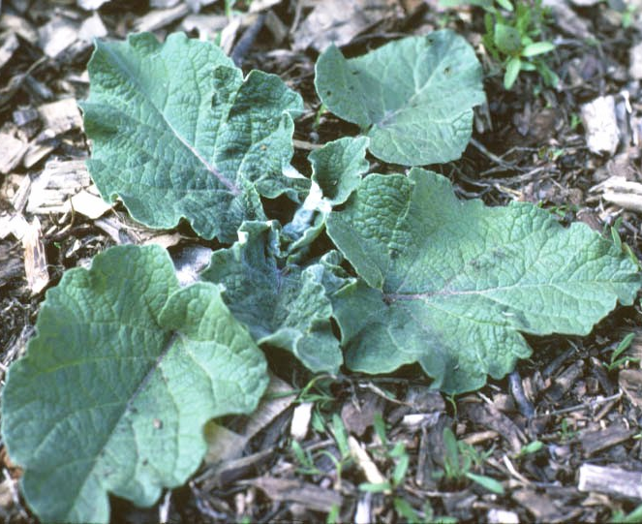
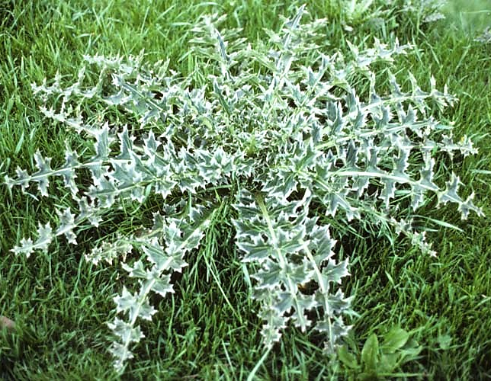
Biennial Weeds
Completes life cycle over two growing seasons
1st year as rosette, 2nd year flowering
Examples are musk thistle and common mullein
Burdock - Flowers
Musk thistle - rosette
Burdock - rosette
Musk thistle - flowers
Notes:
Narration: Biennial weeds take two years to complete their life cycle. The first year’s growth is vegetative with the plant producing a rosette. In the second year, the plant produces flowers and sets seed. It dies by the end of the second year. Examples are musk thistle and mullein. Biennial weeds tend not to be very significant in field crop systems, but are more common in pastures.
Images: Musk thistle rosette - Strand Memorial Herbarium; Common burdock x2 - Strand Memorial Herbarium; Plumeless thistle flower - Strand Memorial Herbarium

Slide 11
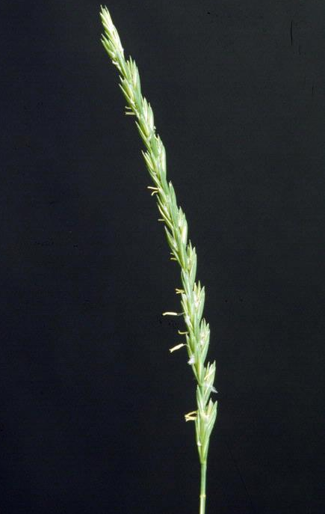
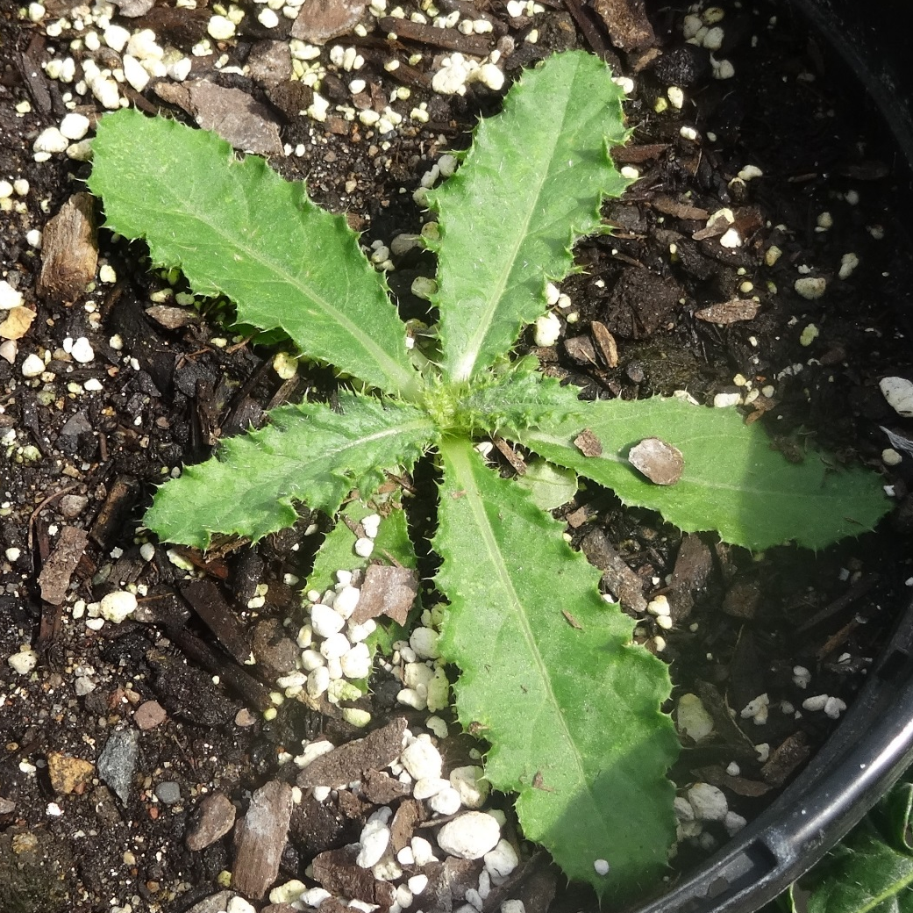
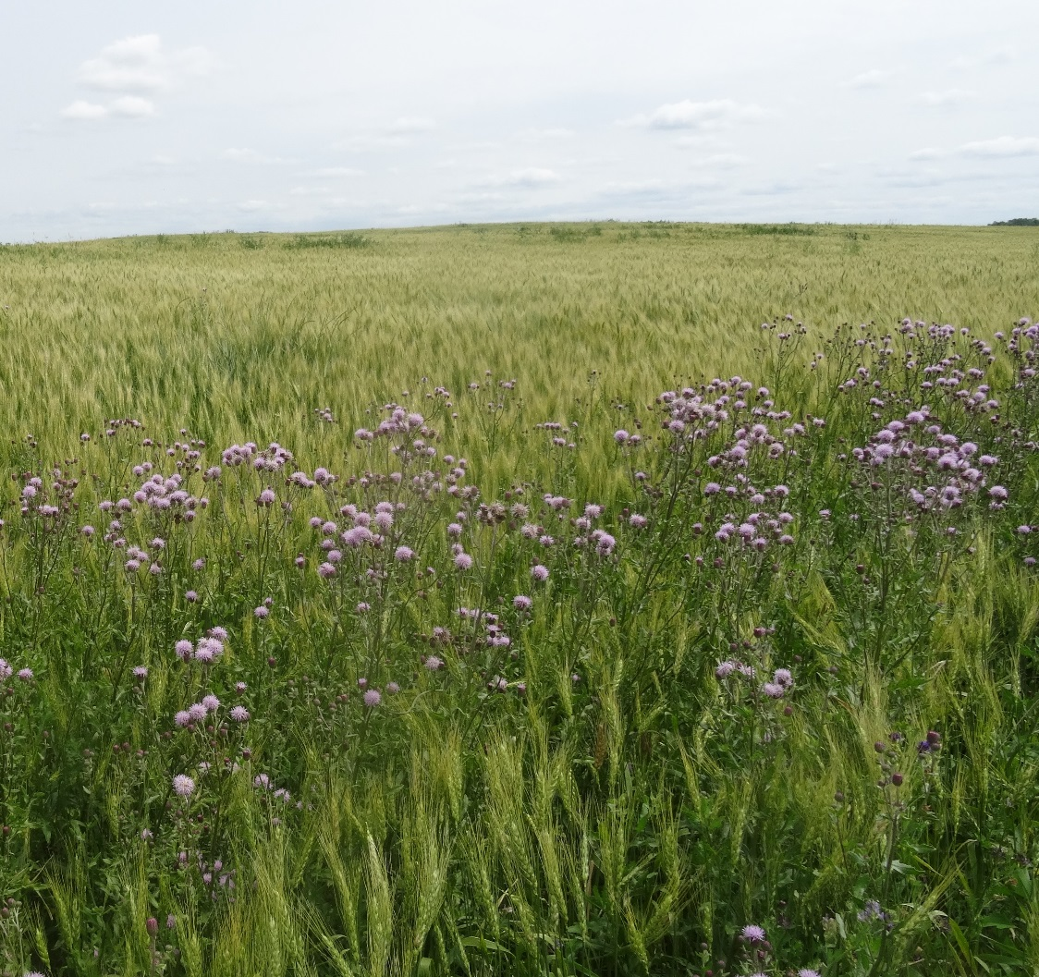
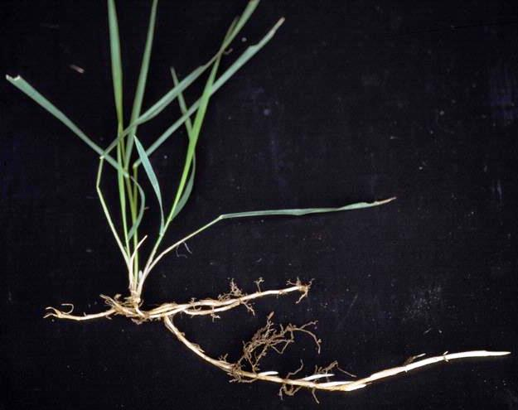
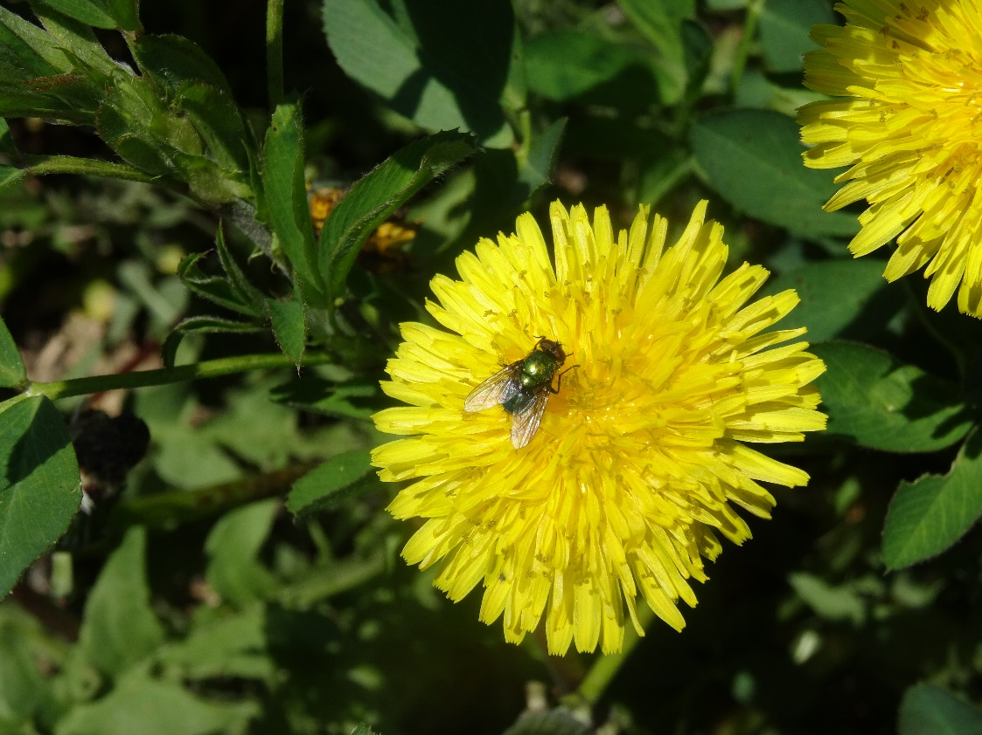
Perennial Weeds
Canada thistle in winter wheat
Can live for years
Spread not just by seed, but vegetatively through rhizomes and other specialized structures
Examples: Canada thistle, quackgrass, dandelion
Quackgrass
Dandelion
Rhizomes
Canada thistle
Quackgrass
Notes:
Narration: A perennial lives longer than two years. A perennial is different from annuals or biennials in that it can replicate itself not just through seeds, but also vegetatively through specialized structures. Canada thistle, quackgrass and dandelion are examples that can be particularly troublesome in perennial crops such as alfalfa.
Images: Canada thistle (2) - Kristine Moncada, University of Minnesota; Quackgrass (2) - Ohio State Weed Lab, The Ohio State University, Bugwood.org (https://www.weedimages.org/browse/detail.cfm?imgnum=1559010); Dandelion – Kristine Moncada, University of Minnesota

Slide 12
Weed Biology
Weed Effects on Crops
Weed Life Cycles
Weed Reproduction
Weed Emergence
Notes:
Narration: In our next section, we will discuss the ways weeds can produce offspring. There can be more than one way, depending on the species.
Image: Brad Kinkaid, University of Minnesota

Slide 13
Weed Seed Production
Weed species | Seeds/plant
Redroot pigweed | 117,400
Lambsquarters | 72,500
Giant ragweed | 10,300
Velvetleaf | 7,800
Yellow foxtail | 6,500
Source: Renner, 2000
Notes:
Narration: One of the reasons that weeds are successfully competitive is that most of them produce a lot of seed, as shown on this table. A single redroot pigweed plant can produce over 100,000 seeds! But even yellow foxtail, with 6500 seeds per plant, is impressively productive.

Slide 14
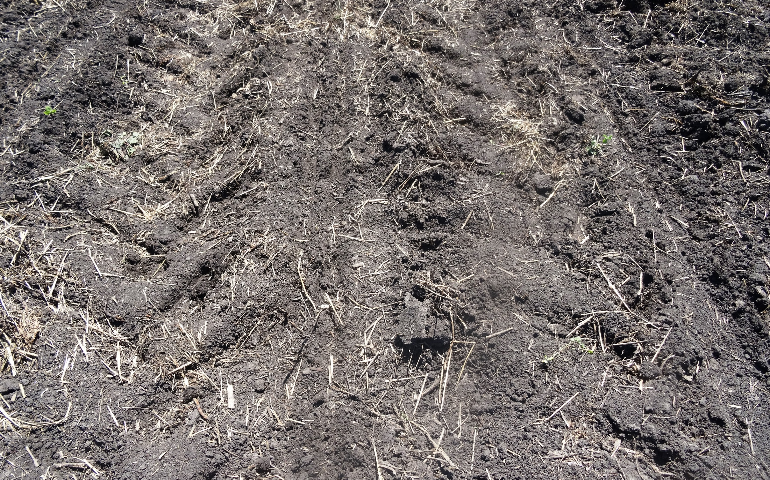
The weed seed bank is the viable weed seeds present in the soil
Cu
Notes:
Narration: Most of the seeds that weeds produce are retained in the soil, where they can build up to an incredible level. The weed seed bank is comprised of the viable weed seeds in the soil.
Image: Kristine Moncada, University of Minnesota

Slide 15
Number of viable weed seeds in soils in four agricultural fields in Minnesota. Adapted from Robinson, 1949.
Location | County | Seed/acre
Sacred Heart | Renville | 5,100,000
Danube | Renville | 8,000,000
Morris | Stevens | 25,500,000
Waseca | Waseca | 333,700,000
Corn planting rate = 34,000 seeds/acre
Notes:
Narration: As shown in this table, there are millions of weed seeds per acre in the seed bank. Compare that to 34,000 seeds/acre, which is a typical corn planting rate in the Upper Midwest.

Slide 16
Weed Seed Viability
Weed species | # of years
Quackgrass | 1-6
Wild oat | 4-7
Cocklebur | 16
Foxtail | 20
Canada thistle | 21
Lambsquarters | 40
Redroot pigweed | 40
Velvetleaf | 40
Seed remains until conditions are right for germination
One strategy to reduce the weed seed bank is by not allowing weeds to set seed
Source: Ross and Lembi, 1999
Notes:
Narration: Seeds in the weed seed bank can remain viable there for years, depending on the species, until the conditions are right for germination. As this table shows, some weeds can stay in the soil for up to 40 years if the conditions are right. One obvious weed management strategy is to not allow weeds to go to seed in the first place. We will discuss more strategies in our Weed Management modules.

Slide 17
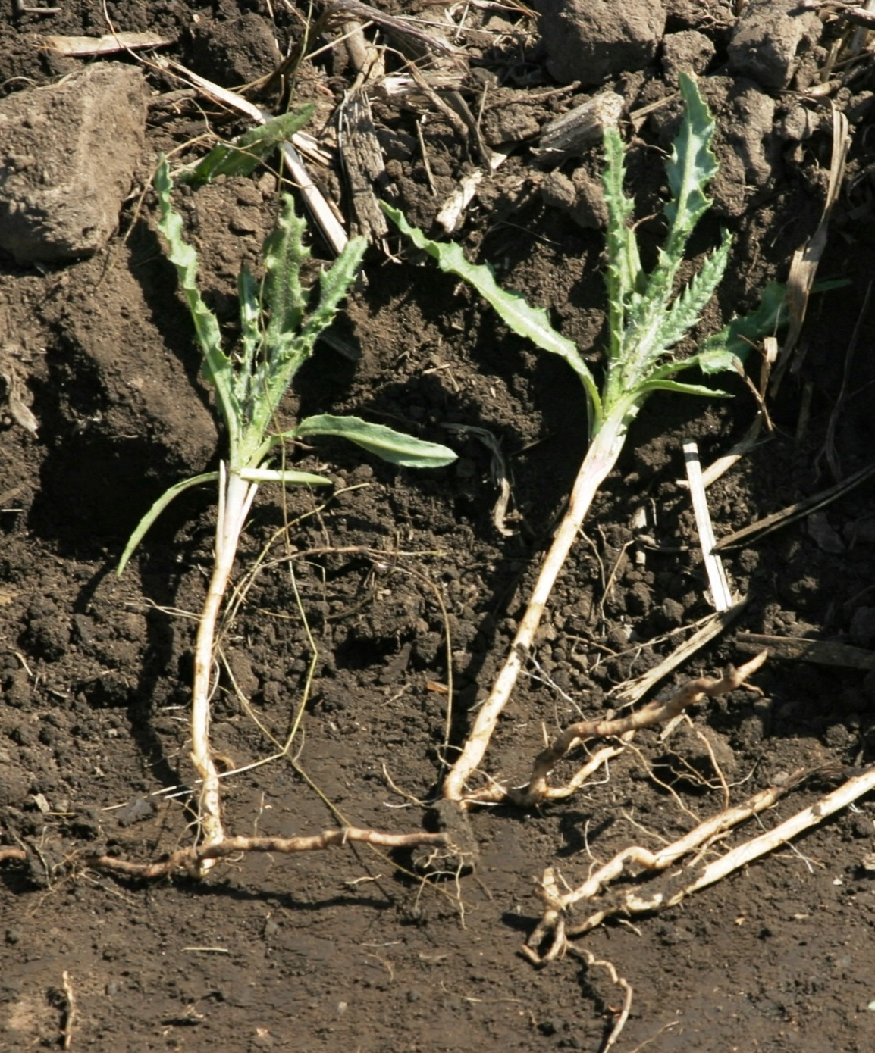
Rhizomes
Vegetative reproduction
Underground stem that produces roots and shoots
Can generate new plants
Prevent spread of rhizomes
Canada thistle rhizome
Notes:
Narration: As mentioned previously, perennials have other reproductive structures in addition to seeds. A significant structure for organic farming is the rhizome, which is a way that plants can reproduce vegetatively. Rhizomes are underground stems that are capable of generating roots and shoots. This means that a small piece of rhizome can generate an entirely new plant. One way to prevent the introduction of rhizomatous perennials is to be careful to not spread rhizomes from one field to another with your equipment.
Image: Brad Kinkaid, University of Minnesota

Slide 18
Weed Biology
Weed Effects on Crops
Weed Life Cycles
Weed Reproduction
Weed Emergence
Notes:
Narration: The last section in our module relates to when weeds emerge, which can vary considerably.
Image: Brad Kinkaid, University of Minnesota

Slide 19
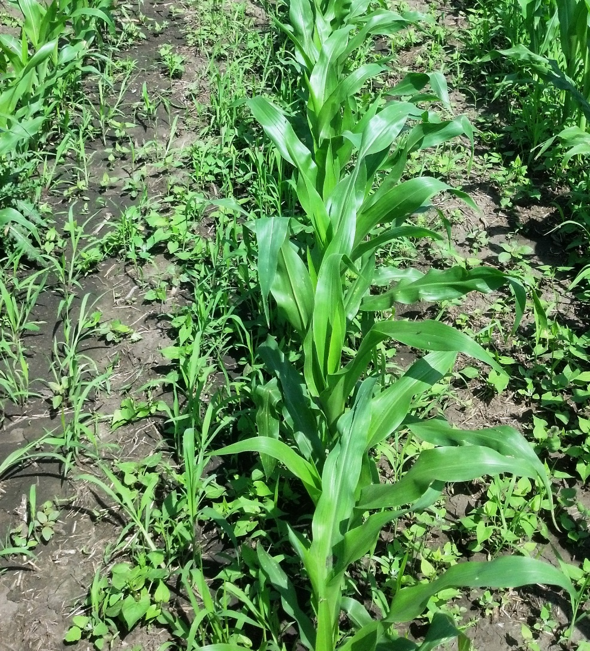
Weed Emergence – General
Depends on soil conditions
Temperature
Moisture
Field operations
Varies by weed species
Notes:
Narration: The time that weed seed germinates in your field is an important factor for management. In a general sense, weed emergence depends on soil conditions such as soil temperature and soil moisture. Other management factors such as tillage can stimulate weed emergence. So emergence can vary from field by field because conditions vary. Additionally, weed emergence varies significantly by weed species.
Image: Carmen Fernholz

Slide 20
Time of Emergence – Species
April |  | May |  | June
Early to Mid | Mid to Late | Early to Mid | Mid to Late | Early to Mid | Mid to Late
Wild Mustard | Lambs- quarters | Common Ragweed | Foxtails | Black nightshade | Crabgrass
Kochia | Giant Ragweed | Wooly cupgrass | Redroot pigweed | Water-hemp | Jimson- weed
 |  | Velvetleaf | Cocklebur
Notes:
Narration: However, there are general trends in times of weed emergence. By learning these, you can gather information to guide your weed management strategy. In this chart we show some common times of emergence for weeds in Minnesota. For example, wild mustard generally emerges in April, velvetleaf in May, and waterhemp in June. Targeting mechanical weed control operations to when problem weeds emerge is critical in their management.

Slide 21
Duration of Emergence
Some weeds have a short window of emergence, others emerge over a longer time span
Velvetleaf
Giant Foxtail
Waterhemp
Notes:
Narration: Not only do weeds start emerging at different times, the length of time they emerge varies by species. For instance, giant ragweed tends to complete its emergence over a shorter period than giant foxtail. In the case of weeds that have a long emergence time, mechanical weed control operations will likely need to be repeated.

Slide 22
Resources
Risk Management for Organic Producers – Weed Biology
Risk Management for Organic Producers – Weed Profiles
University of Minnesota Extension – Weed Indentification
Common Weed Seedlings of the North Central States
Notes:
Narration: Here are some resources we recommend to explore weed biology further.

Slide 23
Weed Biology
Weed Effects on Crops
Weed Life Cycles
Weed Reproduction
Weed Emergence
Notes:
Narration: We have covered some of the basics of weed biology. Please view our modules on cultural and mechanical weed control to see how to apply these principles in practice.
Image: Brad Kinkaid, University of Minnesota

Slide 24
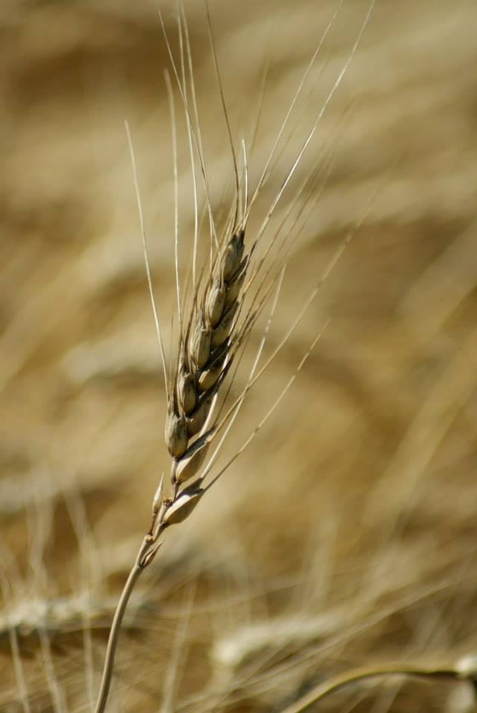
© 2017 Regents of the University of Minnesota. All rights reserved. The University of Minnesota is an equal opportunity educator and employer.
This material is based upon work that is supported by the National Institute of Food and Agriculture, U.S. Department of Agriculture, under grant number 2013-51106-21005.
Notes:
Narration: This material is based upon work that is supported by the National Institute of Food and Agriculture.
Image: Constance Carlson, University of Minnesota

Slide 25
References
Buhler, D.D., R.G.. Hartzler, F. Forcella, and J.L. Gunsolus. 1997. Relative emergence sequence for weeds of corn and soybean. Iowa State University, State Extension.
Buhler, D.D. and R.G. Hartzler. 2001. Emergence and persistence of seed of velevetleaf, waterhemp, woolly cupgrass, and giant foxtail. Weed Science 49: 230-235.
Huerd, S. and K. Moncada. 2010. Weed Biology. Chapter 5 in Risk Management for Organic Producers. Moncada, K. and C. Sheaffer, editors. University of Minnesota, St. Paul, MN.
Iowa State University – University Extension. 2000. Weed Emergence Sequences: Knowledge to guide scouting and control. IPM 64a. http://lib.dr.iastate.edu/extension_ag_pubs/214/
Michigan State University Extension. 2005. Integrated Weed Management: One year’s seeding. Michigan State University Extension Bulletin E-2931.
Renner, K.A. 2000. Weed pest ecology and management in Michigan Field Crop Pest Ecology and Management. Michigan State University Extension Bulletin E-2704, January 2000.
Robinson, R.G. 1949. Annual weeds, their viable seed populations in the soil and their effect on yields of oats, wheat, and flax. Agronomy Journal 41:513-518.
Ross, M.S. and C.A. Lembi. 1999. Applied Weed Science (2nd ed.). Upper Saddle River, NJ. Prentice-Hall

