Slide 1
Marketing
This material is based upon work that is supported by the National Institute of Food and Agriculture, U.S. Department of Agriculture, under grant number 2013-51106-21005.
Authors
Gigi DiGiacomo
Kristine Moncada
Constance Carlson
Craig Sheaffer
Notes:
Narration: Welcome to our module on marketing!
Image: Scott Bauer, USDA-ARS

Slide 2
Marketing
Sale and movement of a product from seller to buyer
Notes:
Narration: Marketing, simply, refers to the sale and movement of a product from seller to buyer.
Image: TeroVesalainen, Pixabay

Slide 3
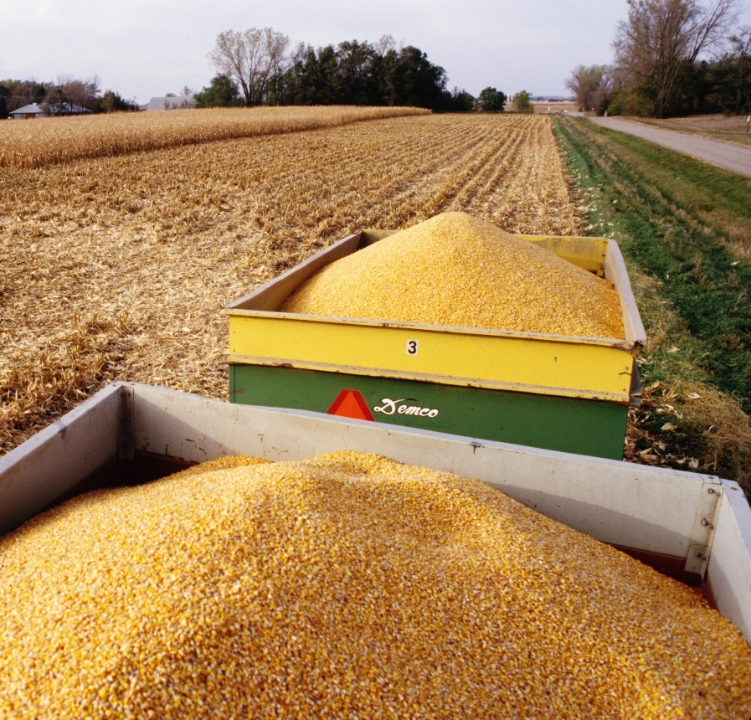
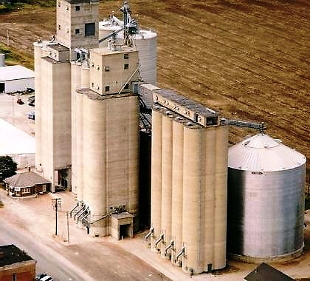
Commodity Marketing
Grains from farmer to local elevator
First point of sale
Notes:
Narration: In agriculture, commodity marketing typically refers to the cash sale and delivery of bulk grains and oilseeds from the farmer to his/her local elevator – or what we call the “first point of sale.”
Images: David L. Hansen, University of Minnesota (grain carts); USDA-ARS (grain elevator)

Slide 4
Marketing
Organic Markets
Organic Challenges
Marketing Organic Crops
Marketing Documentation
Marketing Plans and Tools
Notes:
Narration: A ready market exists for conventional corn and soybeans – anyone can sell into these markets at anytime. Organic markets, however, are specialized and present unique marketing challenges. We’ll discuss these first then describe what’s needed to market organic grains and oilseeds.
Images: David L. Hansen, University of Minnesota

Slide 5
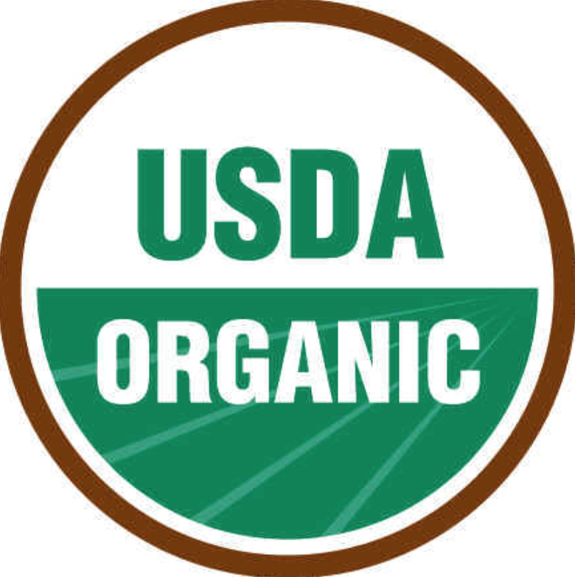
Organic Markets
Organic grains and oilseeds are considered identity preserved (IP) products.
IP products = specialty, high value, premium or niche grains and oilseeds
Notes:
Narration: Organic grains and oilseeds, while still sold in bulk like conventional crops, are referred to as “identity preserved” products. An IP product is differentiated from other bulk commodities by special attributes. In this case, organic crops are special or differentiated from conventional crops because they are grown with organic methods and have been certified as such by the USDA.

Slide 6
Price Premiums
Farmers who sell IP products usually receive a price premium and have some ability to set or negotiate prices.
Notes:
Narration: Farmers who sell IP crops usually receive a price premium above the price paid for conventional crops. Transitioning farmers in Minnesota who were surveyed for the Tools for Transition Project cited “price premiums” as one of their top motivations for going organic. Image: http://www.clipartof.com

Slide 7
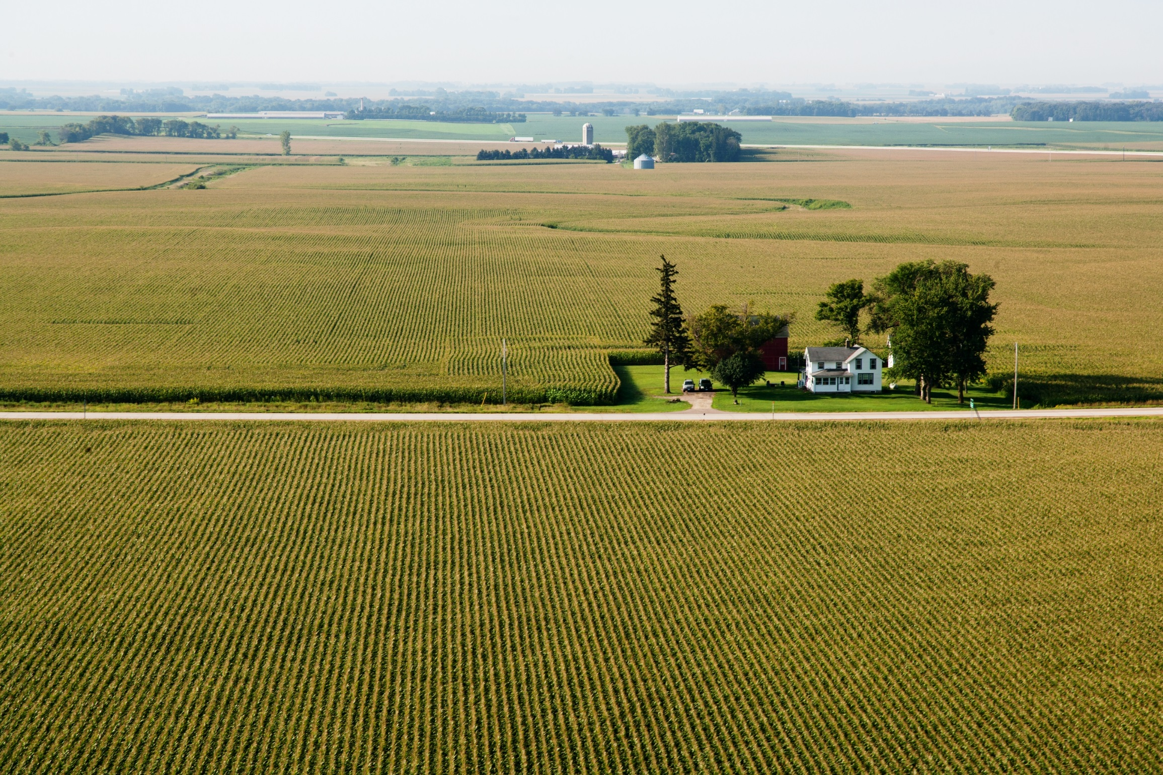
Organic Profitability
National survey (2005) of 320 farmers:
82.5% reported organic farming is more profitable than conventional farming.
Survey Source: Hikaru Hanawa Peterson et. al. “The Motivation for Organic Grain Farming in the United States: Profits, Lifestyle, or the Environment.” Journal of Agricultural and Applied Economics, 44,2(May 2012):137-155.
Notes:
Narration: The majority of farmers who participated in a national survey in 2005 said that organic farming was more profitable than conventional farming.
Image: David L. Hansen, University of Minnesota

Slide 8
Organic Corn Prices
Source: Center for Farm Financial Management’s FINBIN database, cffm.umn.edu/products/FINBIN.aspx
Notes:
Narration: Let’s take a look at organic price premiums for a couple of crops and discuss what this means in terms of profitability. We’ll begin with organic corn. During the past six marketing years, buyers have paid 2-3 times the conventional market price for certified organic corn. The price spread between conventional and organic corn prices ranged from $4.82 per bushel to $7.41 per bushel between 2011-2016.

Slide 9
Organic Soybean Prices
Source: Center for Farm Financial Management’s FINBIN database, cffm.umn.edu/products/FINBIN.aspx
Notes:
Narration: The same goes for organic soybeans where feed buyers paid approximately twice the conventional average price for organic soybeans. The price spread between conventional and organic soybeans was approximately $10-$14.50 per bushel between 2011 – 2016.

Slide 10
MN FARMS: CORN ENTERPRISE | 2011-2016
 | Conventional | Organic
Yield (bu/acre) | 165 | 107
Number of acres per farm | 395 | 80
Price ($/bu) | 4.51 | 10.94
Gross return per acre | $744 | $1,171
Direct & overhead expenses per acre | $670 | $639
Net return per acre | $74 | $532
Net return for corn enterprise | $29,262 | $42,553
Source: Center for Farm Financial Management’s FINBIN database, cffm.umn.edu/products/FINBIN.aspx
Notes:
Narration: Next, let’s look at how much impact organic premiums can have on a farmer’s bottom line financially. The example shown uses data from conventional and organic farms and represents average returns from corn enterprises during the 2011-2016 period. The first thing you’ll notice is that conventional farms average a much higher yield -165 bu/acre compared to 107 bu/acre for the organic farms - and that the conventional farms are, on average, much larger than the organic farms with 395 acres per farm versus 80 acres per farm. In the next row, you’ll see that the average price received by organic farms, $10.94 per bushel, is more than twice the price received by conventional growers, $4.51 per bushel. Thanks to the organic price premium, organic farms averaged a gross return per acre of $1,171. Gross return in this example is equal to price times yield. After subtracting expenses, organic corn farms earned approximately 45% more than conventional farms on less than one fourth the acreage.

Slide 11
Marketing
Organic Markets
Organic Challenges
Marketing Organic Crops
Marketing Documentation
Marketing Plans and Tools
Notes:
Narration: The profitability of organic also comes with challenges.
Images: David L. Hansen, University of Minnesota

Slide 12
Why Isn’t Everyone Farming Organically?
Challenges in production and marketing
Notes:
Narration: With price premiums on offer and the potential for improved profits, why aren’t more farmers going organic? Researchers and farmers cite a slew of production-related challenges that may be familiar to you – such as weed and pest management. However, there are also some genuine differences between conventional and organic markets that many farmers find intimidating or frustrating. Let’s take a look at how organic markets differ from conventional markets and why marketing organic grains and oilseeds can prevent some farmers from jumping into organics.
Image: www.clipartkid.com

Slide 13
Organic Marketing Challenges
Lack of liquidity
Limited infrastructure
Scarce marketing tools
Notes:
Narration: Organic markets differ from conventional markets in a number of ways. Most of these differences boil down to: lack of market liquidity, limited marketing infrastructure and scarce marketing tools. For anyone who is used to marketing conventional grain, these differences may come as a surprise.
Image: Sean McGuire, gratisography.com

Slide 14
Lack of Liquidity
Low trading volume for organic compared to conventional
Data: USDA NASS, 2016
Organic
Notes:
Narration: When it comes to organics, standard sales and procurement practices do not apply! Despite steady growth in organic markets, the overall size of the organic grain market remains small or what traders call “thin.” In other words, the overall market is small, fragmented and still evolving with few sellers and few buyers which translates into low trading volume and limited liquidity.

Slide 15
USDA Organic Price Report – Excerpt
“Too little activity on trades for [organic] oats, rye, and barley to trend. HRW [Hard red winter] feed wheat with no trend available due to lack of comparable trades.”
--Bi-Weekly National Organic Comprehensive Report: Thu, Mar 02, 2017 – Wed, Mar 15, 2017. USDA-AMS.
Notes:
Narration: This is regularly reflected in USDA price reports where there is often too little activity to establish reliable prices on a bi-weekly basis. An example from a recent report states “Too little activity on trades for [organic] oats, rye, and barley to trend. Hard red winter feed wheat with no trend available due to lack of comparable trades.”

Slide 16
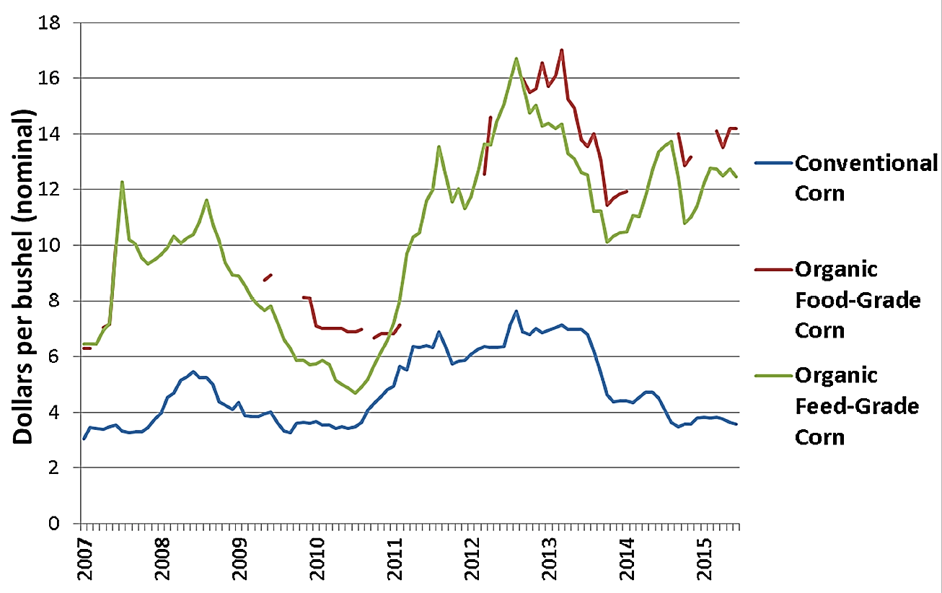
Organic Price Volatility
Source: Greene, Catherine. “The Outlook for Organic Agriculture.” 92nd Annual USDA Agricultural Outlook Forum, Arlington, VA. February 25, 2016. USDA Economic Research Service.
Notes:
Narration: Lack of liquidity or small trade volumes have led to lots of volatility in the organic market. The price chart shown here, from USDA, is a good example of just how volatile organic prices can be compared to conventional prices. This chart shows the movement of conventional corn prices (in blue) compared to the organic corn prices (in green). Conventional prices moved between a spread of approximately $3.00 per bushel to $7.50 per bushel over the 8 years examined. Organic corn prices, by comparison, moved between a spread of approximately $4.25 to $16.50 over the same period.

Slide 17
Organic Marketing Challenges
Lack of liquidity
Limited infrastructure
Scarce marketing tools
Notes:
Narration: Next, let’s take a look at how lack of liquidity can affect organic infrastructure on the ground.
Image: Sean McGuire, gratisography.com

Slide 18
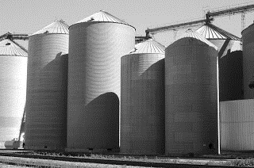
Limited Infrastructure
Handling facilities
Processors
Off-farm storage at grain elevators
Notes:
Narration: Lack of marketing infrastructure within the supply chain and among end-users such as handling facilities, processors, and grain elevators is also a limiting factor for farmers looking to market organic grain.
Image: U of MN Extension

Slide 19
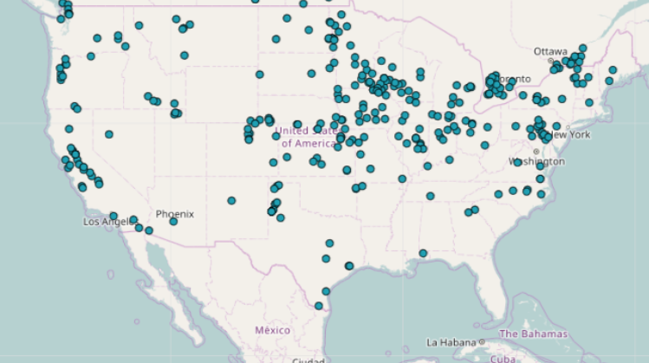
Organic Handling and Processing Capacity
~30,000 facilities
~300 organic facilities
Source: Mercaris Corp.
Notes:
Narration: According to Mercaris Corp, an organic trading platform and research company, there are approximately 340 organic grain and oilseed handlers and processors in the United States as shown on the map. By comparison, the USDA reported in 2007 that there were 30,000 food and beverage processing plants in all. This does not include handlers who are responsible for distribution to processing plants. This means that organic handlers and processors represent, at a maximum, one percent of all food and drink handlers and processors.
Image: Mercaris

Slide 20
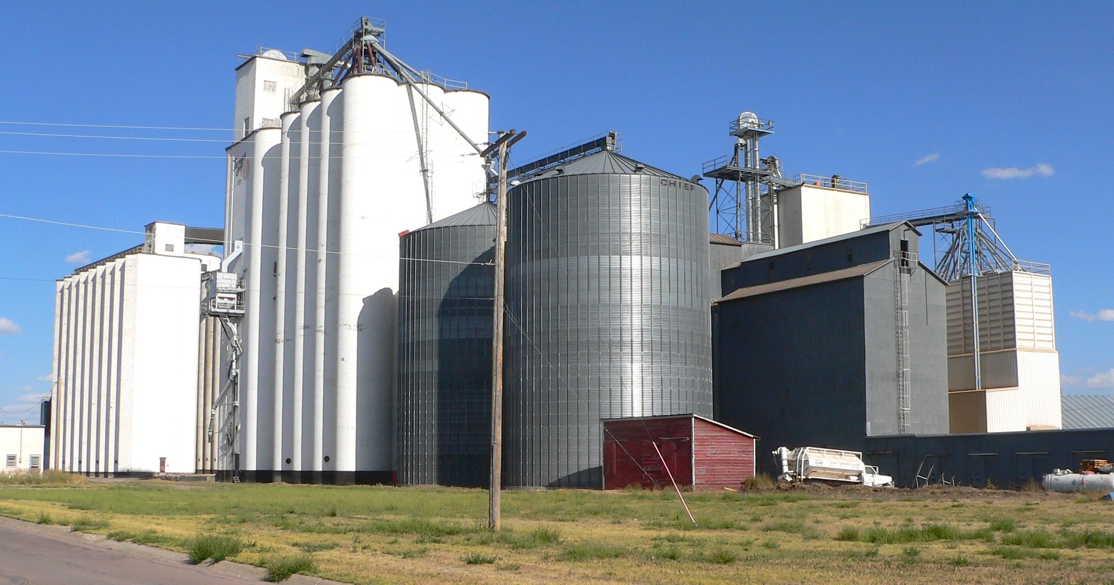
Little or No Off-Farm Storage
Organic farmers often:
Must invest in more on-farm storage
Travel longer distances to market
Notes:
Narration: Given the limited handling and processing capacity, it’s not surprising that there are fewer country elevators handling organic and other IP crops. This is important because, with fewer elevators specializing in organic commodities, farmers have fewer marketing options and must invest in their own on-farm storage and travel longer distances to get their product to market.
Image: Pixabay

Slide 21
Organic Marketing Challenges
Lack of liquidity
Limited infrastructure
Scarce marketing tools
Notes:
Narration: Due to the small size and limited trading volumes that characterize organic markets, there simply isn’t enough information available to develop the marketing tools needed by today’s organic farmers. Price, planting and harvest data that drives conventional marketing decisions is either missing or very limited in the organic sector. Why is this a problem for farmers? Let’s take a look.
Image: Sean McGuire, gratisography.com

Slide 22
Conventional Marketing Tools
Conventional farmers have access to :
Price data
Planting data
Harvest data
Thus, they can more
easily plan ahead
Notes:
Narration: Conventional farmers rely on publically reported price, planting, and harvest data to make marketing decisions, to plan ahead, to sign contracts, and to determine how much to plant the following year.
Image: Pixabay

Slide 23
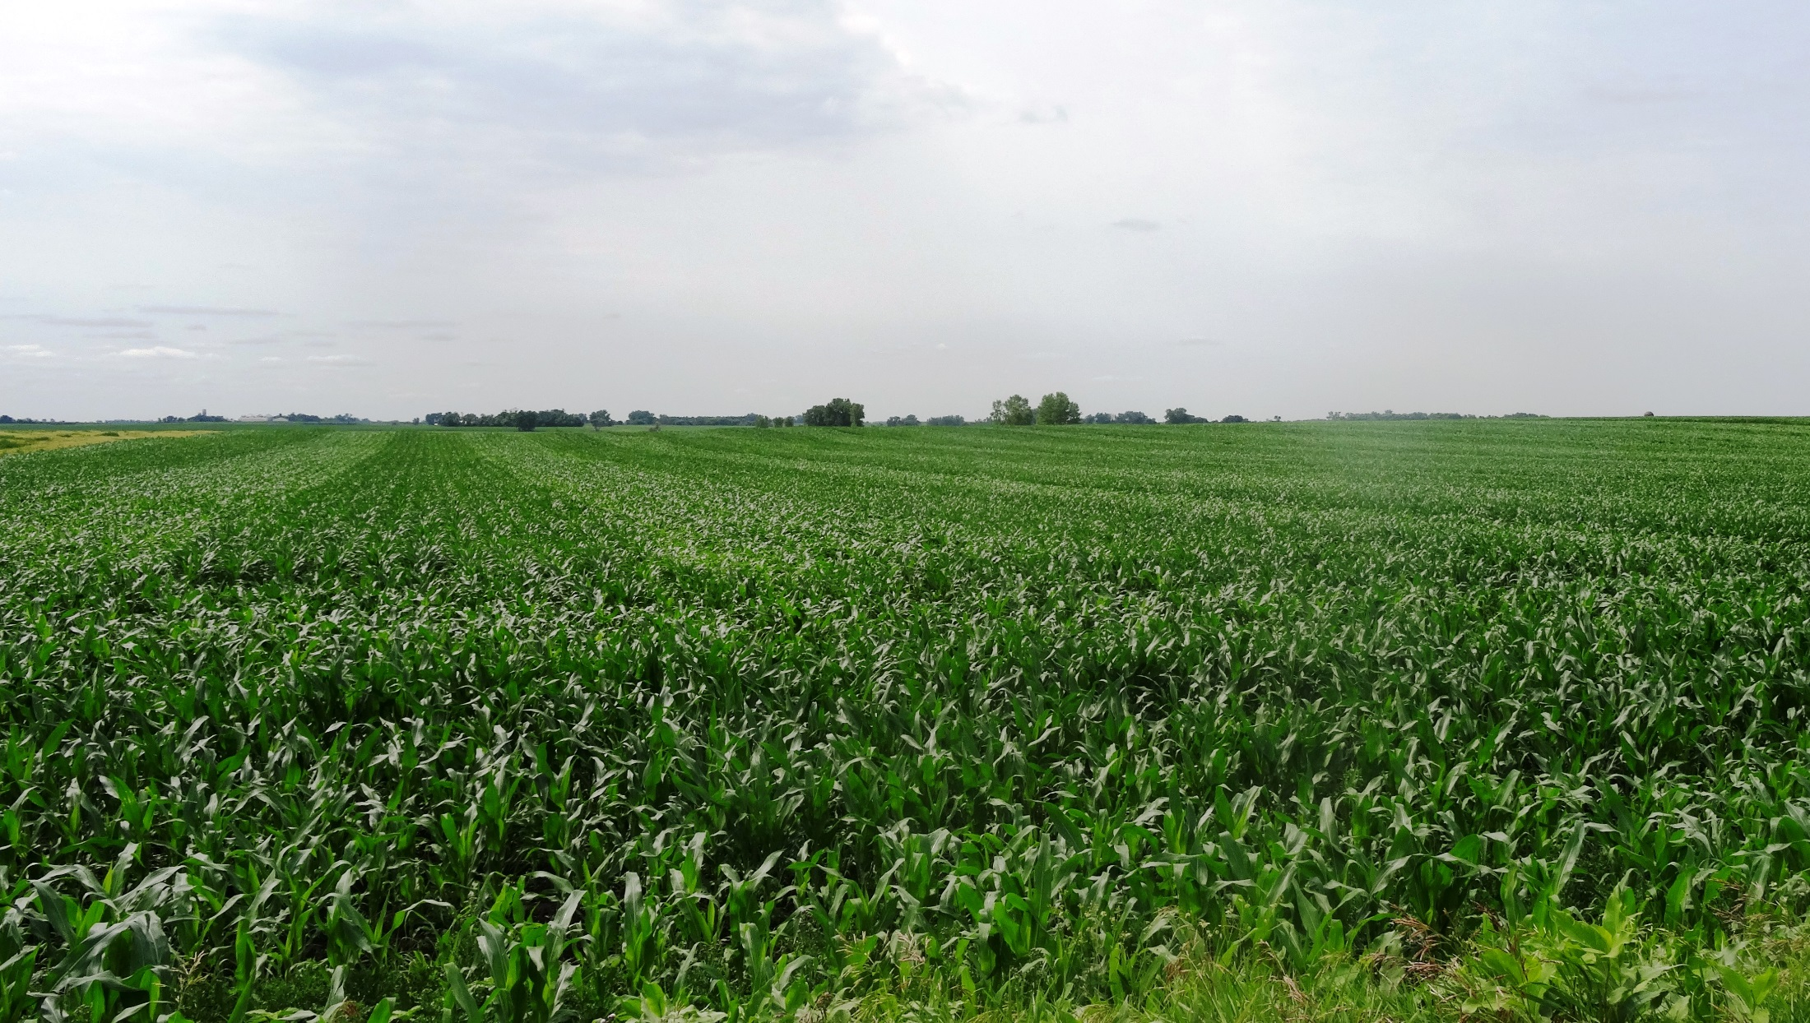
Limited Organic Planting and Harvest Data
“Organic Production and Practices Survey” (every 3 years)
“Organic Certifier Survey” (2014, 2015)
“Agricultural Census” (every 5 years)
Notes:
Narration: Organic planting and harvest data is very limited. This data is available every couple of years through the various USDA surveys listed here. By comparison, planting and harvest data for conventional crops occurs every month.
Image: Kristine Moncada, University of Minnesota

Slide 24
Lack of organic information can make it difficult to make pricing and contracting decisions
Notes:
Narration: Moreover, organic data is reported after planting and harvest rather than in anticipation of these activities (as in the case for conventional production) making it impractical for farmers to make well-informed pricing and contracting decisions ahead of harvest.
Image: Pixabay

Slide 25
Organic Futures Prices
Little or no information
Access to information is cost prohibitive
Information is outdated
Notes:
Narration: Similarly, futures prices for organic commodities don’t exist and cash prices are currently available for a handful of commodities every couple of weeks. Without timely price data, farmers lack the information needed to sign contracts with confidence and to develop projected income scenarios.
Image: Pixabay

Slide 26
Marketing
Organic Markets
Organic Challenges
Marketing Organic Crops
Marketing Documentation
Marketing Plans and Tools
Notes:
Narration: The differences between marketing conventionally and marketing organically can seem puzzling and even daunting at first.
Images: David L. Hansen, University of Minnesota

Slide 27
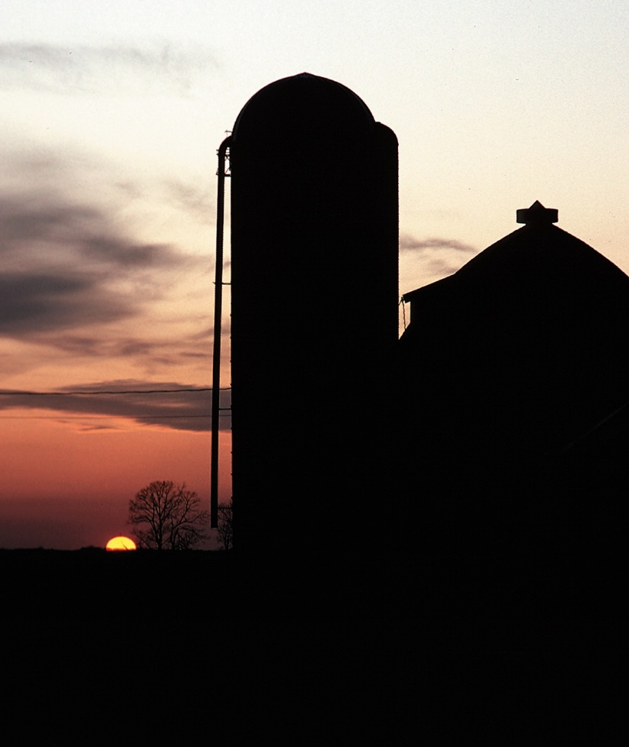
Marketing Organic Crops
“When we farm conventionally, our opportunities are the same as those for 99 percent of the other farmers. But we’re in the one percent category when we grow organically and that opens up a lot more opportunities.”
– Bryan Kerkaert, Minnesota organic grain and oilseed farmer
Notes:
Narration: Once you take the time to learn about and explore organic markets you will find that the challenges can turn into opportunities. As one Minnesota farmer puts it: “When we farm conventionally, our opportunities are the same as those for 99 percent of the other farmers. But we’re in the one percent category when we grow organically and that opens up a lot more opportunities.” Do you want to be part of the one percent? We’ll discuss how in the next section by looking at common organic marketing strategies.
Image: Tim McCabe, USDA-NRCS

Slide 28
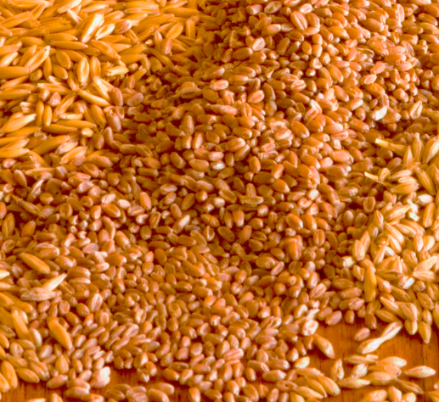
Marketing Organic Crops
Timing
Contracts
Buyers
Notes:
Narration: When you’re ready to market organic grains and oilseeds, there are three general things to consider: timing of pricing, contracts, and buyers. Let’s discuss timing and pricing first.
Image: David L. Hansen, University of Minnesota

Slide 29
Timing
Current market prices
Anticipated or future market prices
On-farm storage
Cash flow
Notes:
Narration: As a grain farmer – organic or conventional – you’ll need to decide when to market your grain. Will you arrange for sales and price your grain before or after harvest? This question of timing will depend on current market prices, anticipated market prices, on-farm storage capacity, and your own cash flow.
Image: MS Clip Art

Slide 30
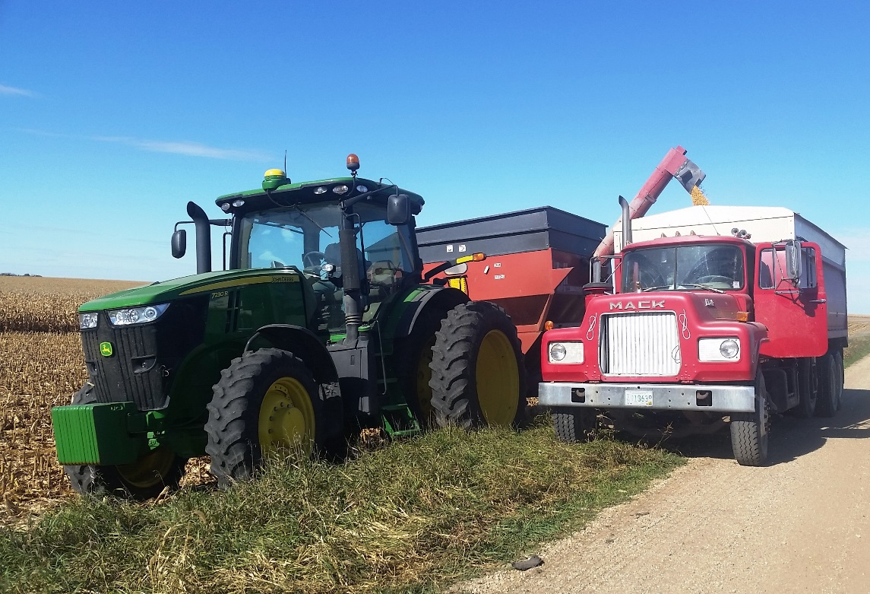
Minnesota Organic and Transitioning Farmers
Post harvest spot or cash sales direct to buyer (31%)
Pre-harvest forward contracts (38%)
Other: farmer owned coops, brokers
Notes:
Narration: In Minnesota, approximately 31% of organic and transitioning-to-organic farmers preferred to sell direct to buyers in what is called the “cash” or “spot” market at current prices with delivery taking place almost immediately. Another 38% of these same farmers preferred to market their grain using “forward contracts.” In other words, they preferred to sign contracts pre-harvest. The remaining marketing channels included farmer-owned co-ops and brokers.
Image: Carmen Fernholz

Slide 31
Marketing Organic Crops
Timing
Contracts
Buyers
Notes:
Narration: When market conditions are right, you may decide to hold onto your grain in storage and/or to forward contract your grain in advance of harvest. Let’s take a look at how forward contracting works when marketing organic grains.
Image: David L. Hansen, University of Minnesota

Slide 32
Forward Contract Types
Contract Type | Duration
Forward cash | This season
Forward short-term | 1-2 years
Forward long-term | 3+ years
Notes:
Narration: There are three types of forward contracts that organic farmers use: the forward cash contract, the forward short-term contract, and the forward long-term contract. Each contract varies in length.

Slide 33
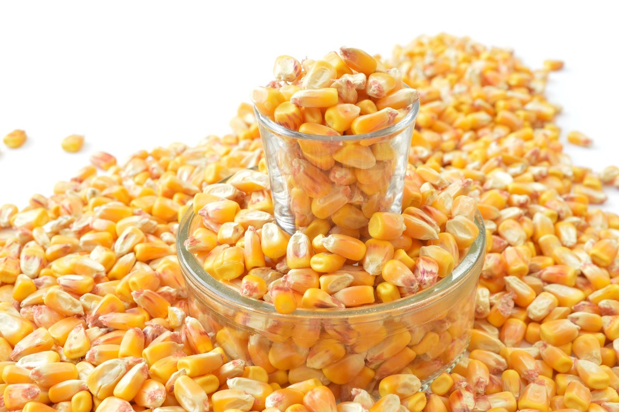
Forward Contract Terms
QUANTITY
$
FUTURE
DELIVERY
DATE
PRICE
Notes:
Narration: All forward contracts specify the quantity, price and a FUTURE delivery date. It allows the farmer to secure a price for his/her crop that is to be grown, is growing in the field, is harvested, or is being held in storage for later delivery. The duration of the contract, usually one year or more, determines how long the farmer and buyer are committed to the contract. Longer-term contracts are more common in the organic market than in the conventional market due to high demand and product scarcity.
Images: Pixabay

Slide 34
Longer Term Contracts
Short-term (1 year)
Long-term
1-3 years
3+ years
Notes:
Narration: In the organic market, it’s quite common for buyers to offer longer-term contracts because of the tight supply situation. There is not enough organic grain being grown in the United States to keep up with US demand. Longer term forward contracts allow buyers to secure grain needs well in advance of delivery. Some contracts last one year. Others can be signed for three years or more – meaning that, as a farmer, you are committed to selling grain from each harvest for up to three years (depending on the contract terms).
Image: Gigi DiGiacomo, University of Minnesota

Slide 35
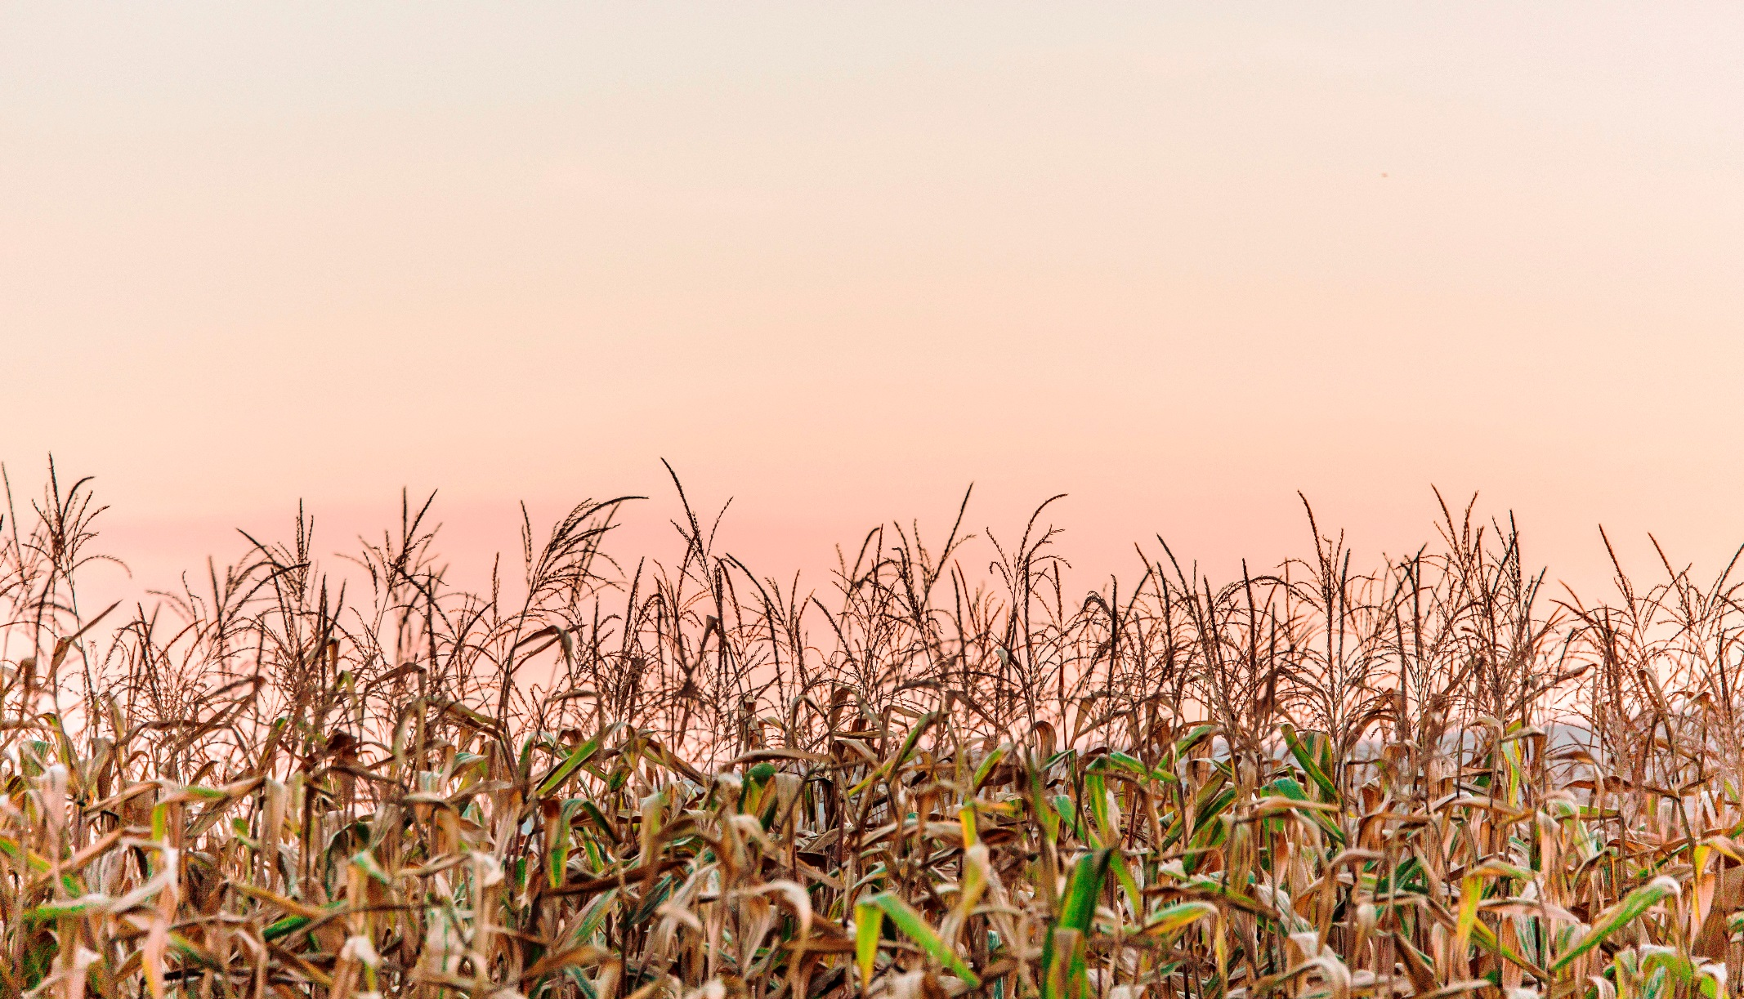
Forward Contract Specifications
Contract duration
Price and price formula
Delivery quantity and quality
Delivery date
Transportation, handling and storage
Termination and dispute resolution
Notes:
Narration: In addition to contract duration or length, most forward contracts address the following terms: 1) prices paid or received and how those prices will be determined; 2) delivery quantity and crop quality; 3) delivery date; 4) transportation, handling and storage of the crop pre- and post-harvest; and 5) clauses regarding termination of the contract and dispute resolution.
Image: Sean McGuire, gratisography.com

Slide 36
Price Determination for Contracts
Base price plus premiums and/or minus discounts
Base price +/- changes in input costs
Market price +/- premiums, discounts
Premiums (additions to price) or discounts (subtractions to price) for crop quality, cleaning, transport and other post-harvest services
Notes:
Narration: Prices specified in forward contracts may use: a “base” price plus premiums or minus discounts; a base price linked to changes in the cost of inputs; or market prices plus premiums or minus discounts. Premiums and discounts are incurred for crop quality, cleaning, transport, and other post-harvest services. Given the lack of price transparency in the market, you may be wondering how “base” prices and “market” prices are determined. That’s a good question!
Image: Pixabay

Slide 37
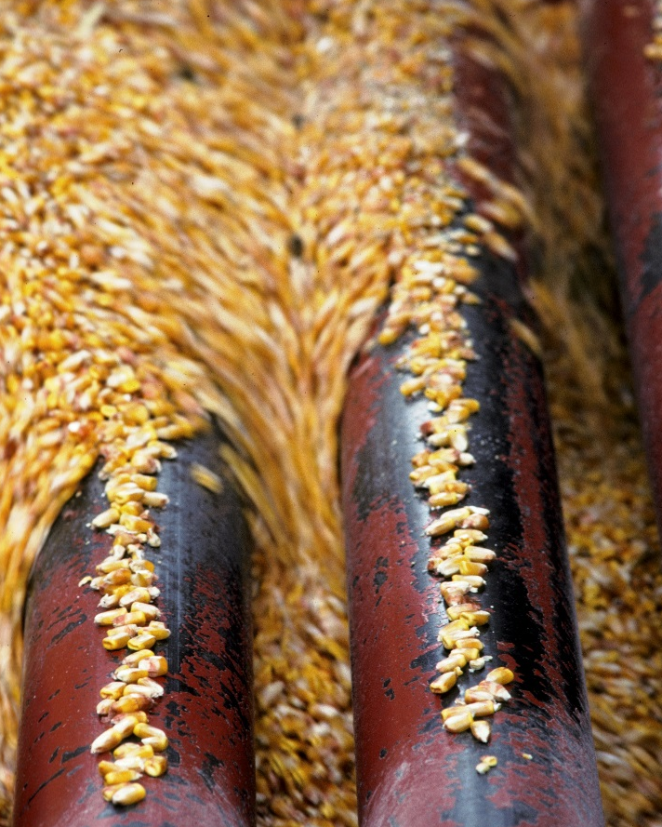
Base Price
Futures or local cash price for
conventional commodities
CORN
SOYBEAN
WHEAT
OATS
RYE
BARLEY
SORGHUM
OTHERS
Notes:
Narration: For the base price, buyers adjust conventional prices using premiums to account for local supply/demand conditions, long range usage, import volumes, and, of course, organic certification. Futures market prices are available for corn, soybeans, soybean oil, soybean meal, wheat, and oats. However, future prices are not available for small grains such as rye, barley, sorghum, or many other crops. This means that you cannot use this pricing method for these crops.
Images: David L. Hansen, University of Minnesota

Slide 38
Market Price
Price reflected in institutional and private reports, such as those produced by USDA and Mercaris, Corp.
Notes:
Narration: Farmers and some other buyers prefer to price organic grains using “market prices” that are based on trades which have already occurred reflecting past or present supply/demand conditions. Using a “market” price approach currently has the same limitations as the base price method. Institutional price reports for organic grains and oilseeds offer only limited market price data for crops other than food-grade soybeans and feed-grade corn. In other words, using the “market price” method for organic small grains and legumes is not very reliable or applicable at this point in time. Image: Pixabay

Slide 39
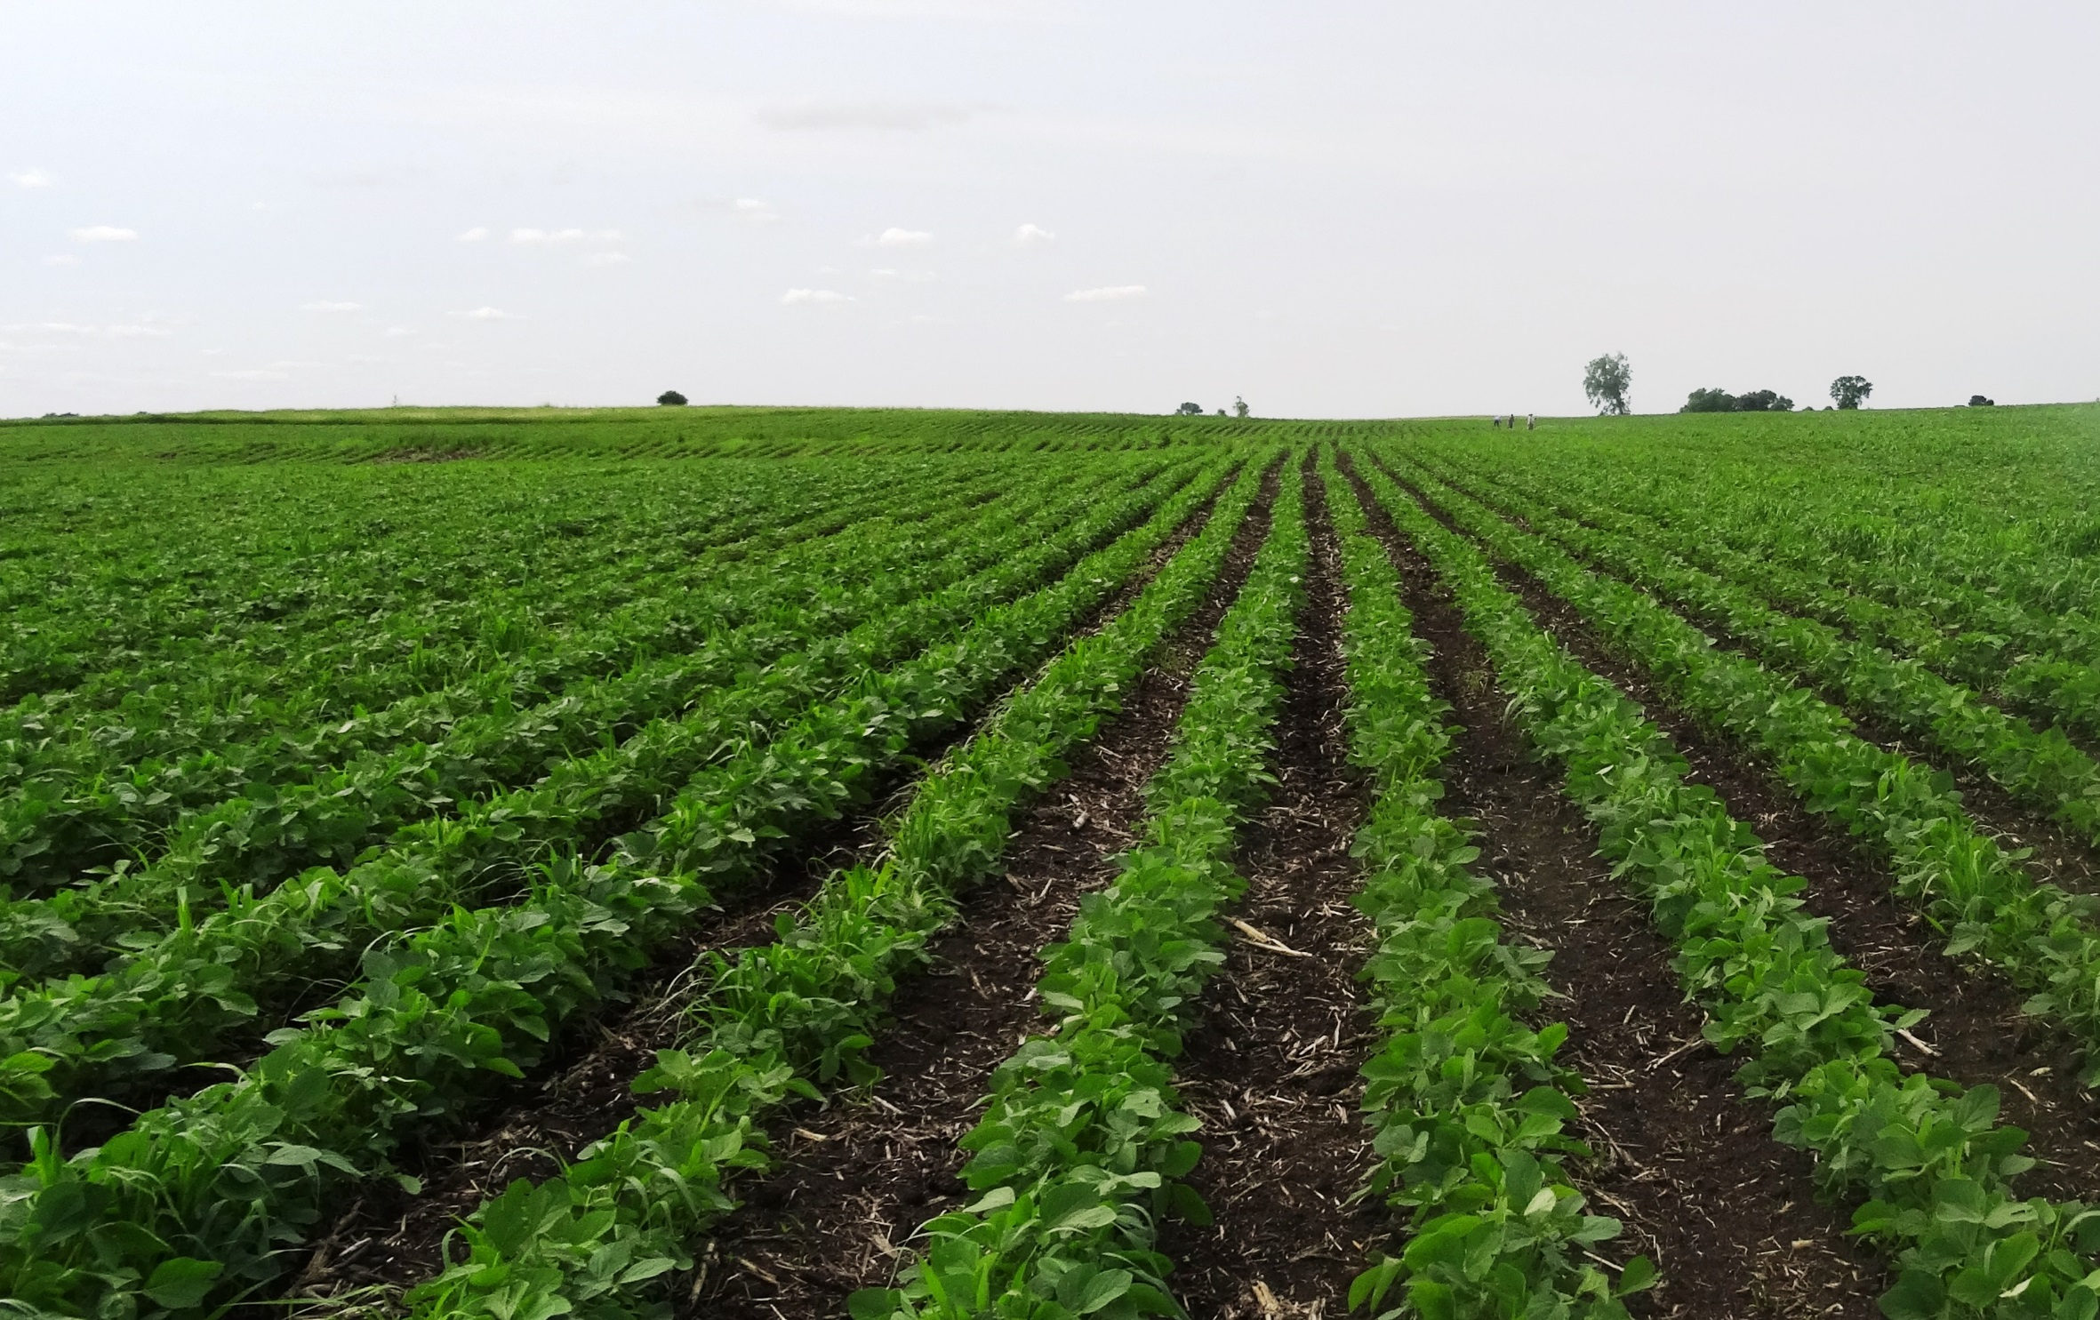
Base price + market price
combination most often used
Notes:
Narration: Most organic farmers use some combination of the base price and market price approach to begin negotiating prices with buyers. Image: Kristine Moncada, University of Minnesota

Slide 40
Price Reports
USDA-AMS, Organic Price Report
Rodale Institute Organic Price Report
Mercaris Market Price Report
Notes:
Narration: So where do organic farmers get market price information? There are three sources of third-party, pricing data available for organic grains and oilseeds. The first comes from the USDA Agricultural Marketing Service, is national in scope, and available at no cost. The second source is prepared by the Rodale Institute using USDA AMS data from terminal markets. The nice thing about this report is that it provides both organic and conventional price information for comparison and is available electronically at no cost. The third and most complete source of price data comes from a private company called Mercaris which charges a monthly fee for its services.

Slide 41
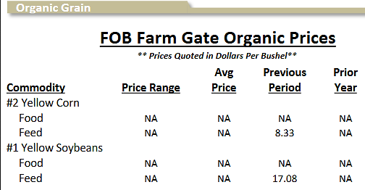
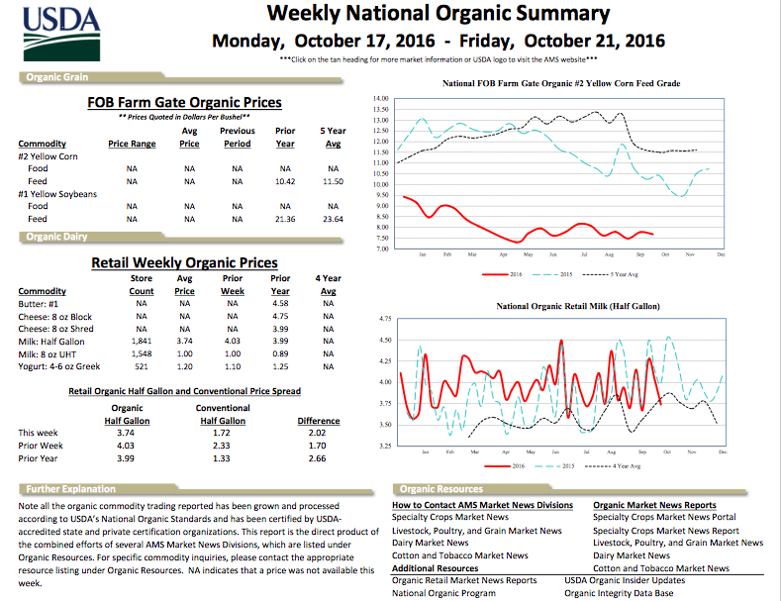
Weekly National Organic Summary
https://www.ams.usda.gov/market-news/organic
Notes:
Narration: Let’s take a closer look at the USDA’s “Weekly National Organic Summary.” This report provides cash and forward contract prices for a variety of markets on a bi-weekly basis. Price data is provided voluntarily from sellers and is reported as a weighted average from trades that have occurred. Some price histories, such as a one-year, previous year, and five year average, are also included when there is enough data to do so. The price report is free and available at the website listed here. However there are often large gaps in the data as noted with “NA” when data is simply unavailable due to thin trading volumes.

Slide 42
Mercaris Reports
www.mercariscompany.com
Notes:
Narration: Mercaris, a private company, reports organic, transitional and non-GMO prices for grains and oilseeds. Data for the report is available weekly and comes from regular surveys of buyers and from trades that occur during the company’s on-line auction. Mercaris also provides a monthly price summary report for organic cash prices and premiums (reported as a spread between the organic cash price and the conventional cash prices) as well as annual spot and forward contract price reports. The cost for these reports ranges from several hundred dollars per month to more than a thousand dollars per month.

Slide 43
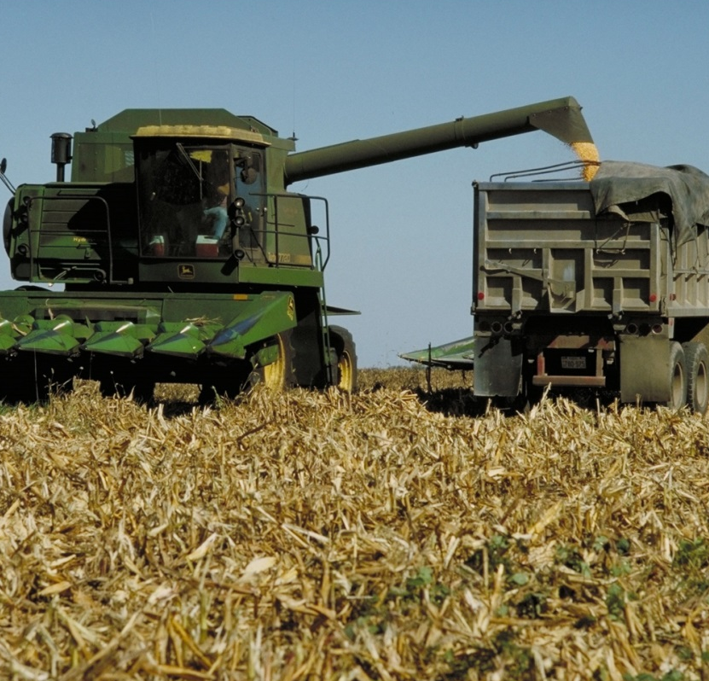
Contract Quantity
Specific quantity: number of bushels or weight
Production level: all harvest from specified acres
Notes:
Narration: The quantity to be delivered and purchased is typically specified in an organic contract in one of two ways: 1) as the quantity to be delivered by weight – for a specific amount of grain; or 2) by production level. A contract based on production levels will state something like “buyer will purchase 100% of the crop produced from 50 acres on Seller’s property listed as the ‘Northwest Plot’ …” In other words, the buyer is committing to purchase the entire crop harvest from a specified number of acres at the specified price or price formula. This type of contract provides some degree of risk protection for farmers because, even if their harvest is poor, they do not have to worry about making up for the harvest shortfall or in the case of a bumper crop, they don’t have to find a buyer for the excess grain.
Image: Dave Hein, USDA

Slide 44
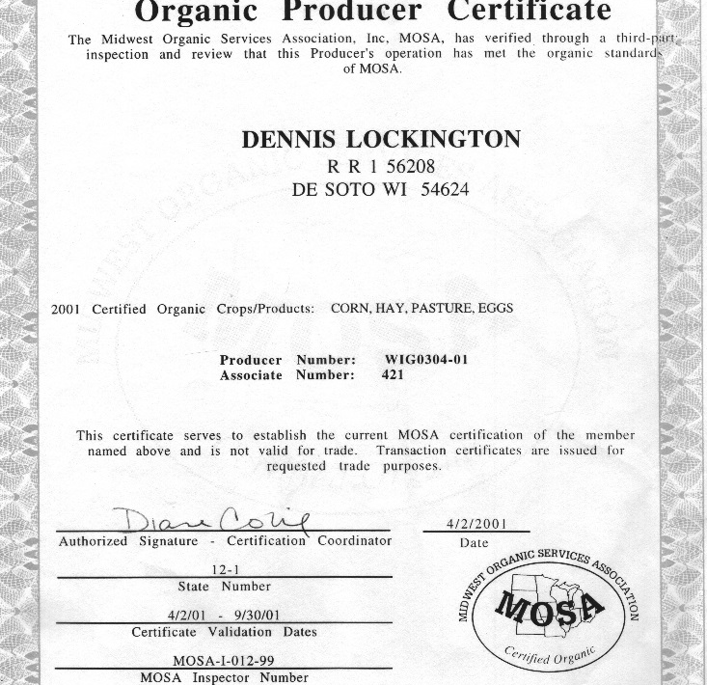
Contract Quality – Provisions
Organic integrity
Weight
Grade
Cleaning
Notes:
Narration: Organic contracts, like conventional grain contracts, will include grain quality provisions (including a scale of premiums and discounts) related to weight, grade, and cleaning. However, the most important quality aspect identified in an organic contract is the “organic” provision itself! Most if not all organic grain and oilseed buyers will require documentation or proof of organic certification at the time a contract is signed. Proof of certification, called an “organic transaction certificate” can be obtained from your farm’s certifier.
Image: Harriet Behar, MOSES

Slide 45
On-Farm Storage
Limited off-farm storage for IP crops
On farm storage requires dedicated, numbered grain bins
Notes:
Narration: As discussed earlier, there is limited off-farm storage available for non-GMO, transitional, organic and other identity preserved crops. If you plan to store harvested grain on-farm, you’ll need dedicated, numbered storage bins.
Image: Kristine Moncada, University of Minnesota

Slide 46
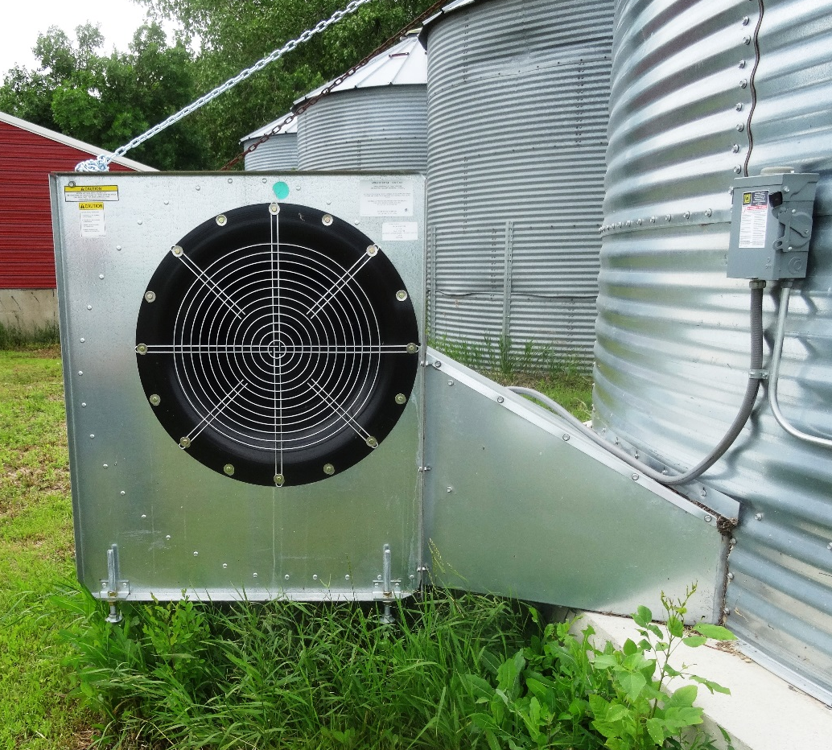
Using Multiple Storage Bins
Allows you to:
Sort grain by grade and quality
Adjust humidity and control moisture more efficiently
Store conventional, transitional and organic crops simultaneously
Grain bin fan
Notes:
Narration: Experienced organic farmers recommend investing in multiple small bins for each crop (rather than a single large bin). This will allow you to sort grain by grade and control moisture and humidity more effectively. Multiple small bins are also useful if you plan to manage a “split operation” – meaning that you will grow organic grain and conventional or transitional grain simultaneously. Image: Kristine Moncada, University of Minnesota

Slide 47
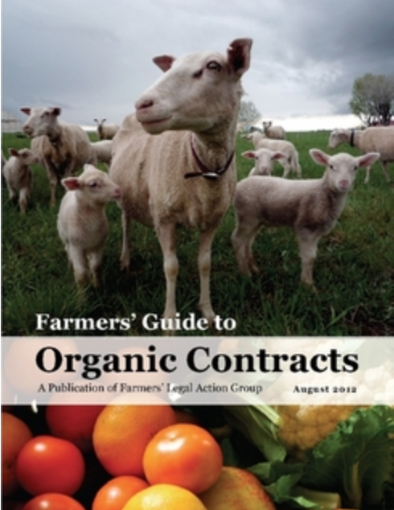
Organic Contracts
Farmers Legal Action Group – learn more about organic contracts
www.flaginc.org/
Notes:
Narration: For more information about organic contract provisions, we suggest visiting the Farmers Legal Action Group home page to learn more about organic contracting. A comprehensive guide on contracting, with sample contracts, is available for download at no cost. Also, it’s always a good idea to have an attorney review your contract to make sure all terms are favorable.

Slide 48
Marketing Organic Crops
Timing
Contracts
Buyers
Notes:
Narration: As you research contract options and timing, it’s a good idea to visit with buyers and learn more about what’s on offer.
Image: David L. Hansen, University of Minnesota

Slide 49
Organic Buyers
Grain companies/elevators
Feed mills
Feed lots
Processors
Brokers
Farmer-Owned Cooperatives (e.g., Organic Valley and OFARM)
Notes:
Narration: Traditional buyers of grains and oilseeds include: grain companies and their elevators, feed mills, feed lots, processors of oilseeds and grain, and brokers. These buyers also source organic grain. In addition, farmer-owned cooperatives such as Organic Valley are big buyers of organic grain as are marketing agencies, such as the Organic Farmers Agency for Relationship Marketing also known as OFARM.
Image: Pixabay

Slide 50
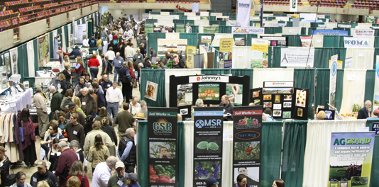
Organic Trade Shows
Iowa Organic Conference (IA)
Illinois Specialty Crops, Agritourism and Organic Conference and Trade Show (IL)
Minnesota Organic Conference (MN)
Northern Plains Sustainable Ag Society Annual Conference (SD)
MOSES Organic Farming Conference (WI)
Ohio Ecological Food and Farm Association Conference (OH)
Notes:
Narration: One of the best ways to connect with organic buyers is by visiting trade shows in your state or region. Trade shows, usually held in conjunction with skill-building workshops and other conference events, are well attended by organic buyers who sometimes offer contracts for transitional and/or non-GMO grain in addition to forward contracts for organic grains and oilseeds. We’ve listed a few of the more well-known conferences in the Upper Midwest here and strongly suggest attending one or more shows as you explore transitional and organic markets.
Image: MOSES

Slide 51
Marketing
Organic Markets
Organic Challenges
Marketing Organic Crops
Marketing Documentation
Marketing Plans and Tools
Notes:
Narration: Next, let’s take a look at the types of documentation or paperwork that will be requested by buyers when purchasing your organic grain.
Images: David L. Hansen, University of Minnesota

Slide 52
Export Documentation
USDA Export Certificate for Japan and Taiwan
Attestation for export to Canada (equivalency)
Notes:
Narration: You should also be aware that there are several types of documentation required to verify organic integrity and quality when selling to an exporter. Documentation will vary by country. For example, if your grains and oilseeds are destined for Japan and Taiwan, the buyer will ask you to provide a “USDA Export Certificate.” Similarly, when your grain is destined for Canada, the buyer will ask you to amend your organic certificate with an “Attestation” or organic equivalency statement (your certifier will do this). Export documentation usually carries additional fees. It is up to you and the buyer to determine, as part of your contract, who will bear the cost of obtaining these documents.
Image: Pixabay

Slide 53
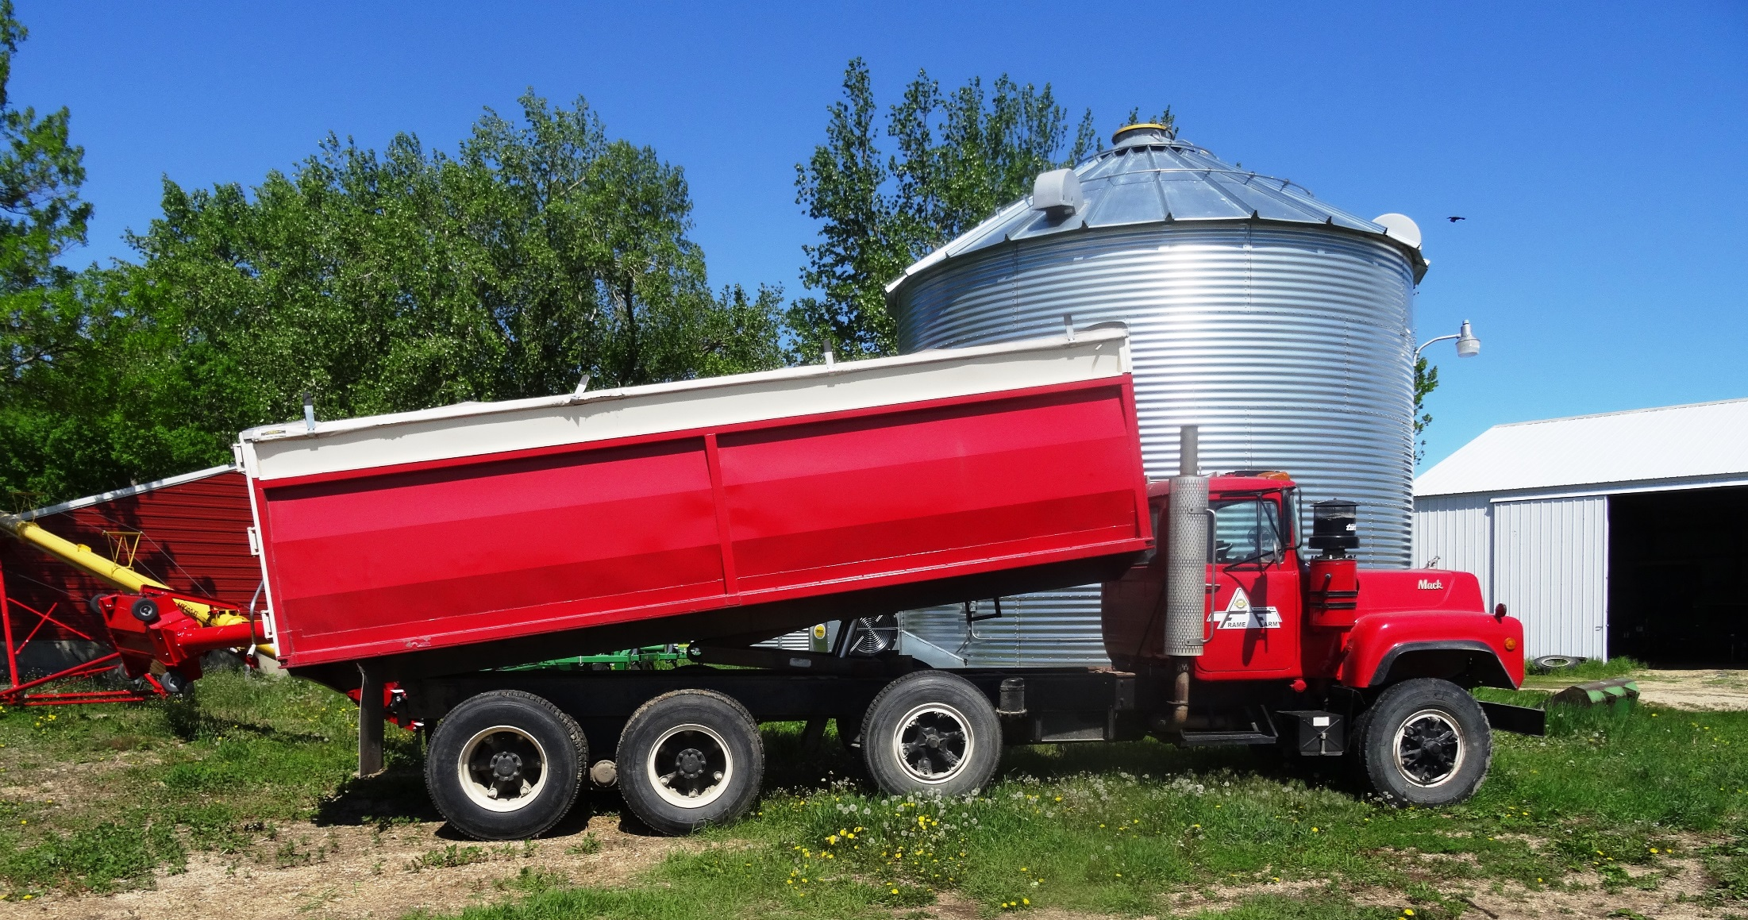
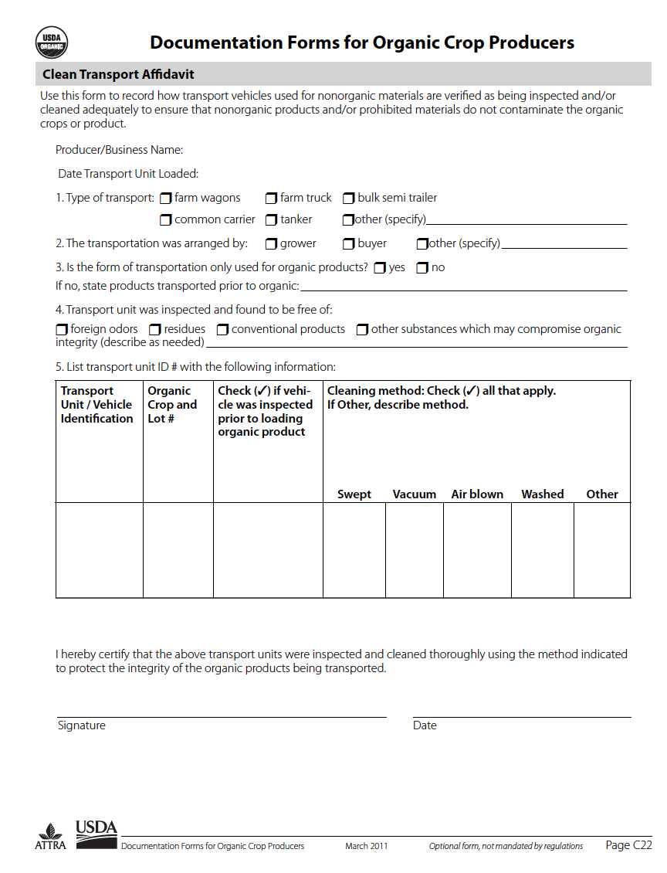
Transport, Handling and Storage Documentation
“Clean Truck Affidavit”
On-farm storage
Off-farm storage
Audit trail
Notes:
Narration: There is no rule of thumb when it comes to the transportation, storage and handling terms of an organic grain contract. The farmer or the buyer may be responsible for arranging and paying for transportation. This will be agreed upon and specified in the contract. If you are responsible for the transport and handling of crops as they make their way to market, you will likely need to obtain a “clean truck affidavit” from the driver proving that the truck was swept and cleaned before loaded with your organic crop.
Image: Kristine Moncada, University of Minnesota

Slide 54
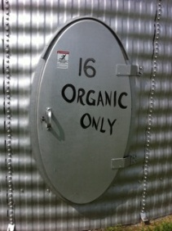
Audit Trail
“Documentation that is sufficient to determine the source, transfer of ownership, and transportation of any agricultural product labeled as ‘organic’.”
Notes:
Narration: Finally, you will be required to maintain an audit trail to verify that the grains you are marketing have been produced, harvested, and handled in accordance with NOP rules. An audit trail, as defined by NOP, is “documentation that is sufficient to determine the source, transfer of ownership, and transportation of any agricultural product labeled as ‘organic’.” In other words, an audit trail is a recordkeeping system that is unique to your farm.
Image: Gigi DiGiacomo, University of Minnesota

Slide 55
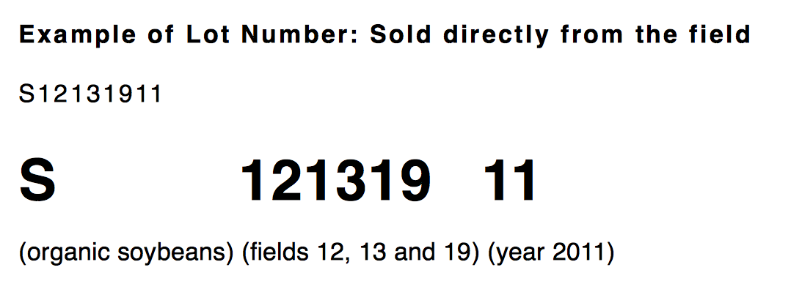
Lot Numbers
Type of crop
Field activities
Harvest activities
Storage unit
Year of production
Source: Minnesota Guide to Organic Certification
Notes:
Narration: An audit trail is not complicated and is dependent on the use of lot numbers. The lot number communicates: the type of crop; the field in which it was grown; field management activities; harvest activities; handling and storage; and the year it was produced. The lot number will be used by you, your certifier, and buyers, and end users to trace the product to its original source if necessary. This is especially important if contamination is discovered.

Slide 56
For More Information
Minnesota Guide to Organic Certification, http://misadocuments.info/MN_Guide_Organic_Certification.pdf
Farm Production Recordkeeping Workbook https://mosesorganic.org/publications/farm-production-recordkeeping-workbook/
Record Keeping Form Templates for Organic Farmers http://www.mda.state.mn.us/Global/MDADocs/food/organic/sampleforms.aspx
Documenting Forms for Organic Crop and Livestock Producers,https://attra.ncat.org/attra-pub/download.php?id=358
Notes:
Narration: For more information on how to establish an audit trail, we recommend the following publications.

Slide 57
Marketing
Organic Markets
Organic Challenges
Marketing Organic Crops
Marketing Documentation
Marketing Plans and Tools
Notes:
Narration: With all the unique considerations associated with organic marketing, we recommend creating a marketing plan. Images: David L. Hansen, University of Minnesota

Slide 58
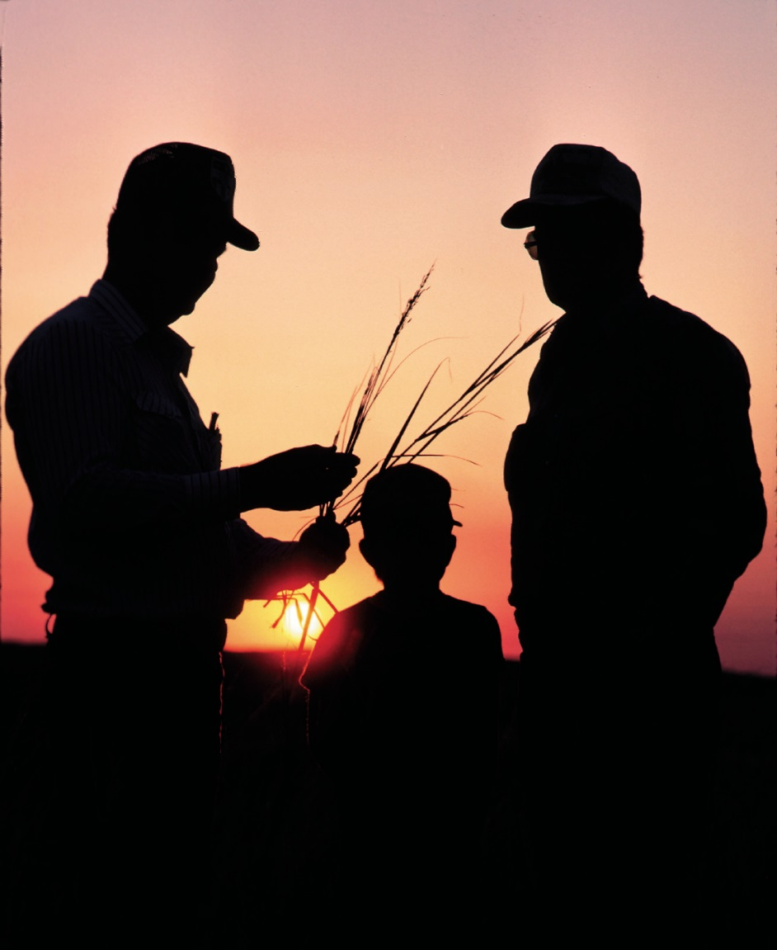
Marketing Plans and Tools
A plan prepares you to:
Address challenges
Take advantage of opportunities
Clarify and communicate ideas
Mitigate uncertainty
Notes:
Narration: Planning is critical when transitioning. Why? It can: help address some of the challenges associated with selling in organic markets, prepare you to take advantage of organic marketing opportunities, clarify communication with family members, business partners, lenders, and certifiers, and most importantly, planning will reduce some of the uncertainty associated with transitioning. It will give you the confidence to move toward your goal of becoming an organic farmer. Image: USDA-NRCS

Slide 59
Marketing Plan Outline
Market overview
Marketing strategy
Crops and rotation
Buyers and pricing
Storage, handling and delivery
Certification and documentation
Risk Management
Notes:
Narration: Marketing plans vary by content and organization depending on the complexity of your business, the products being sold, your target market, and your certification status. Begin your plan with a “market overview” summarizing current market conditions and future opportunities. Much of this information will come from discussions with buyers. Next, describe your strategies for marketing crops during transition and upon certification followed by a careful outline of the crops and rotation that will allow you to take advantage of market opportunities. This can be followed by a description of potential buyers, prices offered, and any contracts that you have signed. Finally, your marketing plan should include storage, handling and delivery content that addresses specialized tasks associated with identity preserved crops including any organic certificates and other documentation required by buyers. All marketing plans should conclude with a brief discussion of any risks associated with your plan, such as price volatility or crop contamination, and your ideas for managing or addressing risks should they arise.
Image: Pixabay

Slide 60
Marketing Plans and Tools
Notes:
Narration: A marketing plan should ultimately allow you to communicate with lenders, business partners, and family members. So, it’s a very good idea to write it down. There are several tools available to help you with this process.
Image: Pixabay

Slide 61
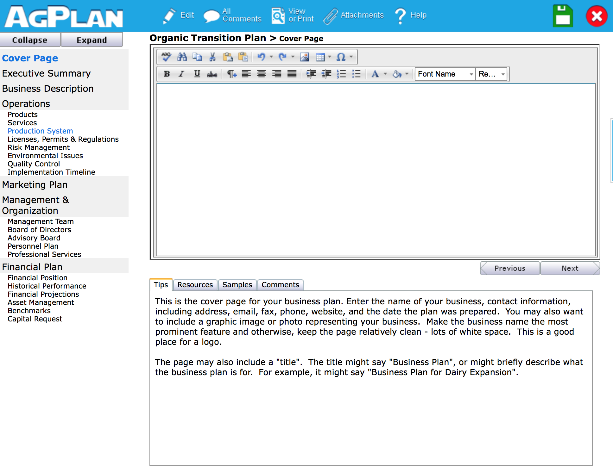
AgPlan
www.agplan.umn.edu
Notes:
Narration: AgPlan, developed by the University of Minnesota’s Center for Farm Financial Management, is one of these tools. It is a business planning software program that includes a marketing component. AgPlan allows users to customize their plans – you can complete only the marketing section if desired and imbed financial information from spreadsheet programs into the plan. AgPlan is available on line at the Center’s website shown here; it is simple, easy-to-use and free of charge.

Slide 62
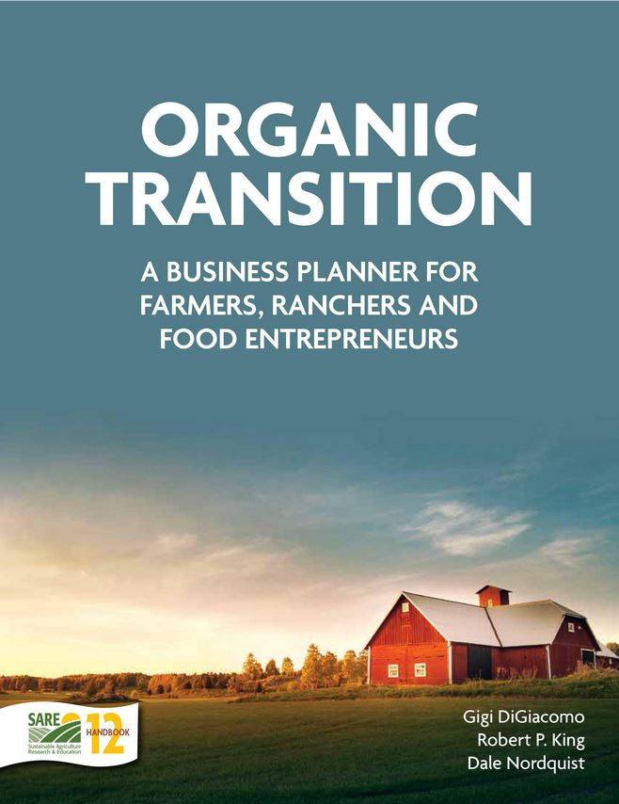
Organic Transition Planner
http://www.sare.org/Learning-Center/Books/Organic-Transition
Notes:
Narration: If you prefer to write things down the old fashioned way, we suggest using the Organic Transition Planner. This workbook is designed to guide you through the development of a business and marketing plan for your transition to organic production. Each chapter includes text, examples from transitioning farmers, worksheets, and resources. Copies of real-life business plans, created by farmers during their transition, are also included. Electronic copies of the Planner are available for free from the Minnesota Institute for Sustainable Agriculture or MISA. Hard copies are available for purchase from USDA-SARE at the website shown here.

Slide 63
Do you think a marketing plan can help you transition to organics? If so, will you use a marketing plan to:
Develop a two-pronged strategy for transitioning and beyond?
Identify markets for rotation crops?
Document market trends?
Communicate with family members about marketing goals?
All of the above?
Notes:
Narration: Think about the difference between conventional, transitional and organic markets. Will you use different marketing strategies to reach buyers and sell your grain? If so, how might a marketing plan help? Will you develop a two-pronged strategy – one for marketing transitional grains and one for marketing certified organic grains? Will you identify and create a plan specifically for rotation crops? Will you use a marketing plan to document market trends and to communicate goals with your family and other business partners? Or will you use a marketing plan to do all of the above?

Slide 64
Marketing
Organic Markets
Organic Challenges
Marketing Organic Crops
Marketing Documentation
Marketing Plans and Tools
Notes:
Narration: This is the end of the Marketing module, thanks for watching!
Images: David L. Hansen, University of Minnesota

Slide 65
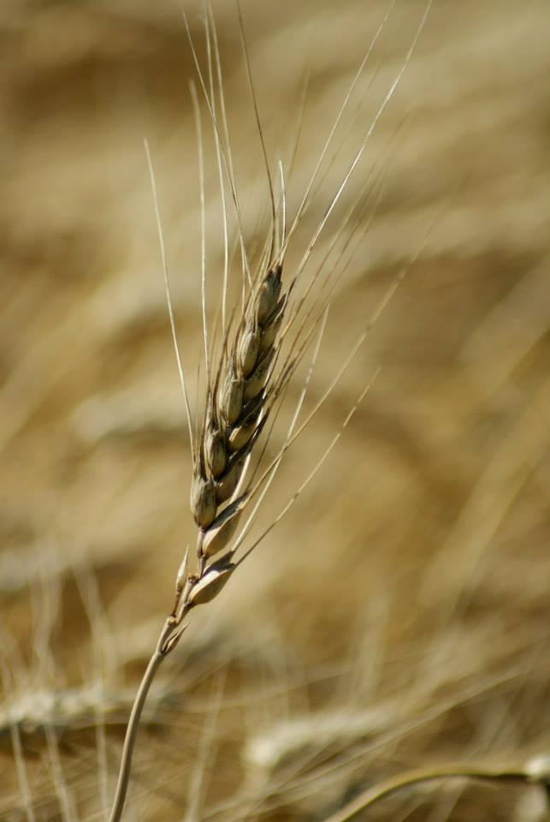
© 2017 Regents of the University of Minnesota. All rights reserved. The University of Minnesota is an equal opportunity educator and employer.
This material is based upon work that is supported by the National Institute of Food and Agriculture, U.S. Department of Agriculture, under grant number 2013-51106-21005.
Notes:
Narration: This material is based upon work that is supported by the National Institute of Food and Agriculture.
Image: Constance Carlson, University of Minnesota

Slide 66
References
Baier, Ann. 2011. Documenting Forms for Organic Crop and Livestock Producers. ATTRA. https://attra.ncat.org/attra-pub/download.php?id=358
DiGiacomo, G. and R. King. 2015. Making the Transition to Organic: Ten Farm Profiles. University of Minnesota. http://eorganic.info/toolsfortransition.
Farmers Legal Action Group. 2012. Farmers Guide to Organic Contracts. http://www.flaginc.org/wp-content/uploads/2013/03/FGOC2012.pdf
FINBIN database. 2017. Center for Farm Financial Management. cffm.umn.edu/products/FINBIN.aspx
German, C.L. 2004. The Farmers’ Grain Marketing Guide. University of Delaware. January 2004. ER04-01.
Greene, C. 2016. The Outlook for Organic Agriculture. 92nd Annual USDA Agricultural Outlook Forum, Arlington, VA. February 25, 2016. USDA Economic Research Service.
Mercaris. 2015. Navigating US Organic and Non-GMO Markets. https://mercaris.com/organizations/1070/report/downloadable

Slide 67
References (cont.)
Peterson, H.H., A. Barkley, A. Chacon-Cascante, and T.L. Kastens. 2012. The Motivation for Organic Grain Farming in the United States: Profits, Lifestyle, or the Environment. Journal of Agricultural and Applied Economics 44,2:137-155.
Riddle, J. and L. Gulbranson. 2011. Minnesota Guide to Organic Certification. Minnesota Institute for Sustainable Agriculture. http://misadocuments.info/MN_Guide_Organic_Certification.pdf.
Tools for Organic Transition Project. 2012. Intake Survey. University of Minnesota. https://eorganic.info/toolsfortransition/reports
Tools for Organic Transition Project. 2014. Annual Survey Results, 2014. University of Minnesota. 2014. http://eorganic.info/toolsfortransition/reports
USDA-AMS. 2017. Bi-Weekly National Organic Comprehensive Report: Thu, Mar 02, 2017 – Wed, Mar 15, 2017. https://www.ams.usda.gov/mnreports/lsbncor.pdf
USDA-AMS. 2017. Organic Integrity Database. https://organic.ams.usda.gov/Integrity/
USDA-ERS. 2017. Manufacturing: Food and Beverage Manufacturing. https://www.ers.usda.gov/topics/food-markets-prices/processing-marketing/manufacturing.aspx

