Slide 1
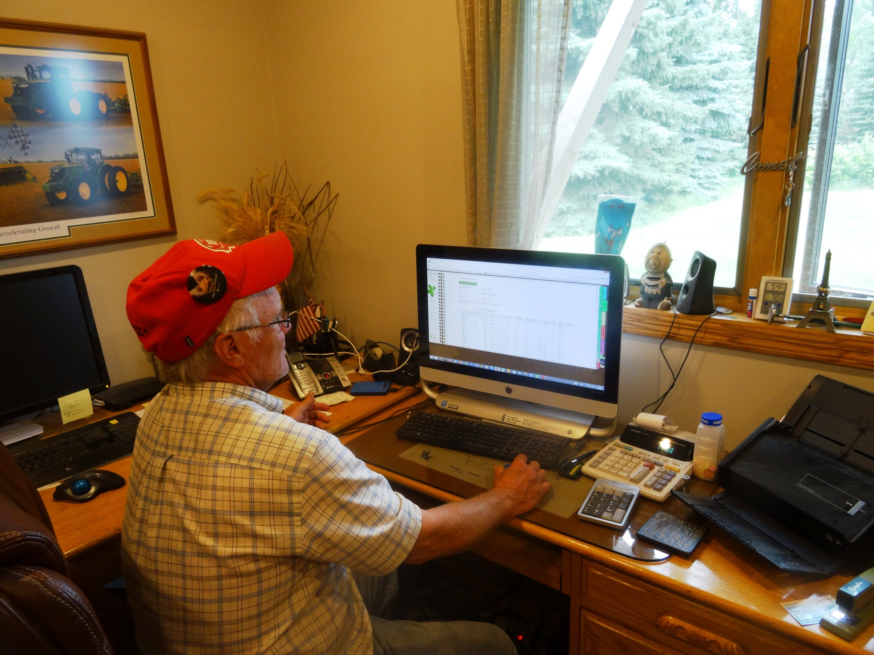
Record Keeping
Authors
Kristine Moncada
Harriet Behar
Jim Riddle
Constance Carlson
Craig Sheaffer
This material is based upon work that is supported by the National Institute of Food and Agriculture, U.S. Department of Agriculture, under grant number 2013-51106-21005.
Notes:
Narration: Welcome to our module on Record Keeping. Image: Kristine Moncada, University of Minnesota

Slide 2
Why Good Record Keeping Is Important
Applying for government programs
Providing figures to lenders
Supporting facts for insurance application and claims
Making production decisions
Why and what things did or did not work
Prevents you from repeating mistakes
Field Operations
Custom Work
Equipment
Seed tags
Inputs
Field Maps
Correspondence
Notes:
Narration: In this module, we will discuss record keeping for organic crop producers. Records are an important part of following NOP rules. However, good record keeping is valuable regardless of what kind of farming you do. Complete and organized records can help with: applying for government programs, supplying figures to lenders when applying for loans, or providing facts when applying for insurance or making claims. It is also important in making production decisions. What things have worked in the past and why? Having an historical reference of your activities and the efficacy of your activities and inputs is invaluable when making production decisions. This can help prevent you from repeating mistakes. Records are not just for organic certification; they also help your economic bottom line.

Slide 3
Record Keeping
Documentation in organic
What to record
Forms and field maps
Tracking and lot numbers
Other tips
Notes:
Narration: If you are a farmer, you are already familiar with many elements of record keeping, such as saving receipts or documenting your yields. Let’s discuss some of the details specific to organic record keeping.
Image: Pixabay

Slide 4
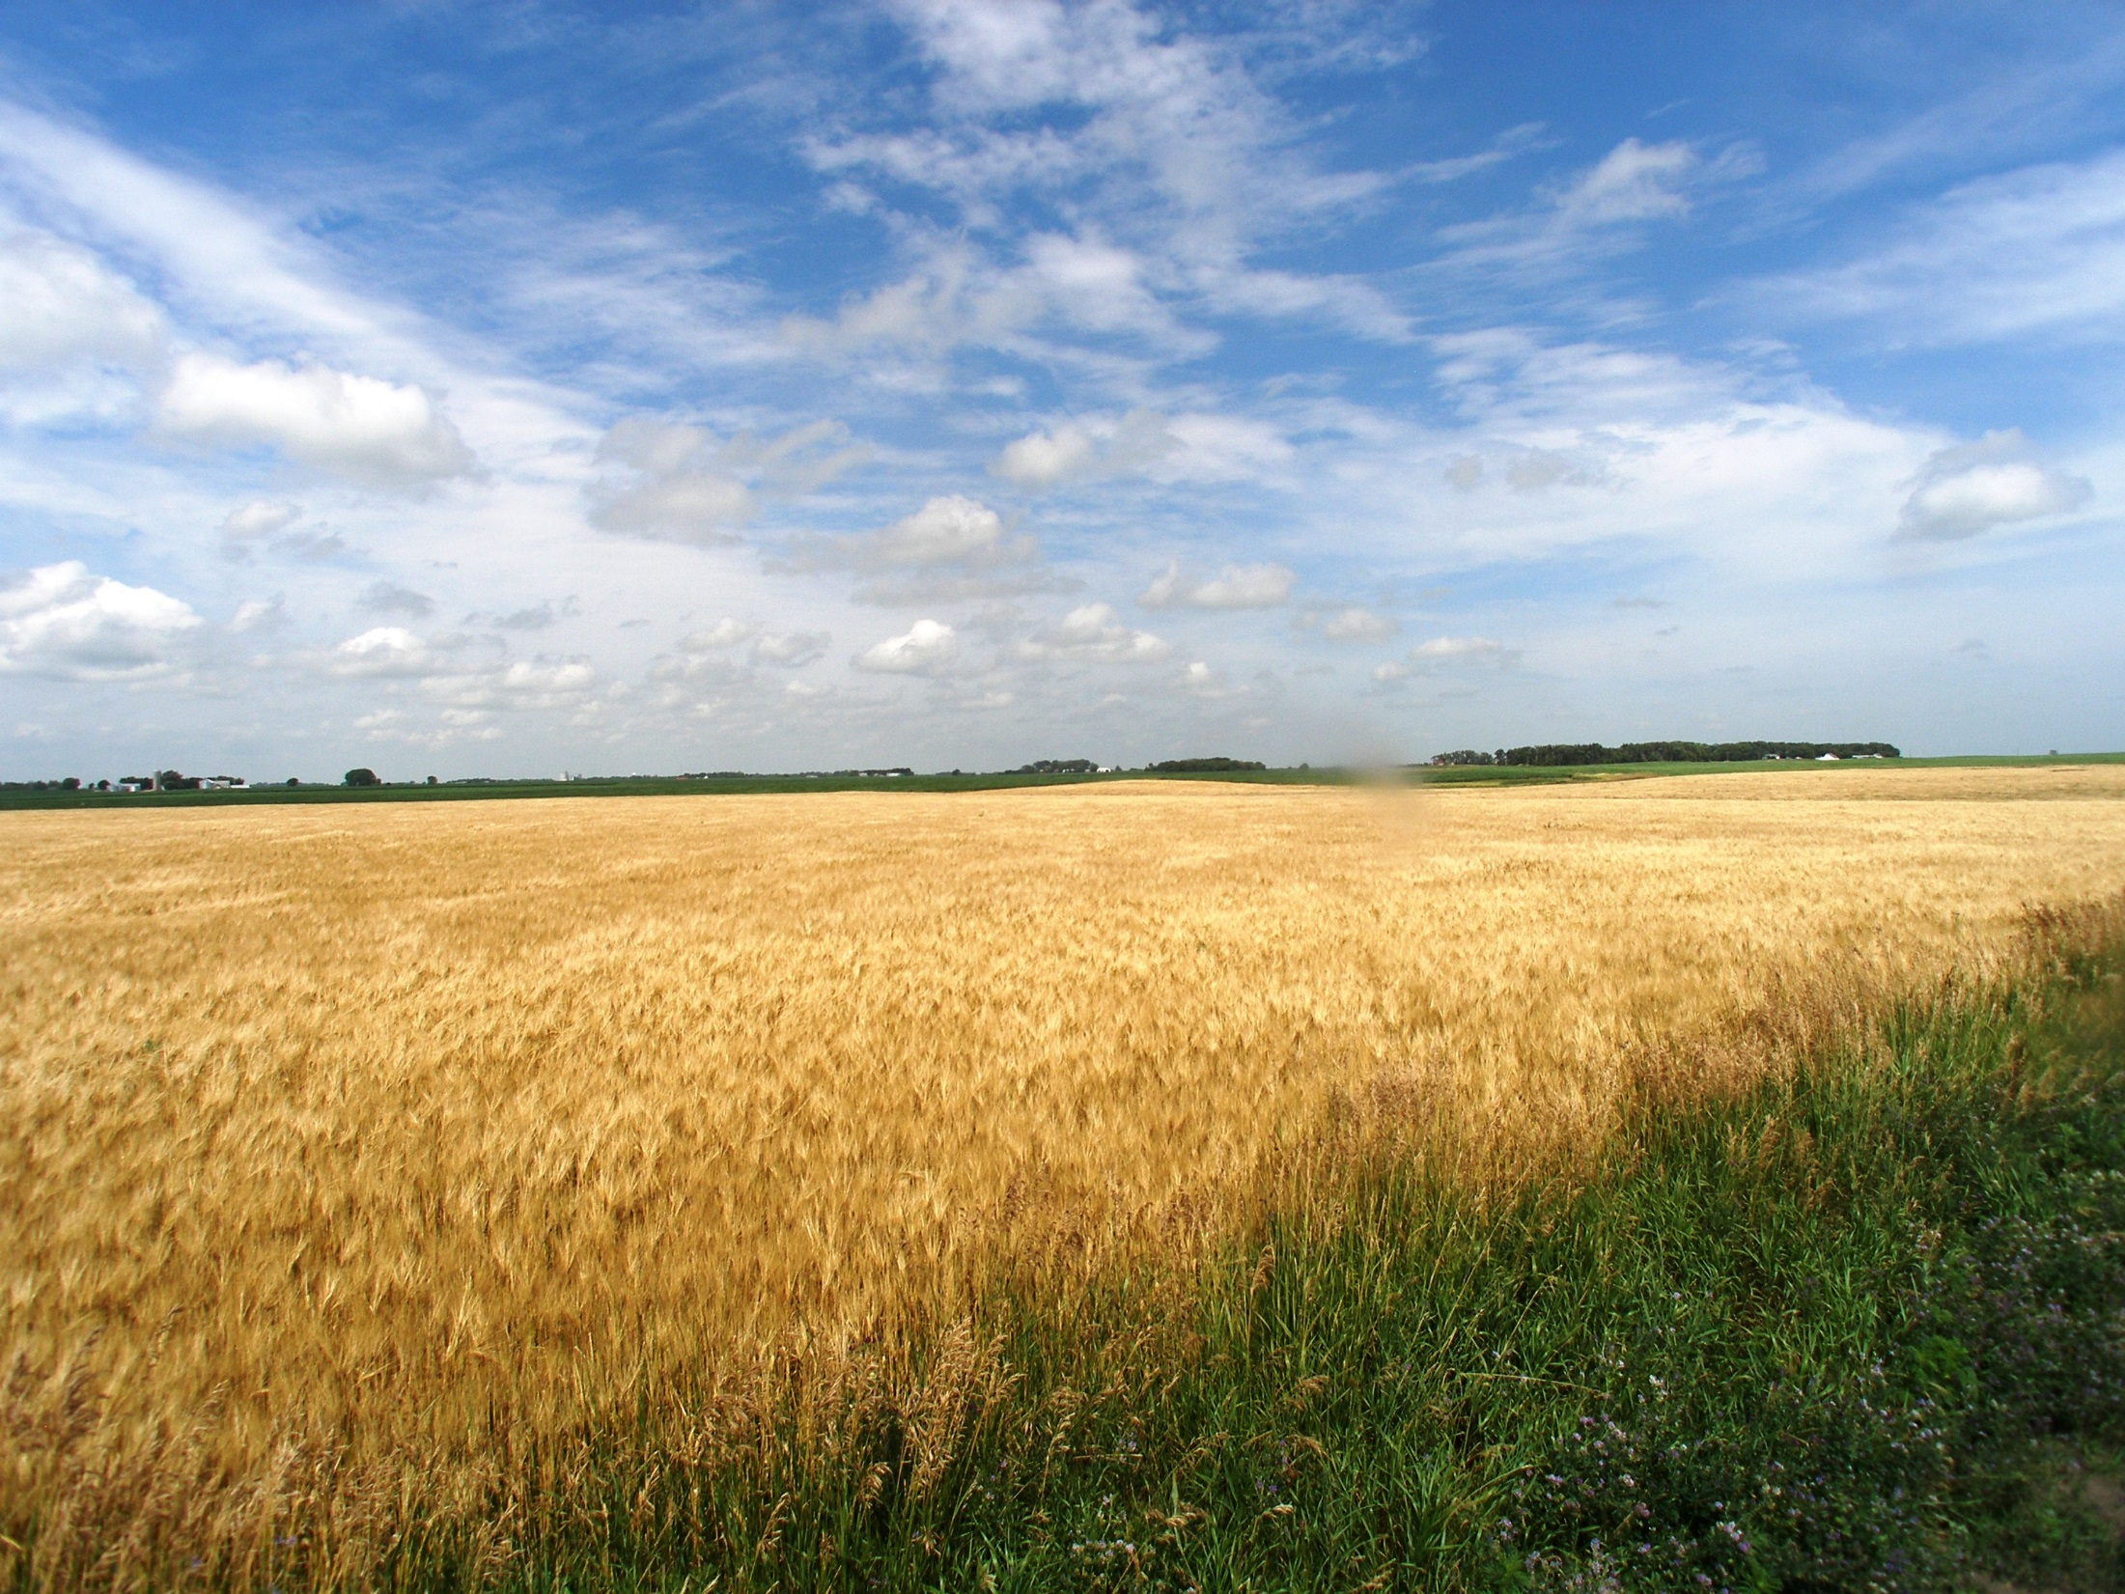
Records – NOP definition
“Any information in written, visual, or electronic form that documents the activities undertaken by a producer, handler, or certifying agent to comply with the Act and regulations”
Notes:
Narration: The formal definition of records under the National Organic Program is ““Any information in written, visual, or electronic form that documents the activities undertaken by a producer, handler, or certifying agent to comply with the Act and regulations.” In the rest of this section, we will describe records that organic farmers keep, some of which may be new to you.
Image: Carmen Fernholz

Slide 5
Start record keeping as soon as you transition – 36 months prior to when you want to be certified
Last prohibited
substance
Start
Prior Year | Jan | Feb | Mar | Apr | May | Jun | Jul | Aug | Sep | Oct | Nov | Dec
Year 1 | Jan | Feb | Mar | Apr | May | Jun | Jul | Aug | Sep | Oct | Nov | Dec
Year 2 | Jan | Feb | Mar | Apr | May | Jun | Jul | Aug | Sep | Oct | Nov | Dec
Year 3 | Jan | Feb | Mar | Apr | May | Jun | Jul | Aug | Sep | Oct | Nov | Dec
Crops harvested can be certified
End
36 months
Notes:
Narration: Organic record keeping should start during your transition, 36 months prior to when you want to get certified. This indicates that you have been following proper methods and have been only using approved inputs during transition. The record-keeping guidelines we will summarize in this module will continue to apply after you are certified.

Slide 6
Audit Trail
Field
Bin
Transport
Sale
Products can be traced from sale back to field
Production methods can be determined
Consumer
Notes:
Narration: Record keeping in organic helps create an “audit trail”. The system is designed so that products can be traced back to the farm or farms from where they came, and the methods and inputs used to produce them.

Slide 7
Record Keeping
Documentation in organic
What to record
Forms and field maps
Tracking and lot numbers
Other tips
Notes:
Narration: So what exactly do organic producers need to document? In this section, we will describe what exactly you will track.
Image: Pixabay

Slide 8
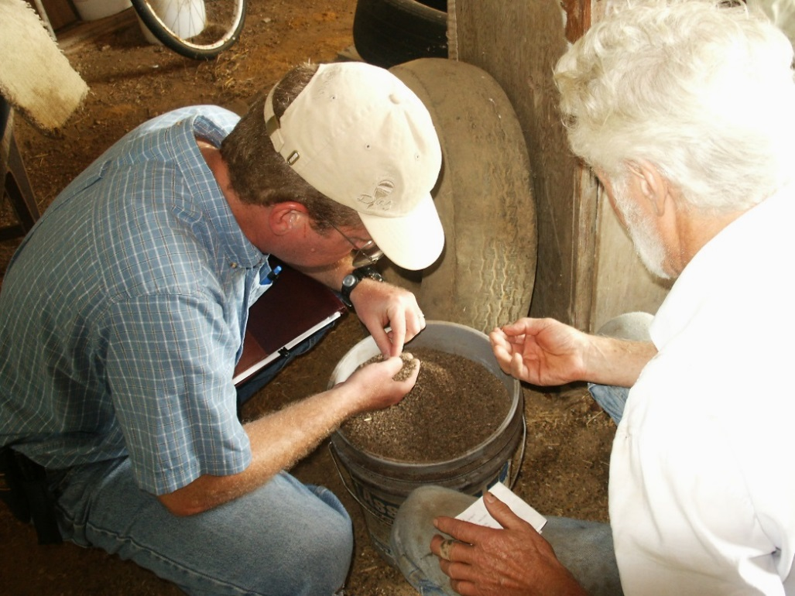
Keep Track of Activities that Occur Over Time
Includes field operations and inputs
Dates must be included
Each field must have a number and its acreage denoted
Notes:
Narration: In your organic record keeping, you will need to document activities that occur over time on a given field. This includes field operations and inputs and the date the activity occurred. Of course, most farms have more than one field. To keep track of what is happening on each field, you will need to assign a unique field number, called a lot number, to each field and note its acreage and location in a field map. We will discuss lot numbers and field maps later in this presentation.
Image: Harriet Behar, MOSES

Slide 9
Field Operations
Tillage
Planting
Fertilizing
Any operation when amendments are applied
Cultivation and other weed control operations
Irrigation
Approved pesticide application
Harvesting (and yields obtained)
Any other operations
Notes:
Narration: Examples of field operations are tillage, planting, fertilizing, other amendment application, weed control operations, irrigation, pesticide application, harvesting and any other operation that occurs on your field.
Image: Carmen Fernholz, University of Minnesota

Slide 10
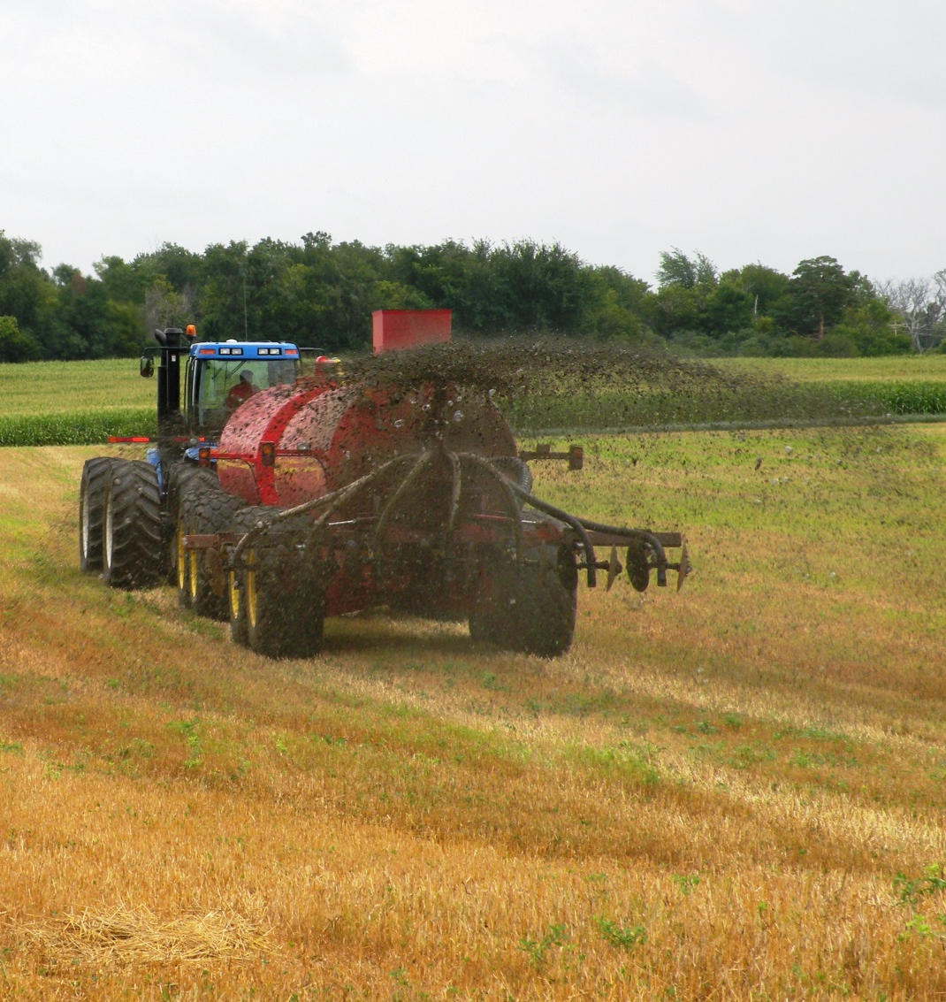
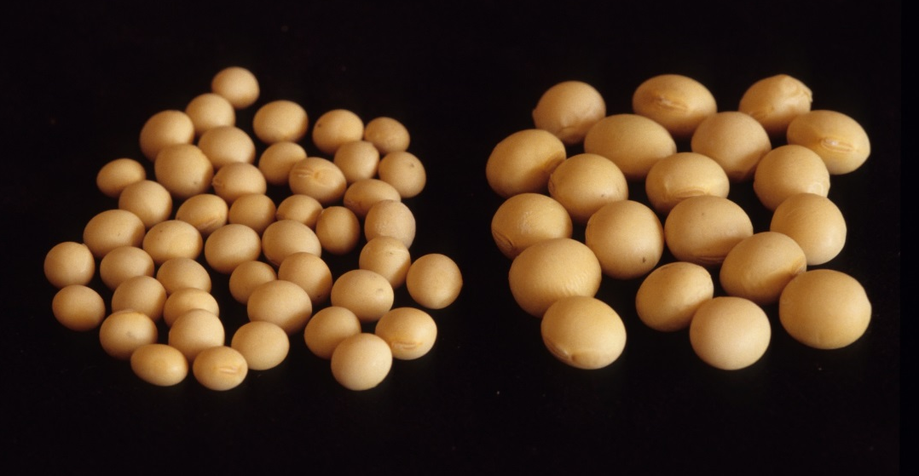
Inputs
Seed variety and source
Seed coatings, treatments, or inoculants
Foliar-applied products
Soil-applied products
Adjuvants or surfactants
Manure, compost, other approved fertilizers, or micronutrients
Approved pesticides
Any other approved inputs
Notes:
Narration: Along with field operations, your record keeping will log the inputs and usually the amount of each input you use on every field. Seed type and source, for example, must be documented. This includes anything applied to the seed such as coatings, seed treatments or inoculants. You must record all foliar- or soil-applied products and the adjuvants or surfactants used as tank additives with products such as these. All fertilizers, whether produced on-farm or purchased, must be noted. If you use an organically-approved pesticide, it must also be recorded. Please remember that ALL inputs must be approved for organic production whether in transition or certified.
Images: University of Minnesota (manure application); David L, Hansen, University of Minnesota (soybean)

Slide 11
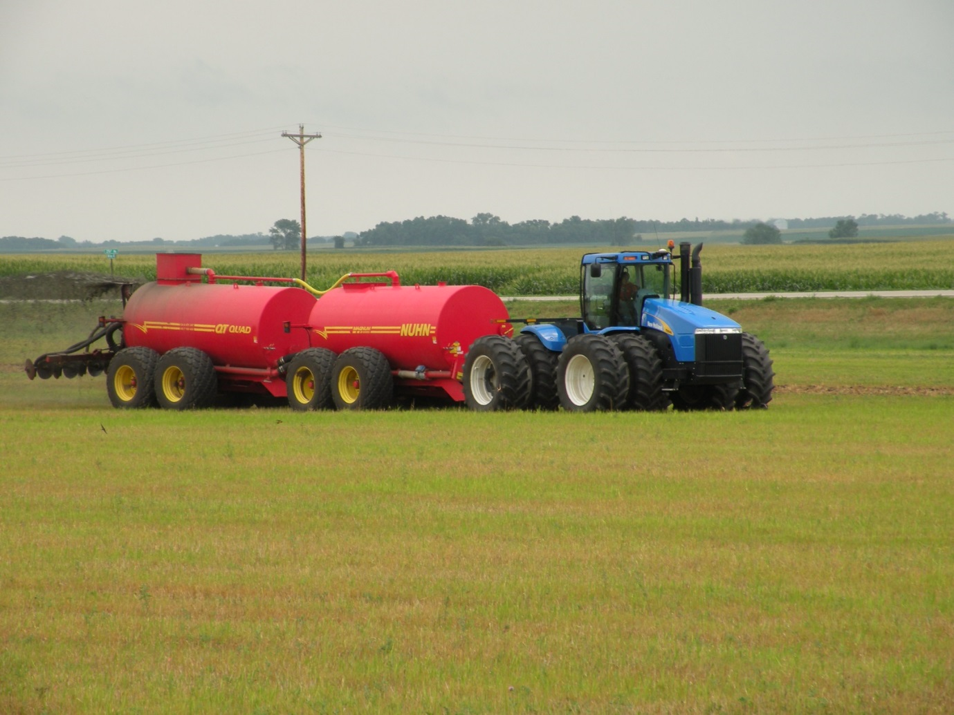
Example – Manure Application
What – what was applied
Who – you or custom work
When – date operation performed
Where – which field
Why – use of some inputs need justification
How – what equipment and rate was used
Notes:
Narration: Let’s go over the details you need to record using manure application as an example. For “what”, you would need to record what type of manure and the source (on-farm or purchased), and you would need to retain pertinent documents such as manure analysis reports. Who performed the work – you or was it custom work? When was the operation performed? To which field was it applied? Why is the manure being used? It may seem obvious that the manure is being used to supply nutrients for a crop, but there are some amendments such as micronutrients that must be justified with a soil test that documents a mineral deficiency. How was the manure applied as far as the rate and equipment used?

Slide 12
Record Keeping
Documentation in organic
What to record
Forms and field maps
Tracking and lot numbers
Other tips
Notes:
Narration: All these details might sound complicated to keep track of for all fields you have and all the operations you perform, but with the right organization, you can make recordkeeping less burdensome. In this section, we will cover examples of the forms you can use.
Image: Pixabay

Slide 13
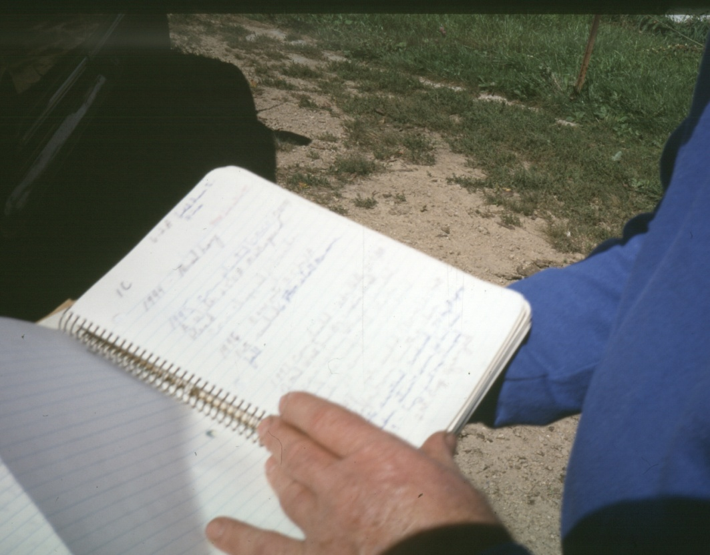
Examples of Forms
Field history and production sheets
Activity log
Inputs record
Harvest and storage records
Equipment cleaning log
Notes:
Narration: Here are some examples of forms you might use. We will go through just a few of these to give you an overview. Remember, however, there is no one way to keep records and different certifiers may have different forms. Contact your certifier if you have one and they can supply you their recommended forms. Not all of these records are necessarily submitted to the certifier, but they need to be available for the inspector to examine so it is good to keep them organized. Additionally, these records will be a great aid in filling out your Organic System Plan.
Image: Harriet Behar, MOSES

Slide 14
Field History Sheets
Riddle and Gulbranson, 2011
Notes:
Narration: Field history logs summarizes what has occurred on that field. You can create a spreadsheet or print out forms from your certifier. All field activities for all fields will need to be documented. History of field activities must be available for the three years preceding your request for organic certification. In this example, field, crop, yield, harvest and storage is listed.

Slide 15
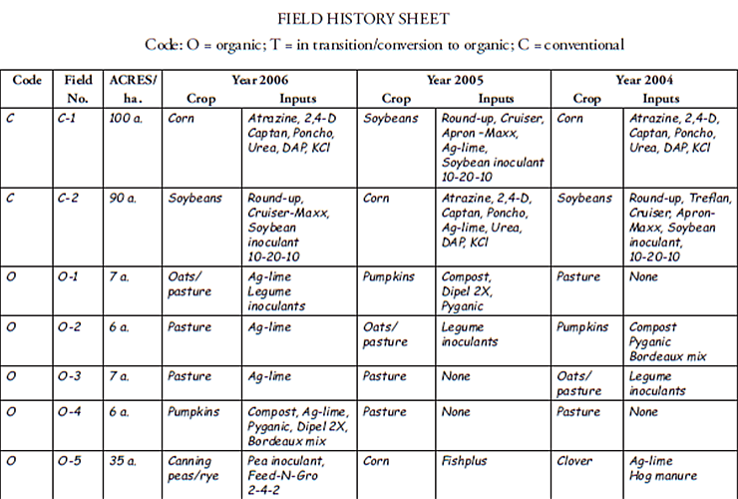
Kuepper, 2006
Notes:
Narration: Here is another example of a field history sheet. This example includes field, crop, and inputs. In split operations, field history sheets are needed for conventional fields, too.

Slide 16
Activity and Input Log
Riddle and Gulbranson, 2011
Notes:
Narration: An activity and input log is another example of an organic production record. This log is where you would note details on activities such as those involving fertilizing, weed control operations, pesticide application, or irrigation.

Slide 17
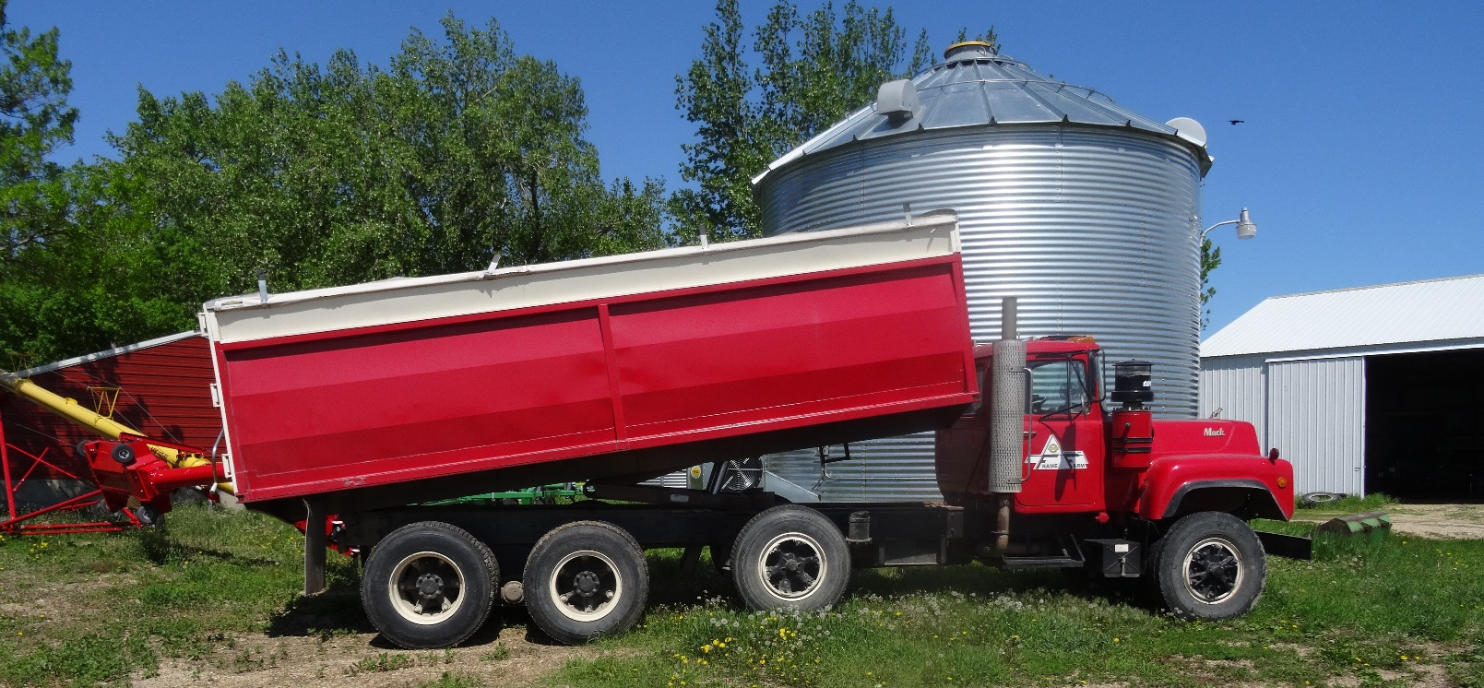
Storage, Transportation and Sales Records
Become important after transition
Help track your products as they enter the organic marketplace
Notes:
Narration: These are additional items to record that will become important after transition, including your storage, transportation and sale of your organic crop. The organic integrity of your crop must be protected from mingling with nonorganic crops, or contact with prohibited substances such as non-approved pest control materials. Image: Kristine Moncada, University of Minnesota

Slide 18
Logs, sheets and forms vary, but the overall information to record is the same
Notes:
Narration: We have shown you a few examples of forms you might use for your operation. The logs, sheets and forms (or whatever they may be called) will vary. The important thing to remember is that the WAY you save information is not as important as WHAT information you save as long as you can indicate to your certifier and inspector what activities and inputs occurred. California Certified Organic Farmers, an organic certifier, has a nice checklist
Image: Midwest Organic Services Association

Slide 19
Record Keeping Templates
Documentation Forms for Organic Crop and Livestock Producers from ATTRA
Your Bridge Between Crop Insurance & Organic System Reporting from MOSES
Minnesota Guide to Organic Certification
Certifier websites (such as MOSA Organic)
Notes:
Narration: You can find templates of forms and logs at many sites. Please check out the publications we list here. Certifiers will often have their preferred forms on their websites so check those out, too, especially if you know which certifier you will eventually be working with. You may choose to use forms that already exist to log your information, but you can always develop your own.

Slide 20
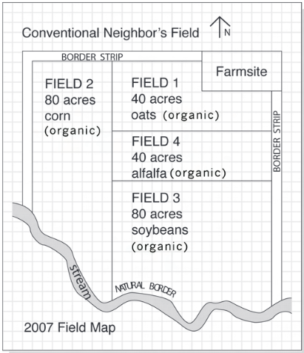
Field Map
Accurate map of your entire farm
Must include:
Fields (location and acreage)
Orientation
All geographical features
2017
Riddle and Gulbranson, 2011
Notes:
Narration: One last document we will cover is the field map. A field map accurately represents your entire farm. Field maps are not required by NOP rules, but almost all certifiers require them. They indicate the location, orientation, and acreage of each of your fields. It will also show all geographical features such as farmstead, barns, sheds, roads, ditches, streams, ponds, buffers, natural areas, and what is in areas adjacent to farm (e.g. conventional farms). Field maps also include conventional fields in split operations.

Slide 21
Satellite Maps
Obtain from NRCS
Outline landscape features for your operation
Watch our module on Certification for more information
Notes:
Narration: Here is another example of a field map using a satellite image instead of a drawing. You can get satellite maps of your farm from the NRCS personnel at your local office and outline the landscape features for your operation.
Image: Harriet Behar, MOSES

Slide 22
Record Keeping
Documentation in organic
What to record
Forms and field maps
Tracking and lot numbers
Other tips
Notes:
Narration: We mentioned earlier that record keeping helps create an “audit trail” so that products can be traced back from point of sale to their field of origin. An important factor for tracking begins at the farm level with the use of lot numbers.
Image: Pixabay

Slide 23
Lot Numbers
Field
Bin
Transport
Sale
First created on-farm as part of audit trail
Assigned to every new product
Used in your logs and other forms
Audit Trail →
Consumer
Notes:
Narration: Lot numbers are first created on-farm as part of the audit trail to track your product from the field to consumer. You will need to apply unique lot numbers to the crops or product from each field before you harvest. Lot numbers will be used in your logs and other forms that record activities such as storage post-harvest.

Slide 24
What Is a Lot Number?
Code used to trace crop
To the field where grown and when grown (place and time)
Indicates all production practices associated with that field (seed, amendments, planting, fertilizing, harvesting, etc.)
Notes:
Narration: A lot number is just a code used to trace your crop back to the field where it was grown and when it was grown. Because of your organic record keeping, your lot number ultimately indicates all the production practices that occurred on that field or to that crop.
Image: Carmen Fernholz

Slide 25
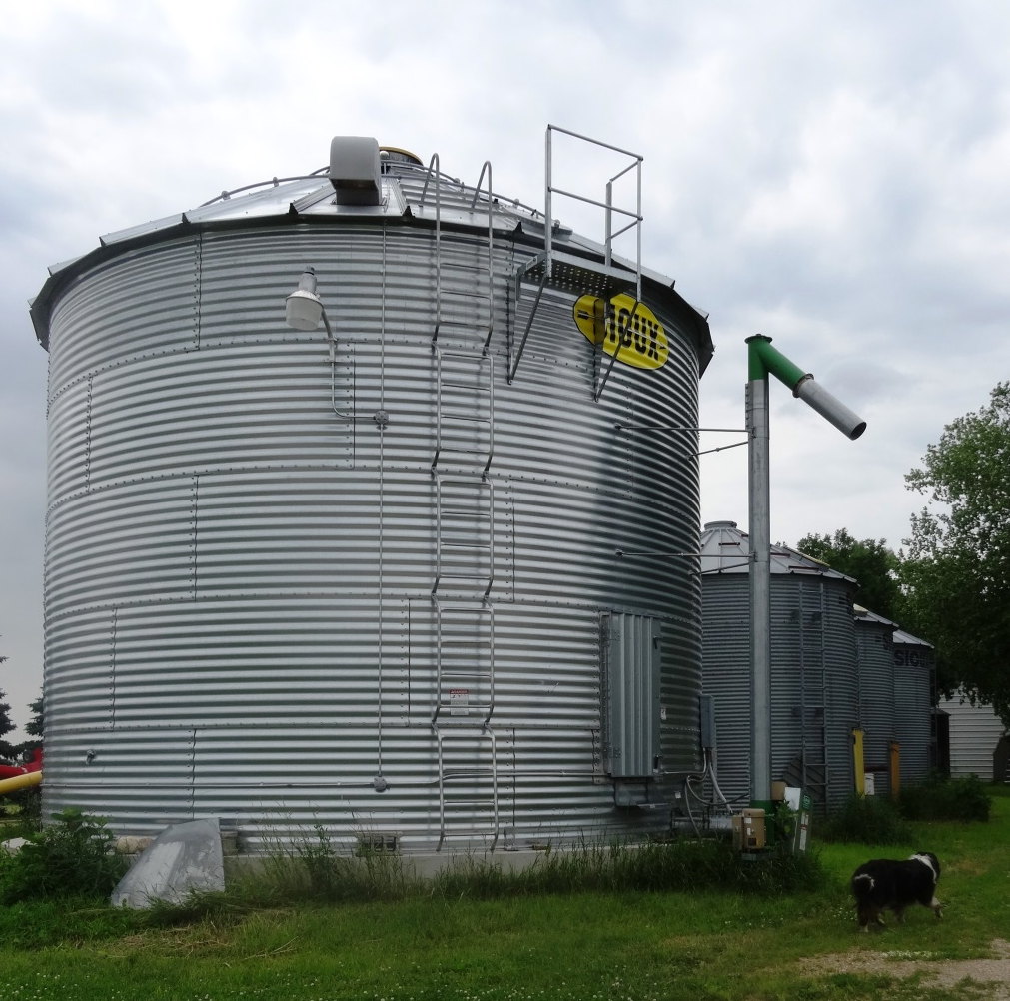
Assigning Lot Numbers
Assigned before the grain leaves the field
Should be specific, consistent, and easy to decipher; can include:
Crop
Field
Bin
Year
Farm name or initials
Notes:
Narration: Lot numbers are assigned before the grain leaves the field. Fruit and vegetable growers also need lot numbers. You can create them how you like, but it makes most sense to incorporate important info such as crop, field, bin, year and farm name.
Image: Kristine Moncada, University of Minnesota

Slide 26
Example
Farm
Year
Crop
Field
Bin
Farm Name
2018
Soybean
7
1
Lot number = FM18S71
Tip: Be consistent when creating lot numbers
Notes:
Narration: Here is an example where the lot number includes the name of the farm, the year, the crop, the field and the bin. A good tip is to be consistent once you have a system down that works for you. Having an easy-to-decipher lot number can cut down on confusion later.

Slide 27
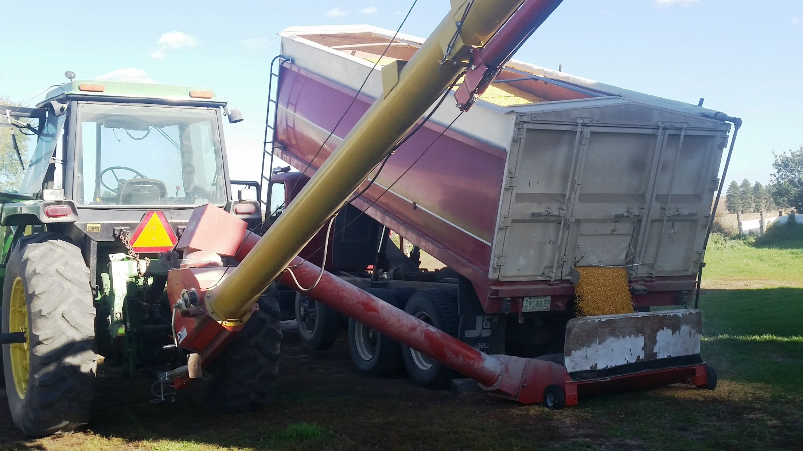
Other Things to Know
When crops are combined, a new lot number is assigned, but records will show associations with old lot numbers
Lot number will travel with the product along the production chain
Notes:
Narration: When you combine crops from different fields in storage a new lot number needs to be assigned. Your records will show which old lot numbers are combined to form the new lot. Of course, record keeping doesn’t end after you sell your crop or product. The lot number from your farm will travel with the product as it progresses to the consumer. The actual number may be reassigned along the line, but it will still be traceable back to your farm and field.
Image: Carmen Fernholz

Slide 28
Record Keeping
Documentation in organic
What to record
Forms and field maps
Tracking and lot numbers
Other tips
Notes:
Narration: We have some final tips to guide you in the organic record keeping process.
Image: Pixabay

Slide 29
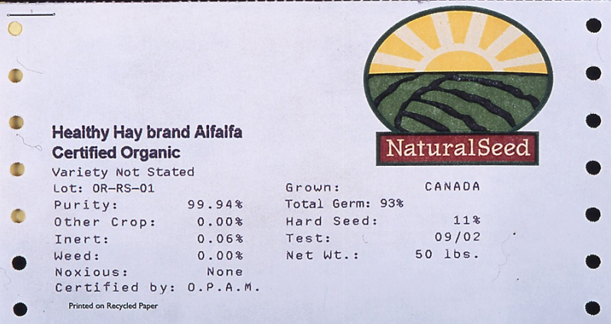
Items to Save
Labels – seed, inputs
Soil and tissue test results
Invoices
Receipts
Communications with your certifier
Keep for 5 years
Notes:
Narration: In addition to keeping records, you should also keep the paperwork you collect relating to your organic production. This includes seed labels, labels from inputs, soil and tissue test results, invoices, and receipts. Communications such as letters or emails from your certifier should be saved; they can provide a good reference in case misunderstandings arise. Just like with your records, these items should be kept for five years.
Images: Harriet Behar

Slide 30
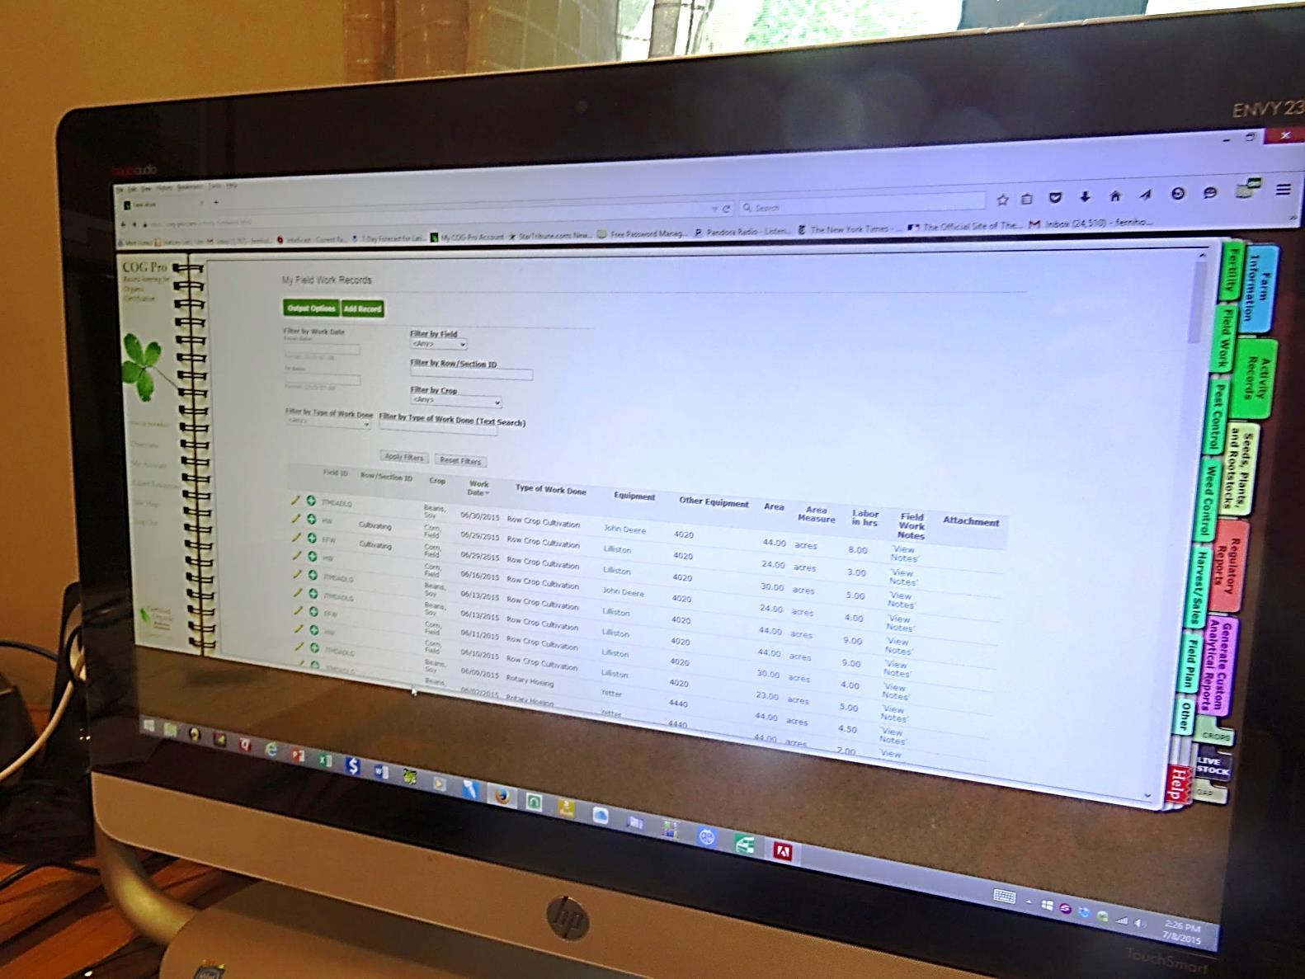
Record Keeping Programs
Example:
COG Pro
Many other options available
Notes:
Narration: There are online programs and software available to farmers to help with record keeping. One example specifically designed for organic farmers is COG Pro. It has online versions of some of the forms we have discussed and allows you to scan items that you need to save like those we listed in the previous slide. There are other software programs for general farming that you might like. Special computer programs are not mandatory, however. A spiral notebook kept in your pickup truck, a calendar with a pen hanging by the door, or even a smart phone are all acceptable methods to maintain records.
Image: Kristine Moncada, University of Minnesota

Slide 31
Protect Your Data!
Notes:
Narration: If using your computer to store your records electronically, back up your data! For paper records, make sure to keep in a safe and accessible place.

Slide 32
Conclusion
Choose the record keeping method that you will be comfortable with
Keep track as you go along
Keep everything organized and accessible
Consult with your certifier with questions
Notes:
Narration: There are different ways to keep records – choose what you are comfortable with. It is best to keep up with logging your data as you go; otherwise, backtracking can become overwhelming and prone to information loss. Above all, keep everything documented in an organized and accessible manner. And as always, your certifier is the best resource if you have questions.
Image: Pixabay

Slide 33
Resources
Record Keeping Checklist for Organic Growers – CCOF Certification Services
Organic Recordkeeping for a Crop Audit – Oregon Tilth
Example Forms – MOSA Organic
Guidebook for Organic Certification - MOSES
Minnesota Guide to Organic Certification – Minnesota Institute for Sustainable Agriculture
Notes:
Narration: Here are some other resources on organic record keeping you may want to explore.

Slide 34
Record Keeping
Documentation in organic
What to record
Forms and field maps
Tracking and lot numbers
Other tips
Notes:
Narration: Thanks for watching our Record Keeping module! We hope what you’ve learned will provide a good basis to start your own organic record keeping program.
Image: Pixabay

Slide 35
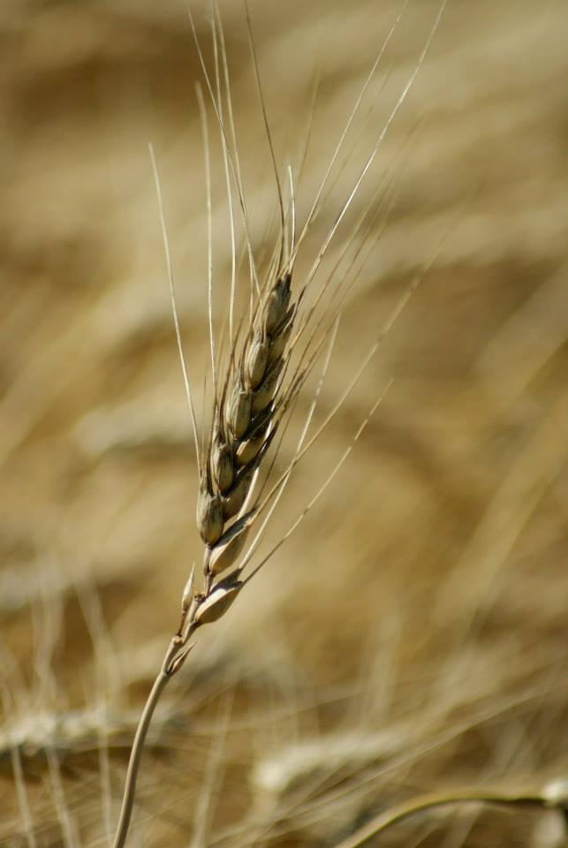
© 2017 Regents of the University of Minnesota. All rights reserved. The University of Minnesota is an equal opportunity educator and employer.
This material is based upon work that is supported by the National Institute of Food and Agriculture, U.S. Department of Agriculture, under grant number 2013-51106-21005.
Notes:
Narration: This material is based upon work that is supported by the National Institute of Food and Agriculture.
Image: Constance Carlson, University of Minnesota

Slide 36
References
ATTRA Sustainable Agriculture. 2016. Question of the Week: What can you tell me about software products for organic farm recordkeeping? https://attra.ncat.org/calendar/question.php/what-can-you-tell-me-about-software-products-for-organic-farm-recordkeeping
Bay State Organic. 2008. Understanding Lot Numbering Systems. http://baystateorganic.org/wp-content/uploads/2016/01/Understanding-Lot-Numbering-Systems-Resource-Sheet.pdf
Behar, H., L. Langworthy, and J. Nelson. 2016. Guidebook for Organic Certification. Midwest Organic and Sustainable Education Service. https://mosesorganic.org/publications/guidebook-for-certification/
Carolina Farm Stewardship Association. 2013. Record Keeping Software Review. https://www.carolinafarmstewards.org/wp-content/uploads/2013/03/Record-Keeping-Software-Final.pdf
CCOF Certification Services. 2017. What is a lot number? https://www.ccof.org/faqs/what-lot-number
Coleman, P. 2003. Guide for Organic Producers. ATTRA. https://attra.ncat.org/attra-pub/summaries/summary.php?pub=67
Iowa Organic Certification Program. 2016. Developing a Producer Lot Number. www.iowaagriculture.gov/AgDiversification/Organic/LotNumbering.doc

Slide 37
References (cont.)
Kime, L. 2017. The Importance of Record Keeping. https://extension.psu.edu/the-importance-of-record-keeping
Kuepper, G. 2006. Organic System Plans: Field and Row Crops and Pasture and Range Systems. ATTRA, the National Center for Appropriate Technology. https://attra.ncat.org/attra-pub/summaries/summary.php?pub=167
MOSA Certified Organic. 2017. Certification Forms. http://mosaorganic.org/certification/forms
Riddle, J. and L. Gulbranson. 2011. Minnesota Guide to Organic Certification. Minnesota Institute for Sustainable Agriculture. https://www.misa.umn.edu/publications/mn-guide-organic-certification
USDA-AMS. 2011. Instruction Recordkeeping. https://www.ams.usda.gov/sites/default/files/media/2602.pdf
USDA-AMS. 2015. Organic Sound and Sensible Project - Examples of Types of Records. https://www.youtube.com/watch?v=cTsFZ_keYsc&feature=youtu.be
USDA-AMS. 2017. Becoming a Certified Operation. https://www.ams.usda.gov/services/organic-certification/becoming-certified

