Slide 1
Soils (Part 2): Sources of Organic Nutrients
Authors
Adria Fernandez
John Lamb
Kristine Moncada
Constance Carlson
Craig Sheaffer
This material is based upon work that is supported by the National Institute of Food and Agriculture, U.S. Department of Agriculture, under grant number 2013-51106-21005.
Notes:
Narration: Welcome to Part 2 – Sources of Organic Nutrients – of our Soils module series. Image: Kristine Moncada, University of Minnesota

Slide 2
Sources of Organic Nutrients
Legumes and green manures
Animal manures
Compost
Processed fertilizers
Micronutrients and other amendments
Notes:
Narration: In this second soils module, we will cover sources of organic nutrients, including legumes and green manures, animal manures, compost, processed fertilizers, and micronutrients and other amendments.
Image: Kristine Moncada, University of Minnesota

Slide 3
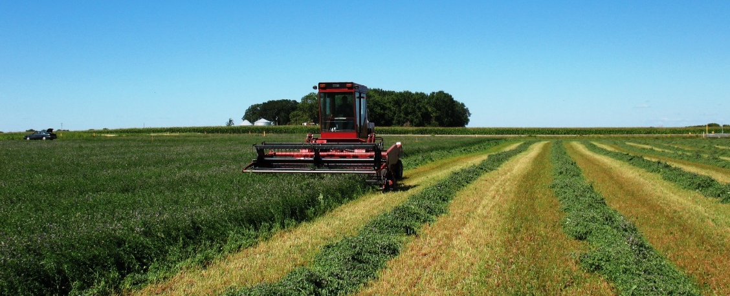
Legume Crops
Fix nitrogen from atmosphere
Rhizobium inoculation will ensure nodulation and N fixation
Include green manure, grain, and forage crops
Notes:
Narration: Soil nutrients can be derived from a variety of sources in organic systems. These include plant sources such as legumes and green manures. Legumes are plants that fix, or capture, nitrogen from the atmosphere by hosting nitrogen-fixing Rhizobium bacteria in nodules on their roots. Seed of these crops should be treated with a Rhizobium inoculant to ensure that they will nodulate and fix nitrogen. Your rotation may include legumes as both green manures, also called plowdown crops; and as grain or forage crops that will be harvested. Image: Craig Sheaffer, University of Minnesota

Slide 4
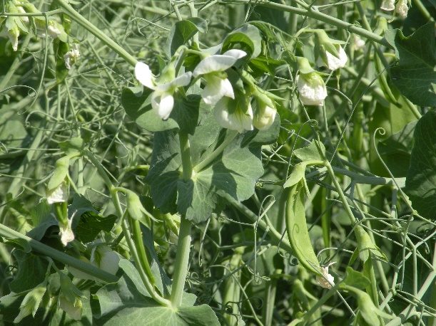
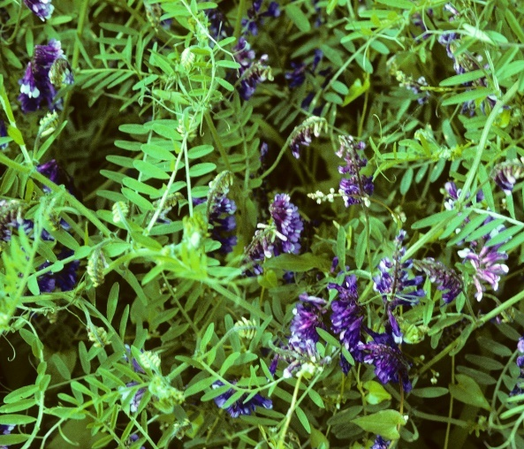
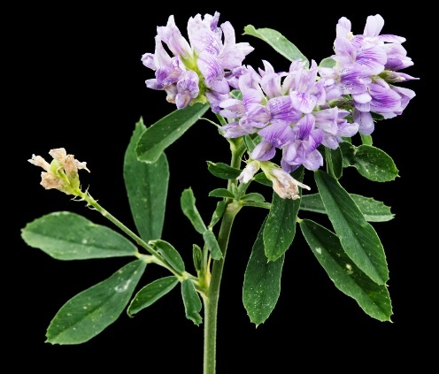
Legume Crops
Grain crops (net N contribution will vary)
Soybean
Pea
Dry bean
Cover crops and forages
Vetch
Clover
Alfalfa
Native legumes
Field pea
Hairy vetch
Alfalfa
Notes:
Narration: Grain legumes include soybean, pea, and dry bean. With any legume that is harvested, some nitrogen will be exported from the farm. However, some grain and forage crops, including pea and alfalfa, may still leave a net positive contribution to soil N after harvest. Cover or green manure crops, like vetch or clover, will return their fixed N to the soil when the biomass is incorporated. Cover and forage legumes include vetch, clover, alfalfa, and native prairie legumes. High biomass producers, like vetch and alfalfa, will provide more plowdown N.
Images: Adria Fernandez, University of Minnesota (pea); David L. Hansen, University of Minnesota (vetch, alfalfa)

Slide 5
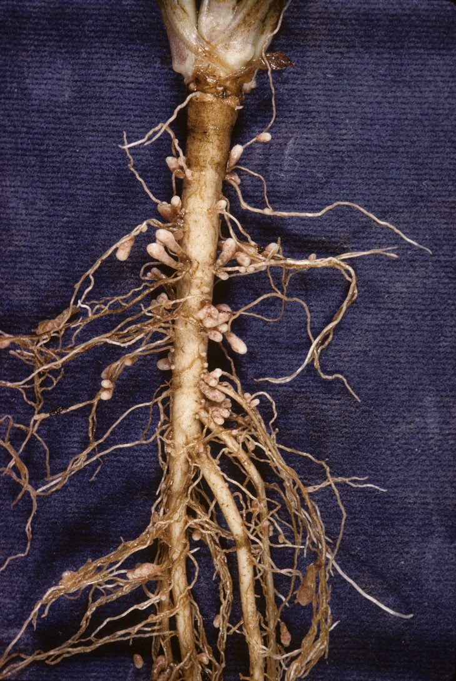
Are Your Legumes Fixing Nitrogen?
Dig up a plant that is over 1 month old, but not flowering
Remove soil from roots
Look for nodules on the roots
Actively-fixing nodules appear pink or red inside
Notes:
Narration: You can check whether your legume crop is effectively fixing nitrogen. Dig up a plant that is over one month old, but not yet flowering. Remove the soil from the roots, and look for nodules, which will be round or elongate whitish growths on the roots. You can split open the nodules with a fingernail. Actively fixing nodules will have a pink or red color inside.
Image: David L. Hansen, University of Minnesota

Slide 6
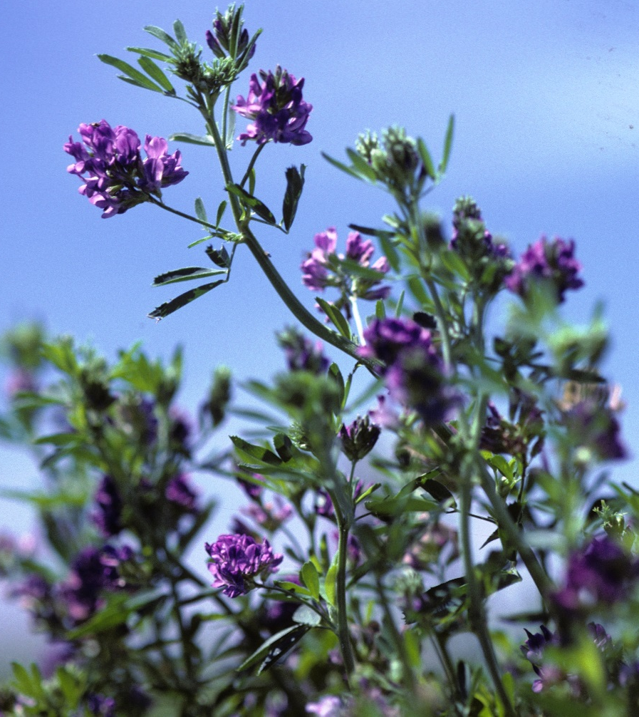
Factors Affecting N Contribution from Legumes
Biomass production
Affected by species, stand density, weed competition, stand age
Biomass composition
Carbon:Nitrogen (C:N) ratio depends on crop maturity
Notes:
Narration: Many factors affect how much nitrogen a legume crop will contribute to the following crop. The first is simply how much biomass it produces—which in turn depends on the legume species used, as well as the density, height, and weediness of the stand—and the stand age, or how long the legume has been in place. The more biomass a legume stand produces and the longer it is in place, the more N it will provide. How much N the legume biomass contains and how readily it will decompose is affected by its composition, particularly the carbon:nitrogen (C:N) ratio, or the amount of carbon relative to the amount of nitrogen. Crop material that is more mature will have a higher C:N ratio, so it will tend to contain somewhat less nitrogen in a given amount of biomass, and will decompose more slowly.
Image: David L. Hansen, University of Minnesota

Slide 7
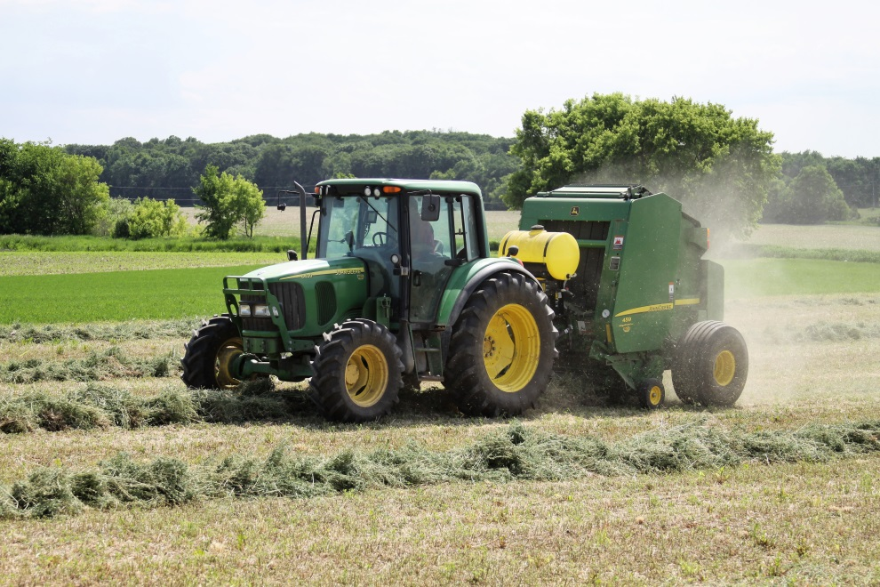
Factors Affecting N Contribution from Legumes
Harvest regime
Number and timing of cuttings
Biomass removal
Method and timing of incorporation
Notes:
Narration: Your management decisions can affect how much nitrogen a legume crop will contribute. Harvesting legume biomass, for example cutting alfalfa for hay, will remove some of the nitrogen that has been fixed, but may also stimulate herbage regrowth and nitrogen release from roots. How and when the biomass is incorporated will also affect how quickly it will break down.
Image: Devan Catalano, University of Minnesota

Slide 8
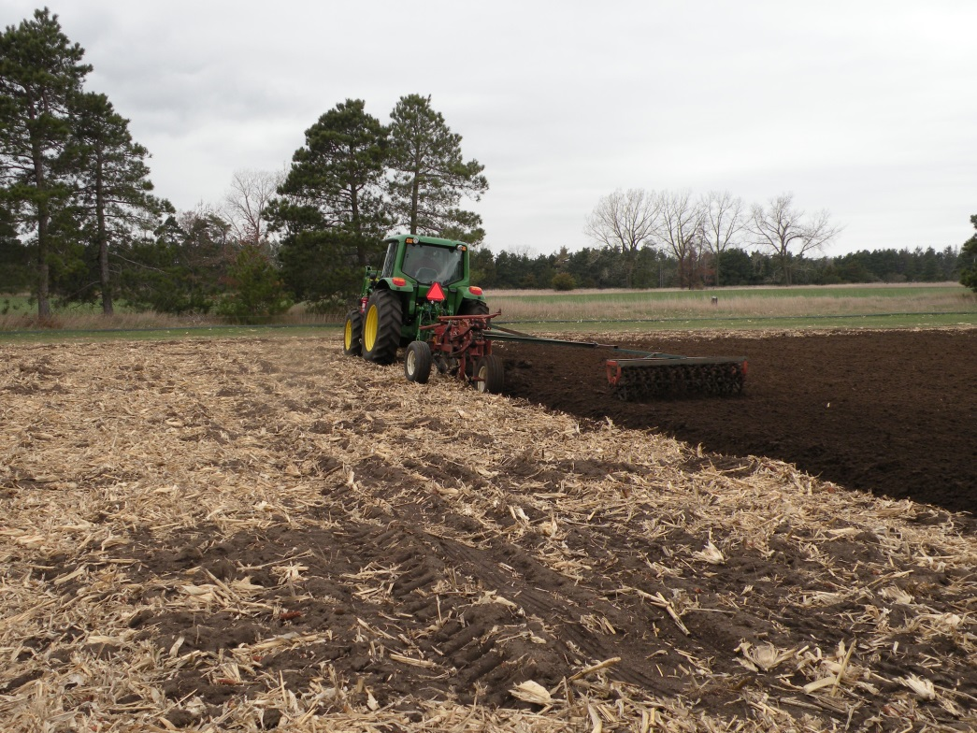
Nitrogen Release and Loss
Decomposition rates depend on soil temperature, moisture, biology
Can be lost to denitrification
Notes:
Narration: While aggressive tillage can accelerate the rate of organic matter decomposition, some factors affecting biomass decomposition and nitrogen release are not controlled by your management decisions. The rate of nitrogen release and loss will depend on soil temperatures, moisture, and biological activity. Biomass will decompose more readily in warmer temperatures and when moisture is adequate, but warm, wet conditions can also lead to denitrification, or loss of N to the atmosphere. Image: Craig Sheaffer, University of Minnesota

Slide 9
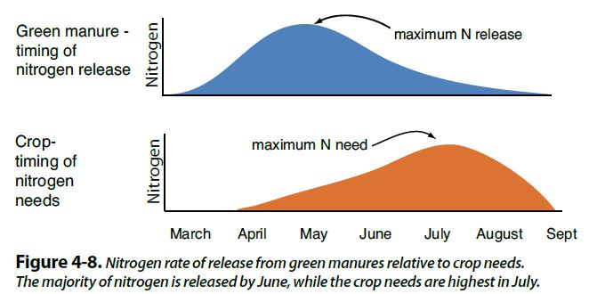
Crop Access to Legume N
Availability may not be synchronous with crop need (feed the soil!)
Maximum N release
Notes:
Narration: Because biomass decomposition depends on soil and weather conditions, the timing of nutrient availability will vary and may not fully align with the timing of crop nitrogen need. It is common for nitrogen release from livestock and green manures to peak early in the season, while a crop, for example corn, may have its period of peak growth and peak N demand in July. Alternatively, in a cool spring, organic materials may be slow to decompose, leaving nitrogen supplies inaccessible until after crop demand has peaked. However, even when nutrient release is not perfectly synchronized with crop demand, the incorporation of green manures can feed the soil, contributing to organic matter stocks and long-term fertility.

Slide 10
N Credits from Legumes
Reduction in fertilizer need of following crop (recommendations developed for conventional agriculture)
Crop | N credit (lb/A) to first-year corn*
Alfalfa
1 year old stand | 75
2+ year old stand | 150
Red or alsike clover | 75
Grass/legume hay | 75
Field peas or dry beans | 20
*On medium-textured soils
Source: Kaiser et al., 2016
Notes:
Narration: The reduction in fertilizer nitrogen needed by a crop following a legume is called an N credit. The N credits shown here represent how much less fertilizer N will be needed for a corn crop when that corn crop follows a legume compared to when it follows corn. These recommendation have been developed for conventional systems, and do not account for variation due to soil texture, organic matter, or cropping system, but you may find them useful as a rough guide. A stand of alfalfa that is at least 2 years old will generally provide 100% of the nitrogen needs of the following corn crop.

Slide 11
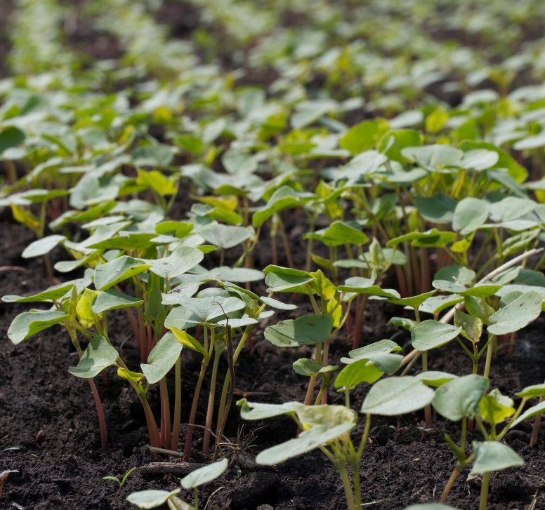
Non-Legume Green Manures
Do not fix N, but can hold nutrients for later release
Contribute to soil organic matter and microbial activity
Decomposition of high C:N crops can immobilize N
Buckwheat
Notes:
Narration: Non-legume green manures can also play a role in building soil fertility. Although they do not fix nitrogen, they can take up nitrogen or other nutrients that would be vulnerable to loss, and hold them in your system in their biomass. Sometimes this process is called nitrogen scavenging. Incorporating the biomass on non-legume green manures will contribute to soil organic matter and microbial activity. However, it’s worth noting that when cover crops with a high C:N ratio are incorporated, available nitrogen can sometimes become temporarily unavailable because of immobilization, which happens when soil microbes take up and hold the nitrogen as they feed on the carbon in the plant material.

Slide 12
Carbon to Nitrogen Ratios of Organic Materials
Material | C:N Ratio
Oat straw | 70:1
Rye cover crop (anthesis) | 37:1
Pea straw | 29:1
Mature alfalfa hay | 25:1
Ideal Microbial Diet | 24:1
Young alfalfa hay | 13:1
Hairy vetch cover crop | 11:1
Notes:
Narration: Generally, grasses or any other materials with a C:N ratio over about 24:1, meaning 24 times as much carbon as nitrogen, are likely to result in some immobilization. This table shows some examples of the carbon to nitrogen ratios of various materials.

Slide 13
Sources of Organic Nutrients
Legumes and green manures
Animal manures
Compost
Processed fertilizers
Micronutrients and other amendments
Notes:
Narration: Another source of organic fertility is animal manures.
Image: Kristine Moncada, University of Minnesota

Slide 14
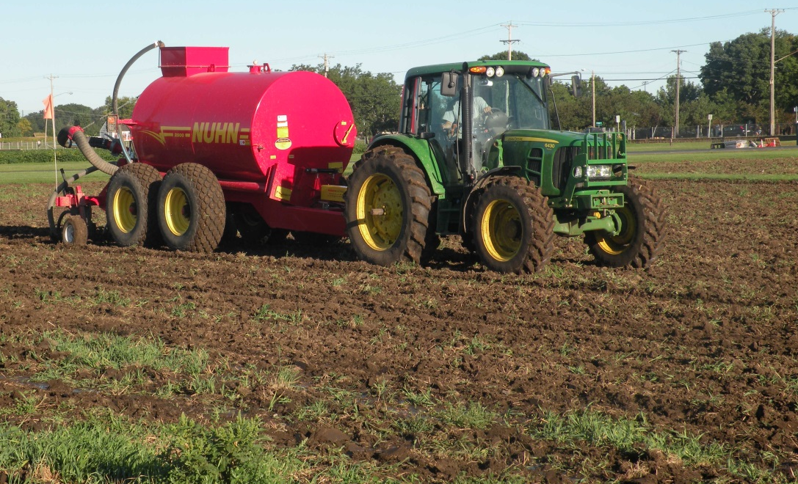
Raw Animal Manures: Summary
May be solid or liquid
Hog, dairy/beef, poultry, other
Need not be from organic sources
Additional testing may be required for conventional manure
Notes:
Narration: Raw animal manures are allowed in organic farming, and may be in solid or liquid forms, from hogs, dairy or beef cattle, poultry, or other livestock. The manures can be obtained from conventional livestock operations and do not have to be sourced from organic livestock. However, you must ensure that any conventional manure you use does not contain prohibited materials. Your certifier should be notified of the source of your manures and they may specify additional testing on conventional manure to confirm they are not contaminated.
Image: Craig Sheaffer, University of Minnesota.

Slide 15
Raw Animal Manures: Application
Cannot apply to frozen ground
Application times restricted for food safety
Crop | Permitted application
Feed crops | Anytime
Food crops with edible portion not in contact with soil (e.g. corn) | ≥90 days before harvest
Food crops with edible portion in contact with soil (e.g. carrots) | ≥120 days before harvest
Notes:
Narration: The organic standards restrict when raw animal manures can be applied. Manure cannot be applied to frozen ground, where it will be vulnerable to runoff, and application times are restricted to protect food safety. Manure can be applied to livestock feed crops at any time. However, for food crops, application must be at least 90 days before harvest in crops whose edible portions are not in contact with the soil, for example, corn. For crops whose edible portion is in contact with the soil, for example carrots, manure application must be at least 120 days before harvest.

Slide 16
Typical nutrient content of stored manure
 |  | N | P₂O₅ | K₂O | N | P₂O5 | K₂O
 |  | pounds/1000 gallons |  |  | pounds/ton
Swine | Farrowing | 27 | 27 | 15 | - | - | -
 | Nursery | 34 | 25 | 18 | - | - | -
 | Gestation | 40 | 42 | 18 | 22 | 27 | 14
 | Finishing | 53 | 39 | 29 | 22 | 22 | 17
Dairy | Cows | 25 | 15 | 27 | 11 | 7 | 9
 | Heifers | - | - | - | 13 | 12 | 19
Beef | Cows | - | - | - | 15 | 10 | 9
 | Steers | - | - | - | 14 | 9 | 14
Poultry | Turkeys | - | - | - | 44 | 63 | 34
 | Broiler | - | - | - | 59 | 63 | 40
 | Layer | - | - | - | 39 | 57 | 30
Adapted from UMN Extension
Notes:
Narration: Animal manures vary widely in their nutrient content, and may vary even among similar sources, so it’s important to have your own manure supplies tested. However, in general, hog and poultry manure tend to be quite high in nitrogen and phosphorus, while solid cattle manures tend to be somewhat less concentrated nutrient sources.

Slide 17
Determining Manure Application Rates
Establish nutrient needs of the crop
Apply credits from legumes or previous manure applications
Determine the nutrient content of manure
Determine nutrient availability to crop
Calculate rate of application
See worksheet and reference tables in Resources section of this unit
Notes:
Narration: Once you know the nutrient content of your manure source, you can calculate the application rate needed to provide the recommended amount of available N and P. Start by using crop-specific recommendations to establish the nutrient levels needed, and subtract appropriate credits for legumes or previous manure applications. Have your manure tested to determine its nutrient content, and calculate the amount of these nutrients that will be available to the crop in the first year after application. Calculate the rate of application that will provide the required amount of available nutrients. A worksheet and reference tables for these calculations are provided in the Resources section at the end of this module. These steps also apply to determining application rates for compost or commercial fertilizers.

Slide 18
% Nitrogen Available over Time and Manure Type (Sweep Application)
Manure Type | Year 1 | Year 2 | Year 3
Beef Cattle | 60 | 25 | 10
Dairy Cattle | 55 | 25 | 15
Swine | 80 | 15 | 0
Notes:
Narration: Not all of the nutrients initially present in manure will be available in the first year of application. Some will remain in the soil and to be potentially available to your crops two and even three years or more after application. The amount of nutrients available post-application from manure will vary due to initial nutrient content, application method, and timing of application. This table demonstrates general trends in the percentage of nitrogen available over three years’ time.

Slide 19
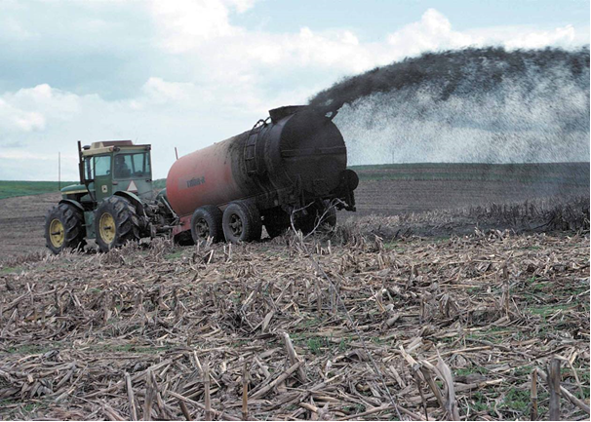
Raw Animal Manures: Considerations
Be aware of contaminants
Certifier may require heavy metals testing
Be careful with flow control to ensure uniform application and desired rate
Broadcast manure application
Notes:
Narration: Although manures from non-organic sources are permitted, many farmers have concerns about contaminants that may be in them, including heavy metals, antibiotics, pesticides, or trash from livestock facilities. Weed seed can also be a contaminant, and may be killed by composting. Some certifiers may require testing to ensure that levels of heavy-metal contaminants are below a certain threshold. When applying, it’s important not to over-fertilize, so be careful with flow control to ensure that you apply manure uniformly and at your target rate. Injection application methods, such as with a sweep or knife, that immediately incorporate manure are recommended over broadcast application.
Image: Tim McCabe, USDA-NRCS

Slide 20
Sources of Organic Nutrients
Legumes and green manures
Animal manures
Compost
Processed fertilizers
Micronutrients and other amendments
Notes:
Narration: Compost is an excellent source of organic matter.
Image: Kristine Moncada, University of Minnesota

Slide 21
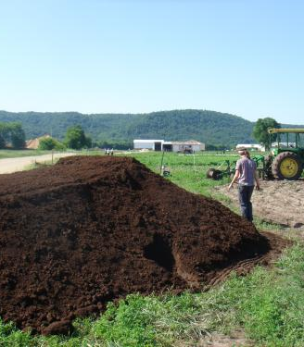
Making Compost
Various base materials
Manure
Bedding
Plant materials
Methods include windrow, static pile, and in-vessel
Must follow guidelines for composting manure
Notes:
Narration: Compost can be made from various base materials, including manure, bedding, and plant materials. Composting methods include windrows that are regularly turned; static, or undisturbed, piles; or enclosed in-vessel systems. When you are composting animal manure, you must follow organic guidelines for making compost.
Image: Jeff Vanuga, USDA-NRCS

Slide 22
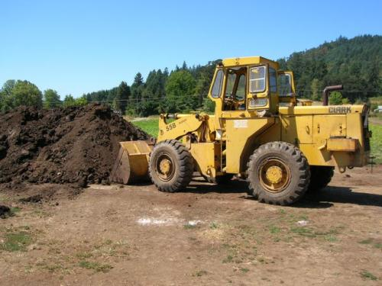
Guidelines for Organic Compost
Initial C:N ratio between 40:1 and 25:1
For contained systems or static aerated piles: temperatures must remain between 131° and 170° F for 3 days
For windrow systems: temperatures must remain between 131° and 170° F for 15 days and windrow must be turned 5 times in that period
John McQueen, eOrganic
Notes:
Narration: The organic guidelines for compost are designed to ensure that any pathogens in the manure are killed. You must start your compost with a material or mixture of materials whose overall C:N ratio is between 40:1 and 25:1. For contained systems or static aerated piles, the temperature of the pile must remain between 131 and 170 degrees Fahrenheit for at least three days. For windrow systems, the temperature must remain between 131 and 170 degrees for fifteen days, and the windrow must be turned five times in that period.
Image: John McQueen, eOrganic

Slide 23
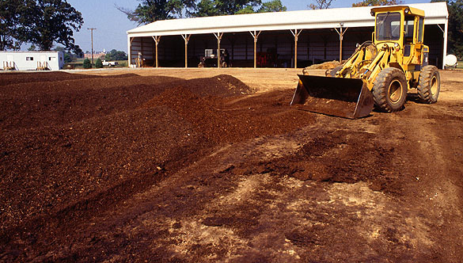
Applying Compost
No organic restrictions on timing of application
State environmental laws may apply
Incorporate to allow microbial breakdown
Manure not composted according to guidelines will need to follow application rules for raw manure
Notes:
Narration: If compost has been made according to the guidelines, there are no organic restrictions on when you can apply it, although state pollution laws will still apply. It is recommended to incorporate the compost to allow soil microbes to break down the compost and release its nutrients. If you have composted manure in a way that doesn’t meet the guidelines, you will need to follow the application restrictions for raw manure.
Image: Ken Hammond, USDA-ARS

Slide 24
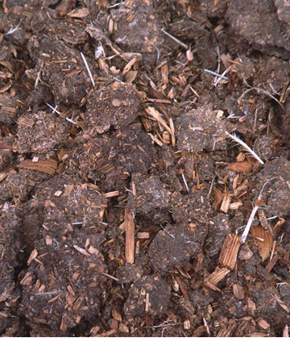
Nutrient Availability from Compost
Generally lower nutrient content than raw manure
Meeting N needs may result in excess P, salt, other ions
30% or less of N available in first year
Will depend on base material and composting method
Composted turkey manure
Notes:
Narration: Compost will generally have lower nutrient content and availability than raw manure, and in particular, it can be difficult to meet crop N needs with compost without exceeding P and K needs. It’s best not to make compost your only N source in the long term, because this can lead to accumulation of phosphorus, salt, and other ions. Like with manure, it’s a good idea to have your source tested for nutrient content. You should assume that 30% or less of the total N content measured in your compost will be available in the first year. The exact amount will depend on the base material and the composting method used.
Image: Jeff Vanuga, USDA-NRCS

Slide 25
Sources of Organic Nutrients
Legumes and green manures
Animal manures
Compost
Processed fertilizers
Micronutrients and other amendments
Notes:
Narration: Various processed fertilizer products are available to organic farmers.
Image: Kristine Moncada, University of Minnesota

Slide 26
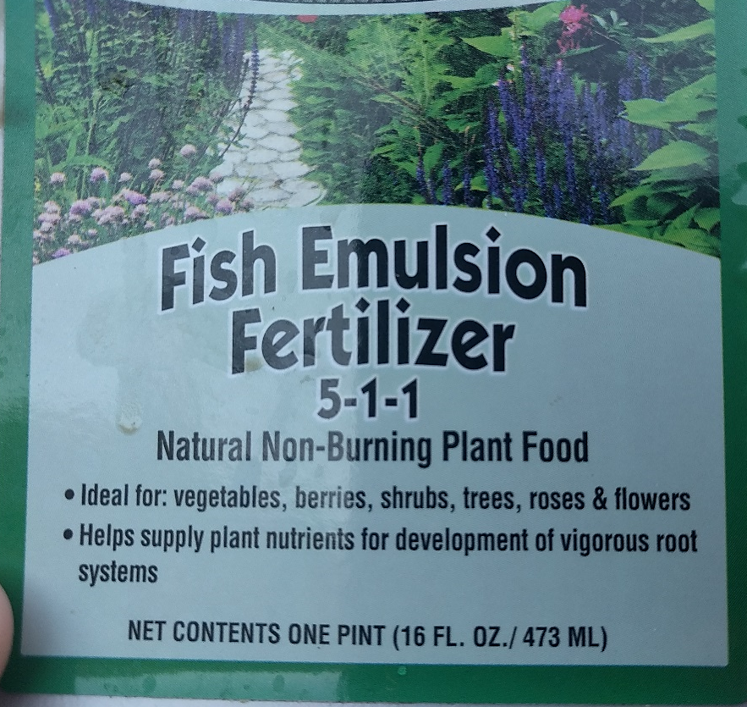
Commercial Fertilizers
Fish products
Heat treated manure products
Sodium nitrate (Chilean nitrate)
Bagged/blended formulations
May contain feather or blood meal, fish or aquatic plant extracts, humic acids
Notes:
Narration: Commercial fertilizers on the market include fish products, heat treated manure products, sodium nitrate (also called Chilean nitrate), and bagged and blended formulations that may contain feather or blood meal, fish or aquatic plant extracts, or humic acids.
Image: Nicole Tautges, University of Minnesota

Slide 27
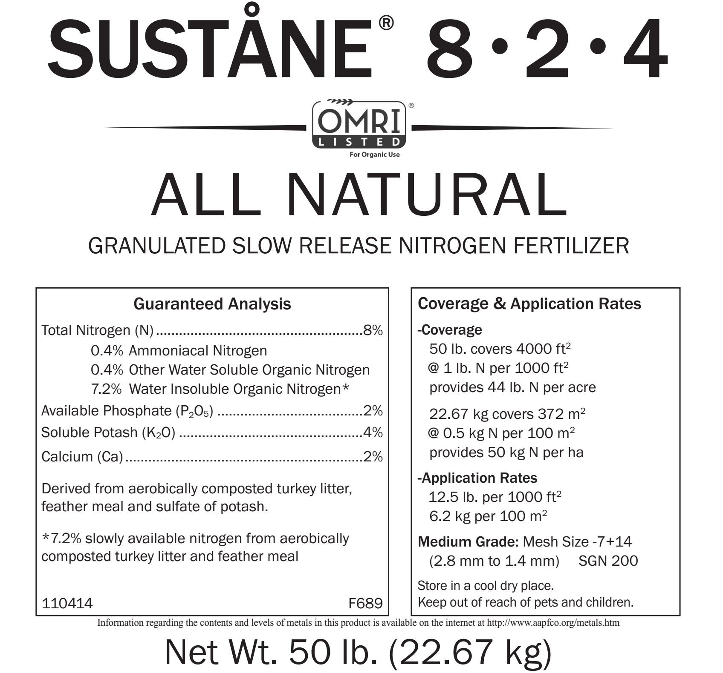
How to Read a Fertilizer Label
% nitrogen-phosphorus-potassium (N-P-K) by weight
Amounts and chemical forms of nutrients present
Percentage of slow release nitrogen
Notes:
Narration: Fertilizers are generally described using three numbers (8-2-4 in this example), which represent the percent of nitrogen, phosphorus, and potassium in the fertilizer by weight. The label on any commercial fertilizer should show a guaranteed analysis, which lists the amounts of nitrogen, potash (potassium), and any other nutrient present as a percent of the total weight of the fertilizer, and the chemical forms that they are found in. The label should also show the percentage of slow-release nitrogen in the material.
Image: Sustane Natural Fertilizer, Inc.

Slide 28
Commercial Fertilizers: Considerations
Check OMRI lists for organic status of products
Apply as directed, within organic guidelines
Some effects may be similar to conventional
Highly available (soluble) nutrients
Vulnerable to leaching and loss
May reduce pH
Notes:
Narration: If you are thinking of applying a commercial fertilizer, there are several things to consider. Be sure to check the OMRI lists to confirm the approved status of particular products. Follow the application directions, and make sure that the rate and timing of application meet organic guidelines for avoiding crop, soil, and water contamination. Check with your certifier if you are unsure about how or when you are permitted to apply a particular product. Some commercial organic fertilizers may have effects that are not so different from conventional fertilizers, including providing highly available soluble nutrients, which can be vulnerable to leaching and other losses, and may result in reduced soil pH.

Slide 29
Sources of Organic Nutrients
Legumes and green manures
Animal manures
Compost
Processed fertilizers
Micronutrients and other amendments
Notes:
Narration: Your soils may sometimes benefit from additions of micronutrients or other amendments.

Slide 30
Micronutrient Amendments
Some synthetics are allowed
Need documentation of deficiency from soil or tissue test
Apply at rates recommended in test results
Check in with certifier!
Notes:
Narration: Some micronutrients are not readily available in natural forms. In these cases, some synthetic products are allowed, but you will need documentation of a deficiency from a soil or plant tissue test. You should apply micronutrients at the rates recommended in your test results. And, as always, if you have doubts about whether the recommendations you have received are appropriate for organics, you should check in with your certifier before applying.
Image: Harriet Behar

Slide 31
Other Products and Practices
“Magic bullets” you may hear about
Base-Cation Saturation Ratio
Fungal:bacterial ratio
Inoculant products (other than Rhizobium)
Many sales pitches use scientific language, but are NOT supported by published, peer-reviewed research
Notes:
Narration: There are a variety of ideas that you may hear promoted as magic bullets or keys to perfecting the health and fertility of your soils. Some frequently promoted ideas include the Base-Cation Saturation ratio, fungal-to-bacterial ratios, and a variety of inoculant products. By the way, we do not include crop-appropriate strains of Rhizobium inoculant in this category, as they are well supported by research. In many cases, you may be urged to pay for products, workshops, or consulting services based on these ideas. These ideas are not necessarily completely invalid, but although the sales pitches can use very scientific-sounding language, the products and services sold are often not supported by published, peer-reviewed research.
Image: padrinan, Pixabay

Slide 32
Other Products and Practices
Not all products are reputable
Be wary of paying $$ for undocumented benefits
Seek guidance from Extension, certifier, experienced growers
If it seems too good to be true, it probably is!
Notes:
Narration: Not all of the products and systems that you will see promoted are reputable. We urge you to use caution when paying for these products or services, and when in doubt, again, consult with Extension specialists, your certifier, and experienced organic growers. If the claims made about a product seem too good to be true, they probably are.
Image: robinsonk26, Pixabay

Slide 33
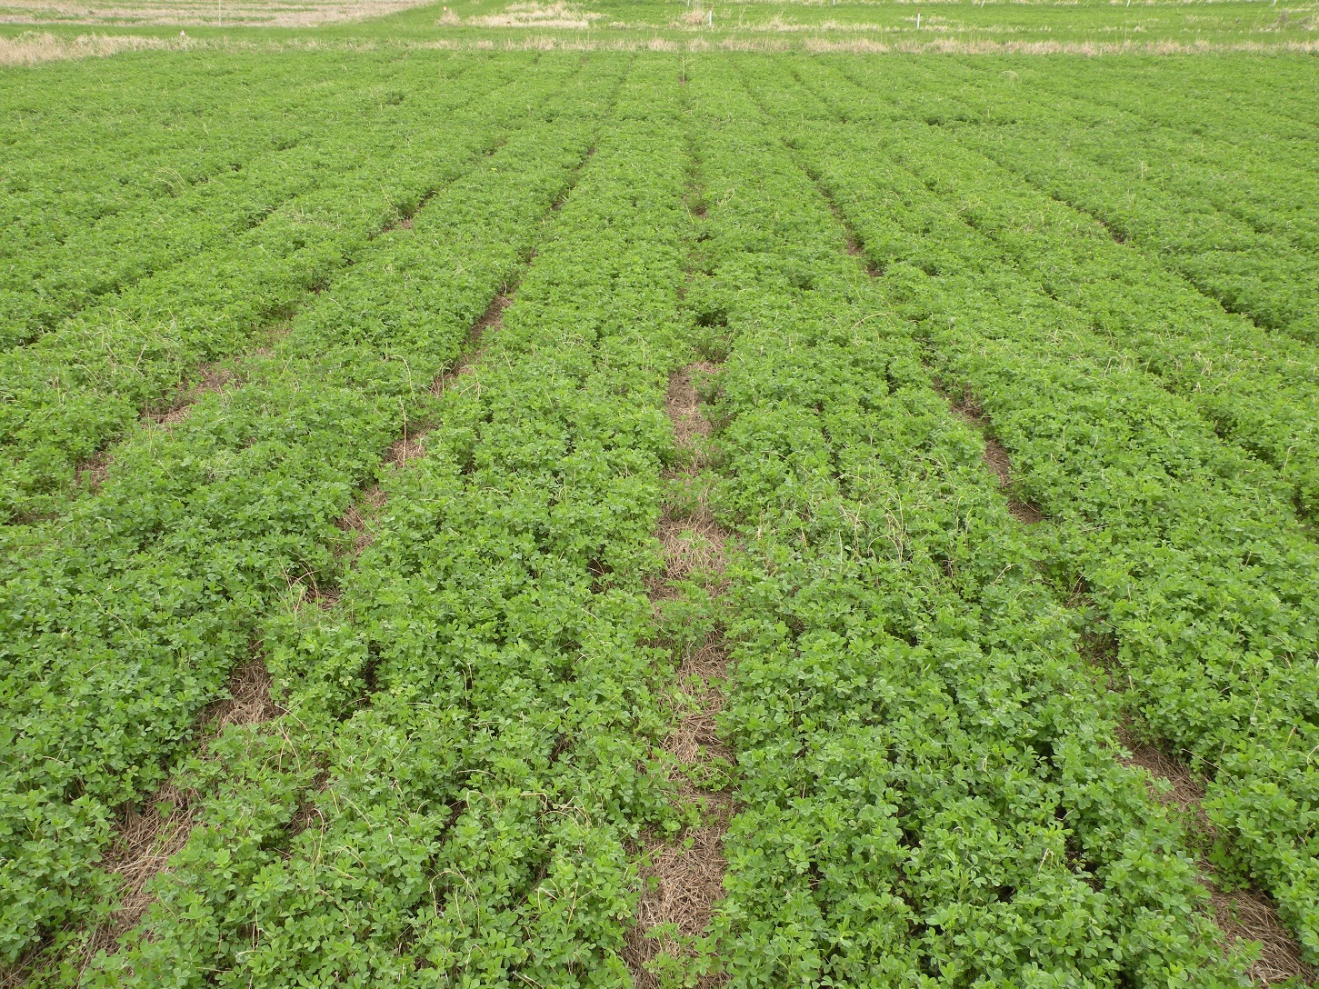
Summary
Rotation is your main tool
Use permitted plant- and animal-based nutrient sources
Check with your certifier!
Notes:
Narration: We hope this module has helped you understand how to build healthy, fertile soils as you transition your farm to organic. Here are some key points to remember from Part 2 of our soil series: Rotation is your main tool for managing soil health and fertility: choose crops and inputs that fit the needs of your soil and your land. Choose permitted plant- and animal-based fertility sources, including green manures, animal manures, and composts. And, whenever you are uncertain about an input or practice, check in with your certifier.
Image: University of Minnesota

Slide 34
Resources
National List of allowed and prohibited substances for organic farming
List of manure testing labs – Minnesota Department of Agriculture
Field soil sampling instructions – University of Minnesota
Worksheet for calculating manure application – University of Minnesota
Composting instructions – eXtension
Organic Production Guide – ATTRA
Guide to permitted inputs – NRCS
Can I Use this Input on My Organic Farm? – eXtension
Notes:
Narration: Here are some resources you may find helpful to learn more about topics we covered in this module.

Slide 35
Sources of Organic Nutrients
Legumes and green manures
Animal manures
Compost
Processed fertilizers
Micronutrients and other amendments
Notes:
Narration: Thank you for watching! This concludes our modules in the Soil series.
Image: Kristine Moncada, University of Minnesota

Slide 36
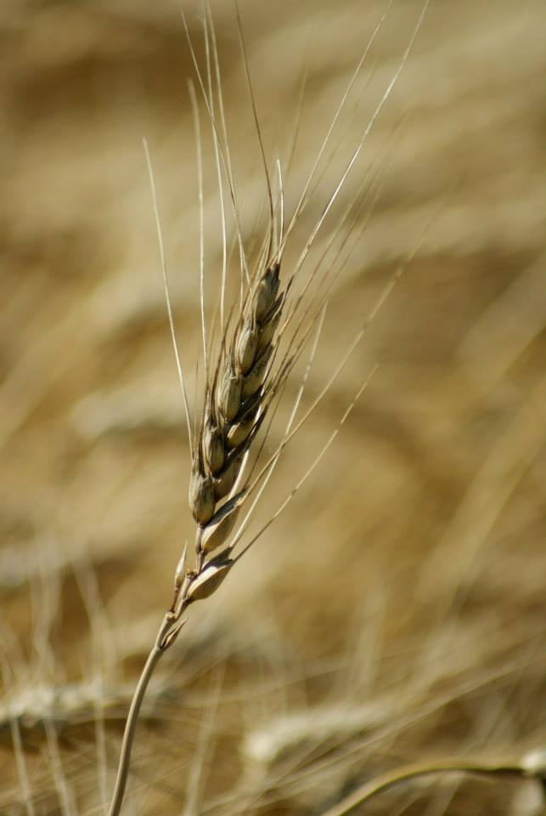
© 2017 Regents of the University of Minnesota. All rights reserved. The University of Minnesota is an equal opportunity educator and employer.
This material is based upon work that is supported by the National Institute of Food and Agriculture, U.S. Department of Agriculture, under grant number 2013-51106-21005.
Notes:
Narration: This material is based upon work that is supported by the National Institute of Food and Agriculture.
Image: Constance Carlson, University of Minnesota

Slide 37
References
Baker, B. 2009. Can I Use this Fertilizer on My Organic Farm? http://www.nrcs.usda.gov/Internet/FSE_DOCUMENTS/nrcs144p2_045863.pdf
Coleman, P. 2012. Guide for Organic Crop Producers. ATTRA. https://attra.ncat.org/attra-pub/summaries/summary.php?pub=67
Eghball, B., and J. F. Power. 1999. Phosphorus-and nitrogen-based manure and compost applications corn production and soil phosphorus. Soil Science Society of America Journal 63: 895-901.
Evans, J., et al. 2001. Net nitrogen balances for cool-season grain legume crops and contributions to wheat nitrogen uptake: a review. Australian Journal of Experimental Agriculture 41: 347-359.
Fernandez, A. L., C. C. Sheaffer, D. L. Wyse, C. Staley, T. J. Gould, and M. J. Sadowsky. (2016). Associations between soil bacterial community structure and nutrient cycling functions in long-term organic farm soils following cover crop and organic fertilizer amendment. Science of the Total Environment, 566: 949-959.

Slide 38
References (cont.)
Hernandez, J.A. and M.A. Schmitt. 2012. Manure management in Minnesota. University of Minnesota Extension. https://www.extension.umn.edu/agriculture/manure-management-and-air-quality/manure-application/steps-for-calculating-rates/table_3.html
Kaiser, D., Fernandez, F., Lamb, J.A., Coulter, J.A., and B. Barber, 2016. Fertilizing corn in Minnesota. University of Minnesota Extension AG-FO-3790-D. University of Minnesota, St. Paul, MN.
Kumar, K., and M. G. Kuan. 2000. Biological nitrogen fixation, accumulation of soil nitrogen and nitrogen balance for white clover (Trifolium repens L.) and field pea (Pisum sativum L.) grown for seed. Field Crops Research 68: 49-59.
Lamb, J., S. Huerd, and K. Moncada. 2010. Soil Health. Chapter 3 in Risk Management for Organic Producers. Moncada, K. and C. Sheaffer, editors. University of Minnesota, St. Paul, MN.

Slide 39
References (cont.)
Lamb, J., C. Sheaffer, and K. Moncada. 2010. Soil Fertility. Chapter 4 in Risk Management for Organic Producers. Moncada, K. and C. Sheaffer, editors. University of Minnesota, St. Paul, MN.
Peterson, T. A, and M. P. Russelle. 1991. Alfalfa and the nitrogen cycle in the Corn Belt. Journal of Soil and Water Conservation 46: 229-235.
USDA-AMS. 2017. National Organic Program. 7 C.F.R. §205.
USDA-NRCS. 2011. Carbon to Nitrogen Ratios in Cropping Systems. https://www.nrcs.usda.gov/
Wander, M. 2015. Managing Manure Fertilizers in Organic Systems. eXtension. http://articles.extension.org/pages/18628/managing-manure-fertilizers-in-organic-systems

