Slide 1
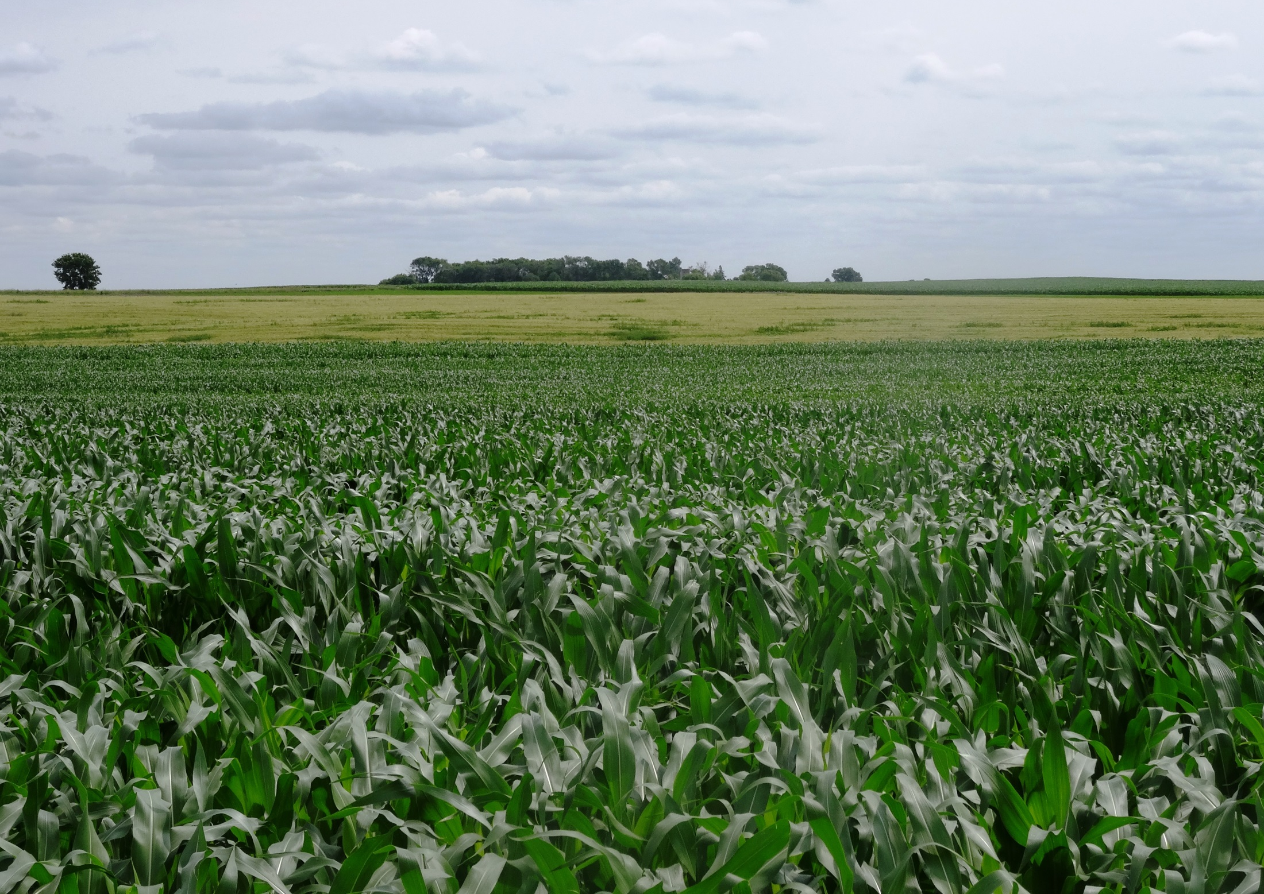
What Is Organic Agriculture?
Authors
Kristine Moncada
Harriet Behar
Constance Carlson
Gigi DiGiacomo
Craig Sheaffer
This material is based upon work that is supported by the National Institute of Food and Agriculture, U.S. Department of Agriculture, under grant number 2013-51106-21005.
Notes:
Narration: Welcome to our What Is Organic Agriculture module!
Image: Kristine Moncada, University of Minnesota

Slide 2
What Is Organic Agriculture?
Organic Definition
Cropping Standards
Regulation
Notes:
Narration: In this module we will provide a brief overview of organic agriculture beginning with how organic is defined, what the cropping standards are and how organic is enforced.
Image: David L. Hansen, University of Minnesota

Slide 3
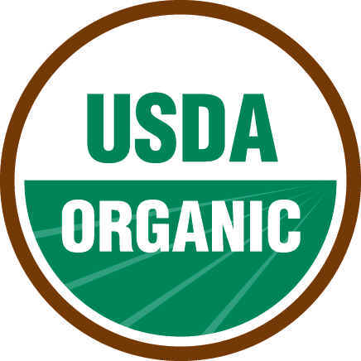
Organic Seal
Notes:
Narration: You might have noticed this symbol on food labels at your grocery store. It is the USDA organic seal, which can only be used on items that meet the organic standards set in the National Organic Program by the USDA’s Agricultural Marketing Service. We cover more on who can use this seal in our Certification module.

Slide 4
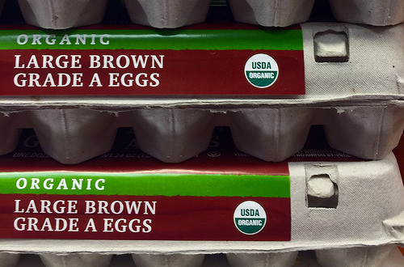
What Does “Organic” Mean?
Marketing term
Defined in the National Organic Program (NOP)
Food products produced using organic standards
Notes:
Narration: Organic has many meanings, but ultimately, at the very basic level, organic is a marketing term defined by federal law under the National Organic Program. The USDA organic seal can only be used on foods that are grown, processed and handled according to USDA organic standards
Image: Miles McEvoy, USDA-AMS

Slide 5
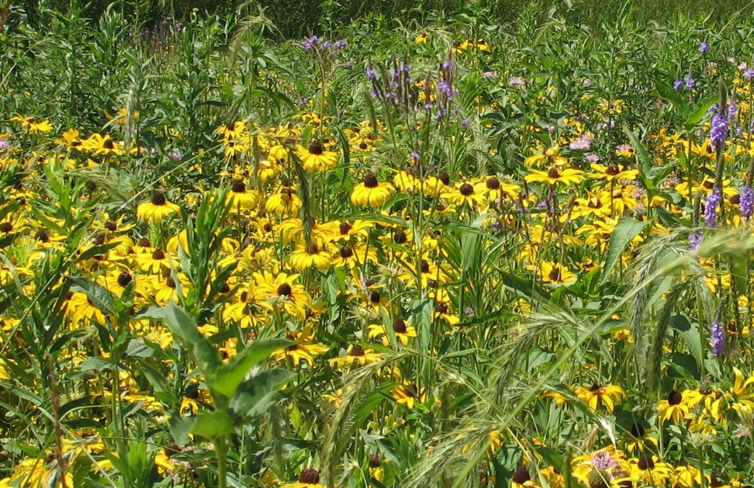
Organic Guiding Principles
Organic agriculture is a holistic ecosystem approach to promote a healthy and diverse landscape
Notes:
Narration: While organic is legally a marketing term, there is much more behind organic in its guiding principles. Practitioners manage their farm holistically as an agroecosystem. They consider the whole ecosystem, including soil, water, and air, in growing their crops.
Images: Kristine Moncada, University of Minnesota

Slide 6
Conventional Agriculture
Notes:
Narration: In discussing organic agriculture, we will be comparing it to what is more typical in agriculture today, a system called “conventional agriculture”. Conventional agriculture, also called industrial agriculture, uses synthetic substances that are prohibited in organic agriculture and is a generally less diverse system.
Image: Craig Sheaffer, University of Minnesota

Slide 7
What Is Organic Agriculture?
Organic Definition
Cropping Standards
Regulation
Notes:
Narration: In this section, we will cover the cropping methods organic famers use in their production systems.
Image: David L. Hansen, University of Minnesota

Slide 8
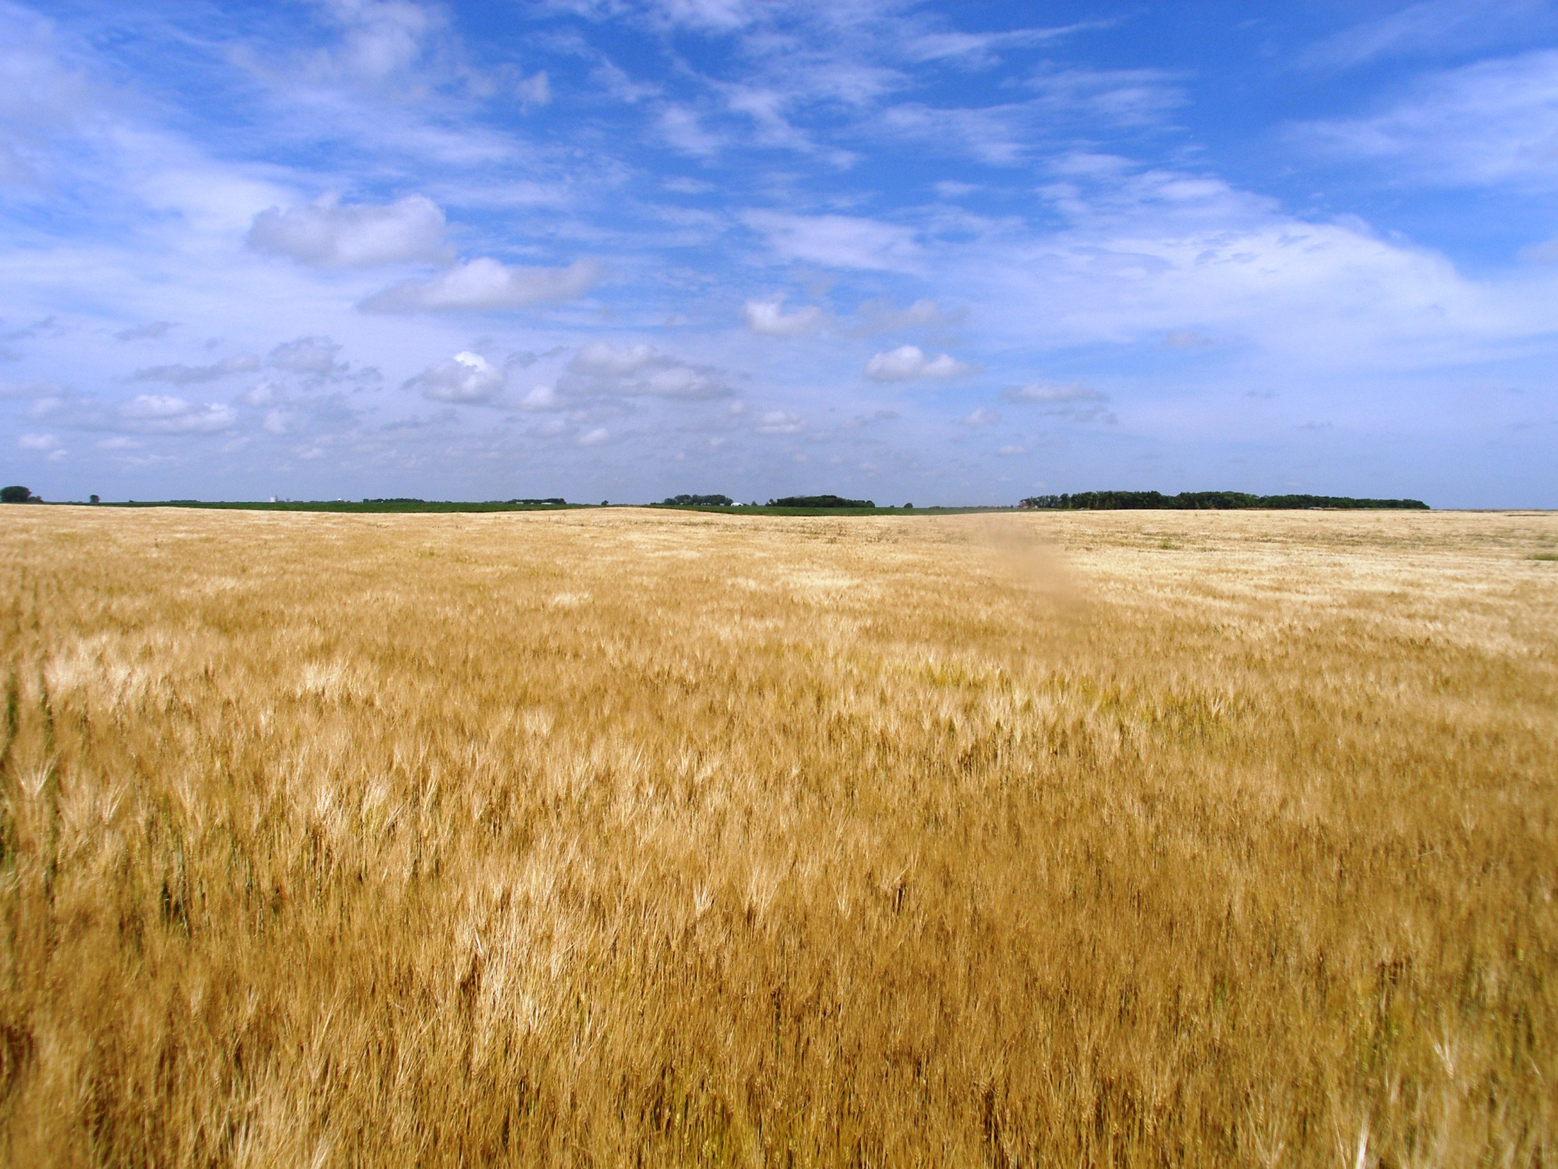
Organic Crop Standards
Maintain soil health
Protect water resources
Promote biodiversity
Prohibit use of synthetic substances
Prohibit genetically modified organisms
Protect organic land and crops from contamination
Notes:
Narration: Organic producers are committed to practices that protect natural resources for later generations. Under the National Organic Program, they follow these guidelines that we will discuss in more detail.
Image: Carmen Fernholz

Slide 9
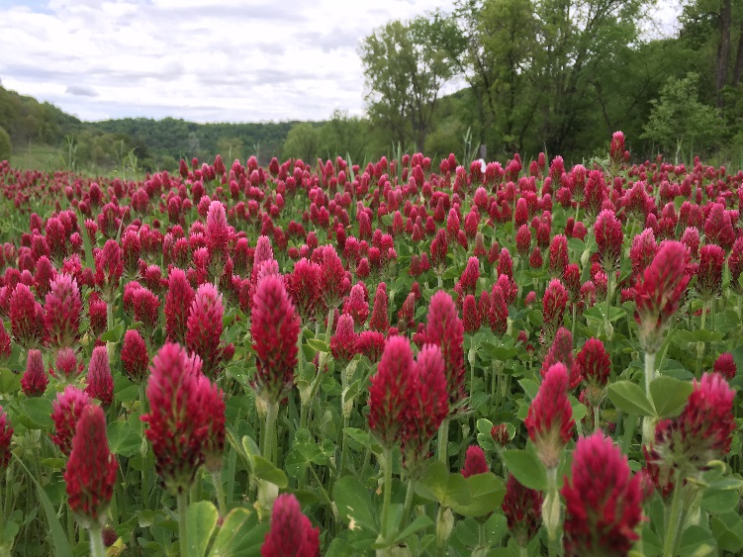
Maintain Soil Health
By using soil-building rotations that include:
Cover crops and perennials to reduce soil erosion
Legumes to provide a natural source of nitrogen
Notes:
Narration: Maintaining healthy soils is one of the most important tenets of organic agriculture. Soil building rotations with cover crops, perennials, and legumes are an integral practice used by organic farmers. Cover crops and perennials such as alfalfa can help protect soil by reducing erosion. They utilize legumes in their rotations to provide a natural source of nitrogen to the soil and subsequently their crops. Images: Craig Sheaffer, University of Minnesota (alfalfa); Harriet Behar, Midwest Organic and Sustainable Education Service (crimson clover)

Slide 10
Maintain Soil Health
By building and preserving organic matter in soil using:
Crop residue
Manure and compost
Green manures and cover crops
Notes:
Narration: Organic farmers maintain and increase soil organic matter by adding manure, compost, green manures and cover crops to their systems. Organic matter is extremely important. It is a source of nutrients for crops, it improves soil structure and moisture retention, and it supports microbial activity.
Images: Carmen Fernholz

Slide 11
Organic Crop Standards
Maintain soil health
Protect water resources
Promote biodiversity
Prohibit use of synthetic substances
Prohibit genetically modified organisms
Protect organic land and crops from contamination
Notes:
Narration: Along with soil, organic farmers aim to protect water resources as well.
Image: Carmen Fernholz

Slide 12
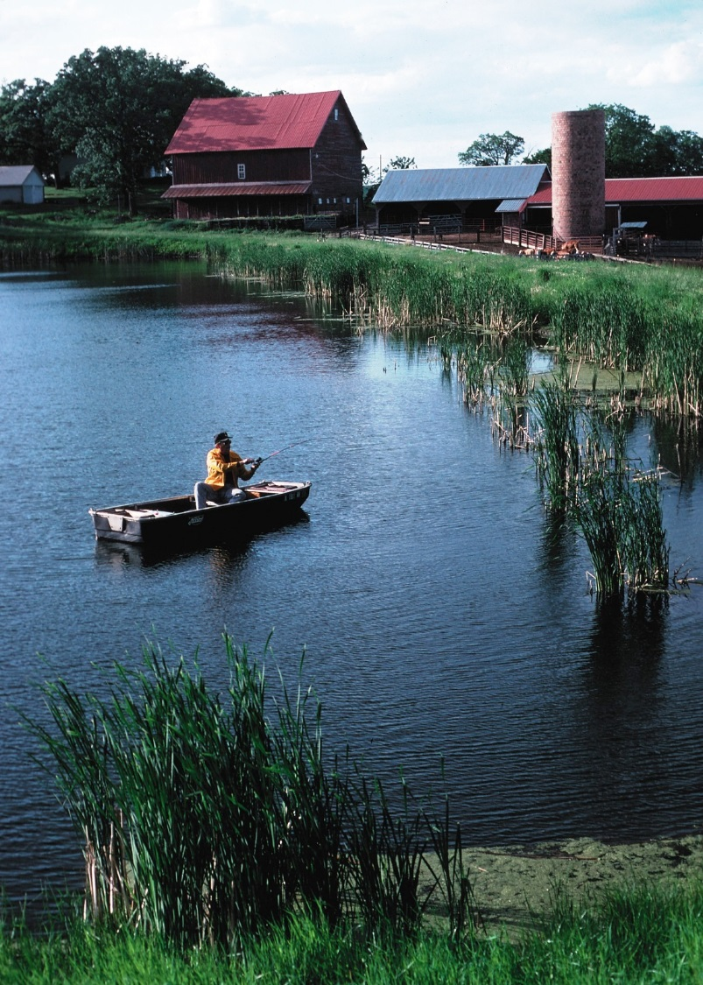
Protect Water Resources
Healthy soils for reduced runoff
Slow-release fertilizers to reduce leaching
Conservation buffers to decrease runoff
Notes:
Narration: Many practices in organic agriculture can help protect water quality. Building healthy soils can increase nutrient and moisture retention to reduce runoff. Slow-release fertilizers like compost and green manures can reduce nutrient leaching. Maintaining conservation buffers can decrease runoff.
Image: Tim McCabe, USDA-NRCS

Slide 13
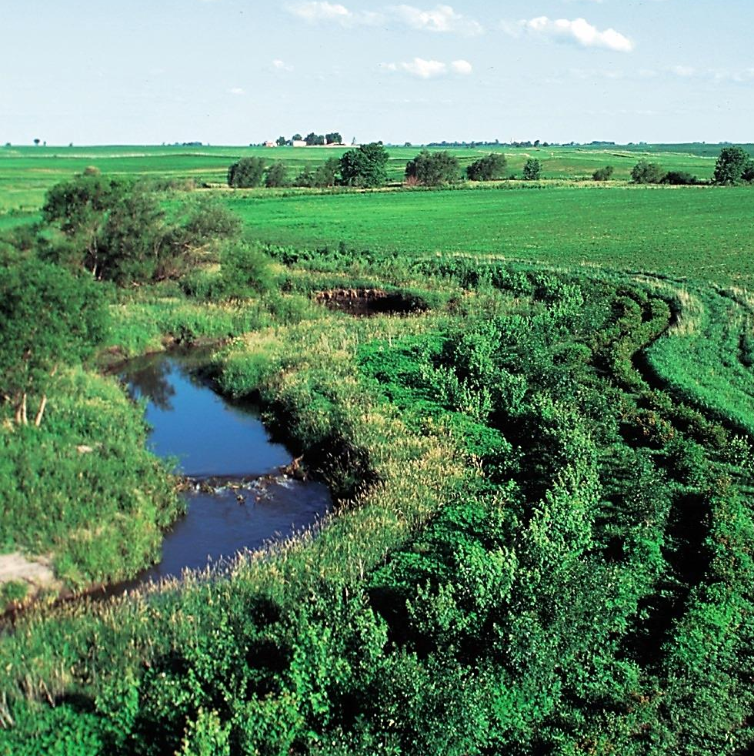
Buffers
High-quality buffer
No buffer
Notes:
Narration: A high quality buffer such as the one on the left protects the stream from contamination and soil sedimentation from erosion. It also provides wildlife habitat. The stream on the right has little protection and no refuge for wildlife. The Farm Service Agency has a program that will pay organic farmers for the land they leave in a buffer zone, similar to Conservation Reserve Payments. Contact your FSA office for more information. Images: Lynn Betts, USDA-NRCS

Slide 14
Organic Crop Standards
Maintain soil health
Protect water resources
Promote biodiversity
Prohibit use of synthetic substances
Prohibit genetically modified organisms
Protect organic land and crops from contamination
Notes:
Narration: NOP rules state that an organic producer must initiate and maintain practices to support biodiversity.
Image: Carmen Fernholz

Slide 15
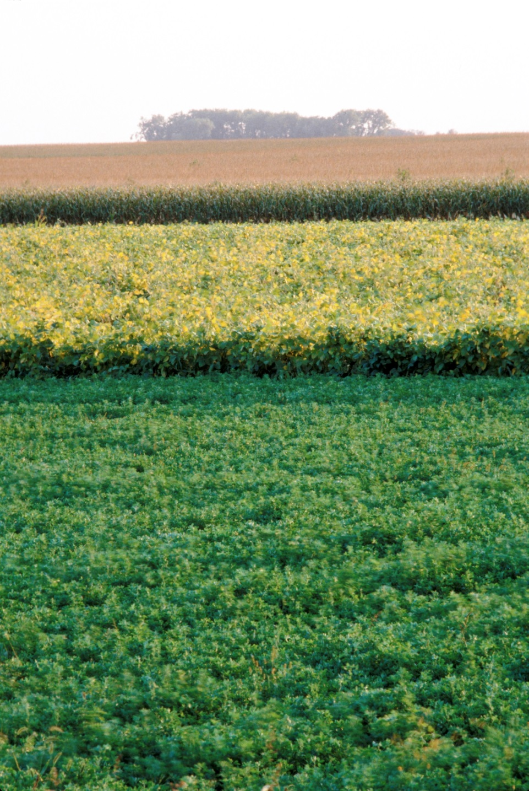
Promote Biodiversity
Diverse rotations with greater number of crops
No continuous cropping
The same annual crop can’t be grown on same field two years in a row
Notes:
Narration: Conventional cropping systems are becoming less and less diverse over time. Organic farmers promote biodiversity in several ways. One way is through diverse rotations. They include different crops in their rotations. They are not allowed to do continuous cropping, which is growing the same crop such as corn every year, or a typical row cropping system consisting of just corn and soybean as a rotation. Organic farmers are also required to have a soil building rotation, which includes use of legumes or small grains. Image: David L. Hansen, University of Minnesota

Slide 16
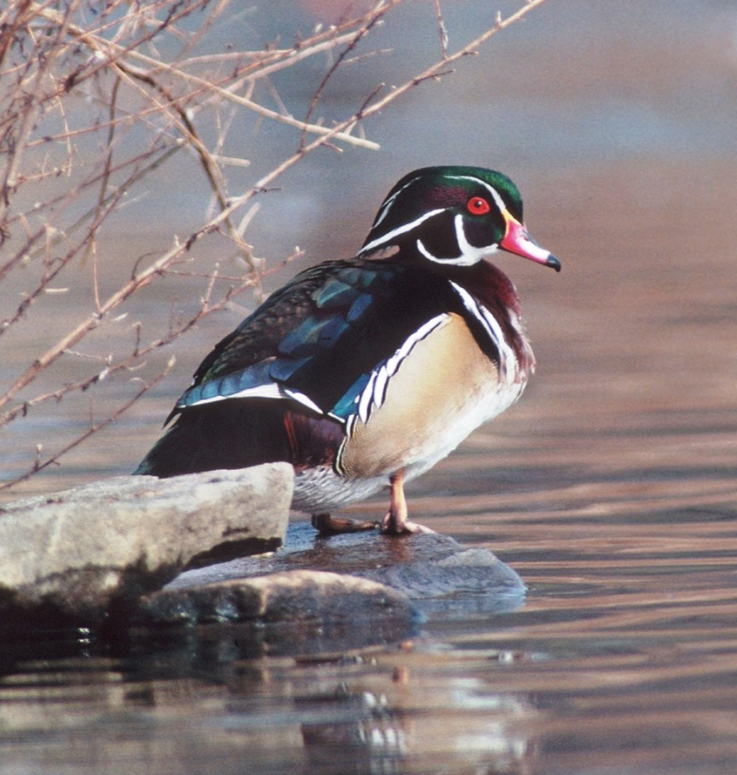
Promote Biodiversity
Habitat
Preserve natural areas such as wetlands and woodlands
Include conservation buffers
Incorporate perennial crops and cover crops
Notes:
Narration: In addition to diverse rotations, organic farmers are highly encouraged to incorporate natural areas such as wetlands, woodlands and conservation buffers for wildlife habitat. Perennial crops and cover crops can also provide refuge for native species, beneficial insects and birds. Images: Tim McCabe, USDA-NRCS (duck); David L. Hansen, University of Minnesota (butterfly)

Slide 17
Organic Crop Standards
Maintain soil health
Protect water resources
Promote biodiversity
Prohibit use of synthetic substances
Prohibit genetically modified organisms
Protect organic land and crops from contamination
Notes:
Narration: Often it seems that organic agriculture is defined by what cannot be used. While we know there is more to it than that, it is still critical for new-to-organic farmers to know what substances they are prohibited from using.
Image: Carmen Fernholz

Slide 18
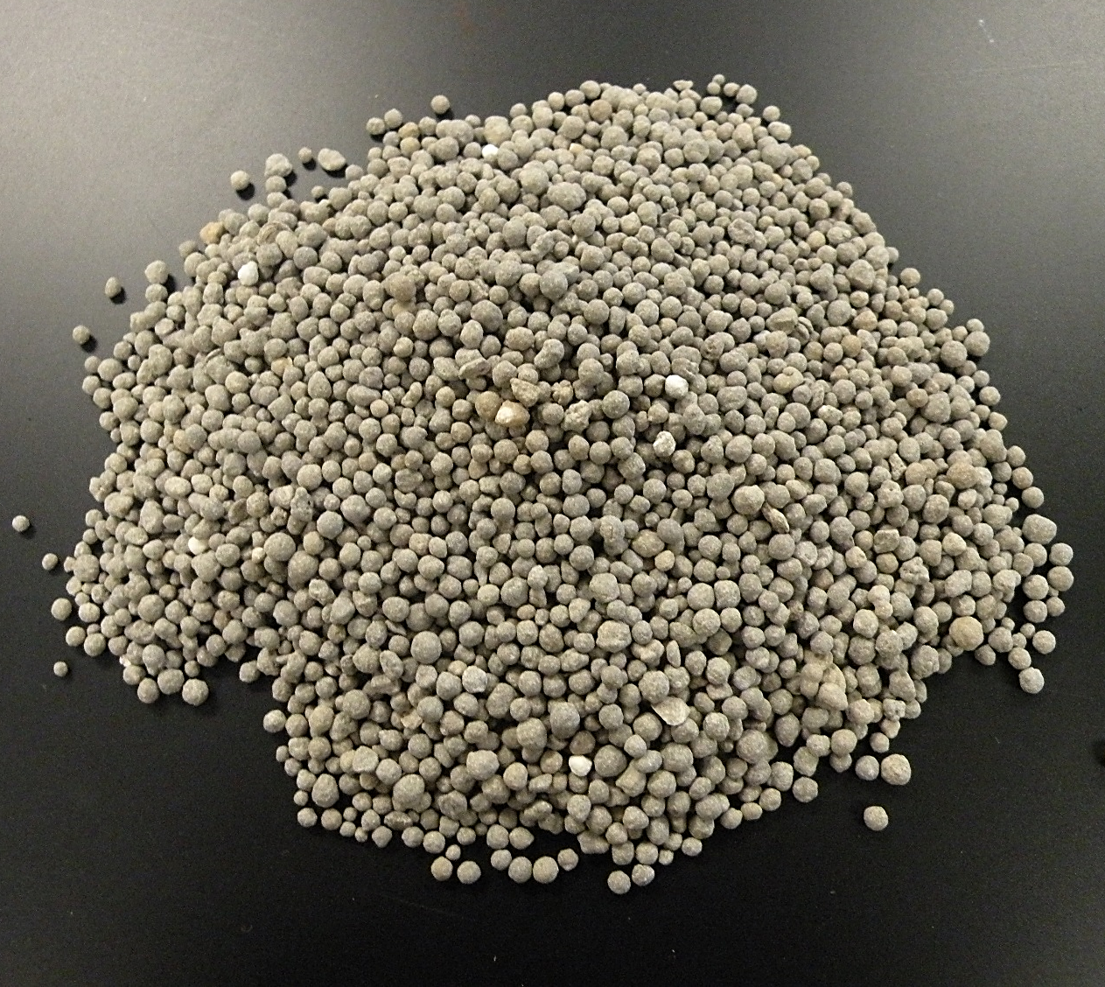
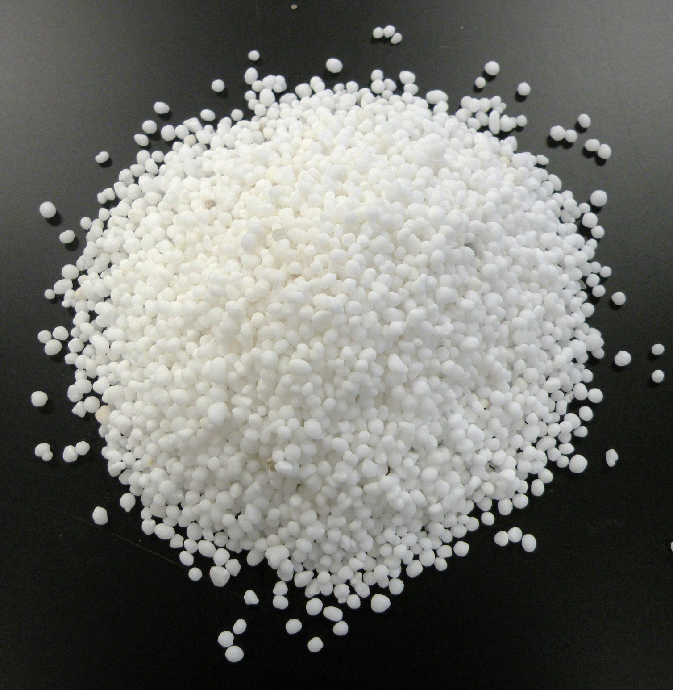
What Are Synthetic Substances?
Artificially created
or
Originate from natural materials but have been chemically changed
UREA FERTILIZER
TRIPLE SUPER PHOSPHATE
Notes:
Narration: In organic agriculture, you will hear the term “synthetic substance” and may not know what exactly that means. A synthetic substance is something that has been artificially created or a substance that originates from natural materials, but has been chemically changed.
Images: Kristine Moncada, University of Minnesota

Slide 19
Synthetic Substances
Prohibited in organic agriculture (some exceptions)
Examples
Fertilizers
Herbicides
Insecticides
Others
Notes:
Narration: As a basic rule, organic farmers can’t use synthetic fertilizers or pesticides. A few synthetics are allowed, but only after rigorous review and approval. Approved synthetics and prohibited natural materials are present on the National List. We will discuss synthetic substances such as fertilizers, herbicides and other pesticides such as insecticides in more detail. We will also discuss what organic farmers do instead.
Image: Kristine Moncada, University of Minnesota

Slide 20
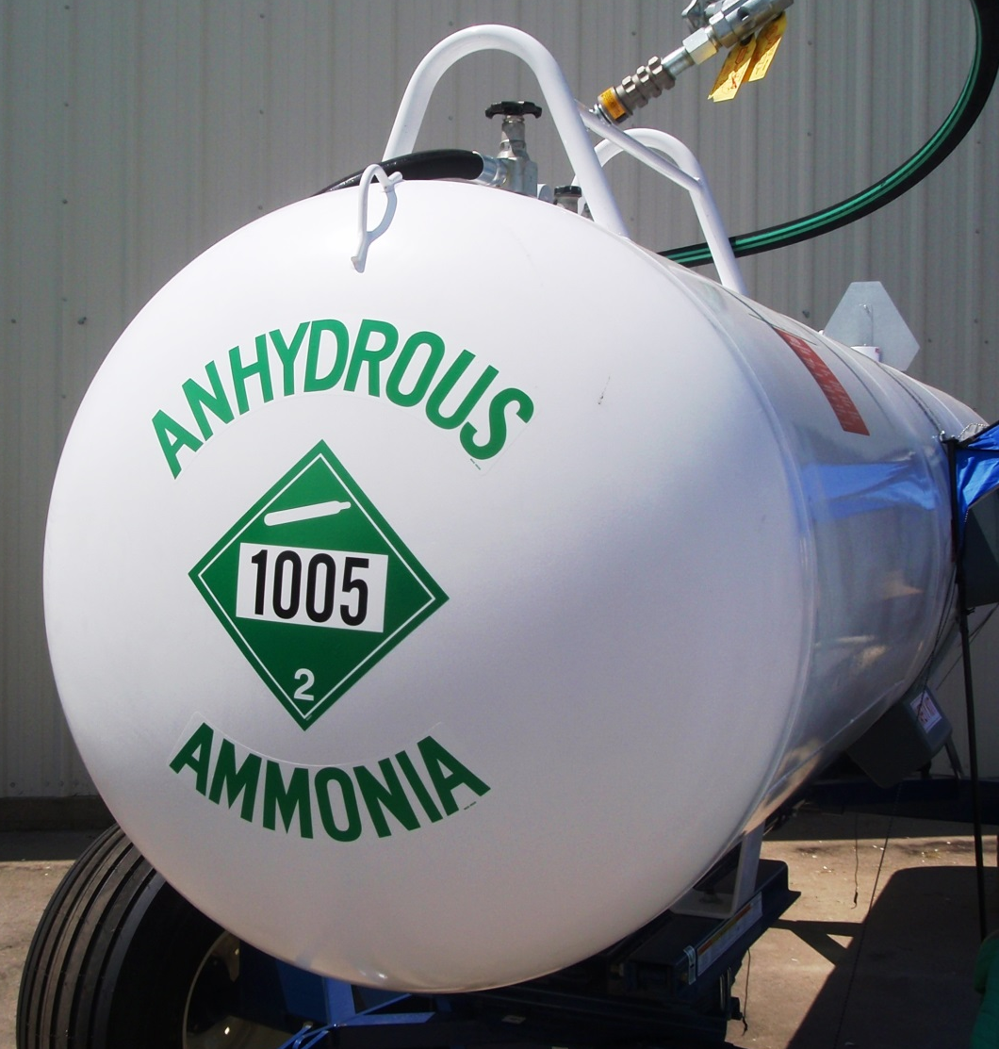
Not Allowed = Synthetic Fertilizers
Derived from chemical processes
Examples
Anhydrous ammonia
Urea
Triple super phosphate
Notes:
Narration: Synthetic fertilizers are derived from various chemical processes and are often highly soluble. Commonly-used examples of nitrogen fertilizers are anhydrous ammonia and urea. An example of a synthetic phosphorus fertilizer is triple super phosphate. There are many other different synthetic fertilizers used in conventional systems.
Image: Jeff Coulter, University of Minnesota

Slide 21
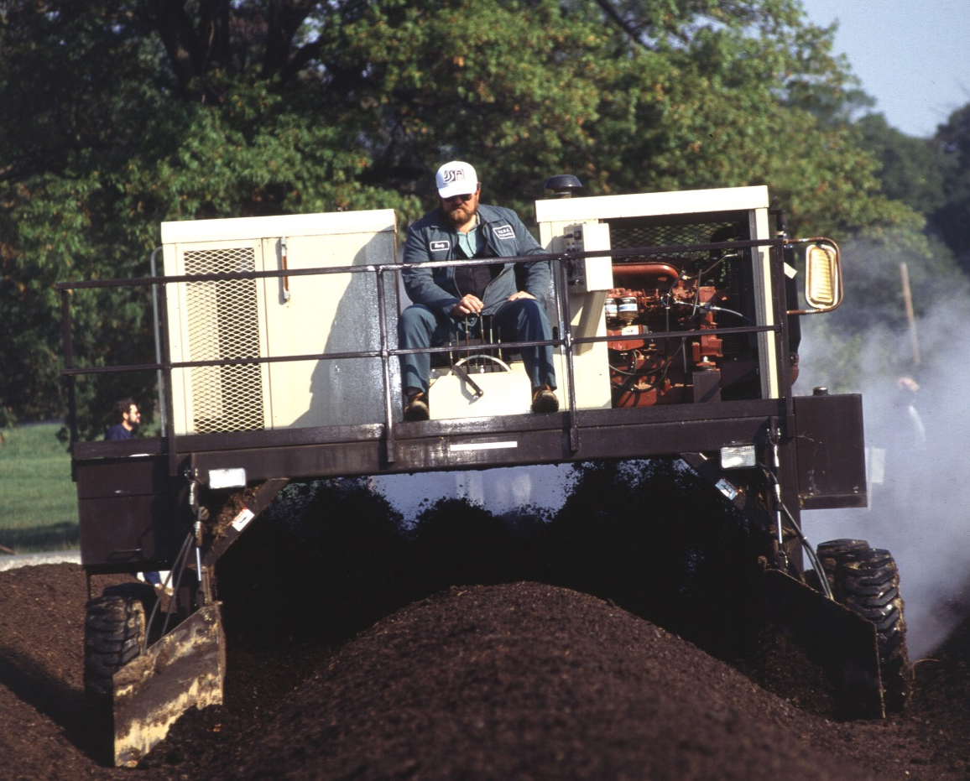
Organic Alternatives to Synthetic Fertilizers
Manure
Compost
Green manures
Legumes in rotation
Commercial organic fertilizers
Compost windrows being turned
Notes:
Narration: Rather than synthetic fertilizers, organic producers use manure, compost, green manures and legumes in their rotations to supply necessary crop nutrients. There are other commercially available products, such as pelletized manure and fish emulsions, that may be allowed. Watch the “Soil Fertility” module for more information on allowed amendments, and the “Certification” module for more on the National Organic Program’s National List of Allowed and Prohibited Substances. Image: Ken Hammond, USDA-ARS

Slide 22
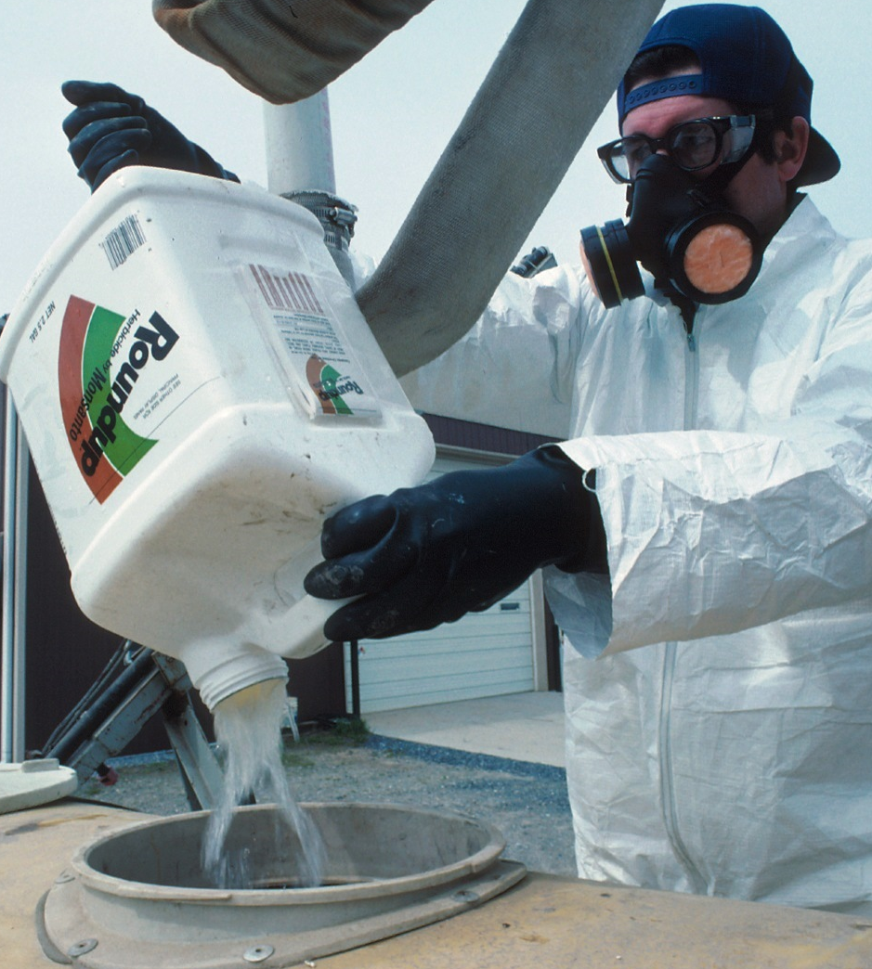
Not Allowed = Synthetic Herbicides
Widely used to kill weeds
Examples
Glyphosate
Atrazine
2,4-D
Notes:
Narration: Synthetic herbicides are widely used to kill weeds, but they may have negative consequences to the environment. Organic farmers cannot use synthetic herbicides such as glyphosate (Roundup), atrazine or 2,4-D in their operations. Some natural-type herbicides are allowed in organic production. Always verify with your certifier that products are allowed before use. Image: Tim McCabe, USDA-NRCS

Slide 23
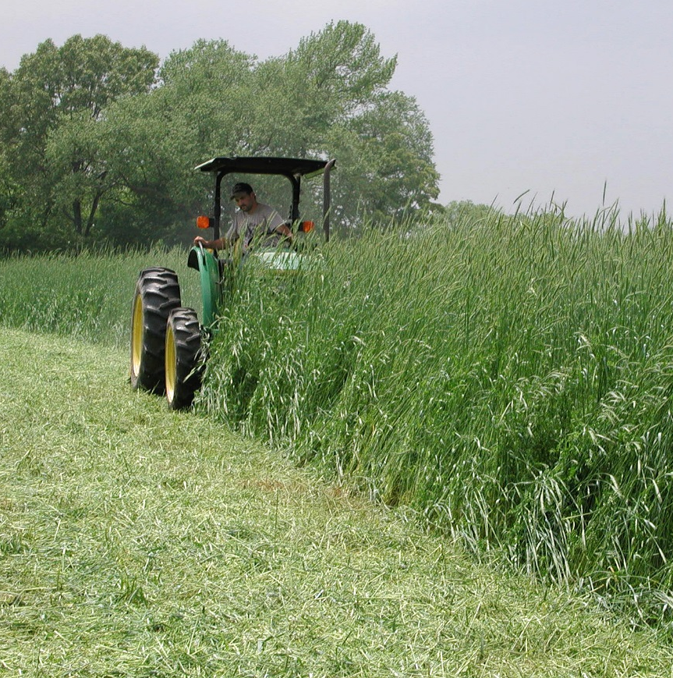
Organic Alternatives to Synthetic Herbicides
Cultural weed management
Rotation
Perennial crops
Cover crops
Alfalfa harvest
Flail mowing a rye-vetch cover crop
Notes:
Narration: Organic alternatives to synthetic herbicides can fall into three main categories = cultural, biological and mechanical management. Cultural weed management includes using rotation and crops such as perennials and cover crops that compete well against weeds. Images: Craig Sheaffer, University of Minnesota (Alfalfa harvest); USDA-ARS (Flail mowing)

Slide 24
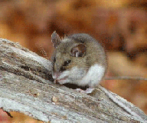
Organic Alternatives to Synthetic Herbicides
Biological weed management
Habitat for weed seed predators
Notes:
Narration: Biological weed management can mean providing habitat for insects and small mammals who eat weed seeds before they become problematic.
Images: USDA-ARS (mouse) and Steve Hurst, USDA-ARS (foxtail millet)

Slide 25
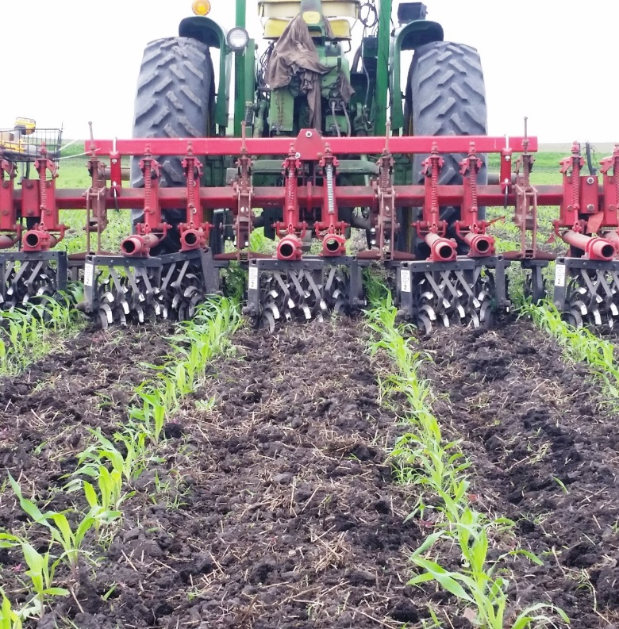
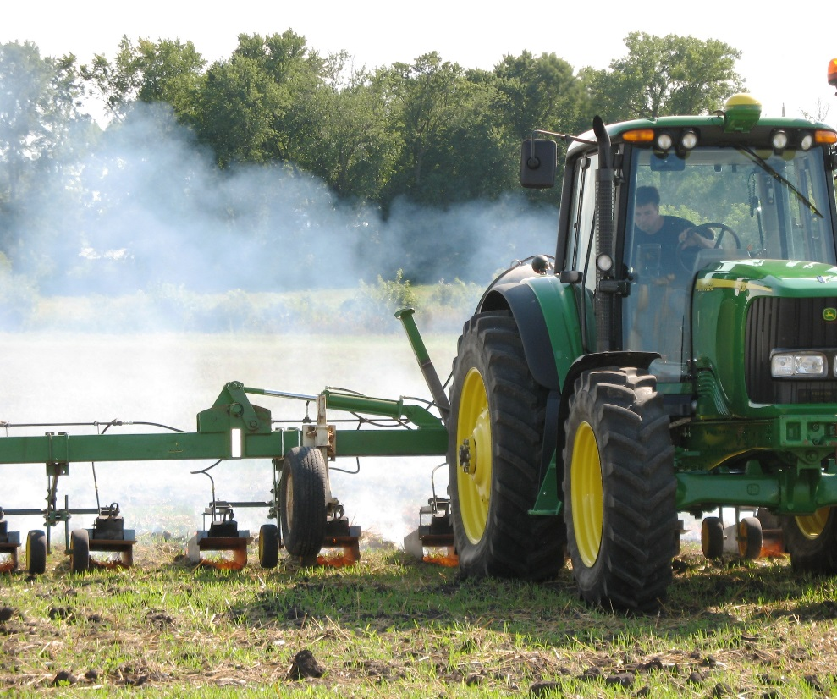
Organic Alternatives to Synthetic Herbicides
Mechanical weed management
Tillage to destroy weeds
Fire to burn weeds
Flame weeding
Cultivation
Notes:
Narration: Mechanical weed management is using physical means, primarily tillage, to destroy weeds. Flame-weeding uses fire to burn and kill weeds. Images: Carmen Fernholz (cultivation); Kristine Moncada, University of Minnesota (flame-weeding)

Slide 26
Not Allowed = Other Synthetic Pesticides
Fungicides, insecticides, nematicides, and others
Notes:
Narration: With a few exceptions, other synthetic pesticides such as fungicides, insecticides and nematicides for disease, insects and nematodes are generally not allowed. Image: David L. Hansen, University of Minnesota

Slide 27
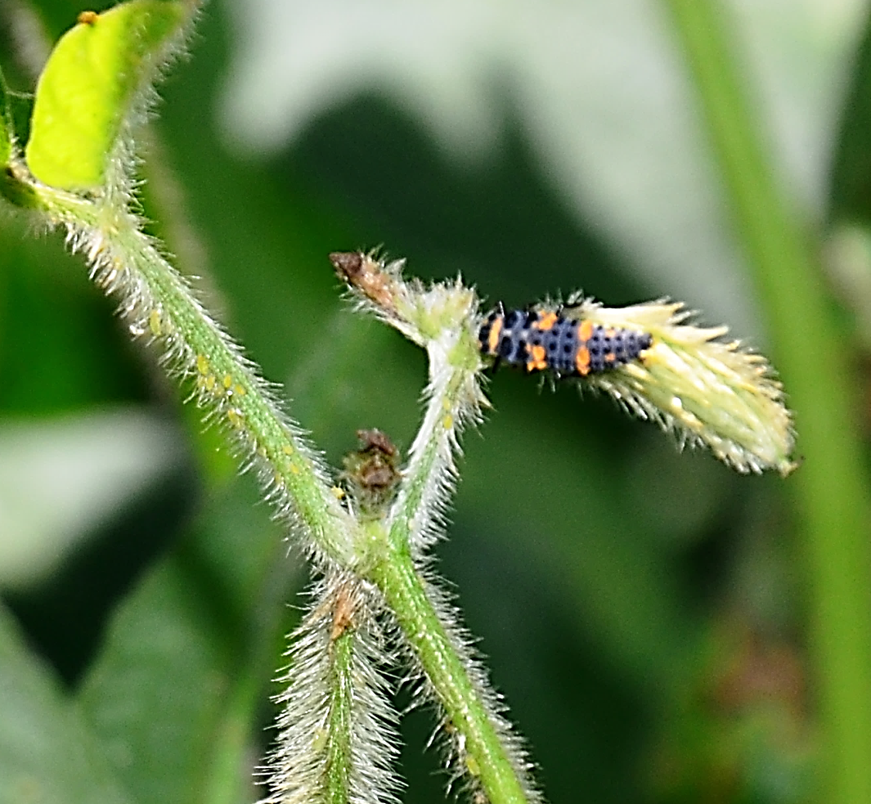
Organic Alternatives to Other Synthetic Pesticides
Cultural management
Rotation
Resistant varieties
Planting date
Sanitation
Biological management
Habitat for insect predators
An Asian lady beetle larva feeds on soybean aphid
Notes:
Narration: The first line of defense against disease and insects is cultural management techniques such as rotation, using resistant crop varieties, changing planting dates to avoid pests, and keeping equipment clean. Providing habitat for insect predators is an example of biological management.
Image: Carmen Fernholz

Slide 28
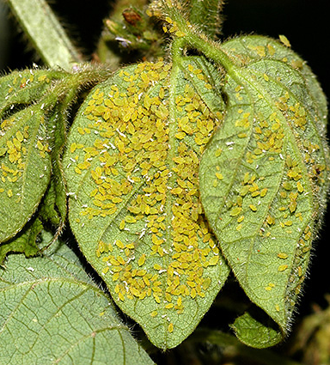
Organic Alternatives to Other Synthetic Pesticides
Non-synthetic products
Insecticidal soap
Neem
Pyrethrum
Select few allowed synthetic products
Soybean aphids
Notes:
Narration: There are organic non-synthetic (or “natural”) products that can be used instead of pesticides such as insecticidal soap, Neem and pyrethrum. A few synthetic pesticides are allowed, but to use approved synthetic products for pest management in organic production, the farmer must document that they used cultural, biological or mechanical methods and/or natural products and found these to be ineffective. Please watch the “Certification” module for more information on finding allowed products. Always consult with your certifier before using new products. Image: Bamphitlhi Tiroesele, USDA-ARS

Slide 29
Organic Crop Standards
Maintain soil health
Protect water resources
Promote biodiversity
Prohibit use of synthetic substances
Prohibit genetically modified organisms
Protect organic land and crops from contamination
Notes:
Narration: There is another category of prohibited substance that you have probably heard of before – genetically modified organisms.
Image: Carmen Fernholz

Slide 30
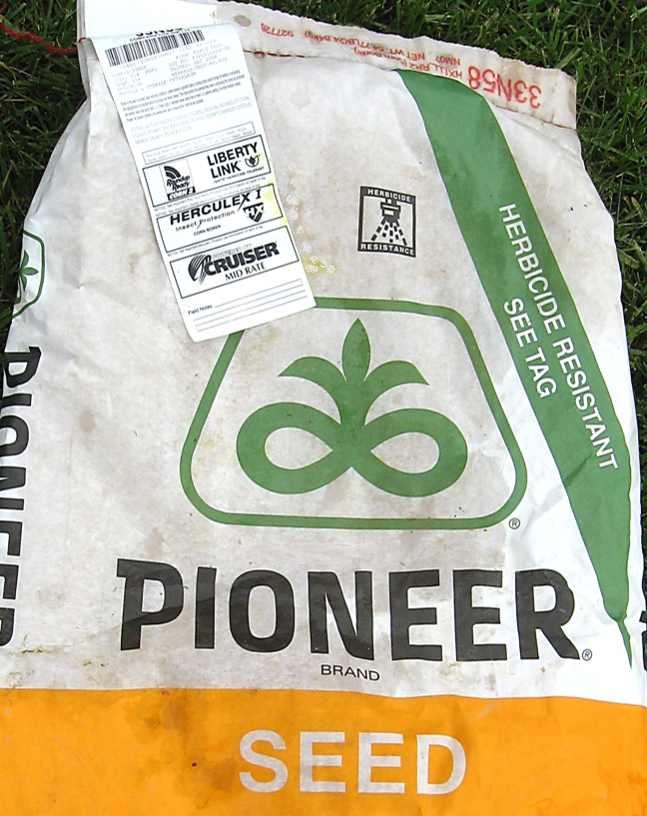
GMO Definition
GMO = genetically modified organism
Technology includes gene deletion, gene doubling, moving genes, and introducing a foreign gene
Notes:
Narration: All genetically modified organisms (GMOs for short) are prohibited in organic agriculture. The technology used to create GMOs includes gene deletion, gene doubling, moving genes within a genome and introducing a foreign gene, when achieved by recombinant DNA technology. These methods generally do not occur under natural conditions and are not considered compatible with organic production. Image: Orin Hargraves, Wikipedia Commons

Slide 31
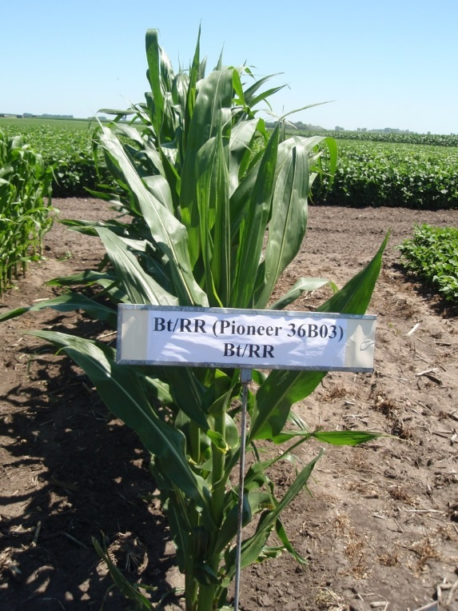
GMO Example
Corn
Common traits:
Bt: tolerance to corn pest insects
Roundup Ready: tolerance to glyphosate herbicide
Notes:
Narration: An example of a crop that is commonly genetically modified is corn. Corn, like the hybrid pictured, can have genes from other species such as bacteria inserted into its genome that result in different traits. In this case, the corn has two inserted genes. One called Bt that offers protection from corn borer insects without the use of pesticides. A second gene called Roundup Ready provides resistance to glyphosate herbicide, allowing farmers to spray their crops for weeds with minimal harm to the crop.
Image: Jeff Coulter, University of Minnesota

Slide 32
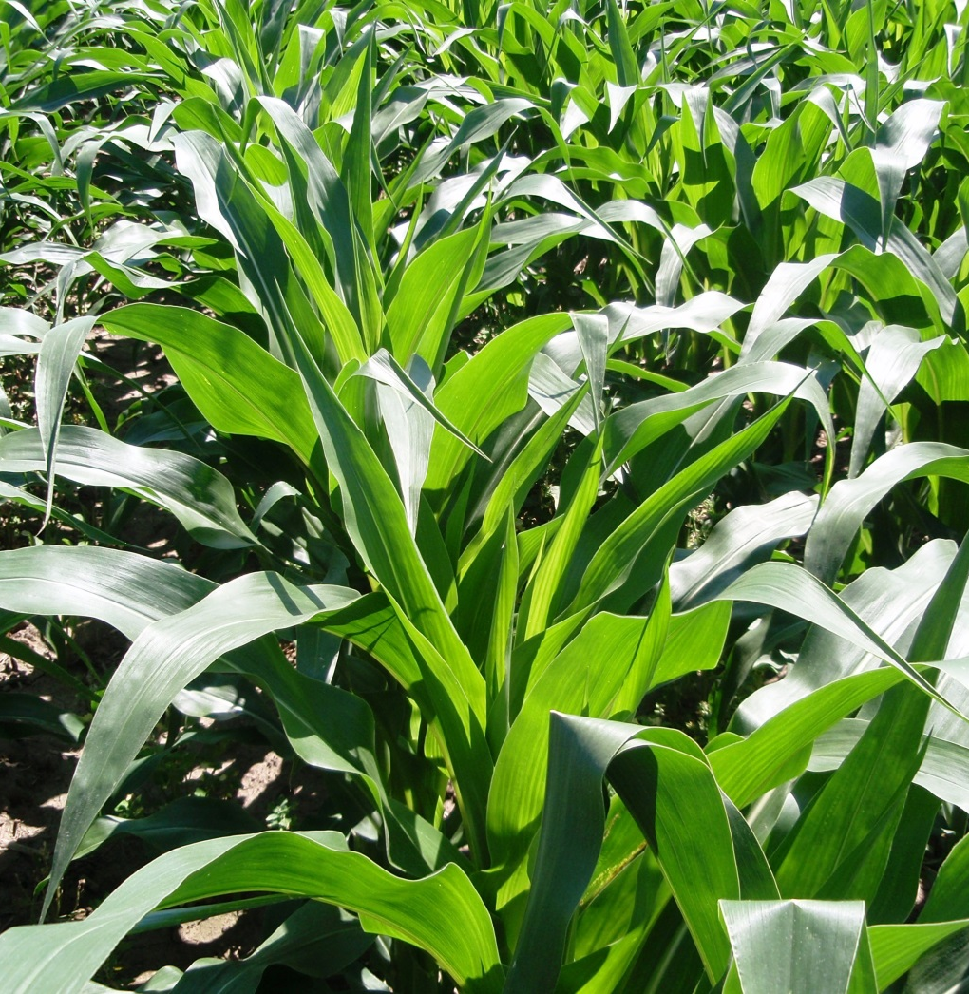
Common GMO Crops
Corn
Soybean
Alfalfa
Canola
Sugar beets
Cotton
(Papaya and summer squash are common horticultural crops)
Notes:
Narration: As future organic farmers, you will need to make sure none of the organic crops you grow are genetically modified. Genetically modified seeds cannot be planted as an organic crop and cannot be used during the three years of transition to organic. These are the common genetically modified crops you may come across at this time, but note that more GMOs are likely to be created in the future. Please watch our module on GMO contamination to learn about genetically modified organisms in greater detail. Image: Jeff Coulter, University of Minnesota

Slide 33
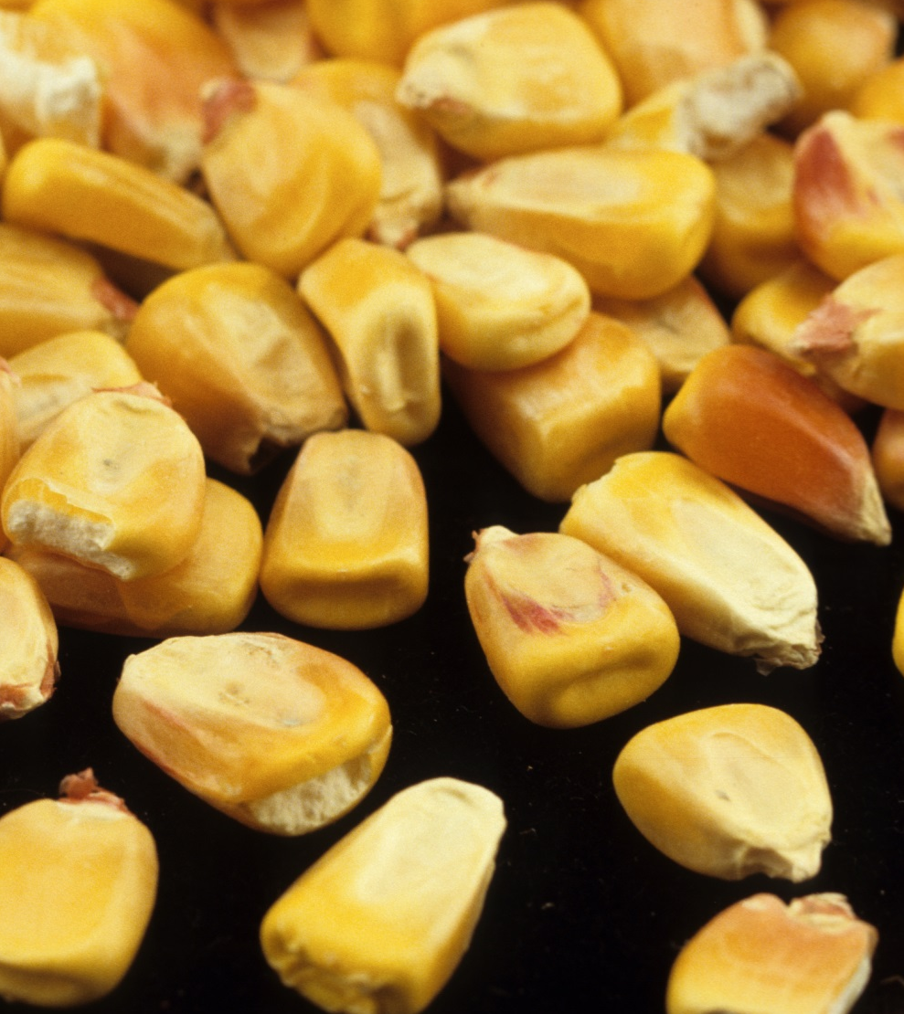
Organic Seed
Organic farmers must use seed that is organic
Grown under organic conditions
GMO-free
Not treated with prohibited substances
Notes:
Narration: To ensure that crop seed is not GMO, organic farmers are required to use organic seed, meaning it has been grown under organic conditions. Not only is organic seed non-GMO, it also does not have prohibited substances such as non-approved synthetic fungicides. During the transition years, untreated non-organic seed is allowed, but once certified organic, organic seed must be sourced whenever possible.
Image: David L. Hansen, University of Minnesota

Slide 34
Other GMO products
GM rhizobia used to inoculate legumes
GM Bt products (Bt products allowed only if non-GMO)
GM microbial soil products
Notes:
Narration: There are other genetically-modified organisms besides crop species. These include genetically-modified rhizobia used to inoculate legumes, Bt products used as biocontrols, and other microbial soil products. All of these are not allowed in organic production. However, when farmers use certified organic products, they do not need to worry about these substances being present. Watch our Resources for Transition module for more information on seed and products that organic farmers can use.

Slide 35
Organic Crop Standards
Maintain soil health
Protect water resources
Promote biodiversity
Prohibit use of synthetic substances
Prohibit genetically modified organisms
Protect organic land and crops from contamination
Notes:
Narration: And lastly, organic farmers need to protect their organic land and their organic crops from outside sources of contamination.
Image: Carmen Fernholz

Slide 36
Protect Land from Contamination
Notes:
Narration: It isn’t enough to just use organic seed and products; organic farmers must make sure that pesticides and GMO materials from adjacent areas don’t contaminate their crops. The primary way organic farmers do this is through buffers.
Image: Carmen Fernholz

Slide 37
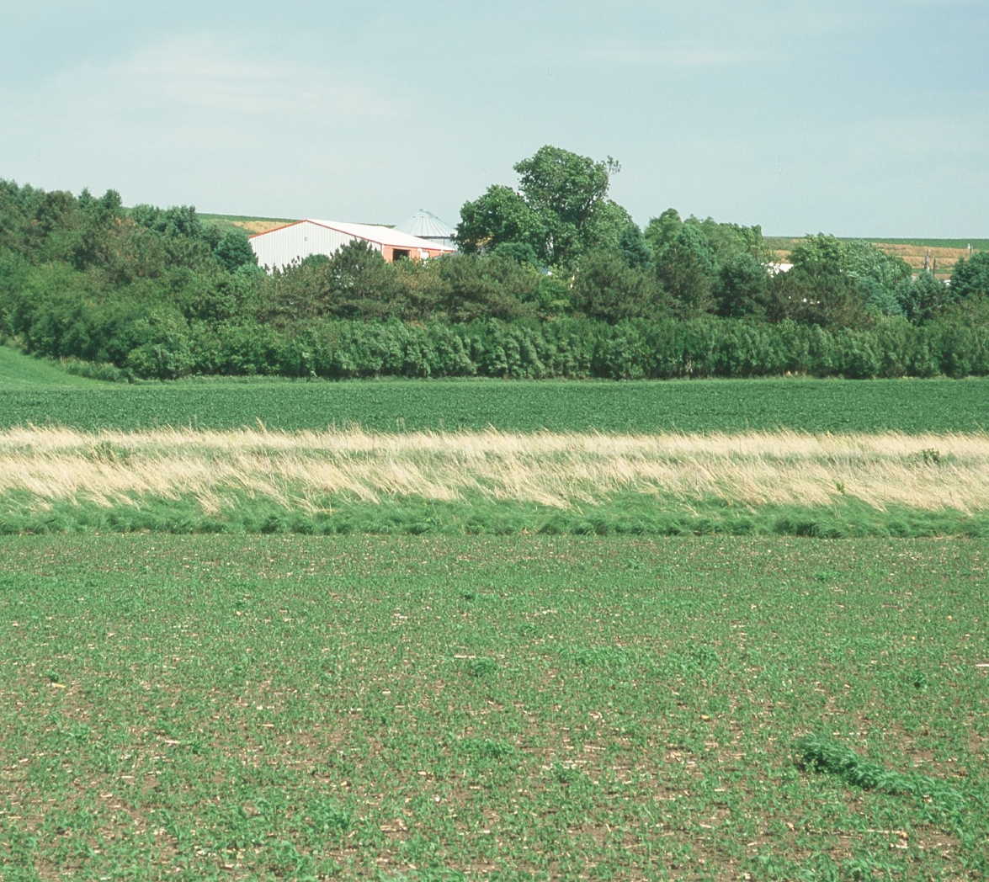
Buffers
Protect organic fields from contaminants
Buffer width varies according to site risk
Notes:
Narration: Buffers are situated between organic and non-organic land to help prevent air- and water-borne materials, such as pesticides and GMO pollen, from contaminating their fields. A specific buffer size is not stated in NOP rules. The width is site-specific based on risk of contamination as determined by the organic farmer’s certifier. A typical buffer in our region is 30 feet wide. Image: Lynn Betts, USDA-NRCS

Slide 38
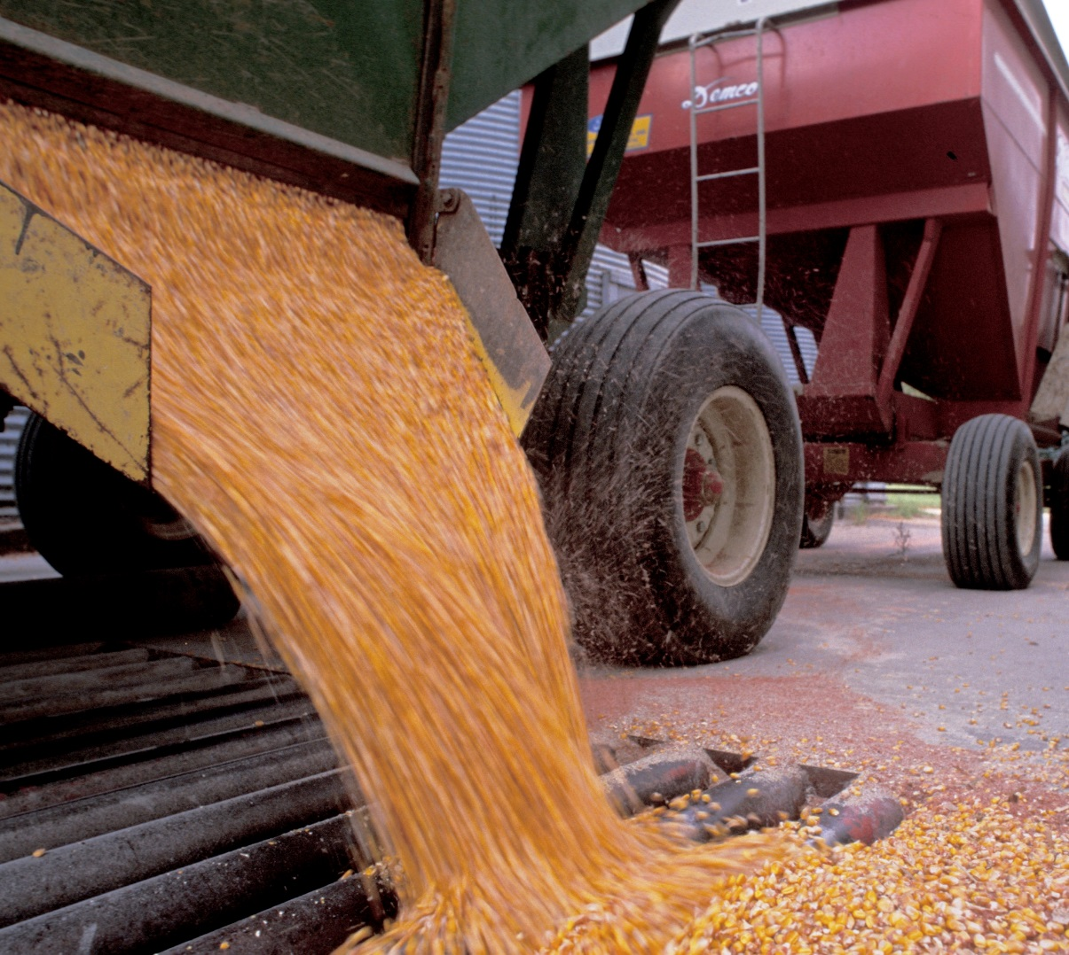
Protect Crops from Contamination
Prevention of co-mingling with conventional crops
GMO testing commonly done on corn and soybean
Notes:
Narration: Organic farmers also have stringent practices to make sure that conventional crops don’t mix in with their organic crops. Of particular concern to grain buyers is GMO contamination. So crops such as corn and soybean are tested by buyers and periodically by certifiers to make sure that GMOs are not present.
Image: David L. Hansen, University of Minnesota

Slide 39
Protect from Contamination
No sewage sludge
Can contain pathogens and heavy metals
No irradiated products
Not a “natural” process
Symbol for irradiated food
Notes:
Narration: Sewage sludge is a product used as a fertilizer by some farmers. It and its by-products are prohibited in organic production. It can contain pathogens and high concentrations of heavy metals. Irradiation is another process prohibited in organics and so are irradiated products. Always verify with your certification agency that a material is allowed before you use an input, whether you are in transition or are certified as organic.

Slide 40
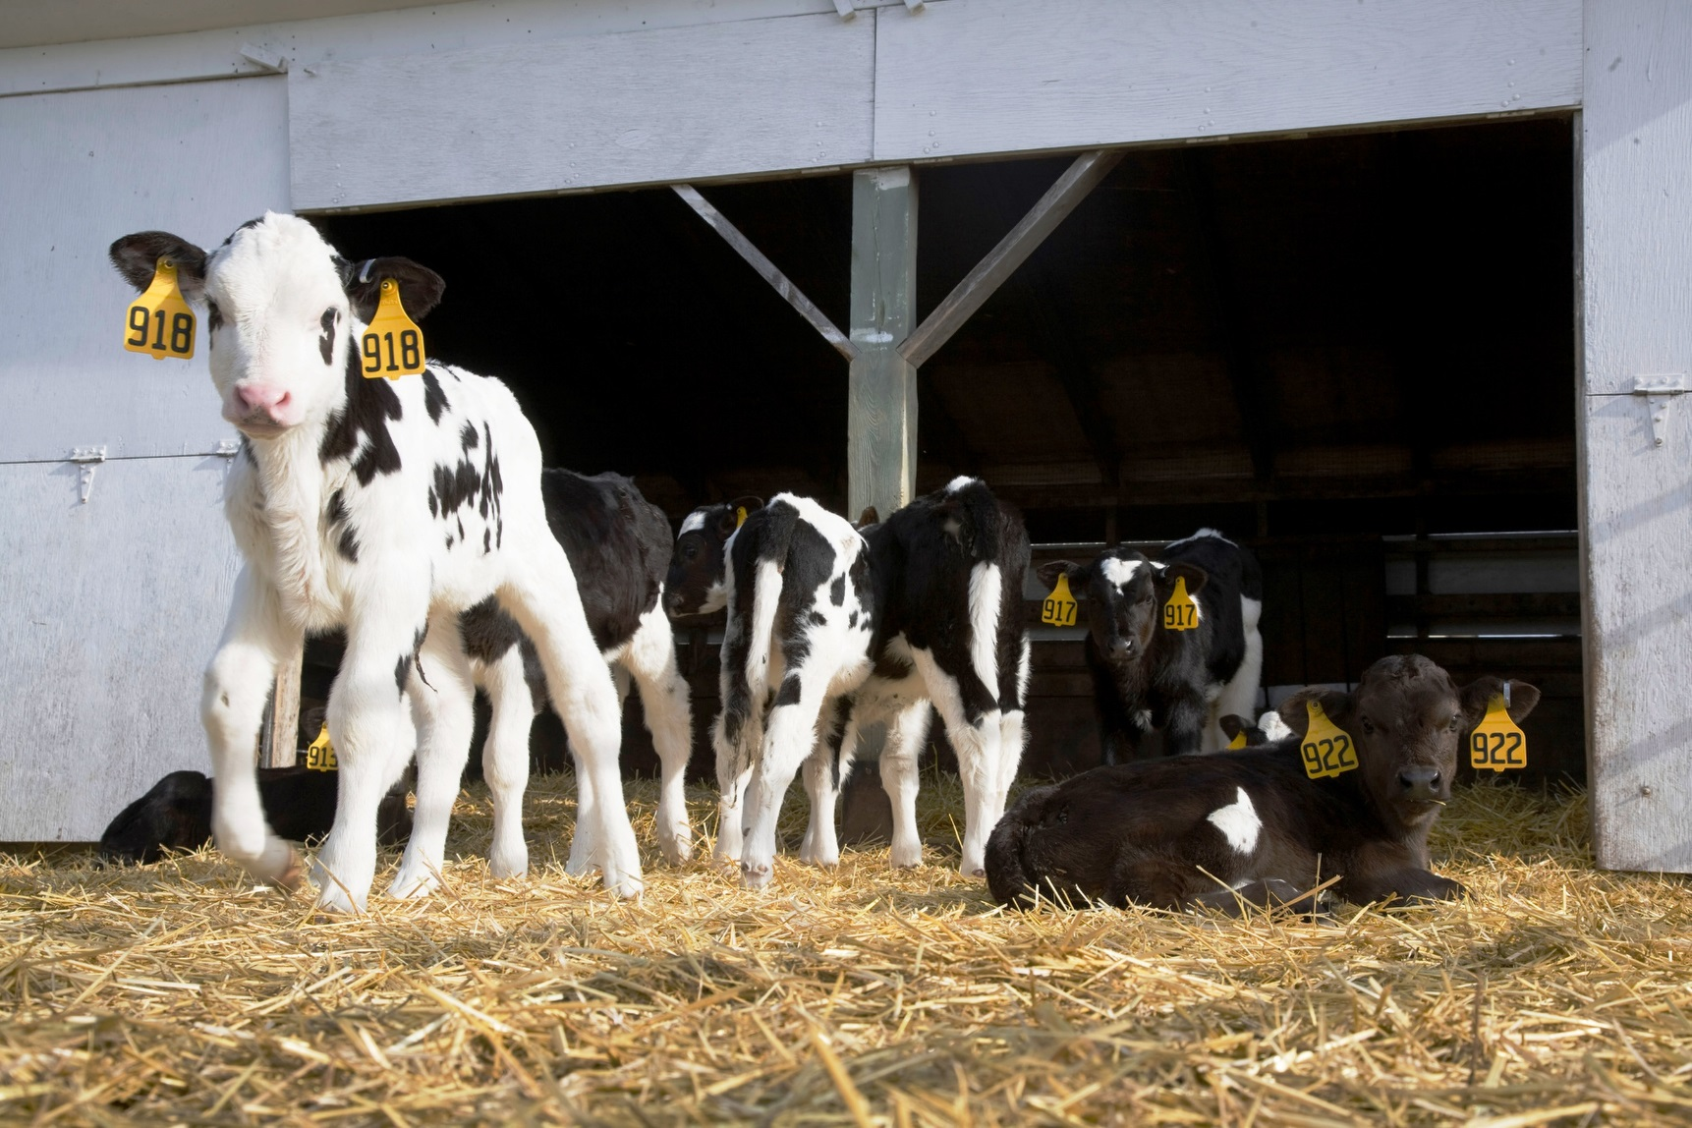
Maintain Food Safety
Notes:
Narration: We’ve discussed many different types of contamination – from GMOs, synthetic pesticides and even pathogens. Pathogens are important to consider in food production because they cause sickness in people. Some allowed amendments, especially those derived from animal products, may contain pathogens. That’s why organic agriculture has rules on manure and compost to maintain food safety.
Image: David L. Hanson, University of Minnesota

Slide 41
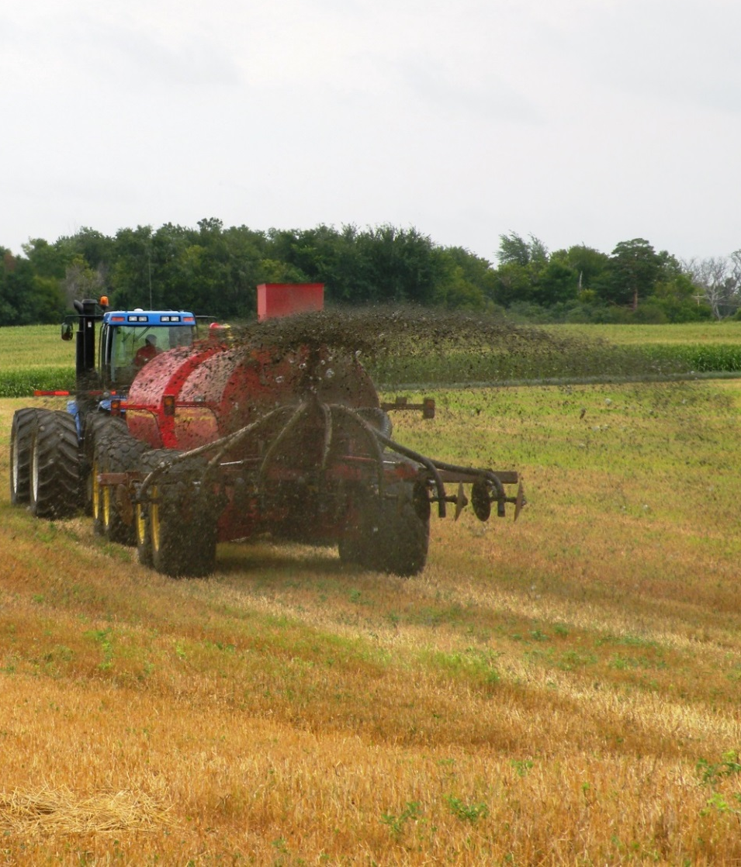
Manure
Can contain pathogens that are harmful to people
Can only be applied at certain times so that food is protected
Notes:
Narration: Animal manure is commonly used as a nutrient source, but it can contain E. coli or other microorganisms. To protect food crops, manure can only be applied during certain times in the growing season so that pathogens won’t be present on harvested materials. We will cover the details on rules for manure application in the Soil Fertility module.
Image: University of Minnesota

Slide 42
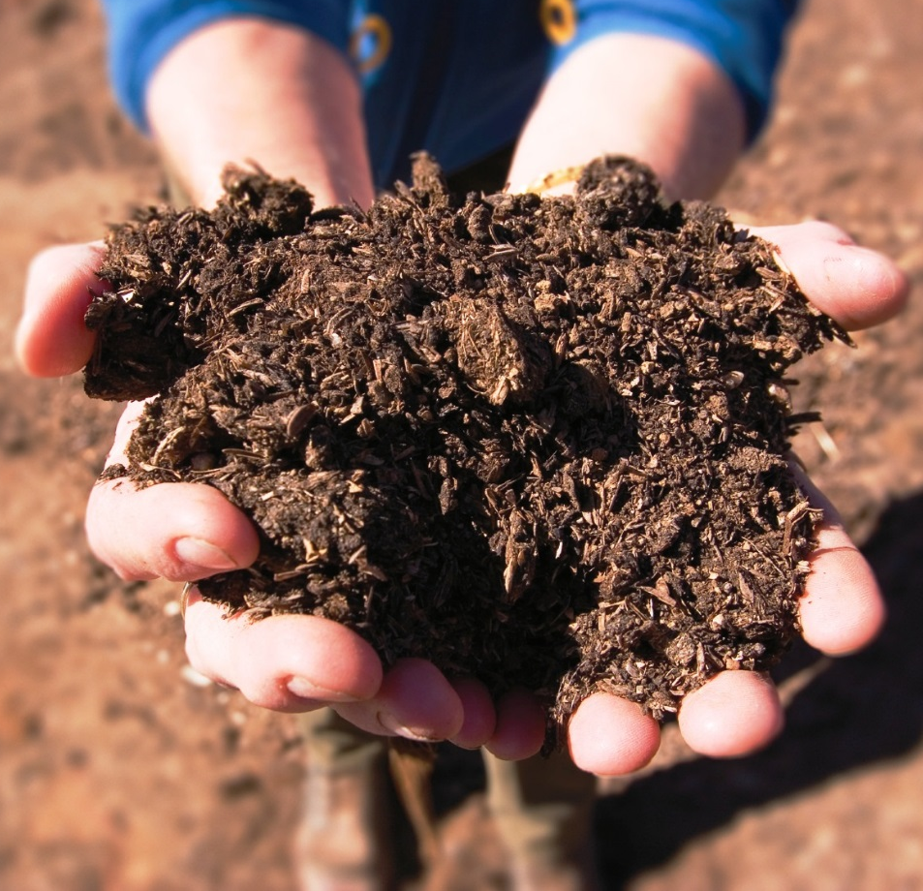
Compost and Heated Manure
Can be applied without restriction
Must be processed according to specific guidelines
Notes:
Narration: Rather than applying raw manure directly to fields, it can be processed, either by composting or by heat treatment to avoid the application restrictions of raw manure. Properly composted manure should not contain pathogens and there are NOP rules that govern composting so that it is heated at high enough temperatures for a long enough time to kill pathogens. Image: USDA-NRCS

Slide 43
Record Keeping
Detailed record keeping
Audit trail means product can be traced back to its source
Notes:
Narration: Another safe guard that organic rules incorporate is detailed record keeping, which can also serve to promote food safety. This means that a product can be traced back to it source more easily than in conventional systems. An organic crop is tracked from seed to sale, and organic farmers keep track of all inputs and activities surrounding their crops’ production, storage and sale. We’ll discuss this more in the Certification module.

Slide 44
What Is Organic Agriculture?
Organic Definition
Cropping Standards
Regulation
Notes:
Narration: There are many rules to follow to be certified organic. Who creates these rules? What is there to stop people from not being compliant to these rules? For the our last topic in the module, we will cover the regulation of the National Organic Program.
Image: David L. Hansen, University of Minnesota

Slide 45
How Organic is Regulated
National Organic Program (NOP)
Part of the USDA Agricultural Marketing Service (AMS)
Acting
Deputy Administrator Dr. Ruihong Guo
Notes:
Narration: The regulatory program responsible for organic is the National Organic Program, which is part of the USDA Agricultural Marketing Service.
Image: USDA-AMS

Slide 46
National Organic Program (NOP)
Oversees development of organic standards
Responsible for enforcement of regulations
Accredits certifying agencies
Notes:
Narration: The primary duties of the NOP is to oversee organic standard development, to enforce organic standards, and to accredit certifying agencies. For more on how this system developed, watch our History of Organic module.

Slide 47
Organic Standards
The NOP develops and updates organic standards
Facilitates the review of allowed materials
Advised by the National Organic Standards Board (NOSB)
Notes:
Narration: Organic standards are developed and updated by the National Organic Program, which facilitates the review of allowed materials. The NOP is advised by the NOSB or the National Organic Standards Board.

Slide 48
NOSB – Who They Are
Federal Advisory Board of citizen volunteers
Organic farmers, processors, retailers, scientists, environmentalists, certifying agents, and consumers
Sonny Perdue
The NOSB is appointed by the Secretary of Agriculture
Notes:
Narration: The National Organic Program gets input on organic rules from a citizen advisory board called the National Organic Standards Board. The board is composed of organic farmers, organic processors, scientists, environmentalists, certifying agents and consumers who are appointed by the Secretary of Agriculture. Image: USDA

Slide 49
NOSB Tasks
Makes proposals to the NOP on practices or substances to be allowed or prohibited
Notes:
Narration: The NOSB reviews and votes on proposals such as which practices or substances should be allowed or prohibited. The National List of Allowed and Prohibited Substances can be found on the Electronic Code of Federal Regulations.

Slide 50
NOSB Process of Review
Gathers public input
Reviews and votes on proposals
Accepted proposals become recommendations to the NOP
Notes:
Narration: The NOSB meets twice per year for 3-4 days of hearings to gather public input. Any citizen can petition to have a material put on or taken off the national list. The NOSB may also develop draft production system proposals. If a proposal gets 2/3 of the board’s vote, it moves on to the secretary of the USDA who must approve these recommendations before they become part of the organic regulation.
Image: Kristine Moncada, University of Minnesota

Slide 51
Organic Certification
Certification of organic farmers performed by certifying agents
NOP assesses certifiers every 2.5 years
Notes:
Narration: The NOP does not directly handle the details of ensuring that individual farmers are following organic standards. They accredit certifying agencies who work with farmers to make sure that organic rules are followed. For more information, please watch the Certification module. Certifiers are assessed by the NOP every 2.5 years in order to retain accreditation. Image: USDA-NRCS

Slide 52
NOP Enforcement
Investigates alleged violations
Levies financial penalties for violations
Notes:
Narration: The USDA NOP investigates alleged violations of organic production, handling, and labeling standards. Violations can have significant financial penalties.

Slide 53
Hierarchy
USDA-AMS
Creates and maintains regulations w/ NOSB
Accredits certifying agencies
Certifying Agencies
Certify farms
Certified Farms
Follow NOP rules
Work with certifiers to get certified
Retailers & Consumers
Assured that organic label has integrity
Inspect farms
Purchase organic products
Verify rules are followed
Notes:
Narration: Here is an overview of the hierarchy of the National Organic Program. It starts with the Agricultural Marketing Service of the USDA, the next level is certifying agencies, then the certified organic farms, and ends with consumers who purchase organic foods.

Slide 54
What Is Organic Agriculture?
Organic Definition
Cropping Standards
Enforcement
Notes:
Narration: We have reached the end of the “What Is Organic Agriculture?” module. Please see our other modules for more information on production and other organic topics.
Image: David L. Hansen, University of Minnesota

Slide 55
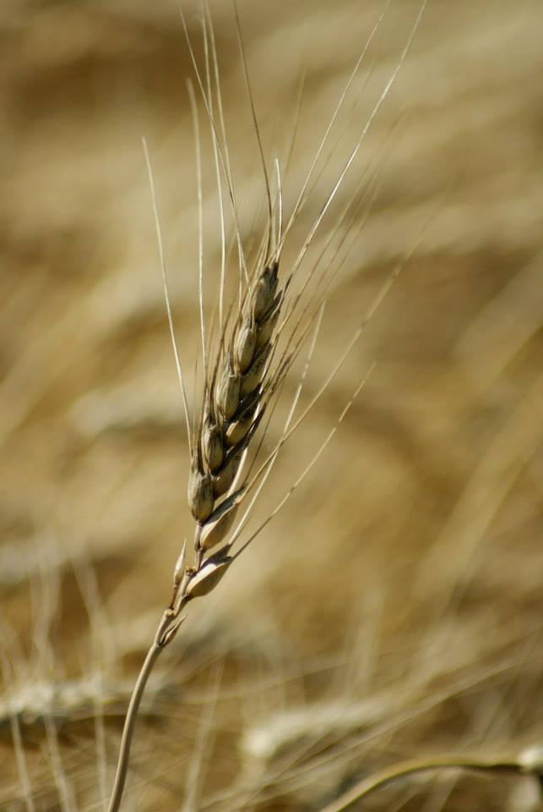
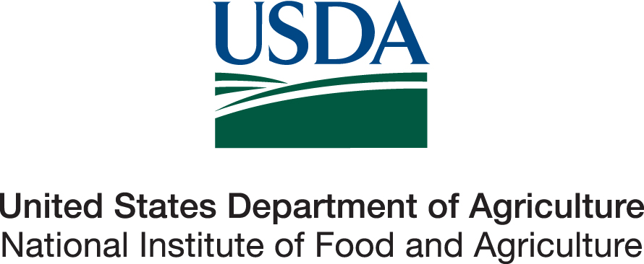
© 2017 Regents of the University of Minnesota. All rights reserved. The University of Minnesota is an equal opportunity educator and employer.
This material is based upon work that is supported by the National Institute of Food and Agriculture, U.S. Department of Agriculture, under grant number 2013-51106-21005.
Notes:
Narration: This material is based upon work that is supported by the National Institute of Food and Agriculture.
Image: Constance Carlson, University of Minnesota

Slide 56
References
Cambardella, C. 2015. Environmental Benefits of Organic Agriculture: Water Quality – Webinar. Science and Technology Training Library. http://www.conservationwebinars.net/webinars/environmental-benefits-of-organic-agriculture-water-quality/
Government Publishing Office. 2017. Electronic Code of Federal Regulations; PART 205—NATIONAL ORGANIC PROGRAM. http://www.ecfr.gov/cgi-bin/text-idx?rgn=div5&node=7:3.1.1.9.32
Keupper, G. 2010. A brief overview of the history and philosophy of organic agriculture. Kerr Center for Sustainable Agriculture. http://kerrcenter.com/wp-content/uploads/2014/08/organic-philosophy-report.pdf
Kirschenmann, F. 2008. It starts with the soil and organic agriculture can help. http://www.leopold.iastate.edu/files/pubs-and-papers/2008-06-it-starts-soil-and-organic-agriculture-can-help.pdf
Koike, S., M. Gaskell, C. Fouche, R. Smith, and J. Mitchell. 2000. Plant disease management for organic crops. University of California, Division of Agriculture and Natural Resources. The Leopold Center for Sustainable Agriculture, Iowa State University. http://anrcatalog.ucdavis.edu/pdf/7252.pdf
Quinn, J. 2015. Environmental Benefits of Organic Agriculture: Biodiversity – Webinar. Science and Technology Training Library. http://www.conservationwebinars.net/webinars/environmental-benefits-of-organic-agriculture-biodiversity
USDA-AMS. 2015. Agricultural Marketing Service’s Nation Organic Program Factsheet. http://www.ams.usda.gov/sites/default/files/media/About%20the%20National%20Organic%20Program.pdf
USDA-AMS. 2016. USDA Organic 201. Presentation. http://apps.ams.usda.gov/organic/201/
USDA-AMS. 2016. Organic Sound and Sensible Project - What is an Organic Systems Plan. https://www.youtube.com/watch?v=GeZZxRd8ulY&feature=youtu.be
USDA-AMS. 2017. National Organic Standards Board (NOSB). http://www.ams.usda.gov/rules-regulations/organic/nosb

